Slide 1

Digital skills & research methods
Student ID: 2120140
Stacey sugarova

Slide 2

Introduction
Technology has become an essential component of modern businesses in the fast-paced, digitally-driven world of today. It has altered how businesses run, communicate, and promote their goods and services. Businesses can now increase productivity, cut costs, and improve customer experience thanks to technology. In this presentation, I'll talk about how British Petroleum (BP), a global oil and gas corporation, has evolved its operations as a result of the use of technology. I will investigate the various technological developments BP has incorporated into its operations and assess how these have affected the company's productivity and performance.

Slide 3
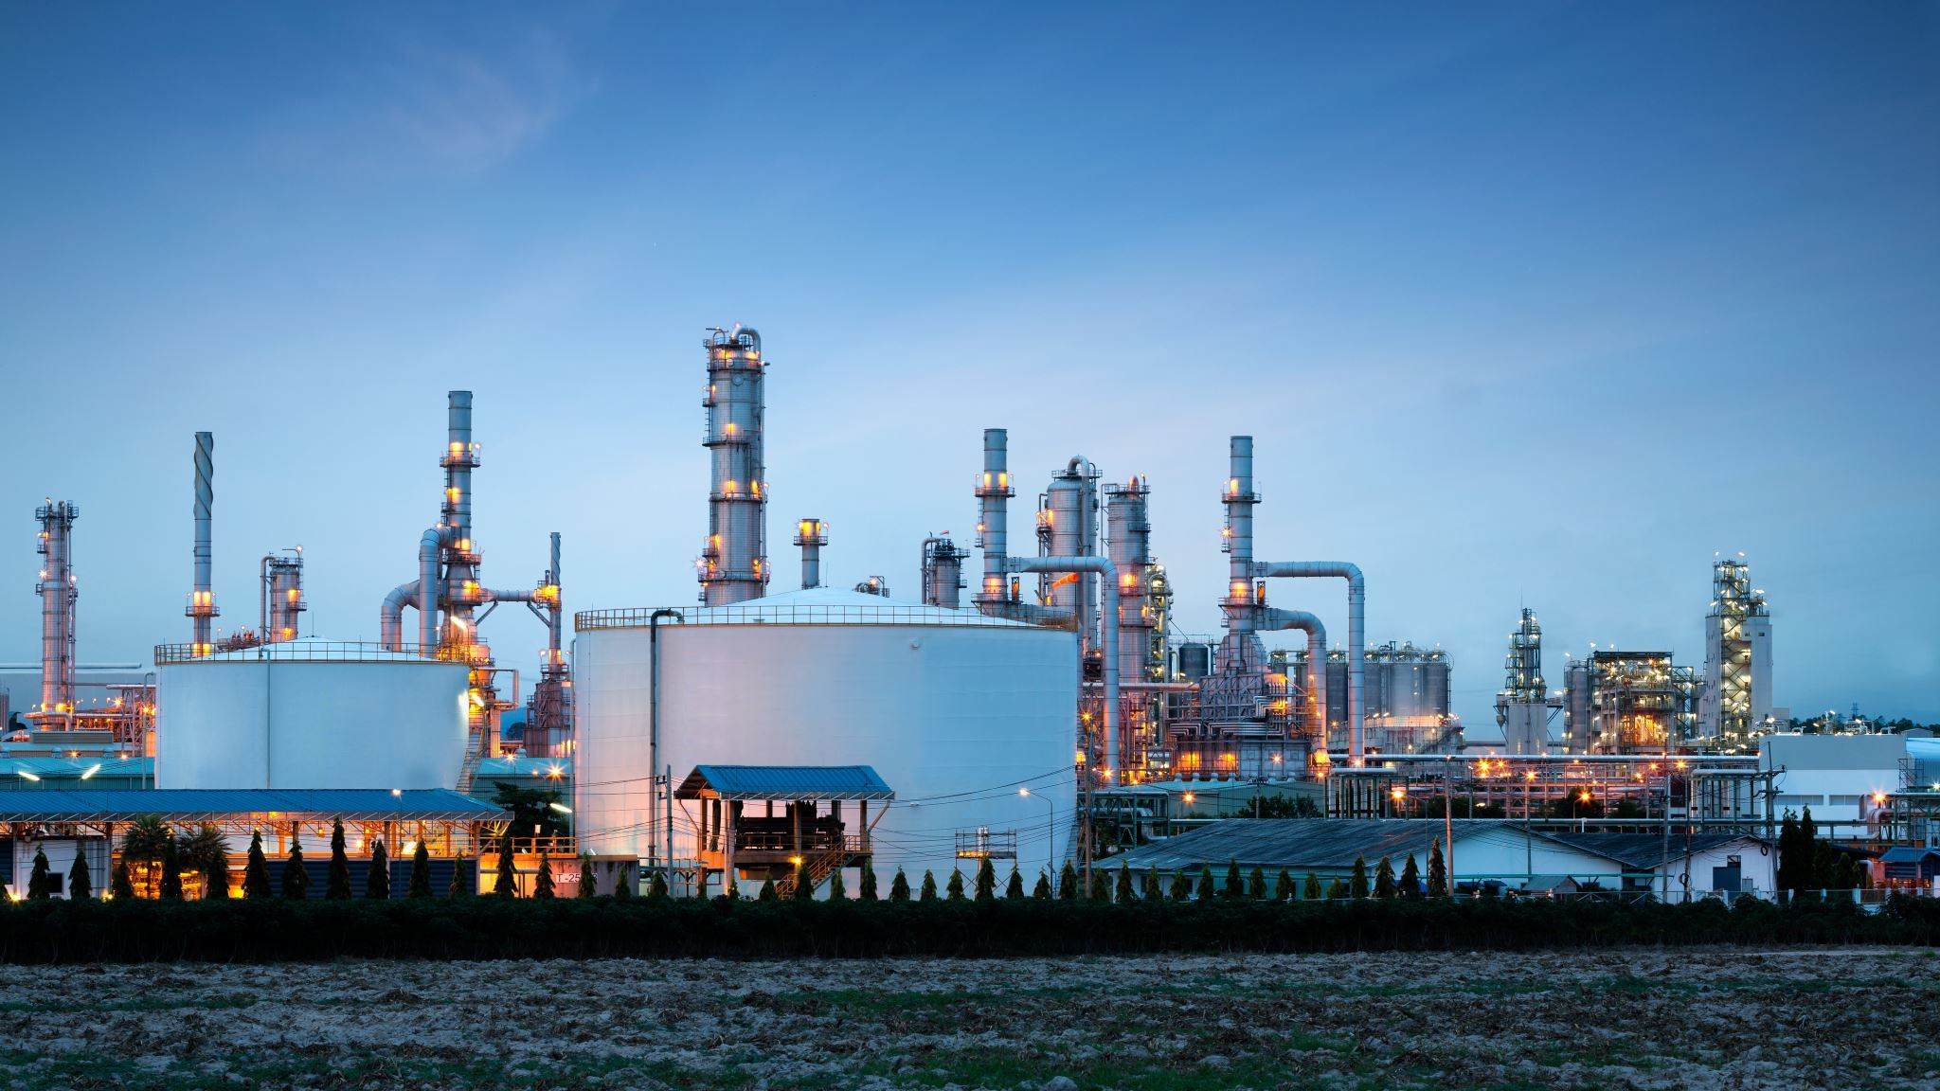
Brief history of British Petroleum
An international oil and gas corporation, British Petroleum (BP), is based in London, United Kingdom.
The Anglo-Persian Oil Company (APOC), which was established in 1908, is where the company's history begins (Tharoor, 2010).
In order to discover and extract oil in Persia (currently Iran), a British protectorate at the time, APOC was founded.
After changing its name to the Anglo-Iranian Oil Company (AIOC) in 1935, the organization carried on business as usual in Iran until the Iranian Revolution of 1979 (Ebrahimi, 2016).
AIOC was renamed British Petroleum Company (BP) in 1965 to better reflect its expanding global presence outside of Iran.
Through mergers and acquisitions, BP has grown its business over the years. Examples include the purchases of Standard Oil of Ohio (Sohio) in 1987 and Amoco Corporation in 1998.
When the Deepwater Horizon oil rig exploded in the Gulf of Mexico in 2010, BP was faced with a serious catastrophe that resulted in both economic and environmental harm (Matthews, 2023).
Since that time, BP has concentrated on strengthening its safety and environmental records and shifting its attention to renewable energy sources.

Slide 4

Aim and objectives of British Petroleum
To ensure safe and reliable operations
To meet the world's energy needs
To deliver value to shareholders
To foster a diverse and inclusive workplace
To support the communities in which it operates
Notes:
The overall aim of British Petroleum (BP) is to be a leading global energy company, providing sustainable energy solutions to meet the world's growing demand for energy. BP's objectives can be summarized as follows:
BP aims to operate its facilities safely and reliably to protect its employees, the environment, and the communities in which it operates.
The company aims to provide reliable and affordable energy solutions to meet the world's growing demand for energy while reducing its carbon footprint and supporting the transition to a low-carbon future.
BP aims to generate sustainable returns for its shareholders by maximizing the value of its assets, improving its financial performance, and managing its costs effectively.
It aims to create a diverse and inclusive workplace where everyone feels valued and respected, and where employees can develop their skills and careers (BP, 2023).
The company aims to be a responsible corporate citizen and support the communities in which it operates by investing in local projects and initiatives that promote social and economic development.

Slide 5
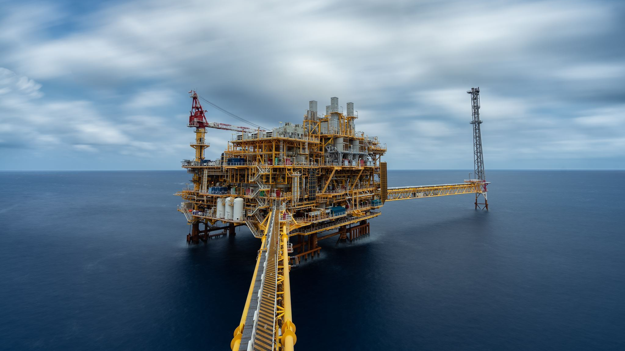
Scope/Purposes of British petroleum
Exploration and Production
Refining and Marketing
Renewable Energy
Technology and Innovation
Corporate Social Responsibility
Partnerships and Collaborations
Notes:
The scope of British Petroleum (BP) is vast and encompasses various purposes that are aligned with its overall aim and objectives. Some of the main purposes of BP are as follows:
Worldwide oil and gas reserve exploration, production, and development are activities carried out by BP (Gao and Gray, 2019). Finding, removing, and producing hydrocarbons from onshore and offshore fields are part of its upstream activities.
In addition to producing a variety of refined petroleum products, such as petrol, diesel, and aviation fuels, BP also refines crude oil. Additionally, a network of retail and commercial channels is used for marketing and sales of these goods.
In an effort to lessen its carbon footprint and aid in the transition to a low-carbon future, BP has recently increased its emphasis on renewable energy sources like wind, solar, and biofuels.
To enhance operations, cut costs, and perform better in terms of safety and the environment, BP makes significant investments in technology and innovation. In order to develop cutting-edge technologies and solutions, it also works with other businesses, academic institutions, and start-ups.
BP aspires to have a positive influence on the communities in which it operates and is aware of its responsibilities as a corporate citizen. It supports initiatives for education and training, makes investments in social and economic development, and encourages inclusion and diversity in its workforce.
To pursue common objectives and have a bigger impact, BP works in collaboration with other businesses, governments, and organisations. These collaborations include everything from joint ventures and alliances to research projects and business associations.

Slide 6
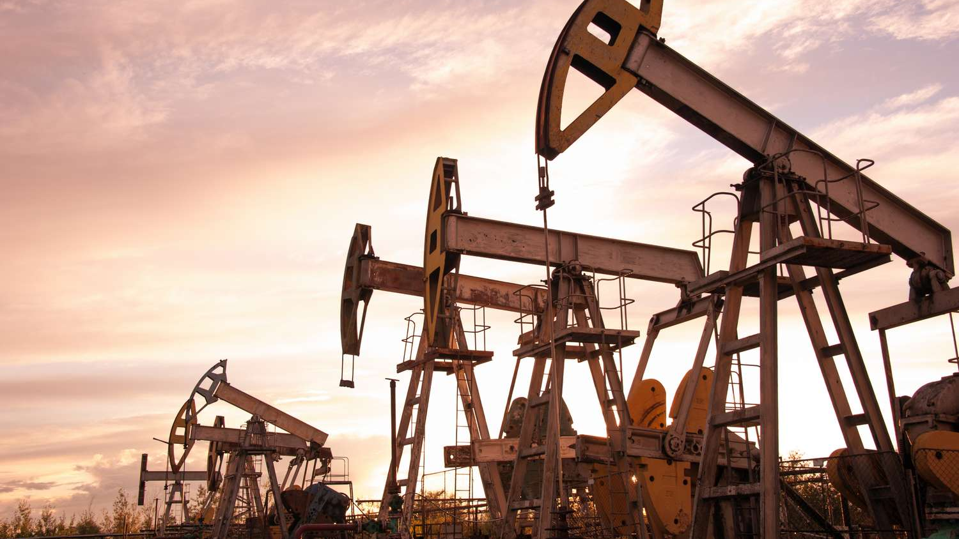
Mission and vision of British Petroleum
Mission: To be a leading global energy company, providing sustainable energy solutions to meet the world's growing demand for energy.
Vision: To be a net-zero company by 2050 or sooner and to help the world reach net-zero (BP, 2023).
Notes:
The mission statement of BP emphasises the company's desire to dominate the global energy market by offering sustainable energy solutions that support the move to a low-carbon future. The company is committed to reducing its carbon footprint and helping the world achieve net-zero emissions, as stated in its vision statement.

Slide 7
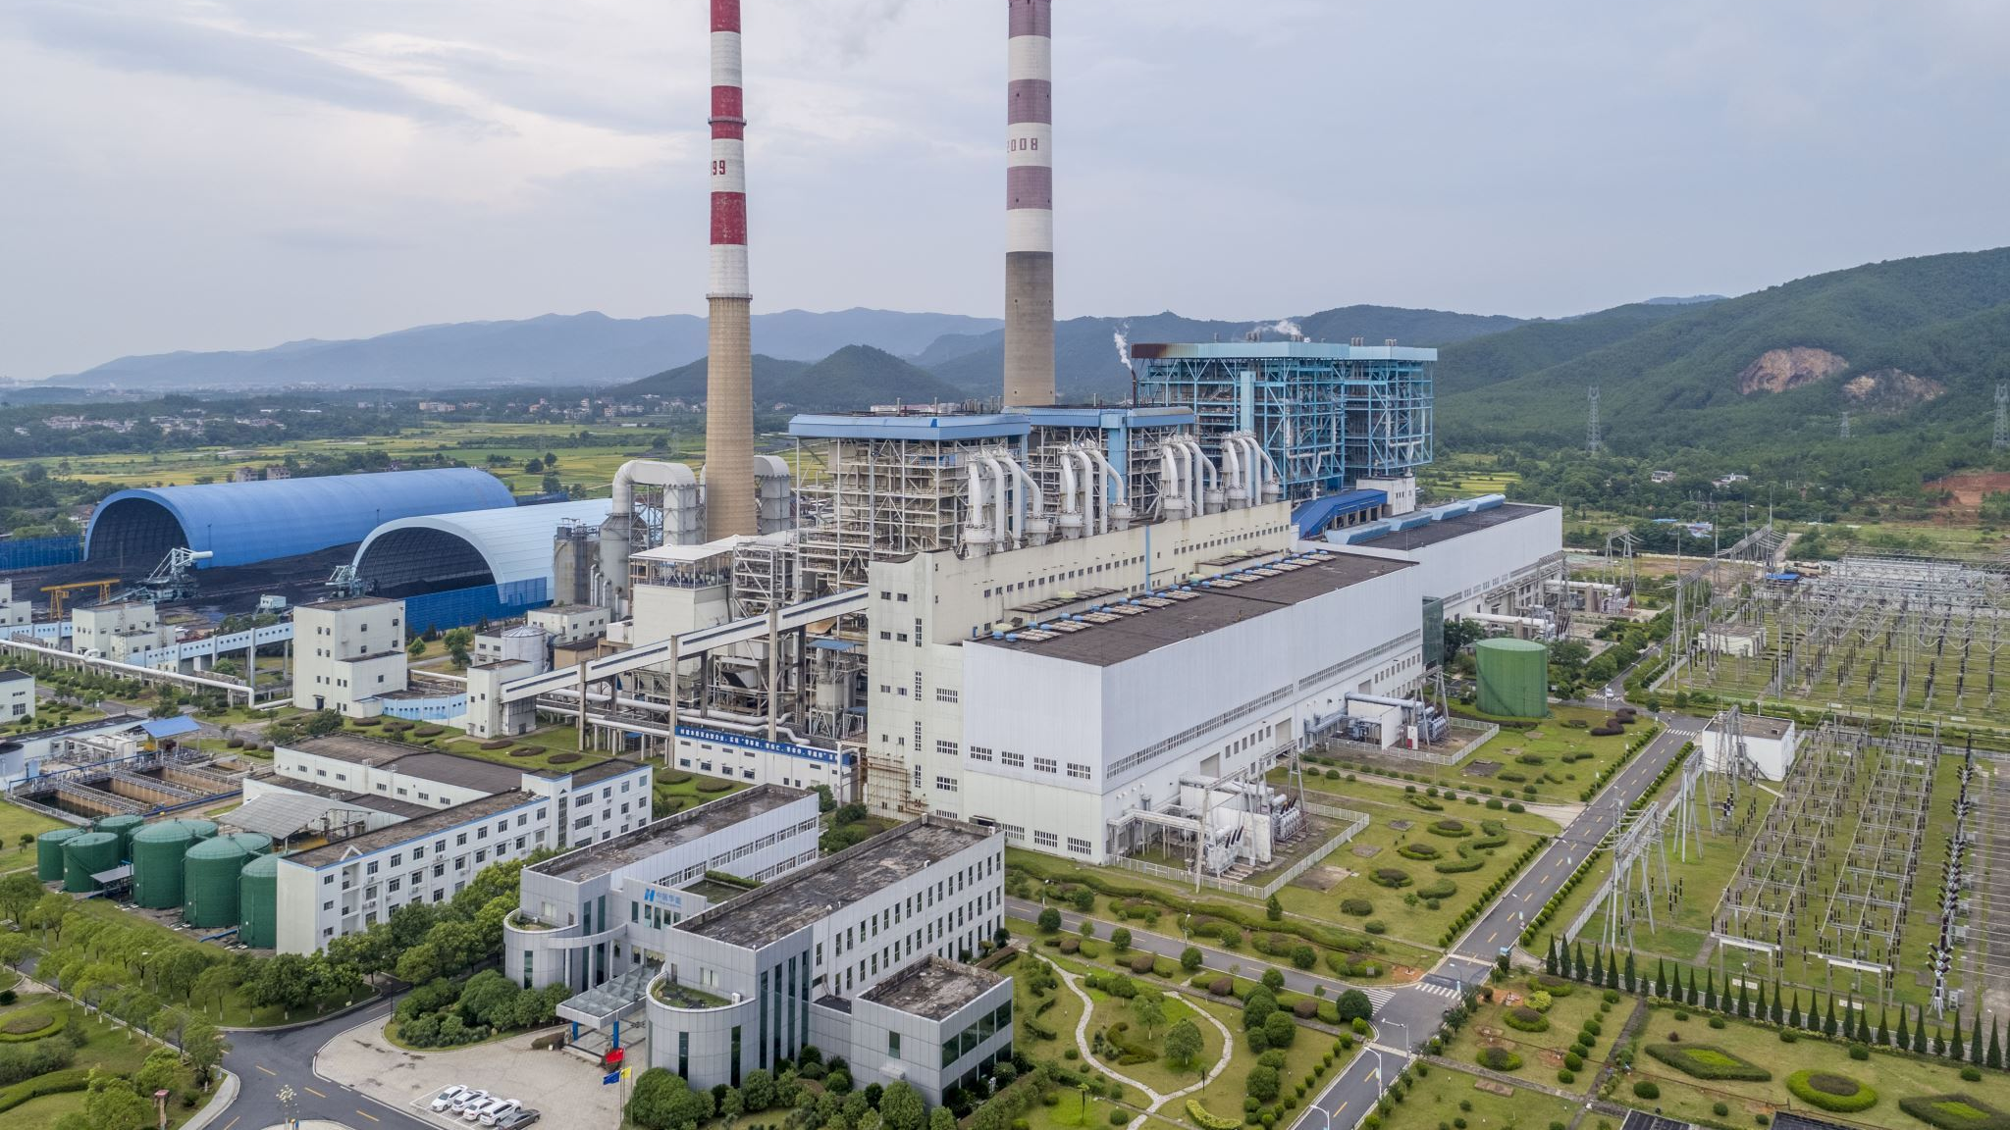
Current Status & Services of British petroleum
Upstream Operations
Downstream Operations
Renewable Energy
Carbon Capture, Utilization, and Storage (CCUS)
Lubricants and Chemicals
Notes:
The current status and services of British Petroleum (BP) can be summarized as follows:
With operations in more than 70 nations, BP is one of the biggest international producers of oil and gas (BP, 2020). Exploration, development, and production of oil and gas reserves are part of its upstream activities.
In addition to producing a variety of refined petroleum products, such as petrol, diesel, and aviation fuels, BP also refines crude oil.
Additionally, a network of retail and commercial channels is used for marketing and sales of these goods.
As part of its commitment to lessen its carbon footprint and support the transition to a low-carbon future, BP has been increasing its focus on renewable energy sources, such as wind, solar, and bio-fuels.
To capture and store carbon emissions from its operations and other industrial sources, BP is investing in CCUS technologies.
BP manufactures and sells chemicals and lubricants for the industry.

Slide 8
Current Status & Services of British Petroleum
Convenience Retail
Aviation fuel
Shipping
Trading and Supply
Notes:
Aside from the previously mentioned services, the current services of British Petroleum also include:
A network of convenience stores run by BP, including BP Connect, Wild Bean Cafe, and BP Shop, are located all over the world.
Worldwide, BP serves customers in the commercial, military, and general aviation sectors with aviation fuel and related services.
For the transportation of crude oil, finished goods, and liquefied natural gas (LNG), BP manages a sizable fleet of ships.
With a broad portfolio of assets and contracts, BP is a significant player in the global oil and gas supply and trading markets.
Overall, BP's current status and services reflect its ongoing transformation into a more diversified and sustainable energy company, with a growing focus on renewable energy and low-carbon technologies.

Slide 9

Challenges at British Petroleum before Introducing Modern Technology
Access to Resources
Transportation
Price Volatility
Competition
Geopolitical Risks
Notes:
Here are some challenges that British Petroleum (BP) faced before the implementation of modern technologies:
Access to oil and gas resources posed a significant problem for BP early on. The business had to spend money on drilling and exploration projects in hard-to-reach areas.
After gas and oil were extracted, transportation became difficult. BP was forced to build its own transportation network, including tankers, pipelines, and storage facilities.
Since the price of oil and gas fluctuated, it was challenging for BP to effectively plan and manage its operations.
Other oil and gas companies competed with BP in both the upstream and downstream markets.
BP's operations were frequently situated in areas with unstable governments, posing risks to its workers and assets.

Slide 10
Challenges at British Petroleum before Introducing Modern Technology
Environmental Risks
Safety Risks
Regulatory Compliance
Health and Safety
Reputation Management
Notes:
On top of the previously mentioned challenges, BP would also face the following challenges.
The reputation and financial performance of BP were constantly at risk from oil spills, leaks, and other environmental risks.
The safety risks associated with BP's operations included accidents, fires, and explosions.
It was necessary for BP to make significant investments in compliance programs and monitoring systems in order to comply with the various local, national, and international regulations that governed its operations.
The health and safety of BP's workers and contractors had to come first, necessitating ongoing training as well as spending on safety systems and equipment.
In order to keep its social license to operate, BP had to make investments in stakeholder engagement and public relations.

Slide 11

Modern technologies at British Petroleum
Advanced Seismic Imaging
Artificial Intelligence (AI)
Robotics and Automation
Internet of Things (IoT)
Notes:
British Petroleum (BP) uses a variety of contemporary technologies in all areas of its business to increase productivity, cut expenses, and have a minimal negative impact on the environment. Here are a few instances:
To enhance oil and gas production and better understand underground reservoirs, BP is utilising cutting-edge seismic imaging technologies.
In order to analyse vast amounts of data and increase operational effectiveness throughout its operations, BP is using AI. For instance, BP uses machine learning to forecast equipment failures, optimise drilling operations, and cut energy use (Hsu and Robinson, 2017).
Automation and robotics technologies are being used by BP to increase operational efficiency and safety. Autonomous underwater vehicles (AUVs), such as those used by BP, can inspect and maintain structures and pipelines offshore.
IoT technologies are being used by BP to gather real-time data from sensors and devices across all of its operations. For instance, BP uses IoT sensors to track asset performance, monitor pipeline integrity, and control energy consumption.

Slide 12

Modern technologies at British Petroleum
Digital Twin
Cloud Computing
Blockchain
Renewable Energy Technologies
Notes:
BP is also using the following technologies:
With the help of digital twin technologies, BP is building virtual representations of its assets and business processes that can be used to increase efficiency, simulate events, and decrease downtime.
BP is utilising cloud computing to lower IT costs, enhance collaboration across its operations, and store and analyse massive amounts of data.
BP is looking into using blockchain technology to increase supply chain traceability and transparency as well as to make transactions more secure and effective (Sundarakani, Ajaykumar and Gunasekaran, 2021).
To aid in its transition to a future with lower carbon emissions, BP is investing in a variety of renewable energy technologies, such as wind, solar, and biofuels.
Overall, in order to transform its business and become a more sustainable and effective energy company, BP is embracing a variety of contemporary technologies.

Slide 13
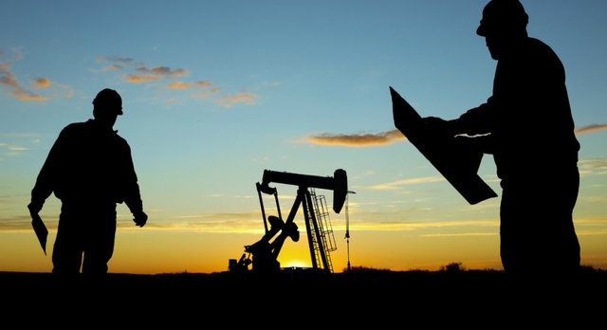
The positive impacts of the modern technologies at British Petroleum
Increased Efficiency
Enhanced Safety
Improved Sustainability
Better Asset Management
Improved Customer Service
Improved Collaboration
Notes:
Modern technologies have had a number of positive impacts on British Petroleum (BP), including:
BP has been able to increase operational efficiency across all of its operations by utilizing cutting-edge technologies like artificial intelligence, robotics, and automation. Costs have gone down, productivity has increased, and decision-making has gone more quickly as a result.
Autonomous vehicles, drones, and real-time monitoring systems are just a few of the safety technologies that BP has put in place. These technologies have increased worker safety and decreased the likelihood of accidents (Campbell, Kinnear and Thame, 2015).
To lower emissions and boost energy efficiency, BP is making investments in data analytics and renewable energy technologies. BP is putting itself in a position for long-term success and lessening its environmental impact by making the transition to a lower-carbon future.
BP can create virtual representations of its operations and assets through the use of digital twin technology, improving asset management and maintenance. As a result, asset uptime has improved, and downtime has decreased, leading to cost savings and increased productivity.
Digital technologies that BP has implemented, like mobile apps and online ordering platforms, have enhanced the customer experience and raised customer satisfaction.
BP's teams are now able to collaborate more effectively and productively across various locations and time zones thanks to cloud computing and other technologies.

Slide 14

The negative impacts of the modern technologies at British Petroleum
Job Losses
Cybersecurity Risks
Environmental Risks
High Costs
Reliance on Technology
Notes:
While modern technologies have had a number of positive impacts on British Petroleum (BP), there are also potential negative impacts to consider, including:
In some areas of BP's operations, particularly in manual labour positions, the increased use of automation and robotics could result in job losses. The local economies as well as the workers and their families may suffer as a result.
Data theft and cybersecurity breaches are more likely as BP depends more and more on digital technologies. This may lead to monetary losses, harm to one's reputation, and legal liability.
Although BP is investing in renewable energy technologies to lessen its environmental impact, its primary business of producing oil and gas still has unfavourable environmental effects. Modern technologies might mitigate these effects, but they could also have unintended effects, like higher carbon emissions from data centres and other technology infrastructure.
Modern technology implementation and upkeep can be expensive, and there is always a chance that the advantages won't outweigh the disadvantages.
There is a chance that as BP depends more on contemporary technologies, it could be exposed to disruptions like power outages, cyberattacks, and equipment breakdowns.

Slide 15
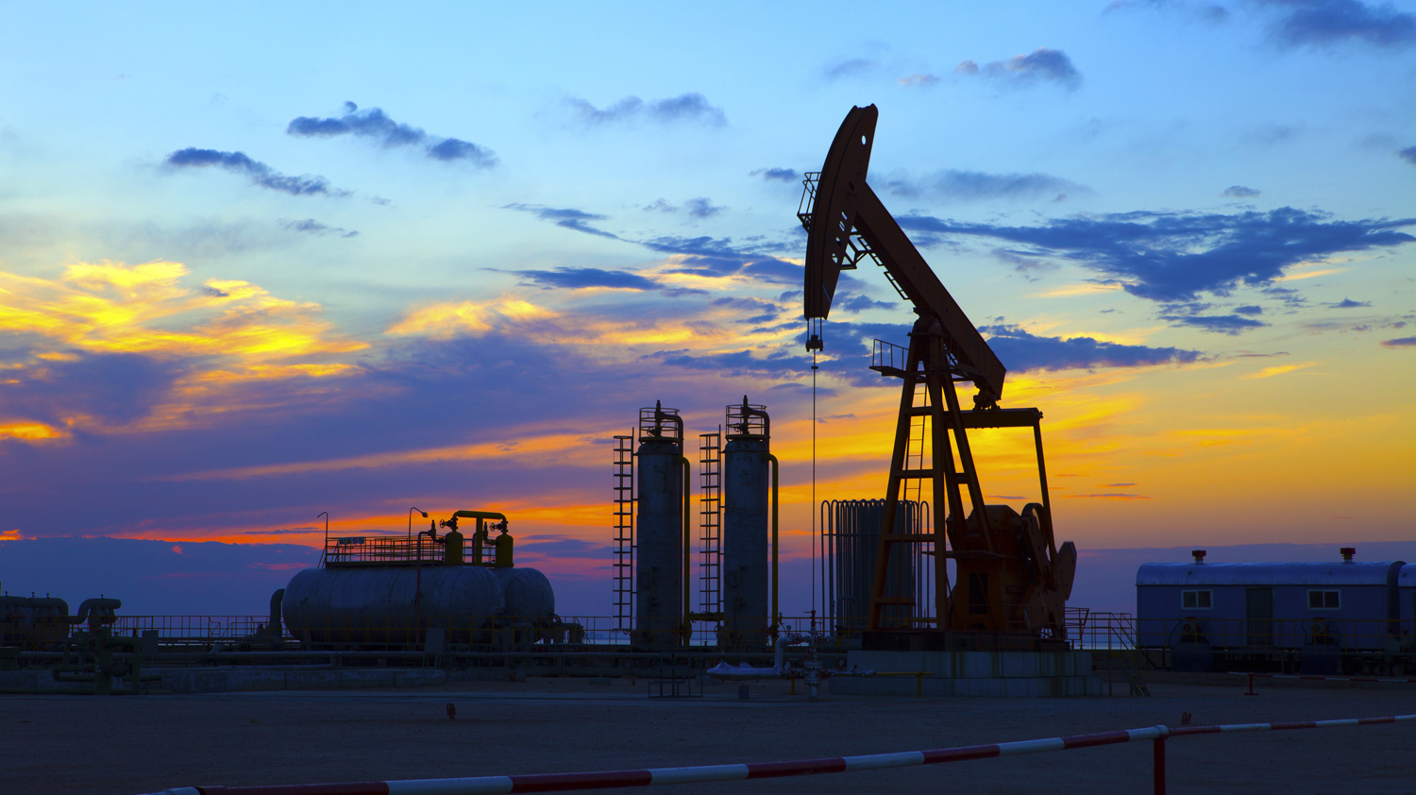
Differences between traditional technologies and modern technologies
Complexity
Automation
Speed
Connectivity
Flexibility
Notes:
There are several differences between traditional and modern technology. Here are some key differences:
Since it frequently includes cutting-edge components like artificial intelligence, machine learning, and the Internet of Things (IoT), modern technology is frequently more complex than traditional technology.
Automation is a feature of modern technology that allows for the automatic completion of tasks and processes without the need for human involvement. On the other hand, traditional technology frequently necessitates more manual labour.
Because it frequently operates more quickly than older technology, modern technology makes it possible to complete tasks more quickly and effectively.
Modern technology is frequently more interconnected, allowing for real-time information sharing and communication between systems and devices. Traditional technology might be less interconnected or necessitate more manual information transfer (Gitlin, 2021)
Modern technology is frequently more adaptable and flexible, with the capacity to be modified and rearranged to meet particular needs. Technology from the past may be more rigid and challenging to change.
In general, modern technology is more sophisticated, automated, and fast, connected, and flexible than traditional technology. However, it might also cost more and take more skill to implement and maintain.

Slide 16

Why modern technology is important for British Petroleum
Increased Efficiency
Improved Safety
Improved Sustainability
Better Asset Management
Improved Customer Experience
Notes:
Modern technology is important for British Petroleum (BP) for several reasons:
Automation, artificial intelligence, and data analytics are examples of contemporary technologies that can assist BP in streamlining its operations and making better use of its resources. This may lead to greater productivity, lower costs, and improved efficiency.
Modern technologies, including drones, real-time monitoring systems, and autonomous vehicles, can help BP operate in a high-risk sector while enhancing worker safety and lowering the likelihood of accidents.
BP is dedicated to lowering its carbon footprint and making the transition to a future with less carbon emissions. Modern technologies like data analytics, digital twin technology, and renewable energy sources can aid BP in achieving these objectives and turning it into a more sustainable energy provider.
BP manages a vast network of resources, including pipelines, refineries, and oil and gas wells. Modern tools like real-time monitoring systems and digital twin technology can assist BP in better managing and maintaining these assets, leading to increased uptime, decreased downtime, and cost savings.
Mobile apps, online ordering platforms, and social media are examples of contemporary technologies that can assist BP in enhancing the customer experience and raising customer satisfaction.

Slide 17

Consequences of not using modern technology in British Petroleum
Reduced Efficiency
Increased Risk
Limited Innovation
Poor Asset Management
Limited Sustainability
Notes:
The consequences of not using modern technology in British Petroleum (BP) could be significant and far-reaching. Here are some potential consequences:
Without contemporary technology, BP probably wouldn't be able to function as effectively as its rivals. Higher costs, lower productivity, and lower profitability might follow from this.
Because BP works in a high-risk sector, using outdated technology could make accidents and other safety-related incidents more likely. This could cause significant harm to employees, harm to the environment, and harm to the company's reputation.
BP would be less able to innovate and create new goods and services without modern technology. This might make it harder for it to compete in the rapidly changing energy market, which might lead to a loss of market share.
BP manages a vast network of resources, including pipelines, refineries, and oil and gas wells. Without modern technology, managing and maintaining these assets would be more challenging, which could lead to more downtime, more expensive maintenance, and a shorter asset lifespan.
By refusing to adopt contemporary technology, BP may find it more challenging to transition to a lower-carbon future. Without access to contemporary technologies for renewable energy, BP might find it difficult to cut its carbon footprint and achieve its sustainability goals.

Slide 18
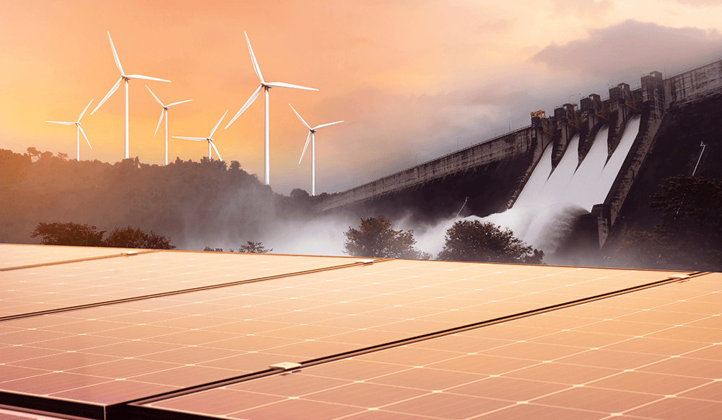
The future prospects of using modern technologies at British Petroleum
Continued Investment in Renewables
Advancements in Digital Technologies
Expansion of Low-Carbon Businesses
Continued Focus on Safety
Customer-Facing Technologies
Notes:
The future prospects of using modern technologies at British Petroleum (BP) are promising. Here are some potential future developments:
BP is committed to transitioning to a lower-carbon future and the company ensures great innovations in renewable energy technologies such as solar, wind, and biofuels with the help of the available technologies. The company can explore the use of digital technologies like AI, data analytics, and IoT to improve its operations and efficiency. BP can expand its low-carbon businesses including EV charging, biofuels, and hydrogen. Safety is a top priority, and BP can continue to invest in new technologies to improve safety for its workers. Finally, BP can improve customer experience and satisfaction through the use of customer-facing technologies like mobile apps and social media.

Slide 19
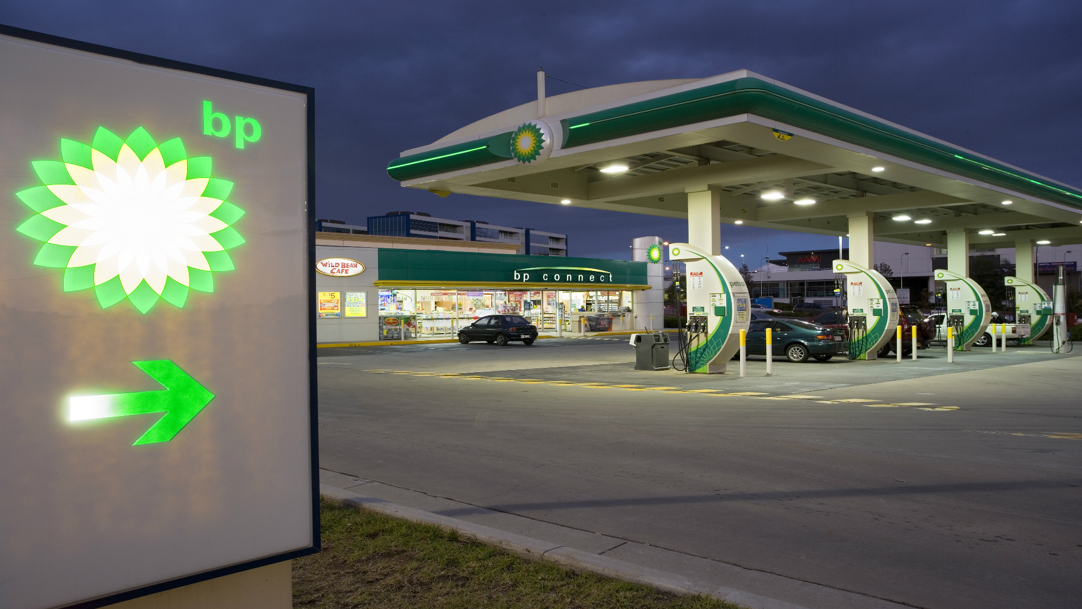
Conclusion
Technology is transforming the operations of British Petroleum in many great ways. In the upcoming days, the company is likely to get benefitted in a range of ways as discussed in the presentation. To effectively enjoy the benefits of modern technologies, the company needs to be aware of the limitations and challenges of the technologies. With the right focus and proper investment, the company can make the best out of the available technologies.

Slide 20

References
BP (2020). Growing the business and advancing the energy transition Advancing energy to improve people’s lives Contents. [online] Available at: https://www.bp.com/content/dam/bp/business-sites/en/global/corporate/pdfs/investors/bp-annual-report-and-form-20f-2018.pdf.
BP (2023). Our beliefs and code of conduct | Who we are | Home. [online] bp global. Available at: https://www.bp.com/en/global/corporate/who-we-are/our-beliefs-and-code-of-conduct.html.
Campbell, K.S., Kinnear, S. and Thame, A.N. (2015). AUV technology for seabed characterization and geohazards assessment. The leading edge, 34(2), pp.170–178. doi:https://doi.org/10.1190/tle34020170.1.
Ebrahimi, M. (2016). British Interest in Iran’s Oil: Prelude to Conflict. SpringerBriefs in environment, security, development and peace. doi:https://doi.org/10.1007/978-3-319-31098-5_1.
Gao, C. and Gray, K.E. (2019). A workflow for infill well design: Wellbore stability analysis through a coupled geomechanics and reservoir simulator. Journal of Petroleum Science and Engineering, 176, pp.279–290. doi:https://doi.org/10.1016/j.petrol.2018.12.077.
Gitlin, M. (2021). The Birth of Modern Tech. 21st Century Skills Library: A.
Hsu, C.S. and Robinson, P. (2017). Springer Handbook of Petroleum Technology. Springer handbooks. Springer International Publishing. doi:https://doi.org/10.1007/978-3-319-49347-3.
Matthews, J. (2023). How did 2010 Deepwater Horizon oil spill impact marine life? [online] FOX 13 News. Available at: https://www.fox13news.com/news/how-did-2010-deepwater-horizon-oil-spill-impact-marine-life [Accessed 1 May 2023].
Sundarakani, B., Ajaykumar, A. and Gunasekaran, A. (2021). Big Data Driven Supply Chain Design and Applications for Blockchain: An Action Research using Case Study approach. Omega, p.102452. doi:https://doi.org/10.1016/j.omega.2021.102452.
Tharoor, I. (2010). A Brief History of BP - TIME. [online] web.archive.org. Available at: https://web.archive.org/web/20100710075234/http://www.time.com/time/business/article/0%2C8599%2C1993361%2C00.html.

Slide 21

Question and answer

