Slide 1
MSCR CONSULTATION SERVICES
Charlene Blissett 1808878
Marjorie Burnett 1808858
Mohammed. S. Ali 1715953
Rachel Nkanga 1810583
Sanara Akbar 1713889

Slide 2
Introduction
MCSR was asked to do a presentation on how to manage team working to a group of managers.
In order to introduce effective team working we need to consider:
Benefits of team working
Stages of team development
Team roles
Successful team development
Managing conflict

Slide 3
Benefits of team working.
Working in a team help to gain new skills that can be used later for your career.
It helps to build trust within the employee and will provides feelings of safety that allows ideas to emerge.
It boosts productivity
It helps to improve services
It improves morale
It helps to improve your service

Slide 4

Stages of group development
Forming
First stage is forming, group members taking time to get acquainted
Will they fit in well with the group
A group member should be chosen to lead

Slide 5
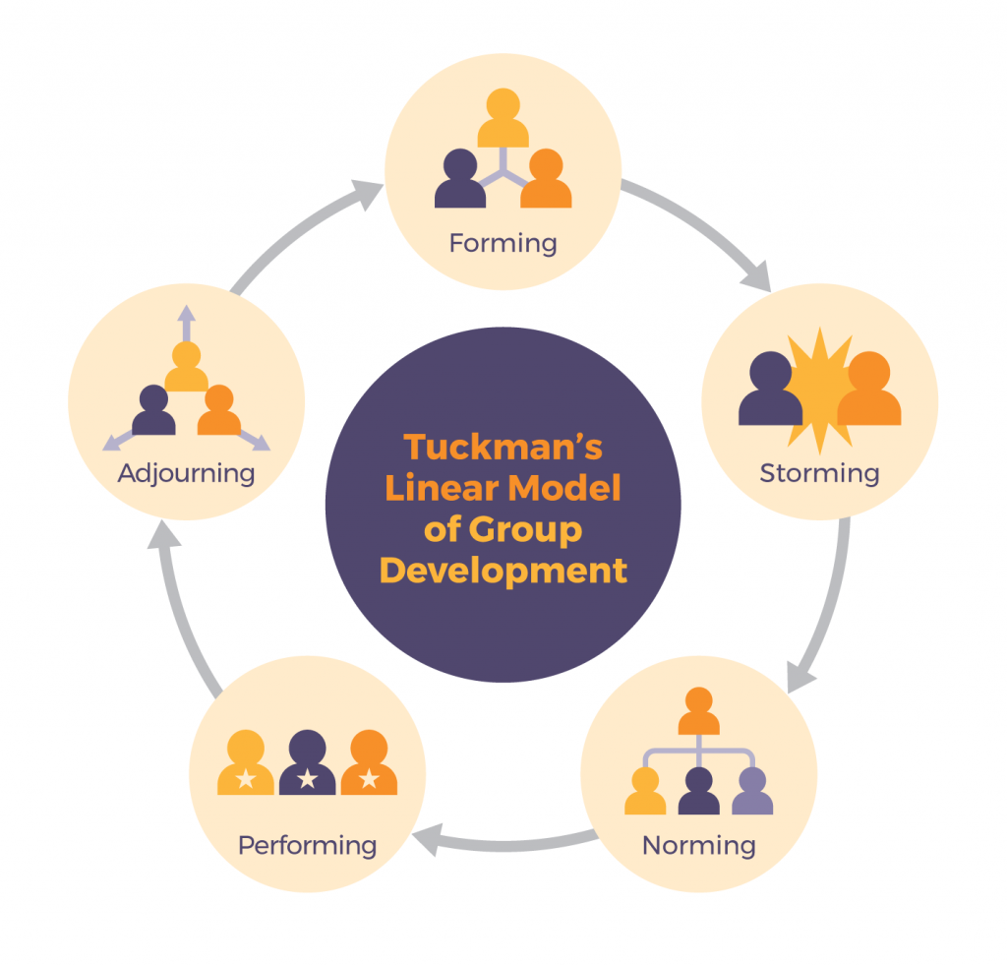
Tuckman’s model
This Photo by Unknown Author is licensed under CC BY-SA

Slide 6
Storming
The second stage is storming
Most difficult stage as the most disagreements and conflicts happen at this stage
Every group member has a different style and methods of working or communicating

Slide 7
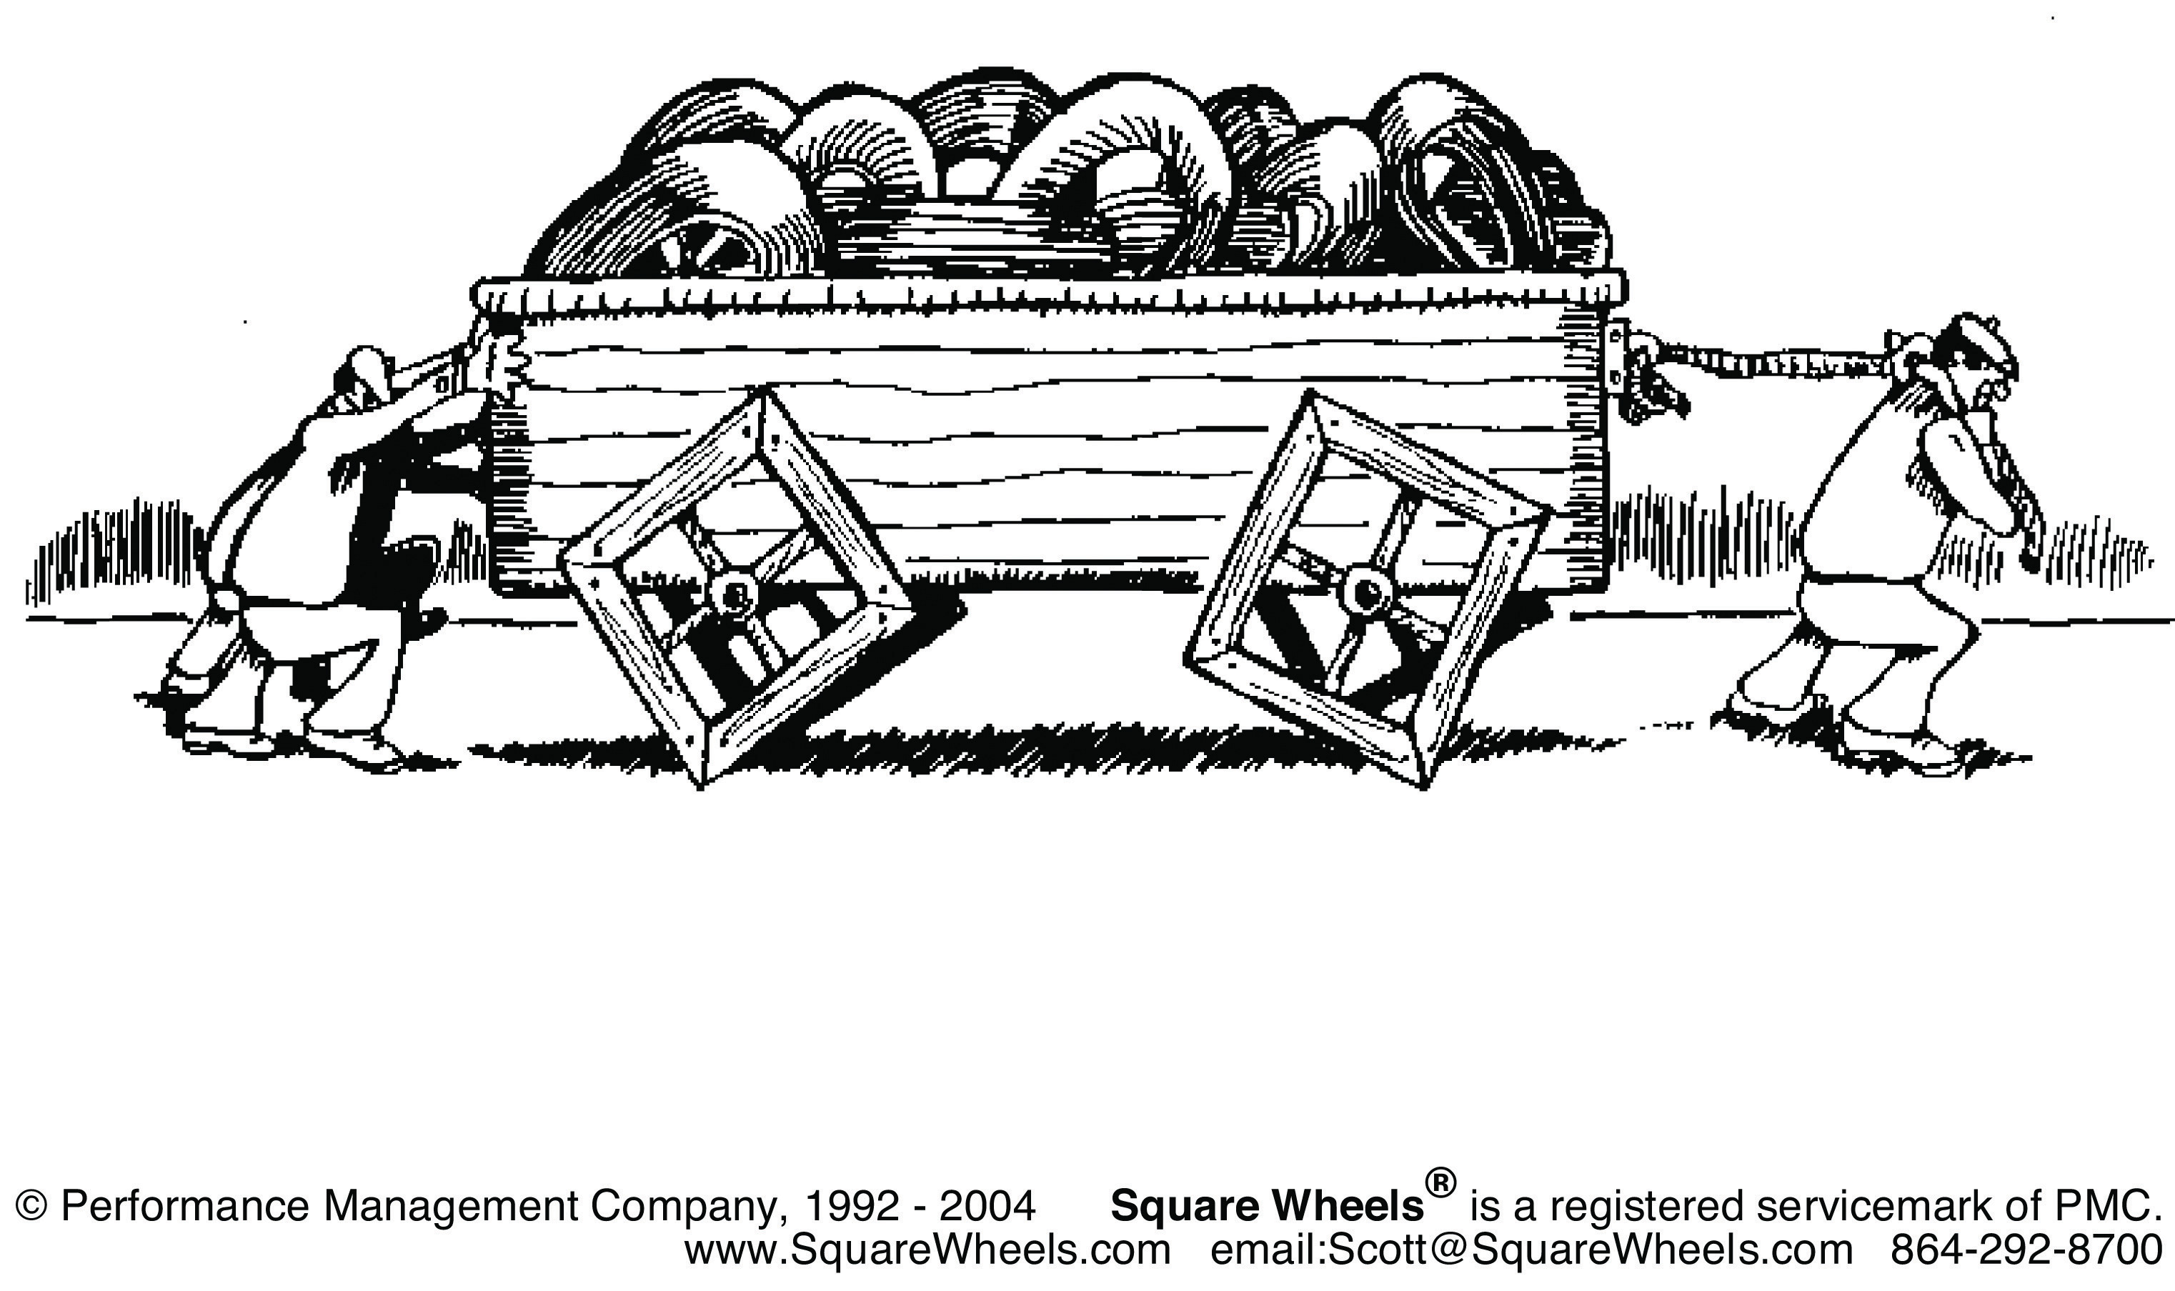
NORMING
The third stage Norming is after the conflicts issues are resolved the group focuses on the goal of the project
Also leaders are chosen to head the project
This Photo by Unknown Author is licensed under CC BY-SA-NC

Slide 8
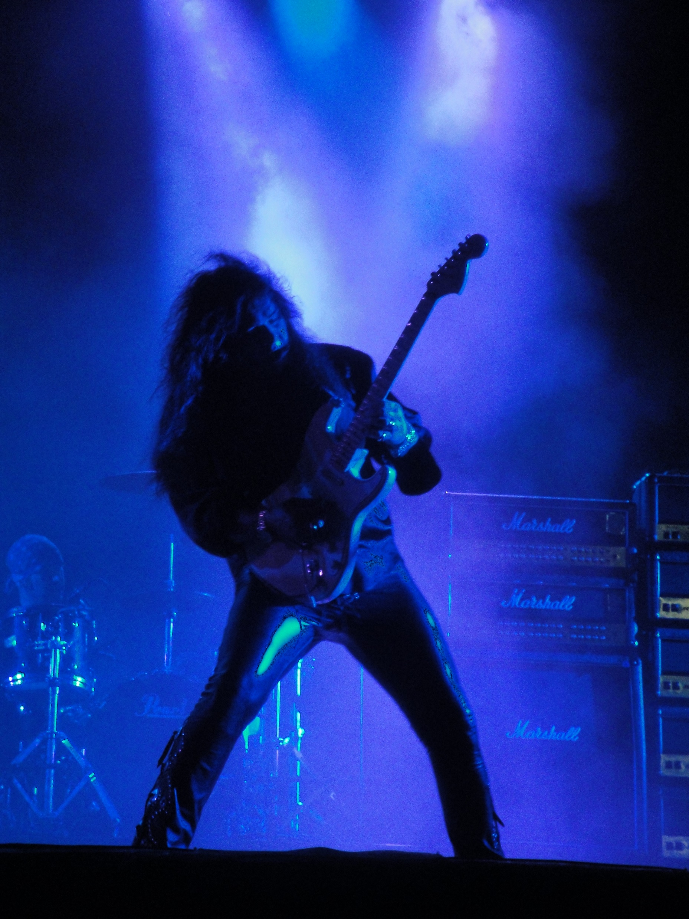
PERFORMING
The fourth stage is performing, this is when the group have reached their goals
The groups have overcome any frictions between themselves

Slide 9
Adjourning
The final stage, when the projects comes to an end, targets are met
The project is complete

Slide 10
Team ROLES
What is a team ?
A group of individuals all working for a purpose
All have common goals
Common objectives
This Photo by Unknown Author is licensed under CC BY

Slide 11
Clarity of the team
Clear expectations
Everyone has clarity
A clear understanding of everyone's role
The leader must have ability to give clear instructions to the rest of the team

Slide 12
How to implement instructions within the team
Work method
Resources
Time frames
Work responsibilities
Work priorities

Slide 13

Team Roles
A team is a group of individuals, all working together for a common purpose.
The individuals comprising a team ideally should have common goals, common objectives and more or less think on the same lines.

Slide 14
Successful team development.
Teamwork is defined by Scarnati (2001) “as a cooperative process that allows ordinary people to achieve extraordinary results”. ​
​
Harris & Harris (1996) also explain that a team has a common goal or purpose where team members can develop effective, mutual relationships to achieve team goals. Teamwork relies upon individuals working together in a cooperative environment to achieve common team goals through sharing knowledge and skills.

Slide 15
Gregory Huszczo outlined seven key components for successful team development.
Clear sense of direction. All team members need to have a shared purpose
Talented members.Its essential that at least one member has the vision of what needs to be accomplished.
Clear & enticing responsibilities. Every one should know their roles and who to report to.
Reasonable & efficient operating procedures. Systems need to be in place to operate the organisation.
Constructive interpersonal relationships. Systems need to be in place to provide support to individuals and handle conflicts.
Active reinforcement systems. Procedures need to be in place to handle accountability and rewards
Constructive external relationships. Good diplomatic relationships with external members.

Slide 16

Aims of managing conflict
The aim is to demonstrate how to mange conflict within the work environment. This will enhance how the team communicate and the effectiveness of the organisation.

Slide 17
conflict management
Annis (2003) states conflict is the process of limiting negative aspects while it increase the positive aspect of conflict in organization.

Slide 18
The main causes of conflict
Misunderstanding
Poor communication( example lack of language: accent or slang ) this will limited the organization performance profit loss and target not been met.
Lack of planning
Poor staff selection and burnout

Slide 19
Five key strategies when it come to conflict developed by Thomas and Kilman(2016)
Avoiding( when the individual just ignore or move away from conflict.)
Competing(individual go into conflict with a plan to win)
Accommodating(is where one party gives in to the wishes of another)
Collaborating(is the method used when individuals are both assertive and cooperative)
Compromising is where participants are partially assertive cooperative.

Slide 20
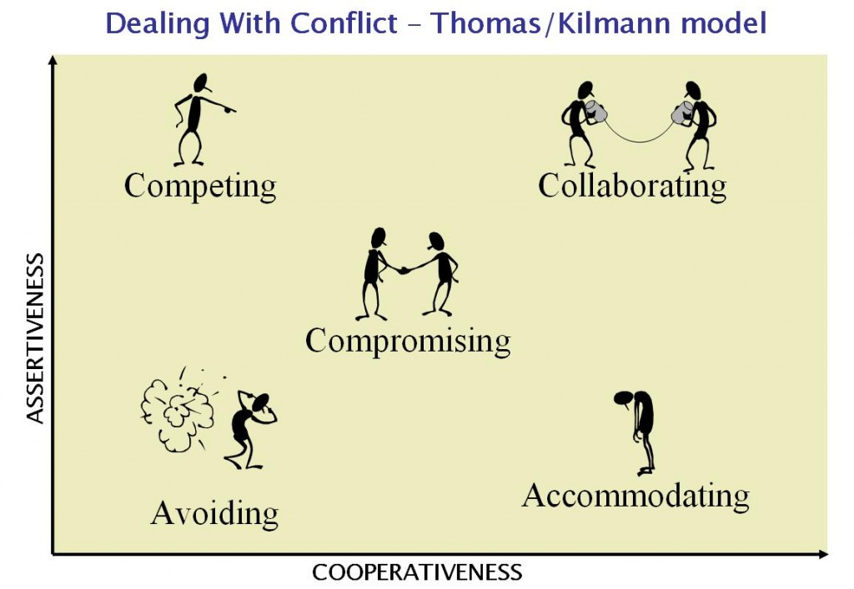
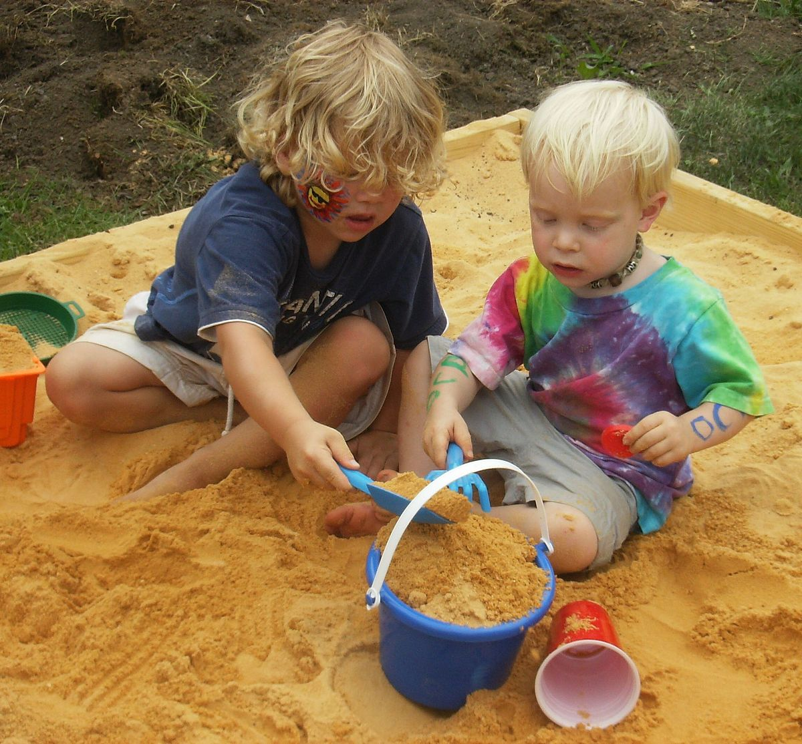
Thomas/Kilmann M model
This Photo by Unknown Author is licensed under CC BY-SA
This Photo by Unknown Author is licensed under CC BY-NC
This Photo by Unknown Author is licensed under CC BY-SA

Slide 21
The approach how to mange conflict
Talk with the individual
Focus on behaviour and event, not on personalities
Listen carefully
Identify point of agreements and disagreement
Priorize the areas of conflict
Develop a plan to work on each conflict
Follow through on the plan
Build on your success
The best approach that was used in the group was carefully listen , we all know what we want to achieved and we just went for.

Slide 22
references
Abudi,G.(2010) the 5 stages of development, available at:https://www.projectsmart.co.uk/the-stages-of-team-devolopment. Accessed on: 1st may 2019.
Annis,B.(2003) same words different languages publish piatkus books. Accessed on 3rd may 2019.
Belbin,(2011) Effective teams, available at:https;//www.mindtools.com>new ldr-83. Accessed on 4th may 2019.
Cameron,I.(2014) 7 components of successful team development, available at:https://www.thebalancecareers.com/how-to-build-powerfully-successful-work-teams. Accessed on 3rd may 2019.
Heathfield,S(2016) build powerfully succesful teams. Available at:htpps://www.thebalancecareers.com. Accessed on 3rd may 2019.
Paych,M(2018) 5 stages of development every leader should know. Available at:https://www.medium.com/swlh/team-devolopment-stages. Accessed on 3rd may 2019
Thomas,K(2001) conflict mode instrument xicom incorporated, is a subsidiary of cppc inc. Accessed on 6th may 2019.

