Slide 1
Best value as an approach?

Slide 2
There is a welcome change in procurement practice to move away from lowest price to best value as the leading selection criterion

Slide 3
The result of pre-construction practice has included an increase in demand for contractor input in the following:
Design and buildability/constructability
Design for manufacture and assembly (DfMA)
Design management
Design completion
Alternative option procurement
Demonstration of best value
Whole-life cost assessment
Value engineering

Slide 4
SELECTION PROCESSES
Negotiation – where a contractor is approached to negotiate a tender price without the need to introduce competitive tenders.
This is more prevalent within the private sector. Negotiation allows early contractor selection; especially where the design would benefit from the constructor’s input.
This can reduce the overall project programme, increase buildability, and tailor the costs to the client’s budget. The counterargument is that the initial price may be higher and difficult to compare with competitive market rates.

Slide 5
SELECTION PROCESSES
Open competitive tendering – where any applicants are allowed to join a lengthy tender list which can, and often is, beyond a sensible level. This arrangement is an approved EU option. Open tendering is used where the lowest price is likely to be selected.

Slide 6
Approved lists and framework agreements
- these enable clients to choose tenderers for a project from a list of contractors, who have been vetted and pre-qualified .
Important to monitor and regularly update their lists of contractors to:
Exclude companies whose performance has been unsatisfactory
Introduce suitable new companies that can demonstrate the required qualifications and abilities
Compile the lists in a form appropriate to the class of project
Include firms with the financial capacity and stability to do the work

Slide 7
One-off (ad hoc) lists
clients, or their consultants, frequently create an initial list of suitable contractors solely for a particular project.
Contractors included on an initial list are usually asked to provide information about their financial and technical performance, particularly in relation to the type of work under consideration.

Slide 8
PRE-QUALIFICATION
Pre-qualification –
‘the provision by a contractor of information as part of a pre-selection process. An application by a contractor to be included on a select list of tenderers.’

Slide 9
Pre-qualification is a necessity for..
public sector and non-governmental organisations –eg
central government authorities
local authorities
universities
NHS Trusts and some utility companies
Large private sector clients with an ongoing programme of work.

Slide 10
PRE-QUALIFICATION
It is used for the establishment by the client of a list of contractors or specialty contractors with the necessary skills, experience, resources, previous tender performance, and desire to carry out the works, bearing in mind the character, size, location and timing of the project.

Slide 11
Pre-qualification will occur sometime before any formal invitations to tender are issued.
It is important for the client to allow a realistic programme covering the whole of the pre-qualification and tendering period, and adequate time is given for each stage.

Slide 12
Comprehensive and detailed information will be required; on major works.
Submissions can take several weeks to prepare.
The European Union (EU) has requirements regarding time periods when tendering for public sector works.

Slide 13
Pre-qualification procedures can be used on a project by project basis or for a framework
agreement.
Being pre-qualified does not guarantee the contractor will be chosen for the tender list. Excessive pre-qualification, with long burdensome questions, adds cost,

Slide 14
The aim of a Pre-Qualification Questionnaire (PQQ)
Designed to check that the bidding company is (for the contract term):
Technically competent
Financially sound
Legally compliant

Slide 15
The next figure shows the evaluation criteria in more detail, split between commercial and technical.
Contracting authorities are required to publish an Award Notification letter providing some information to unsuccessful tenderers about the reasons for their decision.
After the contracting authority has informed tenderers of its decision, there must follow a ten-day standstill period during which the contract cannot be awarded, to ensure there is no appeal.

Slide 16
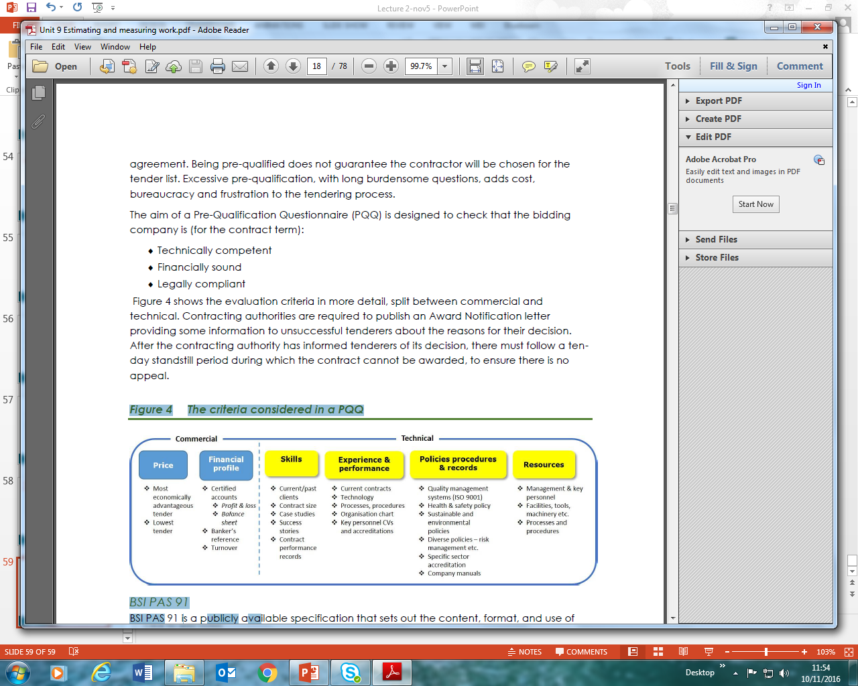
The criteria considered in a PQQ

Slide 17
BSI PAS 91
BSI PAS 91 is a publicly available specification that sets out the content, format, and use of questions that are widely-applicable to pre-qualification for construction tendering.
It specifies what is to be asked in the pre-qualification process for construction-related procurement.
It does not stipulate how the enquiry process is to be undertaken. Its aims is to underpin good practice.

Slide 18
PRELIMINARIES
DEFİNİTİON:
‘Main contractor’s preliminaries are the cost to the main contractor of running a site .’
The preliminaries are a substantial part of the project estimate.

Slide 19
PRELIMINARIES
In groups of four ,list the items to be included in the preliminaries and how you would price those items.

Slide 20
The preliminaries are a substantial part of the project estimate
Next slide shows the items involved in estimating the cost of preliminaries.
Main contractors’ preliminaries exclude costs associated with subcontractors’ or work package contractors’ preliminaries, but they must make allowances for servicing all the specialist contractors.
For example, staff will need washroom facilities, canteen facilities etc. They are sometimes referred to as site overheads (or in the USA as ‘field costs’).

Slide 21
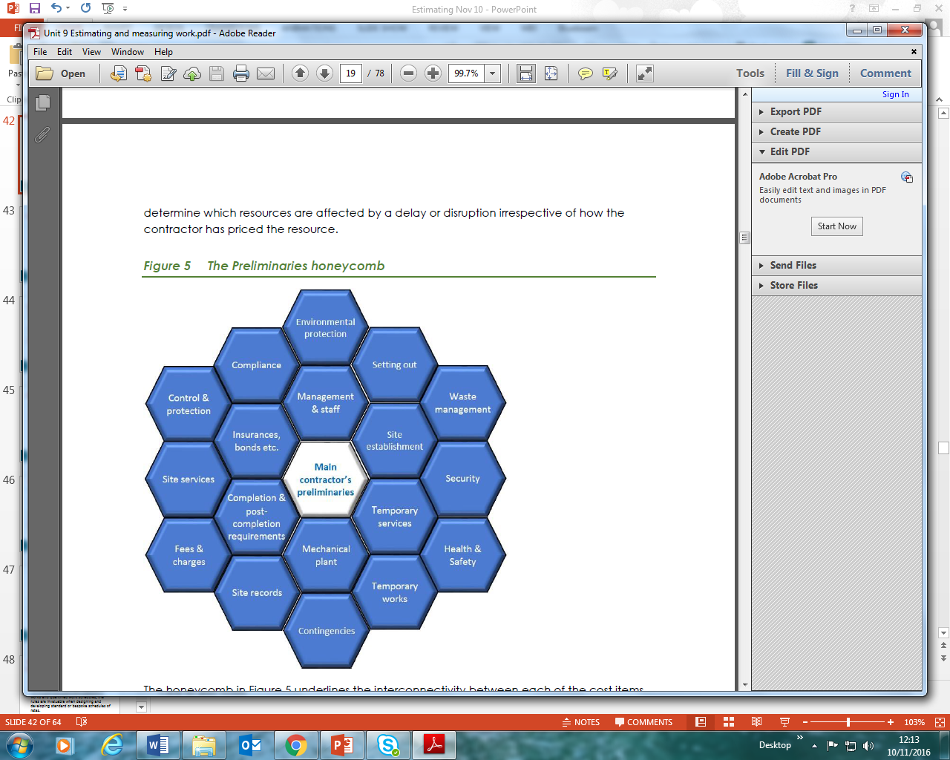
The Preliminaries honeycomb
Shows the items involved in estimating the cost of preliminaries.

