Slide 1

Name: Daberechi Onyinye Eze
Student ID: 2232114
Module Code: LCHS4003
Module : Introduction to Health and Social Care
Lecturer: Jolly Nwankwo
COMMUNITY
DISABILITY
SERVICES

Slide 2
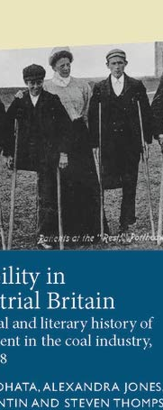
Introduction To Community Disability Services
Disability in the 2010 Equality Act is defined as a physical and mental impairment with a long term adverse effect on a person’s ability to carry out normal day to day activities.
Despite advancement in policies and social attitudes, people with disability often encounter unique challenges.
Community disability services is one of the post war desire for a national health service and it acts as a gate way into more specialist services, potentiality and the control of cost.

Slide 3
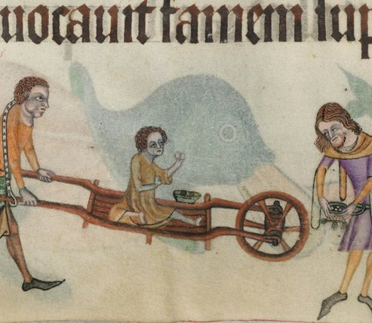
Origin of Community Disability Services in UK
The origin of disability in the communities started since the 1050s in the Bethlem Mental Health Hospital in the medieval time.
In the medieval time, disability was considered a punishment from God for one’s sins or misbehaviour from one’s ancestors. Others view disability as the work of the devil.
After the second world war, the labour government of Clement Attlee established the National Health Service to eliminate poverty for those who cannot pay for treatment and brought all the social care sector under the umbrella of the NHS and it became a big business and everybody’s business.
Glasby, J. (2012)

Slide 4
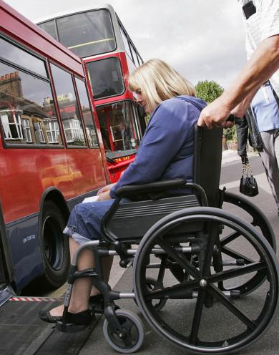
How Community Disability Service Has Developed With Time
The aim of Clement Attlee’s Labour government was to get ride of the poverty in the society because of the effects of the war.
Eliminate ignorance in our society which is caused by lack of education.
Poor Housing
Eliminate Idleness which caused by unemployment.
Eliminate diseases which was caused by inadequate healthcare after the war.

Slide 5

How Community Disability Service Are Running Now In UK
Since the introduction of the lunacy act of 1845, there has never been a destination between learning disability and mental illness.
It was after the introduction of the Idiot act of 1886 that legislation was enacted to distinguish people with learning disability and those with mental illness.
After this period, there were many acts of parliament which tried to improve on the warfare and care of the people with learning disability and mental illness until the establishment of the NHS in 1948.
After the NHS was founded, a lot of mental and disability institutions example, Mencap was taken over by the NHS and warfare officers appointed to work outside hospitals.

Slide 6

How Community Disability Services are running now
In 1990, there was NHS and Community Care Act and a follow up with the Disability Discrimination Act of 1995.
It became an ideal model of mixed economy of care with state, voluntary organisations, private sector and family.
There has been many changes to community disability services through improvements in government policies and implementation.

Slide 7

HOW COMMUNITY DISABILITY SERVICES ARE RUNNING NOW IN UK
Improvement in the way disability patients live in the community through the provision of government housing.
Improvement to public transport facilities which enables disabled patients access public transport.
Increase in government funding example, disability allowance to enhance the living standard of it’s citizens.
Improvement on educational facilities especially, Special schools to take care of disabled people.
Availability of new and improved medications.
Improvement in technology and innovations which enhances movement eg mobility bike.

Slide 8

How Community Disability Services Development Has Aided The NHS
The major aim of community disability services is to aid the NHS in effecting a reduction in health inequalities and behaviour, and to promote independence in all aspects of daily living of patients.
The community disability service work as a team and they are experienced in working with disabled people and help the NHS design the need of patients with disability and this called co-production.
Co – production in the community disability employs people with disability. They use their experience of healthcare to make the NHS services better understand the needs of patients.

Slide 9

CONCLUSION
Community disability services is one of the post war desire for a national health service.
It acts as a gateway into more specialist services , potentiality and the control of cost.

Slide 10
Reference
Basta, E., 2023. The impact of emigration on british society since World War II.
Fraser, A. and Mays, N., 2024. Health policy in the UK. In Research Handbook on Health Care Policy (pp. 497-552). Edward Elgar Publishing.
Glasby, Jon.(2017) Understanding health and Social Care. 3rd Edition. Bristol. Policy Press.
Kaplan, D., 1999. The definition of disability: Perspective of the disability community. J. Health Care L. & Pol'y, 3, p.352.

