Slide 1

Problem Solving and Decision Making
BMSW4004
Cristina Sardaru 1816279

Slide 2
Introduction
Hello and welcome to my PowerPoint presentation where I will be discussing the complex problem of staff shortage in the UK as it is a problem that is quite complex as you have a lot of different sides you have to address and a lot of different viewpoints pf which you have to see for yourself in order to truly address the problem and get to the root of it. So in this presentation we will try to look at all of the different sides of the problem and viewpoints in order to get a better understanding of it and find solutions that will please everyone no matter what their viewpoint and opinion on the problem is.

Slide 3

The Discussion
First point we will discuss is the impact the staff shortage has on the current employees that are still working and the business itself. The first impact the current staff shortage has on the current employees is the fact they are under more stress as they have to work more in order to make up for the missing staff as they will have to work harder and in this scenario to look after more people as the fact that there are around 41,000 nurse vacancies this means that the nurses that are working 2 times as harder and as much to make up for the ones that are missing. Another impact they have is the fact they have to change the shifts as they have to make them longer in order to make sure all of the patients are looked after and treated meaning doctors and the staff in general have to work longer hours.

Slide 4
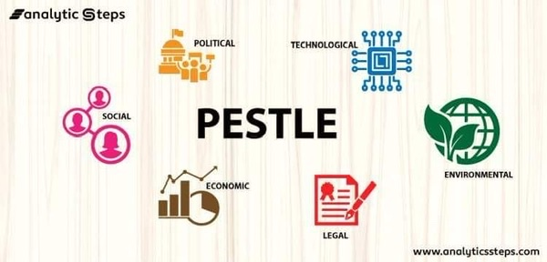
PESTLE Analysis
Political: For the political factor I have chosen Brexit as it has a major role in the staff shortage in the NHS and overall rise of unemployment as a lot of people cannot come into the country anymore as they might be refused entry to the country and some have been deported due to the fact they do not have an immigration status which in turn means a lot of people that are qualified to be doctors and nurses that were willing to fill those vacancies have not been allowed into the country.
Economic: For the Economic factor I have chosen the Unemployment rate as due to the fact that the unemployment rate has gone up because of the pandemic as a lot of people lost their jobs due to it and have been struggling to find jobs same has happened for the NHS as a lot of people stopped working in hospitals and care centers because of the COVID-19 virus and some have been struggling to find work while other have stopped working all together.
Social: For the social factor I have chosen the fact that most people are not enticed into choosing a doctor or a nursing career path because of the pay and working hours. As people now are looking for jobs that are paid well and offer good working hours where as with being a doctor or a nurse the salary is not as high as other jobs and quite low to compared to jobs such as managers and as a doctor or nurse you have to work long non-sociable hours meaning you can either work all day or all night and you will have little to no social life outside of work.
Technological: For the technological factor I have chosen the fact that due to current technological advancements the NHS has started to rely more and more on machinery and technology such as could based saving for patient details and computers to share the information faster and to get more accurate descriptions of what the patient might be suffering from.
Legal: For the legal factor I have chosen the Health and Safety laws as many new employees and employers are put off by the amount of effort, time and money has to go in order to make sure the hospital is up to the standards set by law and employees might be put off by the fact they have to maintain that standard which can take a long time and might not be enjoyable to do.
Environmental: For the environmental factor I have chosen is the fact that many doctors that might be doing their practice in other countries are not enticed to come to the UK to continue their practice in the UK because of the weather as most of the time it is raining and cold and they might be looking for places with a hotter climate.

Slide 5
Fishburne Diagram
Hard to maintain health and safety standards
Low Pay
Brexit
Low employment rate
Weather
Long Hours

Slide 6
Solutions to the problem
  A clear solution to this problem would be to increase the pay rate as if would satisfy the current employees and entice them to keep working while also attracting the past employees that might have stopped working because of the pay rate and new ones. Another thing they could offer to attract more people to apply for the current vacancies is to offer bonuses such as paid vacations, extra pay for working more than their shifts, and paid time off in general as it will entice more people to apply. Opportunities to grow their career should also be offered in order to give an incentive to the people that feel like they are working a dead end job and salary increases to the nurses and doctors that were performing well over a certain period of time as a reward for their performances which other than the pay rise will also give the employees a feeling of being rewarded and appreciated for their work.

Slide 7
P.M.I
Solutions | Plus | Minus | Whats Interesting
Increase pay rate | It would attract a lot of new+4 people to apply for the vacancy as as would offer a more attractive pay package | It would cost us way more to keep that employee in the long and it could lead to current employees who have worked for a longer time for a pay rise -1 | The interesting part is the fact that while we would get a lot of new applicants it could lead to the current employees getting angry and could lead to them either revolted or leaving the business +2
Paid time off | It would lead to us retaining our current employees and making them satisfied and another plus would be the fact it would motivate them as they would have something to work towards. +5 | Again it would lead to this costing more money from our business which in the current economic climate is a huge risk. -0 | The interesting part is that while it would cost more money for us to provide a paid time off programe it would lead to our employees working harder as they would be motivated towards gaining that paid time off +5
Opportunities for career growth | Again it would lead the employees working harder as they would be more motivated to achieve opportunities for career growth and getting stuff such as a higher paid position.+3 | The minus of this is that it would lead to some employees feeling that they have worked hard for nothing if they have not been chosen which would in turn would mean they would feel unappreciated -2 | The interesting part is that while it would increase overall productivity and effort it would also lead to an increase in people feeling unappreciated and being angry at the management +0

Slide 8
Conclusion
In conclusion this is quite complex problem and have a lot of viewpoints and factors you have to take into consideration as they all play a huge role on this problem and to find a solution that addresses all of them.

