Slide 1
Augusto Boal and Theatre of the Oppressed
Intro to AD: Week 2

Slide 2
What is Theatre of the Oppressed?
Theatre as a tool for liberation and empowerment
Uses theatre as way to better understand ourselves, how we fit into the world around us and how we might change those worlds
Schechner has said of Boal: “You have created a theatre that Brecht merely dreamt of”

Slide 3
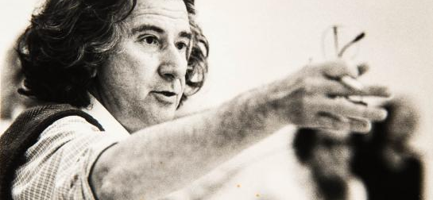
Augusto Boal
1931-2009

Slide 4
1960’s
Arena Theatre in Sao Paulo
Touring Brazil: extreme poverty and oppression
Political theatre: aimed at telling truths and finding solutions

Slide 5
1970’s
Decided this wasn’t enough, so the theatre showed the problem and looked for a solution
The audience could make suggestions to the actors about what could be changed.
This worked ok…

Slide 6
Until one woman got so frustrated that the actor did not get what she was telling him to to do that she stormed onto the stage and did it herself… Forum Theatre was born

Slide 7
Late 1970’s & early 1980’s
Boal came to Europe to share his Theatre of the Oppressed
Although he found communities that suffered similar oppressions to those he had encountered in S. America, there were also oppressions that were new to him.

Slide 8
T.O. in Europe
Oppressions that Boal discovered:
Loneliness
Fear of communitcation
Fear of emptiness
These oppressions are in our minds – ‘Cops in the Head’ or the ‘Rainbow of Desire’ was born

Slide 9
Types of T.O
Invisible Theatre
Forum Theatre
Newspaper Theatre
Rainbow of Desire
Legislative Theatre

Slide 10
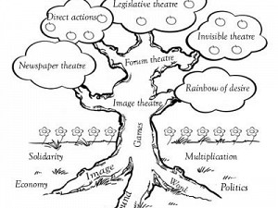
Theatre of the Oppressed

Slide 11
Games for Actors and Non-Actors
(The Arsenal of T.O.)
‘In the battle with the world our senses suffer’
Aim to reconnect us with our senses, to reawaken the senses to allow us to see, hear, smell, touch with renewed clarity.

Slide 12
The Arsenal of T.O.
Games
The body as the emitter and receiver of messages
Extraversion/Dialogue
Exercises
Getting to know your body better
A physical reflection of oneself
Introversion/Monologue

Slide 13
‘In the body’s battle with the world the senses suffer’
5 Groups of exercises and games make up the arsenal:
The gap between feeling and touching
The gap between listening and hearing
Developing the senses all at once
Seeing what we look at
Awakening the memory of the senses

Slide 14
YouTube links to TO projects
Forum for Social Change: https://youtu.be/qTA1b4rlTXI
Researching options through Forum Theatre https://youtu.be/gckv_-nuNbA
Augusto Boal and Son, Julian, lead Seminar on TO
https://youtu.be/RunACGJSrPk
Great example of Legislative Theatre https://youtu.be/66yg9HTkw_M

Slide 15
Bibliography
Boal, A. (2002) Games for Actors and Non-Actors. 2nd Edn. Translated by A. Jackson. London: Routledge

