Slide 1
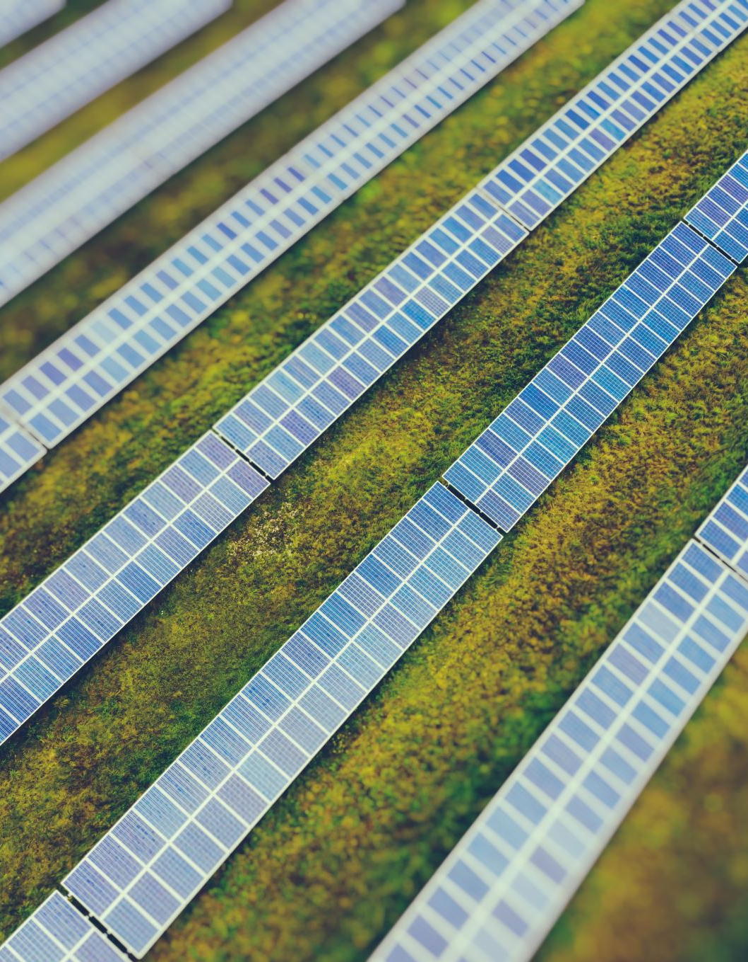
Community Green Initiative: Solar Panel Installation
Sustainable Energy for Our Community
“our project aims to install solar panels in community
buildings, fostering green energy use
to reduce carbon footprint and lower energy costs.”
Notes:
Objectives:
Install solar panels in community buildings.
Reduce carbon footprint & energy costs.
Importance:
Commitment to sustainability.
Promote renewable energy use in the community.

Slide 2

PROJECT DESCRIPTION
Overview: The Community Green Initiative seeks to equip local schools, libraries, and community centers with solar panels. This step aligns with our commitment to renewable energy sources, promoting sustainability and environmental awareness.
Notes:
Description:
Install solar panels in schools, libraries, and community centers.
Foster sustainability and environmental consciousness.
Rationale:
Reduce reliance on non-renewable energy sources.
Educate community on green initiatives.

Slide 3
SCOPE & WORK BREAKDOWN STRUCTURE
Scope: This project includes installing solar panels in five community buildings and providing necessary training for maintenance and energy optimization.
WBS: Visual presentation showing stages - planning, procurement, installation, testing, and training.
Notes:
Scope:
Install solar panels in five community buildings.
Provide training for maintenance and energy optimization.
WBS:
Planning: Site assessment and project planning.
Procurement: Purchase and delivery of solar panels.
Installation: Mounting and connecting panels to the grid.
Testing: Quality checks and system verification.
Training: Educate staff on panel maintenance.

Slide 4

PROJECT SUCCESS CRITERIA
Criteria: Timely installation of solar panels in all designated buildings, achieving a 30% reduction in energy costs within the first year, and successful training of building staff on panel maintenance.
Notes:
Criteria:
Timely installation of panels in all buildings.
Achieve a 30% reduction in energy costs within a year.
Successful training and competency in maintenance for building staff.

Slide 5
QUAD CHART
Accomplishments – Secured necessary funding, partnered with local energy companies. | Challenges – Initial costs, potential weather disruptions during installation.
Metrics – Reduction in energy consumption, cost savings, community engagement levels. | Next Steps – Community engagement programs, ongoing maintenance strategies, expansion plans.
Notes:
Accomplishments:
Secured funding from local sponsors.
Partnerships with energy companies established.
Challenges:
Initial costs for equipment and installation.
Potential weather disruptions during the installation phase.
Metrics:
Measure reduction in energy consumption and cost savings.
Assess community engagement levels.
Next Steps:
Implement community engagement programs.
Develop ongoing maintenance strategies and consider expansion plans.

Slide 6
CONCLUSION & NEXT STEPS
Summary: Our initiative seeks to bring sustainable change, reducing energy costs and environmental impact in our community.
Call to Action: Requesting approval for the project to proceed, additional funding considerations, and engagement from community stakeholders.
Notes:
Summary:
Initiative aims for sustainability and cost savings.
Call to Action:
Request approval for project execution.
Seek additional funding and community involvement.

Slide 7
REFERENCES
Johnson, A. (2021). "The Benefits of Solar Energy in Communities." Sustainable Energy Journal, 8(2), 45-56.
Smith, B. (2020). "Community-Based Renewable Energy Projects." Journal of Environmental Sustainability, 15(3), 112-125.
Green Initiatives Group. (2022). "Local Case Study: Successful Solar Panel Implementation in Schools." Retrieved from www.greeninitiativesgroup.org/casestudies.

