Slide 1
ECIE6001
Moving away from the traditional classroom: Outdoor Education and Learning
Darlith 2 / Lecture 2
The scope and approach to outdoor provision in different settings

Slide 2
The module aims:
To appreciate and critically reflect upon the role of outdoor education in Wales and further afield.
To demonstrate understanding of the debates in outdoor pedagogy.

Slide 3
LEARNING OUTCOMES
Upon the successful completion of this module, you should be able to:
Appreciate the importance of outdoor education on protecting our natural resources now and in the future and an understanding of what this means socially, economically and culturally.
Critically reflect upon the approaches to out of classroom learning and real-life experiences in nature, for all ages and abilities.
Critically discuss/evaluate challenges and multiple benefits of bringing the three strands of natural environment, learning and health together.
Organise their knowledge and learning through use of a range of media, and present their work appropriately in a manner that can be understood by specialist and non-specialist audiences.

Slide 4
Aseiniad Assignment
Portffolio
4 Elements
4000 gair
Dyddiad cau 26.04.26, 23.59
Gweler Cefnogaeth Aseiniad sy’n dilyn
Portfolio
4 Elements
4000 words
Hand in date 26.04.26, 23.59
See following Assignment Guidance

Slide 5
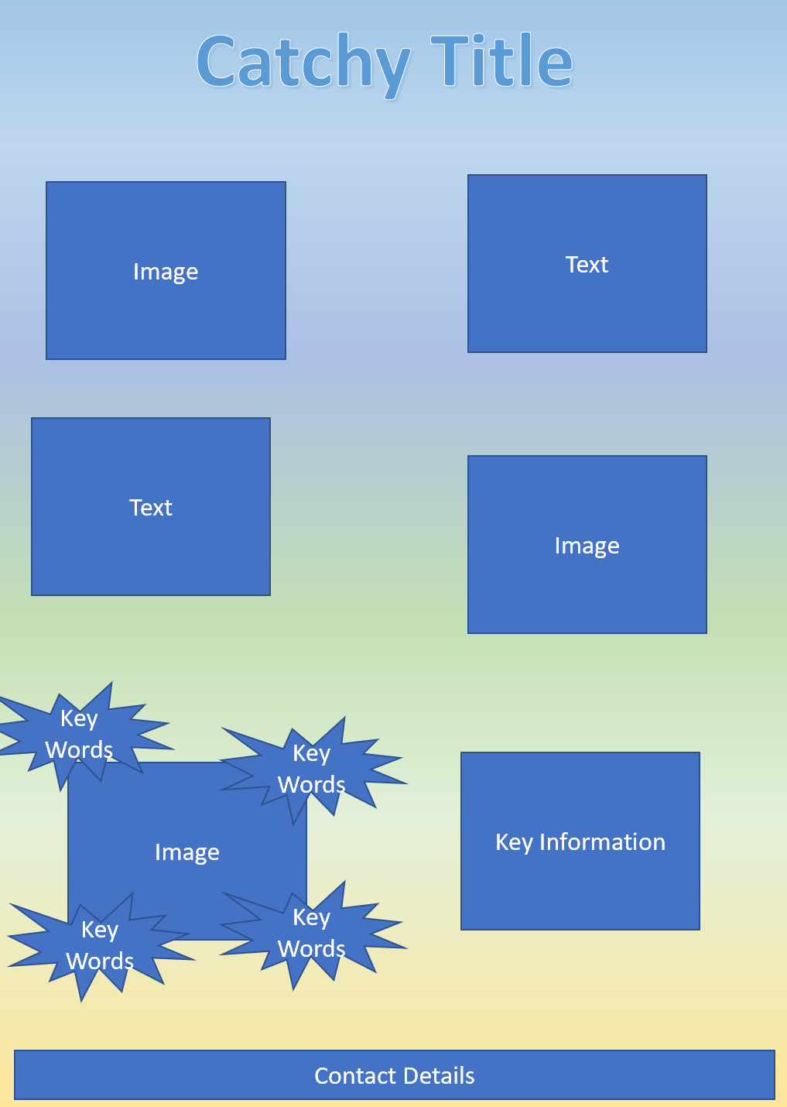
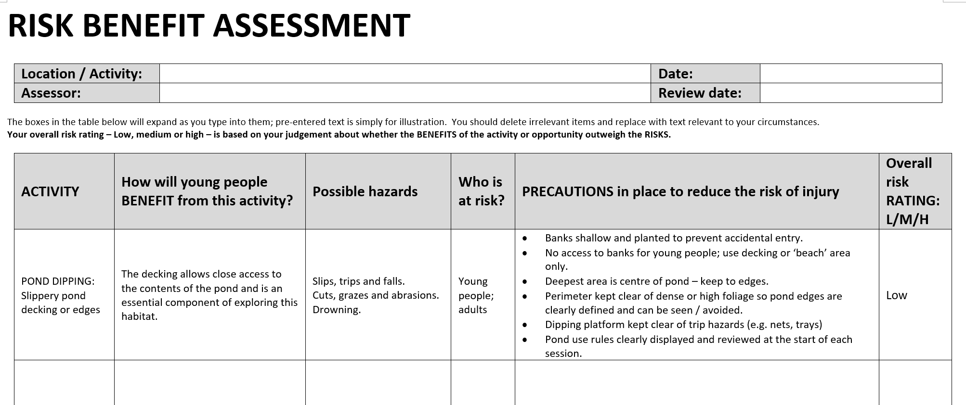
Aseiniad Assignment
Portffolio Portfolio
Essay
‘Compare and contrast the scope and approach to outdoor provision in two types of setting e.g. early years, primary, secondary, PRU, ALN units, etc’
(Approx. 1200 words)
Flyer
(Approx. 500 words)
Risk Benefit Assessment
(Approx. 600 words)
Literature Review
‘The role of Outdoor Education’
(Approx. 1700 words)

Slide 6
Schedule
Week 1:
The role of outdoor education
Week 2:
The scope and approach to outdoor provision in different settings
Week 3:
Risk and Risk Benefit Assessments/ Creating & advertising outdoor learning experiences
Week 4:
Recap theories, policies, best practices/Assignment guidance
or Tutorials

Slide 7
The scope and approach to outdoor provision in different settings
Start by reflecting on your personal experiences*.
Which settings have you worked in? Your children attended?
*Write the essay in the third person throughout, i.e. refer to yourself as ‘The writer’ or ‘The researcher’ rather than using ‘I’, ‘we’, ‘you’, ‘us’.
Compare and contrast the scope and approach in 2 settings you have experience of:
How is outdoor provision used? Planned for? Valued?
What are the benefits to outdoor provision in these settings?
The challenges to outdoor provision in these settings?
On-site? Off-site? Travel implications? Forest School? Eco-School?
Support with evidence -theories/policies/ curricula/best practice examples.

Slide 8
Importance of outdoor provision and learning in EY settings
Supports the core areas of learning (communication & language, physical development, personal/social/emotional development).
Ensures on-going opportunities for learning through play
Encourages sensory exploration and hands-on discovery that cannot be replicated indoors.
Builds gross motor skills and coordination through natural movement.
Strengthens children’s confidence, independence and risk assessment capabilities.
Enhances emotional wellbeing through exposure to nature and freedom of movement.
Provides rich language opportunities in real-world contexts.
Supports inclusive practice by offering flexible spaces for different learning needs.
Encourages social interaction, cooperation, and problem solving (WAG/LTL. 2008)

Slide 9
Good practice in EY settings
Provide continuous access to well-organised outdoor provision, not just at “playtime.”
Ensure environments offer open-ended, natural resources (logs, water, sand, loose parts).
Integrate opportunities for risk-taking in safe, structured ways.
Use outdoor spaces intentionally to extend the indoor curriculum.
Regularly rotate resources to keep the environment stimulating.
Build in opportunities for sustained shared thinking between adults and children.
Prioritise provision of waterproof clothing, boots, shelters for all-weather participation.
Observing children outdoors in order to plan next steps based on how they explore and interact.
(Tinney, 2023)
Theory(ies) that underpin the approach?

Slide 10
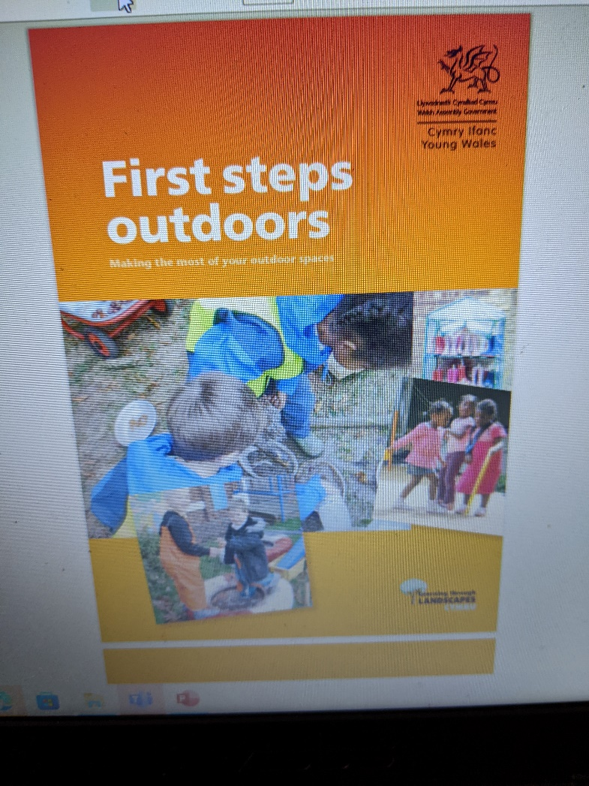
Using outdoor provision effectively in
Early Years
‘The benefits for children include:
Enjoy and achieve new understanding, skills and competence through playful exploration and developing lines of enquiry
Stay safe while developing the skills to manage risk and meet new challenges
Develop skills for life and be part of the community and environment
Build confidence, participate, contribute and develop a sense of wellbeing
The benefits for practitioners include:
The space and freedom the outdoors offers can support effective relationships between practitioners and children…. e.g. children’s involvement levels allow staff to take a more observational role, stepping in when necessary to structure and scaffold learning.’
Welsh Assembly Government/ Learning through Landscapes Cymru, 2008

Slide 11
Importance of outdoor provision and learning in primary school settings
Enhances engagement and motivation across the curriculum by connecting learning to real-life contexts.
Improves physical health and reduces sedentary behaviour.
Strengthens teamwork, communication and collaborative learning.
Supports mental health, reducing stress and improving focus.
Encourages curiosity, problem-solving and critical thinking.
Provides opportunities for active learning in all AOLEs
Builds resilience, independence and positive attitudes to challenge.
Helps children who struggle indoors to access learning in different ways
((Welsh Government, 2009)

Slide 12
Good practice in primary settings
Integrate outdoor learning regularly, not only for special events or one-off lessons.
Plan curriculum links explicitly (e.g. measuring in maths, biodiversity in science, descriptive writing in LLC).
Train staff so that outdoor learning is consistent and purposeful.
Provide defined outdoor learning areas and equipment (e.g. gardens, investigation zones, tools).
Encourage pupil-led exploration and inquiry.
Embed risk-benefit assessments as part of learning, not obstacles to it.
Use local community spaces (parks, woodlands, school grounds) to expand provision.
Ensure inclusive access, adapting tasks for different abilities, needs and interests.
(WAG, 2009)
Theory(ies) that underpin the approach?

Slide 13

Using outdoor provision effectively (3-7)
‘The outdoors is the ideal environment for experiential learning, because it offers unique opportunities to be creative, to move around, to be noisy and to take risks. The outdoors is full of special stimuli such as weather, sounds, smells and textures which can enrich and enhance a child’s learning environment’
.Welsh Assembly Government, 2009

Slide 14
Importance of outdoor provision and learning in secondary school settings
Increases student engagement, particularly for those less motivated by traditional classroom settings.
Builds practical skills relevant to subjects such as science, PE, geography, art and design & technology.
Supports wellbeing, reducing anxiety and improving mood, especially during adolescence.
Encourages teamwork, leadership and communication skills needed for future employment.
Makes learning more memorable through applied practice and real-world problem-solving.
Provides opportunities for physical activity and breaks in sedentary learning.
Helps pupils develop resilience, independence and personal responsibility.
Offers alternative pathways for pupils who may struggle academically (Learning Through Landscapes, 2023)

Slide 15
Good practice in secondary settings
Incorporate outdoor learning into schemes of work across subjects (fieldwork, outdoor art, practical science).
Use outdoor spaces for project-based learning and cross-curricular activities.
Provide structured opportunities for leadership opportunities (e.g. teamwork challenges, environmental projects).
Regularly review risk-benefit processes to enable rather than restrict opportunities.
Train staff in outdoor pedagogy, behaviour management outdoors and safety procedures.
Ensure environments are accessible and inclusive for all students.
Use outdoor learning to support GCSE coursework where relevant (e.g. geography fieldwork).
Provide enrichment activities (Duke of Edinburgh, eco clubs, sports opportunities).
(Learning Through Landscapes, 2023)
Theory(ies) that underpin the approach?

Slide 16
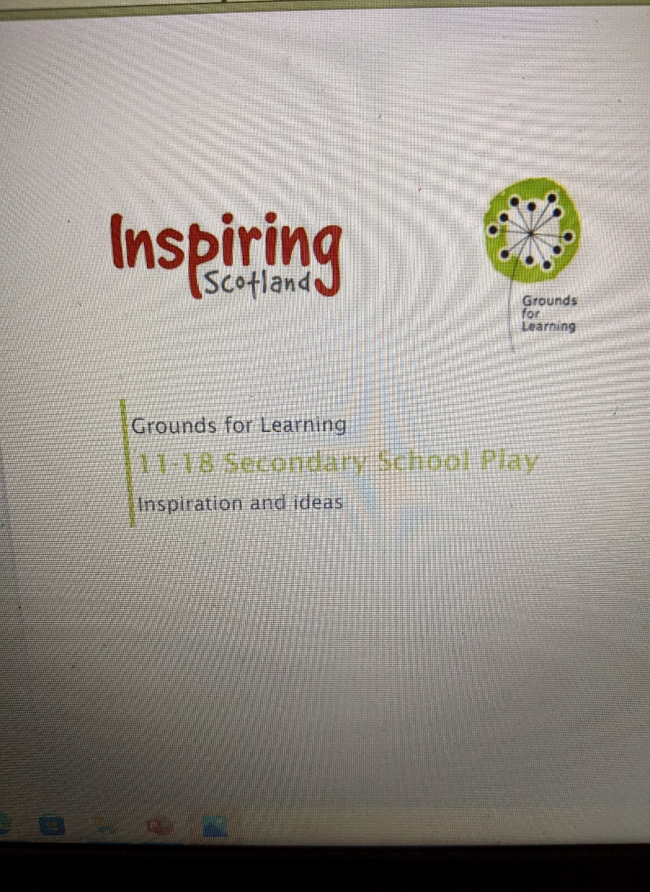
Using outdoor provision effectively in secondary school
‘We don't stop playing because we grow old; we grow old because we stop playing.’
George Bernard Shaw n.d. cited in Grounds For Learning, 2014
‘Young people are happier and healthier when they have regular opportunities to be outdoors. Make curriculum linked outdoor learning a regular part of your practice and you will help ensure positive intellectual, emotional, and social development whilst building the foundations for a lifelong connection with nature and our planet.’
Learning through Landscapes, 2023
(Play Scotland, 2020)

Slide 17
Importance of outdoor provision and learning in PRU settings
Offers a therapeutic environment that reduces stress and supports emotional regulation.
Provides alternative ways for learners to experience success, building self-esteem.
Creates opportunities for engagement where classroom-based learning may be challenging.
Helps develop social skills, cooperation and trust in others.
Supports physical health and provides a safe outlet for high energy levels.
Encourages motivation through real, meaningful, hands-on tasks.
Helps pupils practise risk management and self-regulation in safe ways.
Builds pathways into vocational skills (e.g. horticulture, construction basics, outdoor maintenance).
(Ofsted, 2011)

Slide 18
Good practice in PRU settings
Prioritise calm, structured outdoor routines to create a sense of safety and predictability.
Offer planned, practical activities such as gardening, nature projects, outdoor crafts and team tasks.
Ensure staff use trauma-informed approaches when teaching outdoors.
Use outdoor spaces for mentoring, relationship-building and restorative conversations.
Provide choice and autonomy to build motivation and ownership/belonging.
Plan carefully for behaviour management in open spaces, while avoiding over-restriction.
Use risk benefit assessments positively to enable therapeutic and meaningful activities.
Integrate outdoor learning with individual learning plans and emotional/behavioural targets.
(Institute for Outdoor Learning, 2025)
Theory(ies) that underpin the approach?

Slide 19
Using outdoor provision effectively in a PRU
Bryn y Deryn PRU
‘Most pupils understand the importance of a healthy diet and taking regular exercise. Nearly all pupils at the Bryn y Deryn site take part in regular exercise at the pupil inclusion project. They enjoy a wide range of outdoor education activities including gorge walking and surfing. Pupils on the fitness and leisure learning pathway develop positive attitudes towards physical fitness and helping others. They take part enthusiastically in regular physical activities and a few work as volunteers at local sports centres.’
‘Pupils benefit from involvement in initiatives to improve the local community. These include litter picking in the area around the PRU as part of the ‘keep Cardiff tidy’ campaign and working alongside an environmental agency on a project about the potential flooding of Cardiff.'
‘At the Bryn Y Deryn site, there is an outside play area providing pupils with seating and exercise equipment.’ Estyn, 2016

Slide 20
Some challenges to using outdoor provision in
Early Years, Primary, Secondary Schools, PRUs
Weather
Vandalism
Safety and risk (risk v risk benefit)
Funding/ Resourcing
Maintenance
Staff training/ mindset
Meeting the diverse needs of learners
Shortage of experienced staff
Behaviour management concerns
Poor resourcing
Size/ capacity/other limitations of the space
Learner preference for more sedentary activities (esp. adolescents)
Children’s Commissioner for Wales, 2016
Policies? Legislation?

Slide 21
‘Scope’ and ‘Approach’
Scope means:
What outdoor learning covers
What opportunities it includes
What the setting aims to achieve
The range of activities or experiences offered
Approach means:
How the setting delivers outdoor learning
Pedagogical methods (e.g. learning & teaching theories behind it)
How staff plan, teach, manage and evaluate outdoor learning
How it is embedded in curriculum and policy (e.g. CfW 2022; Four Purposes; ALN Code of Practice 2021; Children’s Rights, relevant school policy(ies) linked to outdoor learning)
Examples of contrasting settings could be:
Early Years / Primary
Primary / Secondary
Primary School / Forest School
PRU / Mainstream School
Urban school setting/ Rural school setting

Slide 22
Suggested essay plan
Compare and contrast the scope and approach to outdoor provision in two types of setting
Introduction
Define outdoor learning (drawing on credible academic source)
Introduce the two settings you will discuss.
Explain that you will compare both in terms of scope and approach.
E.g.:
“This essay examines the scope and approach of outdoor learning in Early Years and Primary School settings, exploring how each context uses outdoor spaces to support learning, wellbeing and curriculum development.”

Slide 23
Suggested essay plan
Compare and contrast the scope and approach to outdoor provision in two types of setting
Focus on the scope of outdoor provision in your first setting (i.e. what their outdoor education aims to include, such as opportunities to support the holistic development of the children )
e.g. If you are discussing Early Years, you could draw on some of these aspects we discussed:-
Supports the core areas of learning (communication & language, physical development, personal/social/emotional development).
Ensures on-going opportunities for learning through play
Encourages sensory exploration and hands-on discovery that cannot be replicated indoors.
Builds gross motor skills and coordination through natural movement.
Strengthens children’s confidence, independence and risk assessment capabilities.
Enhances emotional wellbeing through exposure to nature and freedom of movement.
Provides rich language opportunities in real-world contexts.
Supports inclusive practice by offering flexible spaces for different learning needs.
Encourages social interaction, cooperation, and problem solving (WAG, 2008) )

Slide 24
Suggested essay plan
Compare and contrast the scope and approach to outdoor provision in two types of setting
Then focus on the scope of outdoor provision in your second setting
(i.e. what their outdoor education aims to include, such as boosting motivation and curiosity)
e.g. if you were focusing on a Primary setting you could include some of these points we discussed:-
Enhances engagement and motivation across the curriculum by connecting learning to real-life contexts.
Improves physical health and reduces sedentary behaviour.
Strengthens teamwork, communication and collaborative learning.
Supports mental health, reducing stress and improving focus.
Encourages curiosity, problem-solving and critical thinking.
Provides opportunities for active learning in all AOLEs
Builds resilience, independence and positive attitudes to challenge.
Helps children who struggle indoors to access learning in different ways (Welsh Government, 2009)

Slide 25
Suggested essay plan
Compare and contrast the scope and approach to outdoor provision in two types of setting
Analyse the differences and similarities between the scope of the 2 settings
e.g.
Whereas Setting A focuses on…, Setting B emphasises…”
“In contrast…”
“Similarly…”
“This reflects differences in developmental needs/behavioural expectations/curriculum demands/ age restrictions ……”

Slide 26
Suggested essay plan
Compare and contrast the scope and approach to outdoor provision in two types of setting
Next, do the same with the approach for each setting (i.e. consider the way outdoor learning is delivered in each setting and the theories that underpin that delivery)
e.g. In EY, the best practice approach is to:
Provide continuous access to well-organised outdoor provision, not just at “playtime.”
Ensure environments offer open-ended, natural resources (logs, water, sand, loose parts).
Integrate opportunities for risk-taking in safe, structured ways.
Use outdoor spaces intentionally to extend the indoor curriculum.
Regularly rotate resources to keep the environment stimulating.
Build in opportunities for sustained shared thinking between adults and children.
Prioritise provision of waterproof clothing, boots, shelters for all-weather participation.
Observing children outdoors in order to plan next steps based on how they explore and interact (Tinney, 2023)
Theories underpinning this approach

Slide 27
Suggested essay plan
Compare and contrast the scope and approach to outdoor provision in two types of setting
Next, do the same with the approach for each setting (i.e. consider the way outdoor learning is delivered in each setting and the theories that underpin that delivery)
e.g. In Primary, the best practice approach is to:
Integrate outdoor learning regularly, not only for special events or one-off lessons.
Plan curriculum links explicitly (e.g. measuring in maths, biodiversity in science, descriptive writing in LLC).
Train staff so that outdoor learning is consistent and purposeful.
Provide defined outdoor learning areas and equipment (e.g. gardens, investigation zones, tools).
Encourage pupil-led exploration and inquiry.
Embed risk-benefit assessments as part of learning, not obstacles to it.
Use local community spaces (parks, woodlands, school grounds) to expand provision.
Ensure inclusive access, adapting tasks for different abilities, needs and interests (WAG, 2009)
Theories underpinning this approach

Slide 28
Suggested essay plan
Compare and contrast the scope and approach to outdoor provision in two types of setting
Analyse the differences and similarities between the approach of the 2 settings
e.g.
Whereas Setting A focuses on…, Setting B emphasises…”
“In contrast…”
“Similarly…”
“This reflects differences in developmental needs/behavioural expectations/curriculum demands/ age restrictions ……”

Slide 29
Suggested essay plan
Compare and contrast the scope and approach to outdoor provision in two types of setting
Conclusion
Summarise:
What each setting aims to achieve
Key differences and key similarities
How their approaches may differ but reflect the needs of their learners and the relevant curriculum related to their settings
Reference list
Focus on scope and approach. You do not have enough words to drift off these key aspects.

Slide 30
Aseiniad Assignment
Portffolio Portfolio
Essay
‘Compare and contrast the scope and approach to outdoor provision in two types of setting e.g. early years, primary, secondary, PRU, ALN units, etc’
(Approx. 1200 words)
Flyer
(Approx. 500 words)
Risk Benefit Assessment
(Approx. 600 words)
Literature Review
‘The role of Outdoor Education’
(Approx. 1700 words)

Slide 31
Reference list
Children’s Commissioner for Wales (2016) The Right to Learn. Available at https://www.childcomwales.org.uk/wp-content/uploads/2016/04/Right_to_learn_eng-F.pdf#:~:text=Pupil%20referral%20units%20are%20maintained%20by%20Local%20Education,on%20Inclusion%20and%20Pupil%20Support%20issues%20in%2020062. (Accessed 18.08.2023)
Estyn (2016) A Report on Bryn y Deryn Pupil Referral Unit. Available at https://www.estyn.gov.wales/system/files/2020-08/Bryn%2520y%2520Deryn%2520Pupil%2520Referral%2520Unit.pdf (Accessed 18.08.2023)
Estyn (2019) Effective Practice Case Study. Available at https://www.estyn.gov.wales/effective-practice/using-outdoors-develop-pupils-skills (Accessed 18.08.2023)
Institute for Outdoor Learning (2025) Alternative provision. Available at Alternative Provision (Accessed 08.02.2026)
Learning Through Landscapes (2023) Secondary Guidance. Available at https://ltl.org.uk/secondary/ (Accessed 18.08.2023)
Learning Through Landscapes (2019) Grounds for Learning 11-18 Secondary Play (2014). Available at https://ltl.org.uk/wp-content/uploads/woocommerce_uploads/2019/05/play-in-secondary-schools-ideas-and-inspiration.pdf (Accessed 18.08.2023)
Ofsted (2011) Alternative Provision. Available at https://assets.publishing.service.gov.uk/government/uploads/system/uploads/attachment_data/file/413554/Alternative_provision.pdf (Accessed 18.08.2023)
Play Scotland (2020) Grounds for Learning. Available at Grounds for Learning Scotland - Play Scotland (Accessed 14.02.2026)
Tinney, G. (2023) Big changes! The Great Outdoors and the Curriculum for Wales. Available at Big changes! The Great Outdoors and the Curriculum for Wales - Research Repository
Welsh Assembly Government/Learning Through Landscapes Cymru (2008) First Steps Outdoors. Available at https://hwb.gov.wales/api/storage/79a90e4b-0385-4cc8-be9b-2b20be3a85d0/first-steps-outdoors.pdf#:~:text=This%20guide%2C%20First%20steps%20outdoors%2Cprepared%20for%20the%20Welsh,play%20and%20learning%20opportunities%20within%20the%20Foundation%20Phase. (Accessed 18.08.2023)
Welsh Assembly Government (2009) Foundation Phase Outdoor Learning Handbook. Available at https://hwb.gov.wales/storage/fcb8539c-9be7-4883-8542-35d7b54b56f2/foundation-phase-outdoor-learning handbook.pdf#:~:text=Outdoor%20learning%20is%20not%20just%20taking%20indoor%20activities,than%20a%20bank%20of%20lesson%20plans%20or%20resources. (Accessed 17.08.2023)

