Slide 1

DEVELOPING RELATIONSHIPS AND WORKPLACE ACHIEVEMENTS
BMSW 5102
STUDENTS NAME: Lizel Johan Cedeno CANAS
Id : 2111894
Lecturer: APARNA vENKATESEN

Slide 2

Tesco Background
Tesco is a private retail company and is one of the leading grocery retail stores presented all over the UK.
Tesco holds a consistent market share of more than 26% in the UK in 2022 (Statista, 2022a).
Tesco has accounted for generating more than 55 million British pounds in the UK (Statista, 2022b).
Tesco has been accounted for opening more than 4000 stores, including franchise stores all over the world (Statista, 2022c).

Slide 3

Identify knowledge, skills, and behaviour required by HR Professionals which you should then link to your chosen organisation
Excellent Communication and Interpersonal skills are excessively important for HR professionals (Tripodi, et al. 2021, p.19).
Managerial competence which helps in the problem-solving of other people (Kniveton, B.H. (2004),
TESCO has introduced highly rewarding packages and offered skills training for the development of skills employees (Tesco, 2022).
Thus, it can be depicted that the company is focusing on the skills and strengths of employees, focusing on the HR effectiveness.

Slide 4
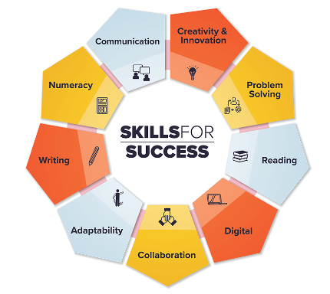
Identify knowledge, skills, and behaviour required by HR Professionals which you should then link to your chose
Active listening skills are also important as they enable an HR professional to understand employees' concerns and ideas.
Active listening skills also support the development of effective Hr policies and initiatives (Xiao et al. 2020, p.2).
“Holland's model of Occupational personality types" suggests that people with social and conventional issues can improve organisational growth (Zainudin et al. 2020, 894).
Collaboration with employees, colleagues, and managers is excessively important to provide an efficient approach to HR management (Gaunt and Tracey, 2020, p.435).

Slide 5

Identify knowledge, skills, and behaviour required by HR Professionals which you should then link to your chosen organisation
In terms of knowledge, HR professionals must be highly knowledgeable about employment laws, regulations and policies, as well as best practices in the job field (Lindblom and Martins, 2022, p.421).
An HR professional must have a piece of knowledge of employee relations to maintain a positive working environment.
The HR management of Tesco has introduced a reward-based programme to motivate employees based on their performance (Tesco, 2022).
Thus it can be depicted that the organisation is focussing on the behavioural skills of employees to maintain a positive environment.

Slide 6

Identify knowledge, skills, and behaviour required by HR Professionals which you should then link to your chosen organization
The behaviours HR professionals must possess are a strong work ethic, integrity, adaptability, and the ability to work collaboratively.
HR professionals must be able to remain calm and professional when faced with difficult situations.
The HR management has introduced group policies and business codes to enable behavioural change in employees and customers (Tesco, 2022).
Thus it can be depicted that TESCO is focussing on behavioural change of employees and consumers.
Notes:
The role of HR professionals is crucial for any organisation, and TESCO is no exception. The behaviours that were expected of HR professionals in TESCO include a strong work ethic, integrity, adaptability, the ability to work under pressure, and a thorough understanding of HR policies and regulations. HR professionals must be able to maintain confidentiality and impartiality while handling employee grievances, disputes and disciplinary issues. The combination of these behaviours will help TESCO to maintain a healthy workplace and retain its position as one of the UK's leading retailers.

Slide 7
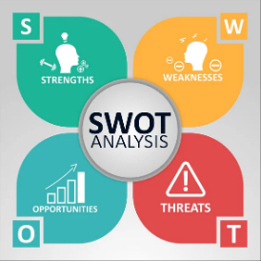
SWOT Analysis for a HR Officer
Strengths | Weakness
Excellent communication and interpersonal skills. Teamwork skills to prosper in the job field. Knowledge of employment laws. | Behaviour skills Leadership skills Time management and behaviour.
Notes:
As an HR professional, I must have excellent communication and interpersonal skills. In order to develop as an HR professional I must improve my teamwork skills and active-listening skills to prosper in the job field. From the above study, it can be understood that knowledge of employment laws, regulations and policies and many more are needed to improve the HR profession at TESCO. From the above case study, I am able to understand that I need to improve my active listening skills to mitigate employee issues. I am also able to understand that I lack leadership skills which I need to improve to prosper in my job role. According to other colleagues of mine, I need to improve my time management and behaviour to maintain a positive environment in the organisation. Thus from the above study, it can be concluded these are my weaknesses and strengths while working as an HR professional at TESCO.

Slide 8
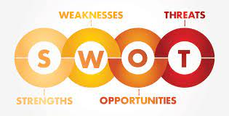
SWOT analysis of an HR Continued
Opportunities | Threats
Excellent communication skills help in building a relationship with employees. Good teamwork skills to maintain work balance. Due to my good communication skills, I can get advantages during digital recruitment. As good communication skills gave me an advantage during digital recruitment, it will further help me to hire employees which is a great opportunity to use my strengths. | I cannot keep calm in difficult situations The risk management skill will affect me in a competitive scenario. As I was unable to keep calm in difficult situations risk management can be a potential threat to me.
Notes:
As an HR professional Excellent communication skills will act as an opportunity in building relationships with employees. Good teamwork skills will also act as an opportunity to maintain a work balance. Due to my good communication skills, I can get advantages during digital recruitment. As good communication skills gave me an advantage during digital recruitment, it will further help me to hire employees which is a great opportunity to use my strengths. I cannot keep calm in difficult situations which will act as a threat in this profession. In a competitive scenario risk management skills will affect me which will be a potential threat to me.

Slide 9

Assess the benefits of training and development for yourself as an HR officer and your chosen organisation.
From the above case study, I can understand that I have weak behavioural skills, for which I have to develop my weakness.
By training and developing skills, I can prosper in the chosen job role.
Training and development of employees will help to develop personal and professional growth, improve job performance and many more.

Slide 10
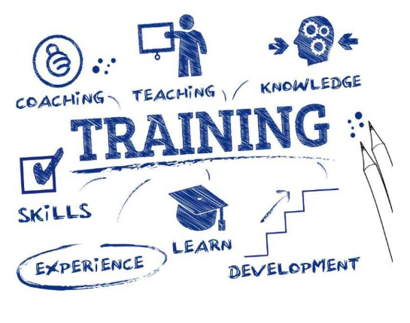
Assess the benefits of training and development for yourself as an HR officer and your chosen organisation.
The investment done by the organisation for the training and development of employees and officers helps to improve their morale.
The training and development processes hosted by the organisation also help to broaden the perspective on HR-related issues and enhance problem-solving and decision-making skills.
The training and development processes help to develop the workforce of the organisation which further helps to meet the company's objectives and goals.

Slide 11
Training Session Plan
Objectives | Required resources | Actions | Responsible person | Time frame
To improve Leadership skill | Books, Online courses, feedback from supervisors such | Pursuing online courses Taking knowledge of well-known leaders Reading of books | Supervisor | 6 months
To develop time management skill | Workshop, Seminar, books, online courses such as | Management workshops Online courses Reading of Books | Supervisor | 4 months
To improve risk management skills | Case study, books, courses, supervisor’s feedback such as / | Reading of Books, Case study analysis, Risk identification Online courses | Supervisor | 6 months

Slide 12
Training Session Plan
Training session for Time Management Skills
Summary :Attendees from Analyst to Manager levels.
Training Objectives : Attendees to understand how to effectively manage time with different sources using the Stephen Covey time management Matrix , Time squared
Duration : 1hrs 15 minutes
Training Contents – Stephen Convey Management Matrix, Eat the Frog videos by BrianTracy
Training Methods/ Activities - breakout team work case Study
Breaks : 2 x 10 minutes break
Warm Up exercises – 20 piece jigsaw puzzle in groups / write down what prevents from using their time effectively
Q&A - 20 minutes
Conclusion – 10 minutes
Feedback for the trainer/ Training Session

Slide 13

Conclusion
In conclusion, the presentation contains a brief introduction of the chosen organisation, in which I am working as an HR professional.
It is to be concluded that the presentation also contains skills, knowledge, and behaviour that were needed to prosper as an HR professional.
The presentation also contains a SWOT analysis to identify my statements and weaknesses while working as an HR professional.
It is analysed that the importance of training and development of employees, HR and organisation plays a critical role in meeting the company's objectives and goals.
Notes:
As an HR professional technological skills and knowledge plays a critical role in achieving the objective and goals of the organisation. The presentation consists of a brief introduction to the organisation for which I am working as an HR professional. In order to analyse the strengths and weaknesses a description of skills, knowledge and behaviour is needed that helps to prosper in the job role. The presentation also contains a SWOT analysis to identify my strengths and weakness that can be possible opportunities and threats. And lastly, the presentation also explains the benefits of training and development of employees, HR professionals and organisational. Thus it can be concluded that training and development plays a crucial role in organisational success.

Slide 14
References
Kniveton, B.H. (2004), "Managerial career anchors in a changing business environment", Journal of European Industrial Training, Vol. 28 No. 7, pp. 564-573.
Gaunt, H. and Treacy, D.S., (2020). ‘Ensemble practices in the arts: A reflective matrix to enhance team work and collaborative learning in higher education.’ Arts and humanities in higher education, 19(4), pp.419-444.
Lindblom, J. and Martins, J.T., (2022). ‘Knowledge transfer for R&D‐sales cross‐functional cooperation: Unpacking the intersections between institutional expectations and human resource practices.’ Knowledge and Process Management, 29(4), pp.418-433.
Statista (2022a). ‘Topic: Tesco plc, Statista.’ Available at: https://www.statista.com/topics/3807/tesco-plc/ (Accessed: March 16, 2023).
Statista (2022b). ‘Tesco Financial Revenue United Kingdom 2015-2022, Statista.’ Available at: https://www.statista.com/statistics/490931/tesco-group-finance-revenue-united-kingdom-uk/ (Accessed: March 10, 2023).
Statista (2022c). ‘Tesco's global number of stores 2022, Statista.’ Available at: https://www.statista.com/statistics/238667/tesco-plc-number-of-outlets-worldwide/ (Accessed: March 9, 2023).
Tesco (2022) ‘Annual report 2022, Tesco PLC.’ Available at: https://www.tescoplc.com/investors/reports-results-and-presentations/annual-report-2022/ (Accessed: March 11, 2023).
Tripodi, N., Cossar, S., Davidson, J., Farmer, R., Gorbonos, J., McDonald, A. and Pierlot, M., (2021). ‘Patient perceptions of allied health student communication and interpersonal skills: A cross-sectional study.’ Focus on Health Professional Education: A Multi-Professional Journal, 22(3), pp.18-32.
Xiao, Z., Zhou, M.X., Chen, W., Yang, H. and Chi, C., (2020, April). ‘If i hear you correctly: Building and evaluating interview chatbots with active listening skills.’ In Proceedings of the 2020 CHI Conference on Human Factors in Computing Systems (pp. 1-14).
Zainudin, Z.N., Rong, L.W., Nor, A.M., Yusop, Y.M. and Othman, W.N.W., (2020). ‘The relationship of holland theory in career decision making: A systematic review of literature.’ Journal of Critical Reviews, 7(9), pp.884-892.

