Slide 1
NHS Structure in Wales
Policy and Impacts

Slide 2
Impact on Health
How do you think politics impacts upon health?
Explain your answer

Slide 3
Politics and Health
Health care funding and systems are totally dependent upon Political Systems
This is because the funding is decided by Government
If the Government changes, so then does healthcare
If the Government change, so then do the policies linked to healthcare

Slide 4
Answer the following:
What does NHS stand for
What does it do
Who pays for it

Slide 5
Answers
National Health Service
NHS Wales provides healthcare to some 3 million people who live in the country. The NHS has a key principle which is that good healthcare should be available to all, regardless of wealth.
The public pay for it via taxes. Money is given from Central Government to Welsh Government. WG spend 55% of their budget on health and social care

Slide 6
Question
Who is the biggest employer in Wales?

Slide 7
Answer
THE NATIONAL HEALTH SERVICE

Slide 8
Statistics
NHS is fifth largest employer in the WORLD
1.7 million workers across England, Wales, Scotland and Northern Ireland.
Biggest employer in Wales with over 82,800 staff directly employed in 2008 (Source: Stats Wales).
NHS Wales alone offers 200 career opportunities

Slide 9
Government
Make notes as we watch this short video on how Government works
HOW GOVERNMENT WORKS

Slide 10
Questions
Based upon that video, what could this mean for health provision and services?

Slide 11
Question
Now take notes as we watch the following:
HOW WELSH GOVERNMENT WORKS
What then does this mean for health policy and provision?

Slide 12
Funding
Taxes are received by Central Government
Central Government give money to Wales as a devolved country
Wales then decides how to spend money
Out of health budget it gives money to local councils and organisations to spend in health boards, trusts and services

Slide 13
NHS Finance
Central Govt
Welsh Govt
Local Govt

Slide 14
But ….
There are over 730 community and town councils throughout Wales
Some represent populations of fewer than 200 people, others populations of over 45,000
Do you think each community has the same health needs?
Explain your answer

Slide 15
NHS Structure
NHS Wales is one service made up of a number of organisations.
7 Public health boards
3 NHS Trusts

Slide 16
PHBs
The seven Local Health Boards (LHBs) in Wales now plan, secure and deliver healthcare services in their areas, replacing the 22 LHBs and the 7 NHS Trusts which together performed these functions in the past.
Aneurin Bevan Health Board;
Abertawe Bro Morgannwg University Health Board;
Cardiff & Vale University Health Board;
Hywel Dda Health Board;
Cwm Taf Health Board;
Betsi Cadwaladr University Health Board; and
Powys Teaching Health Board.

Slide 17
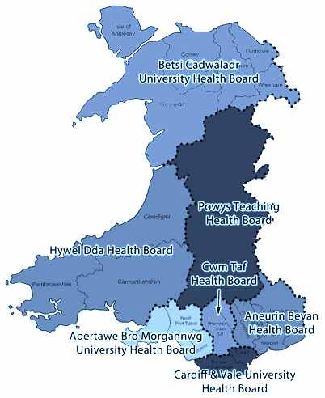
Community Health Councils in Wales are statutory lay bodies that represent the interests of the public in the health service in their district.
They give people an independent voice in their local NHS and the services it provides.
The number of CHCs are being reduced to 7 contiguous with the new Local Heath Boards.
The 7 new CHCs will be underpinned by 23 area associations with strong local links.

Slide 18
PHTs
There are currently 3 NHS Trusts
Welsh Ambulance Services Trust for emergency services
Velindre NHS Trust offering specialist services in cancer care and a range of national support services and the new Public Health Wales
Public Health Wales

Slide 19
Public Health Wales
The unified Public Health organisation in Wales
The organisation became fully operational on 1 October 2009
It now exercises the functions of the National Public Health Service, Wales Centre for Health, Welsh Cancer Intelligence & Surveillance Unit, Congenital Anomaly Register & Information Service for Wales, and Screening Services Wales
Its main job is health promotion and health prevention

Slide 20
Issue
You will be moved into different groups
Please now discuss he following
How much input into health and how people live should the government have
Who should decide where health care money is spent
Do you believe ‘too many cooks spoil the broth’?
Is it possible to keep all groups happy in terms of health care
Have you ever witnessed any inequalities in health treatment or provision or support?
What are your solutions for all of the above
You will be asked to share your answers

