Slide 1

Certificate of High Education
in Employability Skills
LEVEL 4
University of Wales TSD
Effective Teamworking and Communication Module
BMSW4009
March 2025
Adrian Moraru student Id 2410006

Slide 2
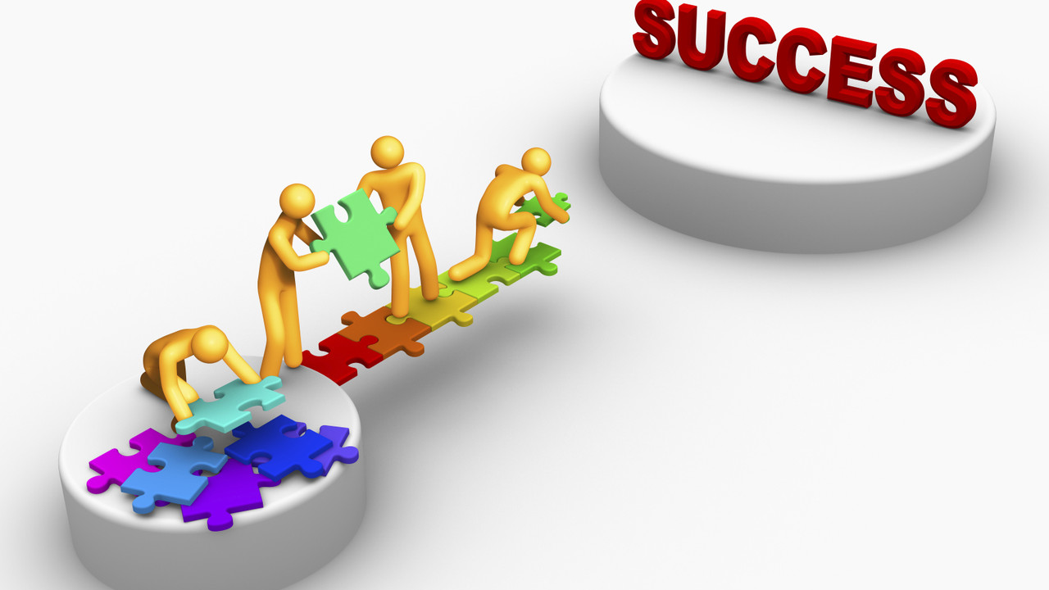
Creating an Effective Team:
Key Strategies for Success

Slide 3
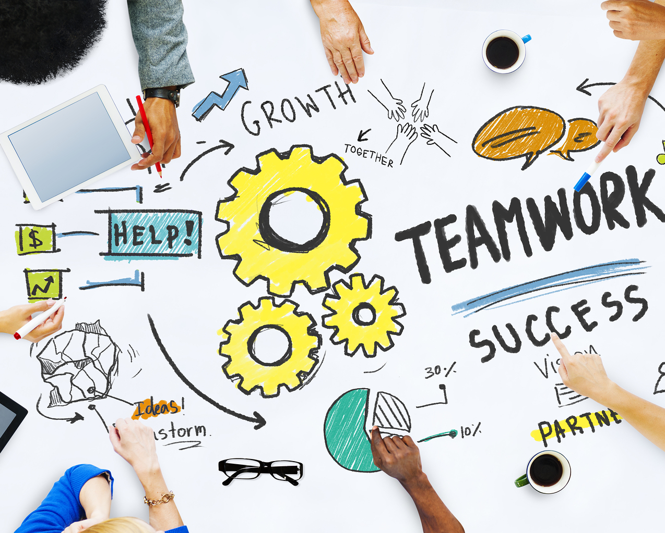
Introduction
In today’s fast-paced and collaborative work environments, the ability to create and sustain an effective team is critical for organizational success. Teams, when properly managed, have the potential to produce higher levels of creativity, innovation, and performance compared to individual work or simple groups. However, creating an effective team requires more than just assembling a group of people; it involves understanding the roles individuals play, how they interact, and how their combined efforts contribute towards achieving common goals.

Slide 4

The Difference Between Groups and Teams
Tuckman’s Stages of Team Development
Belbin’s Team Roles
Building Trust and Communication
References

Slide 5
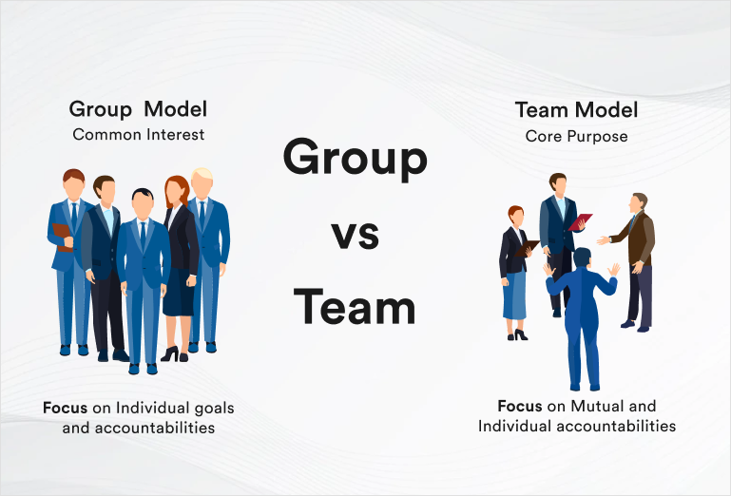
1.1 Defining Groups vs. Teams
A group is simply a collection of individuals who may not have a shared goal or interdependence. In contrast, a team is a group of people who are interdependent and work together towards a common goal (Mullins & Christy, 2016).
Understanding this distinction is essential for fostering collaboration and achieving collective success.
1.2 The Importance of Teams for Organizational Success
Teams contribute to higher performance, innovation, and problem-solving compared to groups that lack a common objective (Tannenbaum & Salas, 2021). Effective teams exhibit interdependence, shared responsibility, and accountability, which leads to better decision-making and achievement of shared goals (Belbin, 2010).

Slide 6
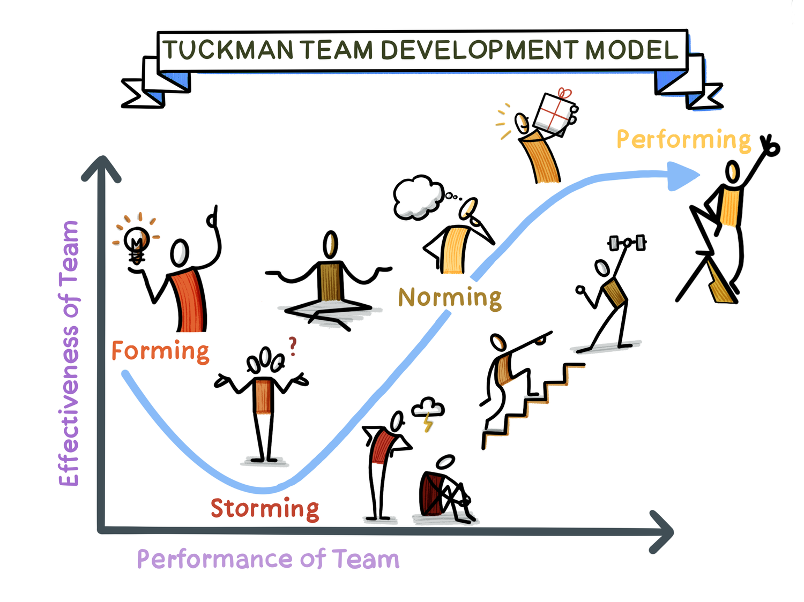
2.1 Introduction to Tuckman’s Model
Tuckman’s model describes the stages teams go through in their development: Forming, Storming, Norming, Performing, and Adjourning (Tuckman & Harper, 2012). These stages help guide the team through the challenges of team dynamics and achieving high performance.
Following Tuckman Model a team or a group can develop
Leadership and Support: Through the whole process, there should be good leadership to guide the team through difficult situations. The leaders should be adaptable, motivating, and ready to step in whenever required.
Clear Communication: At each stage, clear and honest communication is the key to conflict resolution, building trust, and a positive team environment.
Patience: Tuckman's model shows that teams evolve over time. Success depends on patience, commitment, and continuous learning at each stage (Heffernan, 2019)

Slide 7
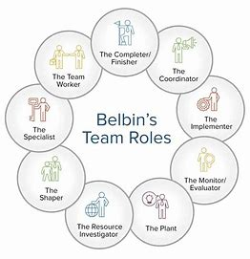
3.1 Understanding Belbin’s Nine Team Roles
Belbin’s model identifies 9 distinct team roles that contribute to effective team dynamics, ensuring a balance of skills, strengths, and personality traits. These roles include the Plant (creative thinker), Shaper (motivator), Monitor-Evaluator (analytical), and others (Belbin, 2010).
3.2 How Belbin’s Roles Contribute to Team Success
Each role helps balance out the strengths and weaknesses within a team. By understanding individual roles, teams can align skills to maximize performance. For example, a Plant generates creative solutions, while a Shaper ensures the team stays motivated and focused (Sinek, 2023).
A team how use Belbin's Theory can increase strength ,flexibility and development, plus can create a positive team culture.

Slide 8
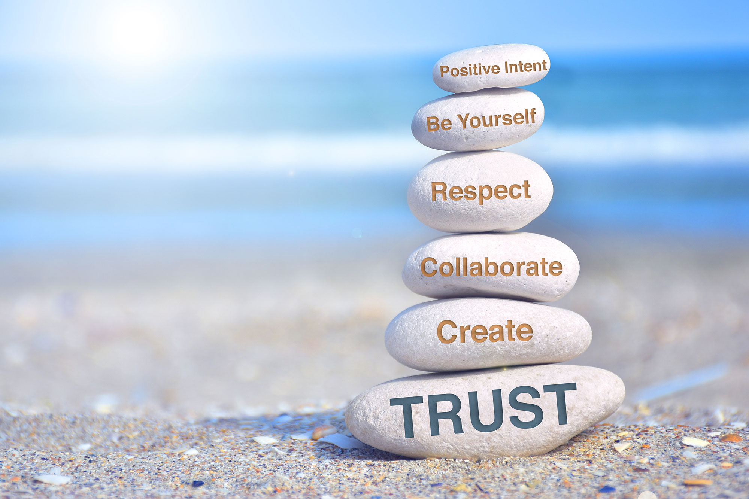
4.1 The Importance of Trust for Team Success
Trust is the foundation for effective communication, collaboration, and conflict resolution within teams. Teams without trust struggle with openness and risk-taking. High trust encourages vulnerability and creates an environment where team members feel comfortable sharing ideas and feedback (Sinek, 2023).
4.2 Building Trust and Enhancing Communication
Encourage transparency, vulnerability, and open dialogue to build trust among team members. Team leaders can foster trust by setting clear expectations and leading by example (Stadler, 2019). Building open communication channels and resolving conflicts constructively are vital steps to strengthen trust.

Slide 9

5. References
Belbin, R.M. (2010). Team Roles at Work (2nd Edition). London: Routledge.
Heffernan, M. (2019). Wilful Blindness. Simon & Schuster Ltd.
Mullins, L.J., & Christy, G. (2016). Management & Organisational Behaviour (11th Edition). Harlow: Pearson.
Sinek, S. (2023). Trust: The Basis of High Performing Teams. [Online] Available at: https://youtu.be/P8ojeO9za84?si=ZDNualg9hPQ_Y5UU
Stadler, S. (2019). Conflict, Culture, and Communication. Milton: Routledge.
Tannenbaum, S.I., & Salas, E. (2021). Teams That Work: The Seven Drivers of Team Effectiveness. New York: Oxford University Press.
Tuckman, B.W., & Harper, B.E. (2012). Conducting Educational Research (6th Edition). United States: Rowman & Littlefield Publishers.
Heffernan, M. (2015). Super Chickens, Forget the Pecking Order. [Online] Available at: https://www.ted.com/talks/margaret_heffernan_forget_the_pecking_order_at_work?utm_campaign=tedspread&utm_medium=referral&utm_source=tedcomshare

