Slide 1
1.0. Corporate Social Responsibility
(CSR) and Social Media and how to respond to challenges.

Slide 2
1.1. What is CSR?
CSR is a concept whereby companies integrate social and environmental concerns in their business operations and in their interaction with their stakeholders on a voluntary basis, Hooley et al (2017).
Companies can become socially responsible by following the law and integrating social, environmental, ethical, consumer and human rights concerns into their business strategy and operations.

Slide 3
1.2. Drivers of CSR Initiatives
Competitive advantage.
Globalisation.
Moral obligation/good citizen.
Sustainable development.
Ethical culture.

Slide 4
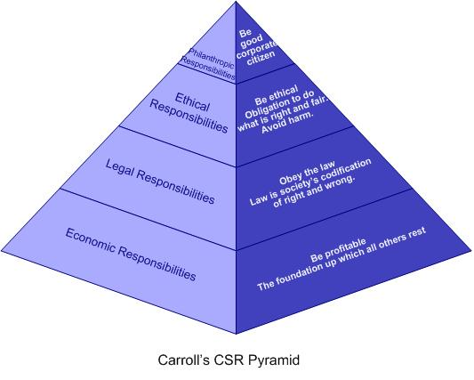
1.3. The four CSR dimensions
The social responsibility of business encompasses the economic, legal, ethical and discretionary/philanthropic expectations that society has of organisations at a given point in time (Carroll 1979. p. 500, 1991 p.83).

Slide 5
1.4. Benefits of CSR
Brand value.
Innovation.
Risk and cost minimization.
Good reputation and legitimacy.
Seeking win-win outcomes through value creation.

Slide 6
2.0. CSR corporates scandals
The Horse meat scandal emerged in 2015 in which Irish inspectors found traces of horse meat in UK supermarkets including Tesco and Lidl.
Avoidance to pay tax by Amazon, Starbucks, Facebook and Apple.

Slide 7
3.0. How marketers can react to CSR challenges
Promote good cause CSR activities e.g., the Microsoft reduction of Carbon emissions campaign.
Marketers should not work in silos but should collaborate with HR and operations.
CSR message should be ethical, clear, honest and fair.
Good leadership and a good CEO.
Avoid backlash campaigns like the recent Kendall Jenner Pepsi controversy. Diversity and inclusivity and women would bring in more diverse ideas.
Have long-term brand commitment campaign like the Heineken ‘Open your world’ campaign (Marketing week 2017).

Slide 8
4.0. Social Media
Technological advancement and use of mobile devices has given rise to online social media communities for consumers to congregate and share experiences. Marketers are using social media platforms such as google+, twitter and Facebook to communicate CSR activities, engage customers and create substantial brand communities (Kotler et al 2017). Marketers should aim at gaining favourable stakeholder attitudes. Communicating CSR to publics is critical in gaining corporate reputation, support and legitimacy (Coombs & Holladay 2012). Marketers could face challenges with posting CSR messages as they could be perceived by publics ‘as self-serving for the corporation than for the community which can create stakeholder scepticism.

Slide 9
Social Media
Consumers are likely to switch brands if associated with a good cause or boycott a brand if associated with negative CSR practices. Social media is interactive, give real-time feedback especially Facebook, and their ‘engagement and social sharing capabilities’ (Kotler et al 2017). Social media are uncontrollable, and users can alter information Friedman (2006). Marketers can sell brands and pledge a part for a good cause. Johnson sold baby shampoo and donated 10 cents to the world wild life fund efforts for every purchase to save animals from extinction (Menon & Kahn 2003) to gain trust.

Slide 10
References.
Baker, R. (2013), Oxfam slams food brands for poor performance, Available online; https://www.marketingweek.com/2013/02/26/oxfam-slams-food- brands-for-poor- ethical-performance/. [Accessed on 02/07/2018].
Barnet, M. (2011), The only way is Ethics, Available online;
https://www.marketingweek.com/2011/08/04/the-only- way- is- ethics/. [Accessed on 2/07/2018]
Barnett, M. (2013), Corporate Social Responsibility: Power to the People; Available online; https://www.marketingweek.com/2013/05/29/corporate-social-responsibility-power-to-the- people/. [Accessed on 02/07/2018].
Carroll, A.B. (1970), A three-dimensional conceptual model of corporate performance. The Academy of Management Review, 4(4), 497- 505.

Slide 11
References.
Cho, M. Furey L.D. & Mohr, T. (2017), Communicating Corporate Social Responsibility on Social Media: Strategies, Stakeholders, and Public Engagement on Corporate Facebook; Available online on, http://journals.sagepub.com/doi/pdf/10.1177/2329490616663708. [Accessed on 5/07/2018].
Coombs, W.T., & Holladay, S.J. (2012). Managing corporate responsibility: A communication approach. Malden, MA: Wiley-Blackwell.
Corporate Social Responsibility (CSR) (No date) https://ec.europa.eu/growth/industry/corporate-social-responsibility_en. [Accessed on 03/07/2018).
Friedman, T.L. (2006). The world is flat: A brief history of the twenty-first century (Rev. ed.). New York, NY: Farrar, Strauss and Giroux.
Hobbs, T. (2017). M&S on how Marks and Spencer can turn sustainability into a success; Available online, https://www.marketingweek.com/2017/12/13/marks-and-spencer- sustainability-new-research/. [Accessed on 31/06/2018].

Slide 12
References.
Hooley, G. Nicolaud, B. Piercy, N. Ruud, J. (2017), Marketing Strategy and Competitive Positioning, 6th Ed. Pearson,
(p, 462-477).
Jones, M.C. (2016), Why perfecting corporate culture is the first step to nailing real time marketing; Available online; https://www.marketingweek.com/2016/10/17/why- perfecting-corporate-culture-I s-the-first-step-to-nailing-real-time-marketing. [Accessed on 2/07/2018].
Kotler, P. Armstrong, G. Harris, LI.C. Piercy,N. (2017) Principles of Marketing, 7th European ed. Pearson.
Marketing Week (2004), CSR Message must be honest, ethical & fair, Available online, https://www.marketingweek.com/2004/02/26/csr-message-must-be-honest- ethical- and-fair/. [Accessed on 3/07/2018).
Menon, S. and Kahn, B.E. (2003).Corporate sponsorships of philanthropic activities: when do they impact perception of sponsor brand?. Journal of Consumer Psychology, 41, pp. 847-855.

Slide 13
References.
O’Reily, L. (2013), Microsoft has the best global CSR reputation; Available online, https://www.marketingweek.com/2013/10/01/microsoft-has-best-global-csr-reputation
[Accessed on 1/07/2018).
Parsons, R. (2013), Moving CSR from Philanthropy to alignment with commercial objectives; Available online; https://www.marketingweek.com/2013/10/09/
moving-csr-from-philanthropy-to-alignment-with-commercial-objectives/. [Accessed on 2/07/2018].
Rogers, C. (2016), The importance of social purpose over CSR; Available online; https://www.marketingweek.com/2016/05/24/lord-browne-former-ceo-of-bp-on-the-importance-of-social-purpose-over-csr/. [Accessed on 2/07/2018].

Slide 14
References.
Vizard, S. (2017), Horsemeat has had such a lasting effect on how food is marketed , Available online; https://www.marketingweek.com/2014/01/03/horse-meat-scandal-has-had-a-lasting-effect-on-how-food-is-marketed/. [Accessed on 3/07/2018].

