Slide 1
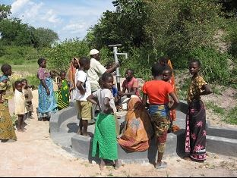
Working in Development: Practical Preparation
Part 2: What is a “project”? Partners and partnership
Who works in Development?
What is a “project”?
Who are the partners?

Slide 2
Who works in Development?
Individual Research task
The task is:
To collect information on the range of organisations which are currently active in the field of international development – and something about their objectives, areas of work, size, funding etc.
To make notes (on paper or digitally) on the information you have gathered, so that we can assemble that information in class.
Let’s discuss your findings…

Slide 3

Who works in development?
Patrick Magara, VSO Kenya (VSO Jitolee) 3:34
https://www.youtube.com/watch?v=KJ4srHoCcmI

Slide 4
Jobs in development
Some websites:
https://www.bond.org.uk/jobs
https://jobs.theguardian.com/jobs/international-development/
http://www.devnetjobs.org/
https://peacekeeping.un.org/en/working-with-us

Slide 5



What is a “project”?
What “projects” do we already know about?
What are they about?
What are their objectives?
Who’s involved?

Slide 6

Visit to Oxfam
Schedule for Andy Bevan
Thursday, 27 April 2017 at Oxfam House, John Smith Drive, Oxford OX4 2JY
09:00 Brian McSorley (Water and Sanitation Engineering Advisor, Global Humanitarian Team)
11.15 Irene Guijt, Head of Research, Campaigns, Policy & Influencing Team
12.30 Penny Lawrence, Deputy CEO - over lunch
01.30 Richard Corbett, Oxfam GB Humanitarian Lead, International Programmes Team (by telecon)
02:15 Duncan Green, Senior Strategic Adviser, Campaigns, Policy & Influencing Team

Slide 7
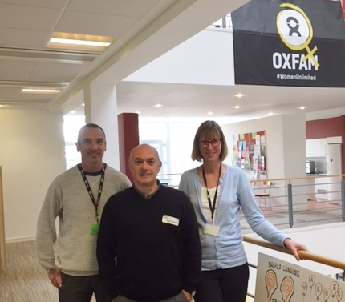
.
Brian McSorley, Andy Bevan and Penny Lawrence, meeting at Oxfam HQ, 27 April 2017

Slide 8


So, who are the partners?
PLUS project: VSO Uganda, UNICEF and Irish Aid: (17:53) https://www.youtube.com/watch?v=hHHTXV7lhOI
New school in West Pokot (participatory budgeting) (7:58) https://www.worldbank.org/en/news/video/2018/03/07/towards-a-more-inclusive-development-in-kenya
Congolese refugees in Uganda (UNHCR) https://www.youtube.com/watch?v=SPMx5QH7dek (3:17)
How can we describe the relationships between partners?

Slide 9
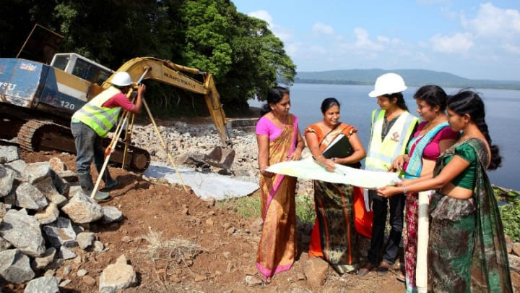
Class exercise on partnership working

