Slide 1

The First 1000 Days
ECEY 4005
p
S
r
b
c
a
o
o
k
Javaria Rehman
Student ID: 2128580

Slide 2
Contents Page
Introduction – The First 1000 Days………………………………………………………..Slide 3
Why the First 1000 Days are Important…………………………………………………...Slide 4
Services Available for New and Expectant Parents……………………………………..Slide 5
What is Exceptional Care and Why it is Important……………………………………….Slide 6 – 7
Pikler’s Approach to Exceptional Care…………………………………………………….Slide 8
How do Babies Brains Grow During the First 1000 Days……………………………….Slide 9 -12
The Importance of Nutrition………………………………………………………………..Slide 13
Challenges in Providing High Quality Care………………………………………………Slide 14 - 15
Professional Partnerships………………………………………………………………….Slide 16 - 17
Importance of Play………………………………………………………………………….Slide 18 – 19
Learning Through Play……………………………………………………………………..Slide 20
Sensory Play…………………………………………………………………………………Slide 21 - 22
Loose Parts Play…………………………………………………………………………….Slide 23
Enabling Environments……………………………………………………………………..Slide 24 - 25
References…………………………………………………………………………………..Slide 26 - 32

Slide 3

The First 1000 Days
The first 1000 days is the term used to describe a child’s life from the time of conception until the age of 2 years old. During this period, the child’s immune system, body and brain all undergoes substantial growth and development. The health, diet, and stress levels of the mother during pregnancy may have an influence on the baby’s future. Following birth, the newborn's physical surroundings, diet, and relationships with others can all have a long-term effect on their health and wellness. Babies need nutritious food, safety and security, close and loving relationships with time for play and a healthy atmosphere, even within the womb (Healthdirect Australia, 2023).
These early stages play a pivotal role in shaping a person's body, brain, metabolism, and immune system. Malnutrition during this is linked to various health issues including obesity and impaired growth (Likhar and Patil, 2022).
During this crucial period, the building blocks of a child’s development are established. A child's chances in life are enhanced if their body and brain develop properly. During this time, if a child is exposed to any stresses, this can then cause their development to fall behind their peers (Health and Social Care Committee, 2019).
https://vimeo.com/872473651?share=copy
Public Health Wales, (2024).
Background Image Source: hpa, (no date).

Slide 4
Why the \First 1000 Days are Important.
A child's first 1000 days are important as the foundations of a child's health and development, which is the physical, cognitive, social and emotional, and behaviour is all established. Addressing nutritional needs during this time can prevent long-term developmental issues (Cusick and Georgieff, 2023).
As stated by HM Government (2021) the first 1000 days are also important for the development of communication and physical skills. By the age of two, babies can usually walk without support, pronounce around 50 words, climb onto furniture and kick a ball
Both parents and caregivers should support and encourage their infants to develop these skills, and they must monitor their development. Significant problems could develop if delays go unnoticed and are not treated early.
Health and Social Care Committee (2019), states that early intervention can improve outcomes.
Before conception, if the parents have health issues, this can affect the child’s health and development. Expectant mothers who are in good health at the beginning of pregnancy, typically have babies with better health outcomes (Health and Social Care Committee, 2019).
https://www.ncbi.nlm.nih.gov/pmc/articles/PMC8775982/
Brines and Rigourd and Billeaud, (2022)

Slide 5

Services Available for Expectant and New Parents.
A variety of Start for Life services are available for expectant and new parents to access, these are delivered by highly qualified professionals.
These services include:
Midwifery
Health visitors
Parent and infant mental health
Infant feeding
Special educational needs and disability
Safeguarding
Available funding to promote these services by local authorities will ensure that families are aware of these services to access them (Department of Health and Social Care, 2023).
The 6 Universal Start for Life services.
Above is a QR code of an image with details of the services provided. Source: Department of Health and Social Care, (2023)
Or click the link below for further information.
https://assets.publishing.service.gov.uk/media/642172ee5155a200136ad78c/DHSC-The-Best-Start-for-Life-A-progress-report-on-delivering-the-Vision-print-corrected.pdf
Source: Department of Health and Social Care, (2023).

Slide 6
What is Exceptional Care and Why it is Important?
Public Health England, (2016), states that ensuring mothers are healthy during pregnancy is vital for safe deliveries and a healthy birth weight of their baby, this will ensure they receive the best start in life. It is essential to prevent health issues during pregnancy. Babies born prematurely or with low birth weight are at a higher risk of experiencing poor outcomes. Throughout the first 2 years of life, the brain exhibits an impressive ability to take in information and adjust to its environment. For children to have the best possible start in life, positive early experiences are crucial to prepare them for learning, school readiness, and to enhance their life prospects (Cusick and Georgieff, 2013).
Public Health England, (2016), also states that this all depends on the following factors:
Parents that are attuned sensitive and understanding. The effects of someone’s status in society. The impact of a good education and care in early life. The parents have the most impact on their child's early years of learning. For instance, a baby's language skills can be stimulated from birth if the parents talk and read to them. Cognitive skills which are important for children’s development, including working memory and reading skills are developed through the language skills that they gain. This can aid in getting children ready to learn by age 2 and prepared for school by the age of 5.

Slide 7
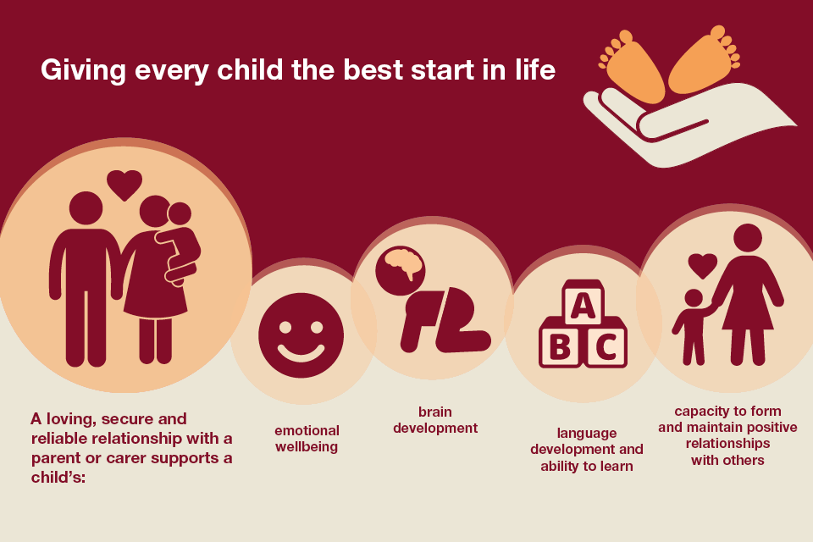
The experiences during pregnancy and early childhood have lasting effects on both physical and emotional well-being throughout adulthood. . It is essential to prevent adverse health factors during pregnancy. Premature and underweight infants are at a higher risk of experiencing negative outcomes. Delaying treatment carries a significant price, impacting both individuals and society. Treating perinatal mental health issues alone incurs an annual cost of £8.1 billion each year (Calderdale Council, 2017).
Image source: (Calderdale Council, 2017).

Slide 8
Pikler’s Approach to Exceptional Care Pikler's approach to exceptional care for infants and young children highlights the importance of treating them with respect, being attentive, and nurturing their development through loving interactions, all to build secure attachments and promote healthy growth (Marlen, 2024). Caregivers should establish a strong bond with the children in their care, show respect and meet the needs of the child, encourage children to lead in their own initiated activities as well as taking part in adult led activities and have respect and effective collaboration between caregivers and parents (The Education Hub, 2020).
Respect and Trust Also stated on The Education Hub, (2020), adults should respect and trust the abilities of infants and toddlers, allowing them to take the lead in their natural development. Practices that demonstrate respect and trust include, respecting children's expression of emotion rather than providing distractions, and allowing children to solve problems on their own through play, rather than instructing or solving problems for them.
Care-giving as a learning opportunity Taking care of infants and toddlers, including feeding and dressing, is an important opportunity for them to learn through attentive interactions and meaningful exchanges with their caregiver. These caregiving times provide opportunities for cooperation and bonding, creating a secure and predictable environment for children, thus creating a sense of security (Whiteford, 2016).

Slide 9
How do baby’s brains grow in the first 1000 days?
The brain grows faster in the first 1,000 days of life than it does at any other point. A large portion of this early brain growth and development is fuelled by nutrition. It lays the foundation for a child's cognitive, motor, and socio-emotional growth, all of which have an impact on the child’s future academic achievement and opportunities in the economy. A child’s quickly developing brain is susceptible to inadequate nutrition, neglect, and the harmful stress associated with hunger and food uncertainty. The impact on a child's development can be severe and have a lasting negative affect. For this reason, a healthy future depends on providing both women and the children with the nutrition and support they require during this time (Thousand days, no date).
The period from birth to two years of age is characterised by rapid and dynamic brain development, which has a substantial impact on cognitive development and the risk of developing disorders like autism and schizophrenia. This time frame is very important for the development of brain pathways and possible risk factors for various conditions (Gilmore et al, 2018).

Slide 10
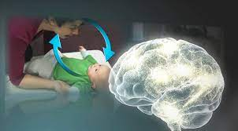
As stated on The Center of the Developing Child (2016), young children facing difficult situations during their lives can have negative developmental outcomes. Neuroscience is showing evidence which suggests that to achieve a positive outcome, it is vital to support parents with young children sooner, particularly those suffering with biological disruptions of toxic stress.
The intricate framework of the brain is shaped by serve and return interactions. Neural pathways in the child's brain are established and reinforced when an infant or young child babbles, gestures, or cries and then receives a responsive suitable reaction from an adult, whether through verbal and communication, eye contact, or physical affection such as a hug. These relationships are essential for developing social skills and communication abilities.
Early encounters and experiences become embedded within our bodies and have a long-lasting influence on behaviour, learning, and mental and physical health (Center on the Developing Child, 2016).
Image source: Center of the Developing Child, (2016).

Slide 11
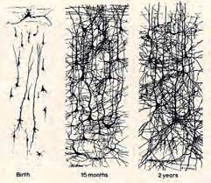
Brain Development
The image below illustrates the increase in synapse development in the brain within the initial two years. These play a crucial role in how the brain processes this information (Calderdale Council, 2017).
In the early stages of development, the neurons within a child's brain have an amazing ability to form new connections, between 700 and 1000 connections each second, on average. Neural networking is developing at an unprecedented rate that does not repeat again in later phases of development (UNICEF, 2017).
Image source: Calderdale Council, 2017).

Slide 12
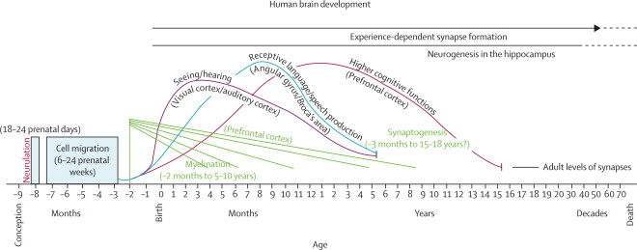
Social and biological factors can affect children's development as well as genetic inheritance. Crucial developmental milestones occur across every domain which is why the initial years of life are so significant. The brain undergoes swift advancement through processes involving the growth of neurons, formation, and elimination of connections between them, cellular restructuring, insulation of neural pathways, and the production of support cells.
Below is an image that shows that these genetic events occur at various stages and gradually influence each other. Small disruptions during these stages can have a lasting impact on how the brain is structured and how well it functions (Grantham-McGregor et al, 2007).
Image of Human brain development. Source: Grantham-McGregor et al (2007).

Slide 13
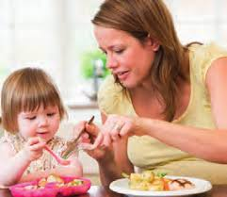
The importance of nutrition during the first 1000 days.
As stated by Likhar and Patil, (2022), it is important to ensure that the mothers nutrition is taken care of during her pregnancy, and the child’s up until their second birthday. For the first few months, the baby’s nutritional requirement is breast milk.
When the mother’s diet and health are compromised, it can negatively affect the child’s well-being.
There are four stages during the child’s growth:
(1) Nine months to zero months: pregnancy.
(2) Zero to six months: breastfeeding.
(3) Six to 12 months: solid food is introduced.
(4) 12 months plus: transitioning to the family diet (Likhar and Patil, 2022).
Image source: (Calderdale Council, 2017).
For further information click on the link below:
https://www.ncbi.nlm.nih.gov/pmc/articles/PMC9640361/

Slide 14
Challenges in providing high quality care.
Mothers should receive support on reducing smoking during pregnancy, as smoking increases the risk of preterm births, miscarriages, and perinatal deaths during pregnancy. It can also cause health problems in infants including abnormalities, low birth weight, and reduced lung function.
Mothers should also receive advice on safe sleeping positions for their babies to prevent sudden infant death syndrome (RCPCH, 2018).
The Royal College of Paediatrics and Child Health, (2018) advises the Health and Social Care Select Committee on addressing key issues, such as vaccination, breastfeeding, infant mortality, and smoking during pregnancy. For each of the key issues mentioned, the RCPCH states that poor outcomes are increased for children suffering with poverty.
Shortages in staff are causing parents to feel neglected, putting infants and young children at risk of harm, delayed medical diagnosis, and other issues, leading to potentially devastating and life altering outcomes (Wilkinson, 2022).
In order to provide high quality care, services should be adequately staffed and funded (Oxtoby, 2022).

Slide 15
Babies can be affected by stress that the parents may be suffering, bought on by domestic violence. This could create challenges for the parents to form a loving bond with their baby (Department of Health and Aged Care, 2024).
Adverse childhood experiences (ACEs) can have a detrimental effect, which stems from exposure to factors such as poor parental mental health, abuse, neglect, and parental substance misuse, among other risk factors.
It is vital that parents and carers get the support they need as early intervention can improve outcomes (HM Government, 2021).
Early diagnosis of any disability or developmental problems can improve long term outcomes, therefore parents and carers should be provided with all the information and support they require (HM Government, 2021).
Covid -19 has created unmet needs as other non-covid related healthcare services were scaled back to allow patients with the virus to be treated. The pandemic has made health inequalities worse. People that were suffering with health problems before, have been more deeply affected (BMA, 2023).

Slide 16

Professional Partnership
Partnerships are created to provide the best possible outcomes for children in education. For an effective partnership, all parties must benefit (sagepub, no date).
In early childhood settings, different teams of professionals such as education and health and social care services work in collaboration with families. This ensures that individual needs of the child are met, however any information that needs to be given is on a need-to-know basis as policies and procedures need to be followed on confidentiality and data protection (Early Years Matters, 2023).
Image Source: The Open University, (2024).

Slide 17
Providing excellent childcare, play opportunities, and early education is vital for giving young children the optimal beginning in life. Working with children can be an immensely fulfilling experience. Professionals in childcare have an important role which includes supporting, inspiring, and establishing the groundwork for comprehensive development of children during their early years and preparing them for adulthood. Children require positive role models, these people all play an important role in their lives. A common aspect of working with children typically includes collaborating with parents, assisting them in understanding and fostering their child's growth within the home learning setting. This can often involve working as part of a team with others (Pacey, 2024).
Bronfenbrenner’s Ecological Systems Theory highlights the benefits of working in partnership for a common aim. His theory investigated how various elements in children’s lives could impact their development. This explained that the microsystem which is those closest to the child, for instance the parents and practitioners had the most impact, the mesosystem which has a connection with the microsystems and works closely to benefit the child, for example a parent actively participating in an early years environment, then we have the macrosystem, which still impact the child, however they are more remote such as cultural values and the economy (The Early Years and Childcare Service, 2021).

Slide 18

Importance of Play
Image Source: Early Years Matters, (2023)

Slide 19
Importance of play
It is important for children to have a safe and loving relationship as this will help their development. Through these relationships babies can learn how to communicate, think, understand, and express their emotions. These relationships also have an impact on the way they see the world and aid their understanding of a place for them in society.
To help babies feel secure and loved, it is important to play, sing, read and talk to them (Department of Health and Aged Care, 2024).
Play is crucial in the EYFS, supporting children's learning and development in various aspects. It helps children naturally develop language, emotions, creativity, and social and intellectual skills. While most children engage in play spontaneously some may require additional assistance from adults (Early Years Matters, 2023).
Children engage in play both indoors and outdoors, using these varied spaces to explore and uncover their surroundings. Within this environment children experiment with new ideas and skills, take risks, use their imagination, and solve problems independently or collaboratively (Early Years Matters, 2023).
Through play children can learn social skills, for example, sharing toys, taking turns, and even working together to create a building whilst using small blocks where the larger materials are unavailable. Children learn through hands-on experiences, they develop knowledge through play, interacting with objects and people (UNICEF, 2018).

Slide 20
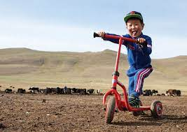
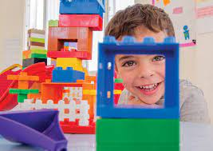
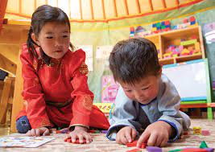
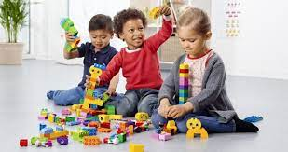
Learning
Through
Play
Image Source: UNICEF, (2018)
Image Source: UNICEF, (2018).
Engaging in play is a natural an enjoyable way for children to stay active, maintain well-being, and experience happiness (nidirect, no date).
Image Source: teachwire, (2024).
Image Source: UNICEF, (2018).

Slide 21
Sensory
As stated on NHS Lothian, (2024), sensory development is crucial for overall health and well-being. It starts to develop in the beginning - in the womb and carries on into adulthood.
The eight senses are touch, smell, hearing, taste, and vision, and then some others which are less familiar with vestibular (which senses movement and aids in balance), proprioception (which helps with our movements and the location of our bodies in space), and interoception (which is an internal sense such as hunger, pain, or temperature).
When babies are born, they are already able to recognise their mothers voice, rhythms, and smell.
It is through these senses that babies learn about playing, connecting, sharing, loving, and movement (NHS Lothian, 2024).
Sensory Play
Sensory play involves activities that promote the development of language and motor skills. These include hands on activities that help children to learn and develop through touch, sight, smell, sound, and taste. Babies need sensory stimulation as this is the way they learn about their surroundings. Giving them the opportunity to explore and get messy can help to learn effectively. It helps with language development, cognitive development, it encourages social interactions, and it also helps with fine and gross motor skills (Jackson, 2022).

Slide 22
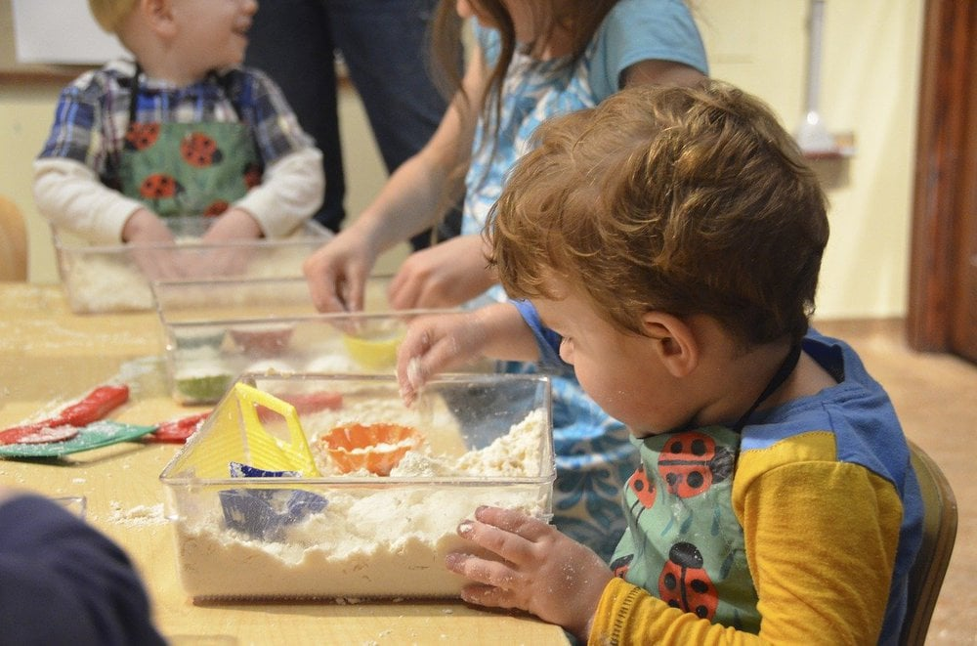


Sensory Activities
Hearing
Singing songs.
Storytelling.
Musical toys.
Vision
Black and white shapes.
Making eye contact.
Books with pictures.
Touch
Massage
Toys with different textures.
Water play/ bubbles (NHS Lothian, 2024).
https://youtu.be/7e7QzOVKl-Y?si=epcCXjWsHK3fPnCO
YouTube, (2018).
Images Source: Action for Children, (2024).

Slide 23
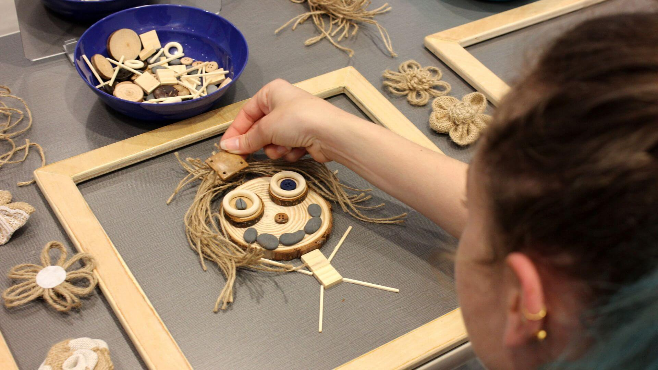
Loose Parts Play
Children will occupy themselves with all sorts of objects, for example some pebbles or empty jars and lids, these objects have no limitations, no instructions of play, children can use them as they wish and have the freedom to explore and create a meaning for these objects, this is called ‘loose parts play’. The teaching behind the loose parts theory which was developed by Simon Nicholson is to give children the freedom to use everyday objects to explore their own learning (pacey, 2019).
Image source: OSC, (2020).

Slide 24
Enabling Environments
The environment is crucial, it should support and extend the learning and development of the children. Enabling environments promote play among young children by making them feel comfortable, relaxed and at ease. Children are more likely to explore and take an interest in their surroundings if they feel emotionally safe (Early Years Matters, 2023).
As stated by Early years Alliance, (2019), an enabling environment is an engaging space where risks are effectively managed and minimised, whilst ensuring that children are safeguarded from any harm or abuse.
An enabling environment should be:
Warm, inviting, nurturing and foster a sense of belonging.
Have a wide range of resources that children are familiar with, as well as new material too, also meet the needs of all the children.
Ensure that the environment is suitable for both indoor and outdoor play.
The activities should inspire imagination, explore feelings, problem solving, quiet time and reflection.
The environment may also promote effective collaboration with family members, which could be to have family photos around the setting, sing familiar songs from home and welcome parents to join staff and their child.
The activities should be accessible for the children and at their height which can be moved from one place to another.
Children could also be involved with making the ground rules for the setting (Early Years Alliance, 2019).

Slide 25
It is crucial to have both indoor and outdoor learning spaces for children. These environments act like a ‘third teacher’, shaping how children feel, interact, and learn. Well-designed spaces spark creativity, boost cognitive development, and offer diverse sensory experiences with colours, textures, and natural elements. They encourage exploration, discovery, and play based learning, making children more engaged and helping their development (Young Academics, 2021).
Early Years Matters, (2023), states that the indoor space should be vibrant, comfortable, and engaging, tailored to suit the children's developmental stages. It is also important to have spaces that feel safe, encourage both play and learning, and which adapt to the changing interests and requirements of the children. Offering good quality, easily accessible resources and materials is key for children to use their imagination and facilitate learning, turning the indoor environment into a nurturing area where children can confidently explore and grow.
Children should have access to outdoor environments too as this enables them to have a wider space to move around more freely, allows them to breathe fresh air and absorb their surroundings with different sounds and colours and the scale of the space around them. It allows children to have the opportunity of ‘big scale play’ with others around them. Physical activity is also increased along with calculated risk taking. Children can use their imagination whilst playing with tyres, crates, and logs in different ways, all emphasising that outdoor learning is important for active, holistic development. Children’s learning can be enhanced when balanced with a quiet area for refection too (Early Years Matters, 2023).

Slide 26
References
1,000 Days (no date) Building Brains. Available at: https://thousanddays.org/why-1000-days/building-brains/ (Accessed: 24 December 2023).
Action for Children (2024) What is sensory play and why is it important. Available at: https://www.actionforchildren.org.uk/blog/what-is-sensory-play-and-why-is-it-important-1/ (Accessed: 23 January 2024).
BMA (2023) The impact of the pandemic on population health and health inequalities. Available at: https://www.bma.org.uk/advice-and-support/covid-19/what-the-bma-is-doing/the-impact-of-the-pandemic-on-population-health-and-health-inequalities (Accessed: 21 February 2024).
Brines, J. Rigourd , V. Billeaud , C. (2022) 'The First 1000 Days of Infant', National Library of Medicine, 10(1): 106. Available at: https://www.ncbi.nlm.nih.gov/pmc/articles/PMC8775982/ (Accessed: 22 January 2024).
Center on the Developing Child at Harvard University (2016) From Best Practices to Breakthrough Impacts. Available at: https://developingchild.harvard.edu/wp-content/uploads/2016/05/From_Best_Practices_to_Breakthrough_Impacts-3.pdf (Accessed: 1 January 2024).

Slide 27
Collaborative Partnership Working (2024) Available at: https://www.open.edu/openlearncreate/mod/oucontent/view.php?id=146352&printable=1 (Accessed: 18 January 2024)
Cusick, S., Georgieff, M. K. (2013) The first 1,000 days of life: The brain’s window of opportunity. Available at: https://www.unicef-irc.org/article/958-the-first-1000-days-of-life-the-brains-window-of-opportunity.html (Accessed: 7 February 2024).
Department of Health and Aged Care (2024) The first 1,000 days. Available at: https://www.pregnancybirthbaby.org.au/the-first-1000-days#:~:text=It's%20through%20their%20relationships%20that,to%20feel%20safe%20and%20loved. (Accessed: 20 January 2024).
Department of Health and Social Care (2023) The best start for life: a progress report on delivering the vision. Available at: https://www.gov.uk/government/publications/the-best-start-for-life-a-progress-report-on-delivering-the-vision/the-best-start-for-life-a-progress-report-on-delivering-the-vision (Accessed: 10 January 2024).
Early Years Alliance (2019) Enabling Environments. Available at: https://www.eyalliance.org.uk/enabling-environments#:~:text=An%20enabling%20environment%20is%20a,facilitates%20a%20sense%20of%20belonging (Accessed: 23 January 2024).

Slide 28
Early Years Matters (2023) Enabling Environments. Available at: https://www.earlyyearsmatters.co.uk/our-services/school-and-nursery-improvement-partner/enabling-environments/ (Accessed: 23 January 2024).
Early Years Matters (2023) Indoor and Outdoor Environment. Available at: https://www.earlyyearsmatters.co.uk/our-services/school-and-nursery-improvement-partner/enabling-environments/indoor-and-outdoor-environment/ (Accessed: 10 February 2024).
Early Years Matters (2023) Play and Learning. Available at: https://www.earlyyearsmatters.co.uk/eyfs/a-unique-child/play-learning/#:~:text=Play%20underpins%20the%20EYFS.,need%20extra%20help%20from%20adults. (Accessed: 18 January 2024).
Early Years Matters (2023) Working in Partnership. Available at: https://www.earlyyearsmatters.co.uk/eyfs/positive-relationships/working-in-partnership/#:~:text=The%20benefits%20of%20working%20in,needs%20to%20receive%20coordinated%20support. (Accessed: 17 January 2024).
Gilmore, J.H. Santelli, R. K. Gao, W. (2018) Imaging structural and functional brain development in early childhood. Available at: https://www.ncbi.nlm.nih.gov/pmc/articles/PMC5987539/#:~:text=Overall%20growth%20of%20the%20brain,80%25%20of%20adult%20size3. (Accessed: 23 December 2023).

Slide 29
Grantham-McGregor, S., Cheung, Y.B., Cueto, S., Glewwe, P., Richer, L., Strupp, B., The International Child Development Steering Group. (2007) 'Developmental potential in the first 5 years for children in developing countries', THE LANCET, 369 (9555), pp 60-70. Available at: https://doi.org/10.1016/S0140-6736(07)60032-4
Health and Social Care Committee (2019) First 1000 Days of Life. Available at: https://publications.parliament.uk/pa/cm201719/cmselect/cmhealth/1496/1496.pdf (Accessed: 9 January 2024).
Healthdirect Australia (2023) The first 1,000 days. Available at: https://www.pregnancybirthbaby.org.au/the-first-1000-days#what-is (Accessed: 24 December 2023).
Health New Zealand (no date) First 1,000 Days. Available at: https://www.hpa.org.nz/programme/first-1000-days (Accessed: 26 December 2023).
HM Government (2021) The Early Years Healthy Development Review Report. Available at: https://assets.publishing.service.gov.uk/media/605c5e61d3bf7f2f0d94183a/The_best_start_for_life_a_vision_for_the_1_001_critical_days.pdf (Accessed: 10 January 2024).
Jackson, L. (2022) Sensory Play In The Early Years: 25 Amazing Activity Ideas For You To Try. Available at: https://blossomeducational.com/blog/sensory-play-in-the-early-years-25-amazing-activity-ideas-for-you-to-try/ (Accessed: 23 January 2024).

Slide 30
Likhar, A., Patil, M, S., (2022) 'Importance of Maternal Nutrition in the First 1,000 Days of Life and Its Effects on Child Development: A Narrative Review', National Library of Medicine. Available at: https://www.ncbi.nlm.nih.gov/pmc/articles/PMC9640361/.
Marlen, D. (2024) Respectful care in Early Years – Exploring the Pikler Approach to nappy changing. Available at: https://www.teachearlyyears.com/under-2s/view/the-pikler-approach-part-1 (Accessed: 8 February 2024).
NHS Lothian (2024) Sensory. Available at: https://services.nhslothian.scot/pairs/sensory/ (Accessed: 23 January 2024).
nidirect (no date) How play helps children's development. Available at: https://www.nidirect.gov.uk/articles/how-play-helps-childrens-development#:~:text=Play%20improves%20the%20cognitive%2C%20physical,confidence (Accessed: 22 January 2024).
OSC. (2020) Nature Portraits: Loose Parts Play Activity for Little Learners. Available at: https://www.osc.org/nature-portraits-loose-parts-play-activity-for-little-learners/ (Accessed: 26 February 2024).

Slide 31
Oxtoby, K. (2022) Challenges in child health: A hidden backlog of unmet need. Available at: https://www.nursinginpractice.com/analysis/challenges-in-child-health/ (Accessed: 12 February 2024).
pacey (2019) Getting to grips with loose parts play. Available at: https://www.pacey.org.uk/news-and-views/pacey-blog/2019/march-2019/getting-to-grips-with-loose-parts-play/ (Accessed: 23 January 2024).
Public Health England (2016) Health Matters: giving every child the best start in life. Available at: https://www.gov.uk/government/publications/health-matters-giving-every-child-the-best-start-in-life/health-matters-giving-every-child-the-best-start-in-life (Accessed: 21 January 2024).
Public Health Wales (2024) First 1000 Days - A Public Health Approach to Supporting Parents. Available at: https://vimeo.com/872473651?share=copy (Accessed: 22 January 2024).
The Early Years and Childcare Service (2021) Exploring Pedagogy - Introducing Urie Bronfenbrenner. Available at: https://www.theeducationpeople.org/blog/exploring-pedagogy-introducing-urie-bronfenbrenner/ (Accessed: 18 February 2024).
The Education Hub (2020) The Pikler/ Resources for Infant Educarers approach. Available at: https://theeducationhub.org.nz/the-pikler-resources-for-infant-educarers-approach/ (Accessed: 20 January 2024).

Slide 32
The Hidden Gem (2018) 10 Simple Sensory Activities for Babies | DIY Baby Entertainment. 23 February. Available at: https://www.youtube.com/watch?v=7e7QzOVKl-Y (Accessed: 22 January 2024).
teachwire (2024) Learning Through Play in Early Years. Available at: https://www.teachwire.net/news/learning-through-play-in-early-years/ (Accessed: 22 January 2024).
UNICEF (2018) Learning through play. Available at: https://www.unicef.org/sites/default/files/2018-12/UNICEF-Lego-Foundation-Learning-through-Play.pdf (Accessed: 19 January 2024).
Whiteford, L. (2016) Nurturing trust. Available at: https://www.teachearlyyears.com/images/uploads/article/The_Pikler_approach_Part_1.pdf (Accessed: 9 February 2024).
Wilkinson, E. (2022) 'Health visitor shortages are risking child health and piling pressure on other services', thebmj, 2022 ; 378. Available at: https://doi.org/10.1136/bmj.o2189
Young Academics (2021) Learning Environments – the importance of carefully designed indoor / outdoor learning spaces. Available at: https://www.youngacademics.com.au/learning-environments-the-importance-of-carefully-designed-indoor-outdoor-learning-spaces/ (Accessed: 10 February 2024).

