Slide 1

Community mental health services

Slide 2
What is community mental health services?
Community mental health services provide localized care for people with severe or enduring mental health issues, aiming to support recovery while enabling them to remain in their own homes .professionals that deal with mental health are ;psychiatrists, mental health nurses, psychological, social workers and more. they provide care for challenges such as stress, anxiety, depression, trauma, relationship issues, addiction, and serious mental health conditions.
I picked the mental health service as this topic intrests me and keeps me curiousity me as its about understanding emotions, trauma, human growth.

Slide 3
What are the challenges of community mental health services?
Community mental health services play a vital role in supporting people. however, they face several persistent challenges such as funding and resource; shortage of psychiatrists, insufficient trained professionals, staff turnover due to workload and low compensation.

Slide 4
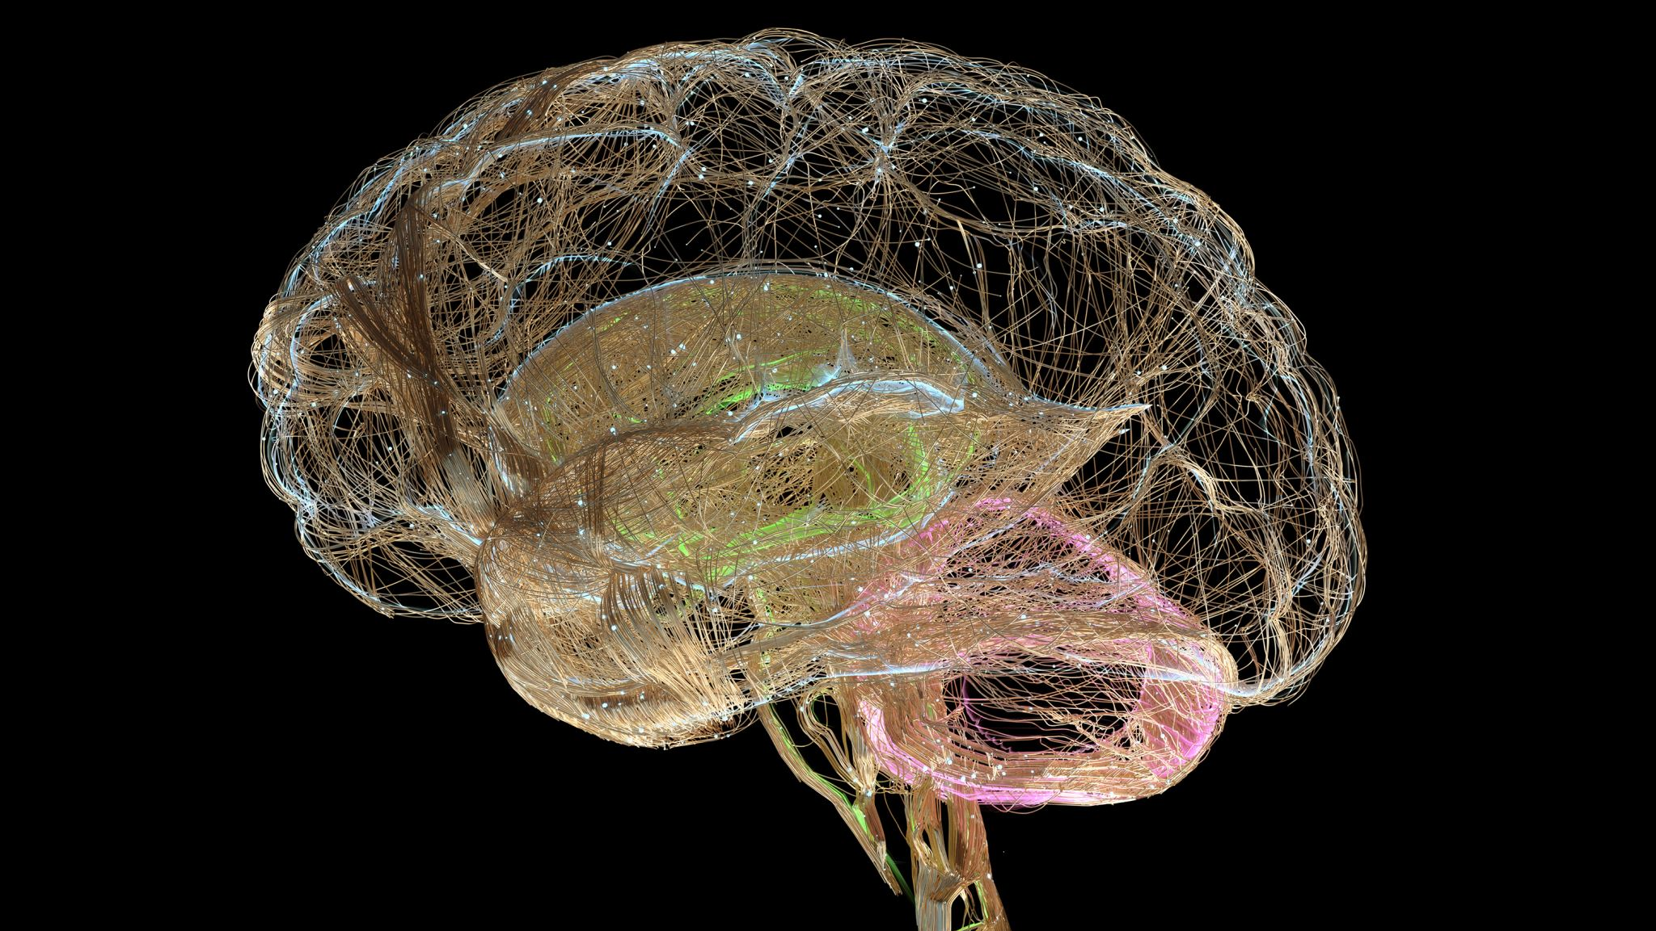
Referrals and demand for mental health support are at record high levels. over 2 million people were in contact with nhs mental health services. nhs trusts are increasingly using the independent sector to deliver mental health care where nhs beds and services are stretched almost 30%of nhs funded mental health beds may be provided this way.

