Slide 1
ECEY4002: Ymarferydd Proffesiynol
ECEY4002: Professional Practitioner

Slide 2

DEDDFWRIAETH/ LEGISLATION

Slide 3
Trafodaethau grŵp
Group discussion
Pam mae angen deall hanes a deddfwriaeth diogelu plant?
Beth i chi’n meddwl yw/bydd eich rôl mewn swydd sydd yn gweithio gyda phlant?
Why is it necessary to understand history and legislation relating to safeguarding children?
What do you believe will be your/is your role working with children?

Slide 4
Diffiniadau Definitions
Beth yw amddiffyn plant?
Beth yw camdrin plant?
Diogelu
What is child protection?
What is child abuse?
Safeguarding
Notes:
4

Slide 5
Diogelu/ Safeguarding
Diolgelu yw’r camau rhagweithiol rydym yn cymryd i cadw pob un o’n plant yn diogel
Safeguarding is the proactive steps that we take towards keeping all our children safe
Amddiffyn Plant/ Child Protection
Amddiffyn plant yw’r gweithredoedd adweithiol sydd yn digwydd fel canlyniad o consyrn
Child protection is the reactive actions that occur as a result of a concern

Slide 6
Camdriniaeth Abuse
Camdrin Corfforol
Camdrin Emosiynol
Camdrin Rhywiol
Esgeulustod
Physical Abuse
Emotional Abuse
Sexual Abuse
Neglect
https://www.nspcc.org.uk/what-is-child-abuse/types-of-abuse/
Notes:
Domestic abuse, child trafficking and modern slavery, online abuse,

Slide 7
Niwed Harm
…gall niwed fod o ganlyniad digwyddiad uniongyrchol neu fethiant i ddarparu gofal cywir neu y ddau, (Prydain Fawr, Yr Adran Iechyd, 1999).
…camdriniaeth neu’r amhariad iechyd neu ddatblygiad, (Bentovim et al., 2009).
…harm may be the result of a direct act or by a failure to act to provide proper care or both. (Great Britain, Department of Health, 1999).
…ill treatment or the impairment of health or development. (Bentovim et al., 2009).

Slide 8
Cefndir Background
Achosion blaenorol
Byrddau Lleol Diogelu Plant (LSCB)
Deddfwriaeth
Previous cases
Local Safeguarding Boards (LSCB)
Legislation

Slide 9

https://learning.nspcc.org.uk/child-protection-system/history-of-child-protection-in-the-uk/
1989 – Children Act for England and Wales
2001 – First Children’s Commissioner
2004 – Children Act, UNCRC
2014 - The Social Services and Well-being (Wales) Act
2019 – Child Protection Procedures
2022 - Children (Abolition of Defence of Reasonable Punishment) (Wales) Act)
Notes:
A few examples important in wales

Slide 10
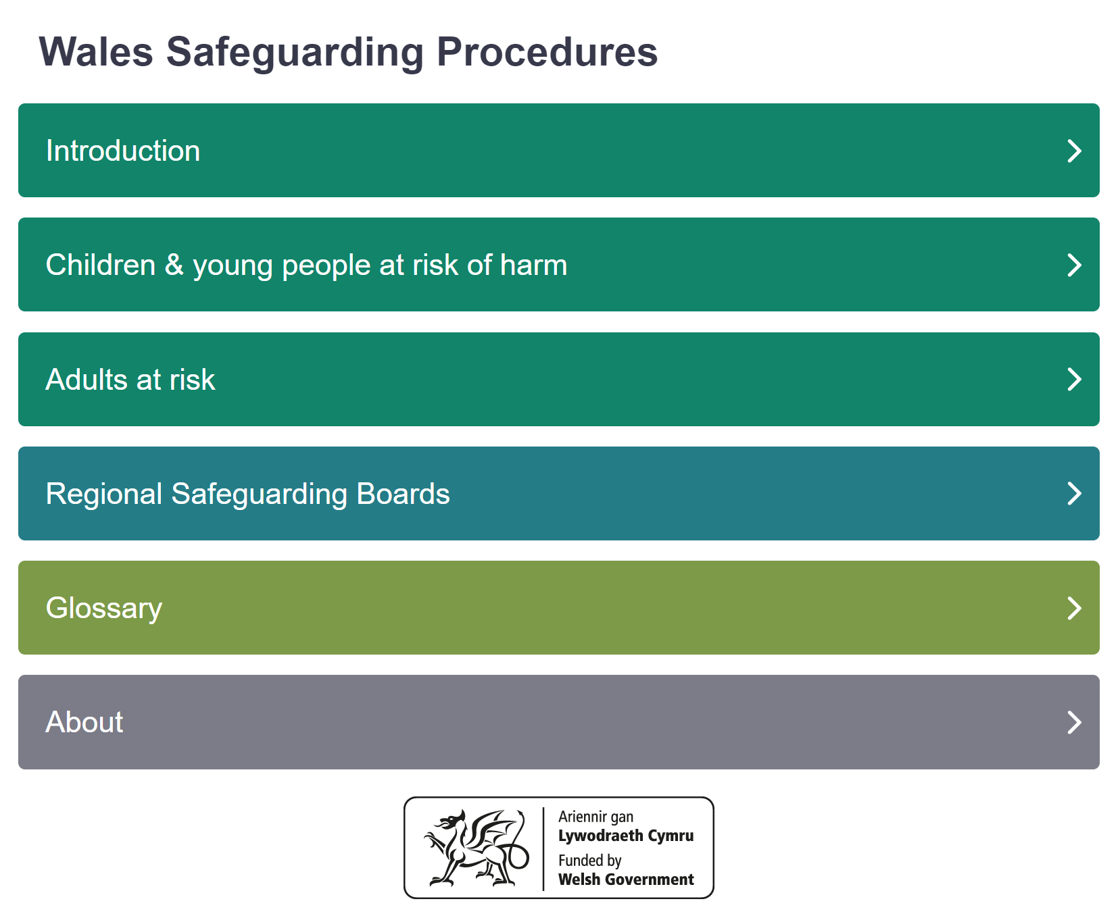

App Gweithdrefnau Diogelu Cymru
Wales Safeguarding Procedures (2019) App

Slide 11
Ethos
Gweithgarwch i’w wneud gyda phlant yw diogelu, nid rhywbeth i’w wneud iddyn nhw.
Peter Clarke
Safeguarding children is an activity that is done with our children rather than to them.
Peter Clarke

Slide 12
7 nod craidd
Dechrau da mewn bywyd;
Amrywiaeth gynhwysfawr o gyfleoedd addysg a dysgu;
Mwynhau’r iechyd gorau posib, yn rhydd o gamdriniaeth, erledigaeth a cham-fanteisio;
Mynediad at weithgareddau chwarae, hamdden, chwaraeon a diwylliant;
Eu clywed, eu trin â pharch, a bod eu hil a’u hunaniaeth ddiwylliannol yn cael eu cydnabod;
Byw mewn cartref diogel a chymuned sy’n cefnogi lles corfforol ac emosiynol;
Peidio â bod dan anfantais oherwydd tlodi.

Slide 13
7 core aims
Have a flying start in life;
Have a comprehensive range of education and learning opportunities;
Enjoy the best possible health and are free from abuse, victimisation and exploitation;
Have access to play, leisure, sporting and cultural activities;
Are listened to, treated with respect, and have their race and cultural identity recognised;
Have a safe home and a community which supports physical and emotional well being;
Are not disadvantaged by poverty.
Notes:
Welsh Government 7 core aims
Based upon UNCRC and children’s rights in Wales

Slide 14
I bwy? For whom?
Cyfrifoldeb ar BAWB i amddiffyn plant a phobl ifanc rhag niwed
  Unigolion
  Asiantaethau
EVERYONE is responsible for protecting children and young people from harm
  Individuals
  Agencies
Notes:
Working Together to Safeguard Children (2018): A guide to inter-agency working to safeguard and promote the welfare of children – HM Government

Slide 15
Rôl yr ymaferwr
The role of the practitioner
Hyrwyddo lles y plentyn
Cydweithio
  Gwasanaethau Cymdeithasol
  Heddlu
  NSPCC
Nid mater o ddewis yr unigolyn yw hyn
Promoting the child’s welfare
Collaboration
  Social Services
  Police
  NSPCC
  This is not a matter of individual choice

Slide 16
Cyfeirnodau / References
Batty, D. (2005) ‘Timeline: A History of Child Protection’ https://www.theguardian.com/society/2005/may/18/childrensservices2 [Accessed: 8th September 2016].
Bentovim, A., Cox, A., Miller, L. B. and Pizzey, S. (2009) Safeguarding Children Living With Trauma and Family Violence: Evidence Based Assessment, Analysis and Planning Interventions. London: Jessica Kingsley Publishers.
Great Britain: Department of Health. (1999) Working Together to Safeguard Children. London: HMSO.
NSPCC. (2021) ‘History of child protection in the UK’ https://learning.nspcc.org.uk/child-protection-system/history-of-child-protection-in-the-uk
Wales Safeguarding Procedures (2019) https://safeguarding.wales/

