Slide 1




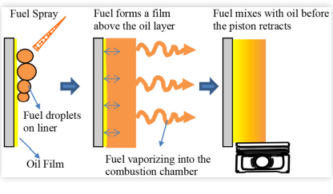
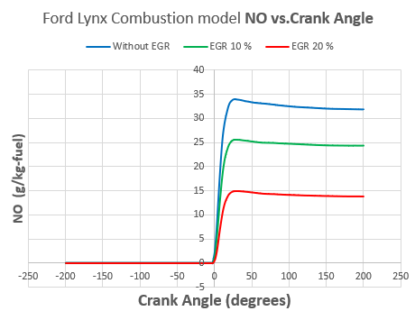
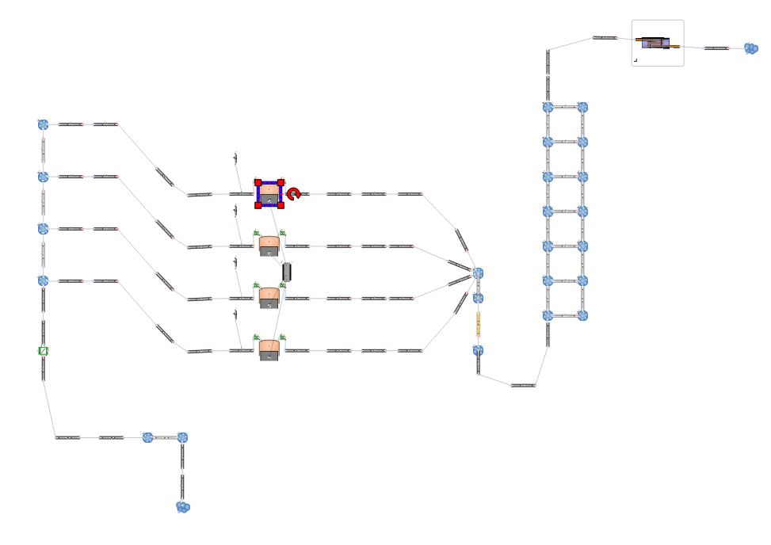
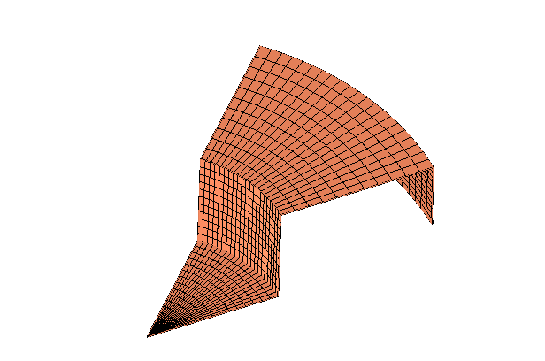
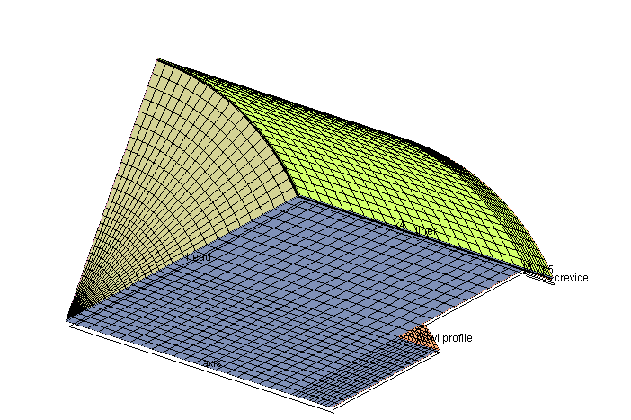
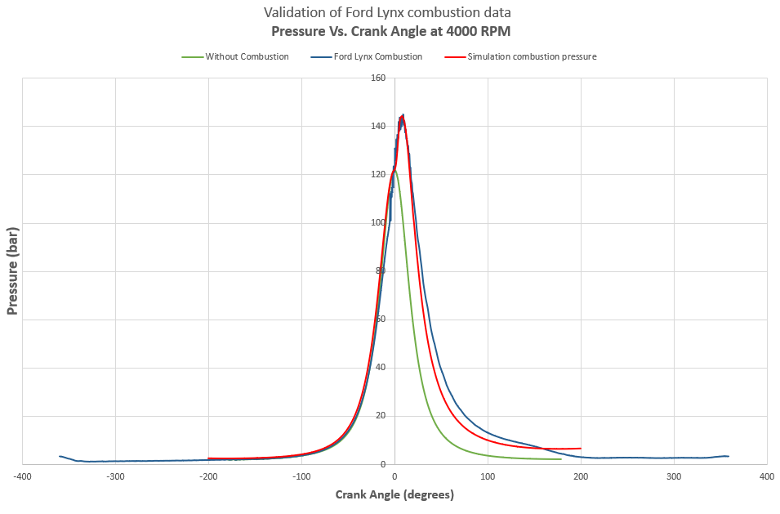
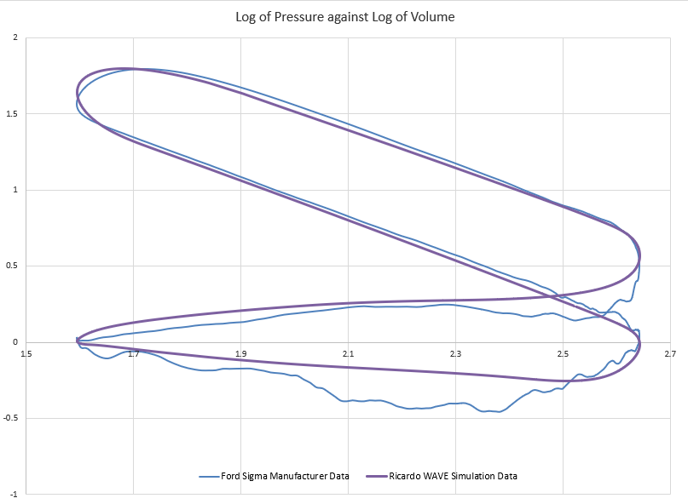
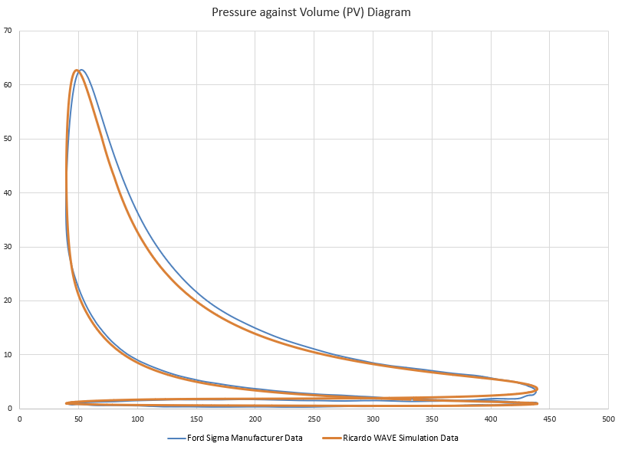
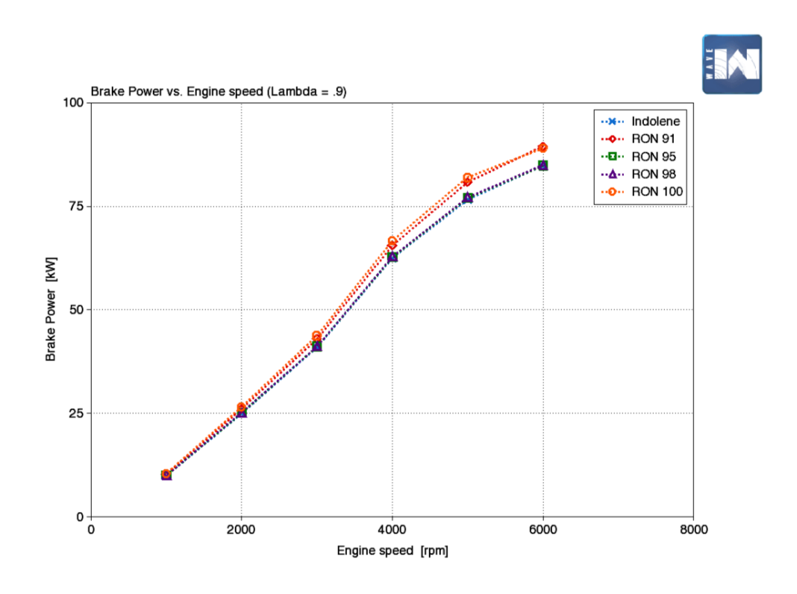

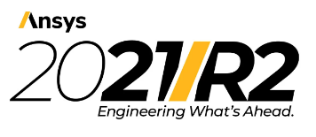
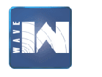
Your Pic
Tribological analysis and the effects of fuel/oil chemistry on engine
performance and emissions
Name: Krishnadas Pachery Chandradas
Supervisor : Dr. Owen Williams
School of Engineering | M.Sc. Motorcycle Engineering
Introduction
The research investigates about the combustion performance and emissions due to varying Research Octane Number (RON) in gasoline blends, piston top land crevice volume radial clearance and molecular diffusion of lubricant layer and fuel resulting in the hydrocarbon emissions, multigrade lubricant specifications and frictional performance ,EGR and combustion emissions in a computation simulation environment.
Based on the results collected from the 1D/3D CFD after the validation of manufacturer data (Ford Lynx and Sigma ) ,the significance of varying fuel and lubricant properties were studied in performance and emission perspective.
Introduction
Project Aims
Figure 1:Formulation of fuel-oil film on liner (molecular diffusion) [1].
Methodology
Figure 5 : Effect of EGR on NOx emission index
Conclusion
From a performance perspective, RON 100 has more performance than RON 91, which makes it the feasible performance fuel for engines. RON 100 and RON 91 have similar output as high-performance fuels followed by RON 98 and 95, which are considered as low performance fuels. Even though RON 95 and RON 98 have least engine performance, NOx production and unburned hydrocarbon emissions, another key advantage of both fuels is that they are superior in the reduction of CO emissions.
Molecular diffusion is an inevitable phenomenon in ICE due to the presence of piston top land crevice volume. This concludes that the fuel absorption and accumulation in piston top land and oil layer increases as a function of powertrain life. Lubricants have a very negligible impact on the frictional performance of an engine. Simulation results conclude that different grades with varying oil properties like viscosity and density does have minute influence in friction characteristics.
Results
Conclusions
Figure 2 :Ford Lynx and Sigma combustion model (Ricardo WAVE and Ansys FORTE R2)
Project Aims
Study influence of wide range of RON on engine performance and emissions.
Understand the unburned hydrocarbon emissions due to molecular diffusion at piston top land crevice volume.
Influence of lubricant specifications on frictional performance and energy loss.
Study the efficiency of CFD combustion modelling on gasoline and diesel combustion.
Analyse the varying radial clearance effects on hydrocarbon emissions
Methodology
Validation of Ford sigma Ricardo WAVE combustion model with manufacturer data (Linear P-V and Log P-V data)
Validation of Ford Lynx Ansys FORTE R2 combustion model with manufacturer data ( Linear P-V diagram)
Figure 3 : Validation of combustion models (Ford Lynx and Sigma)
Results
References
[1] Liu, Y., 2017. “A Multi-Scale Model Integrating both Global Ring Pack Behaviour and Local Oil Transport in Internal Combustion Engines. Ph.D. thesis, Department of Massachusetts Institute of Technology, Cambridge.
[2] Yew Heng Teoh, H. G. H. K. H. Y. H. G. C. W. L. Y., 2018. Journal of Advanced Research in Fluid Mechanics and Thermal Sciences. Influence of Octane Number Rating on Performance, Emission and Combustion Characteristics in Spark Ignition Engine, Issue 1, pp. 22-34.
Figure 4 : Influence of RON on Brake Power (0-6000 RPM)
School of Engineering

