Slide 1


ECAD6002C -ASSESSMENT & DATA:
Recognising Prior Attainment
Monitoring and Assessment
https://padlet.com/mathewreesjones/Assessment

Slide 2

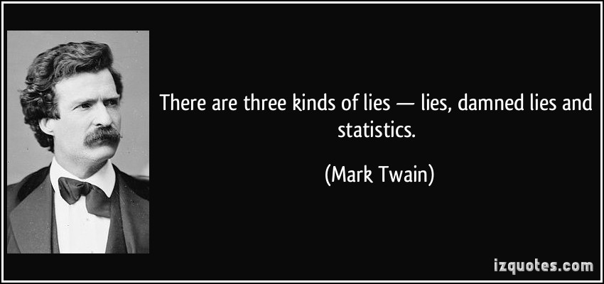
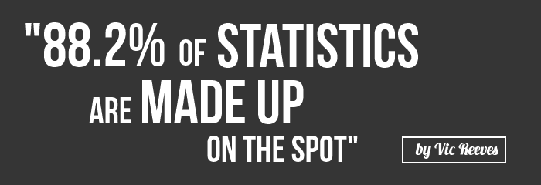
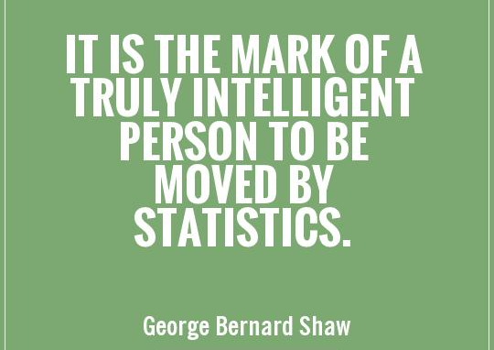
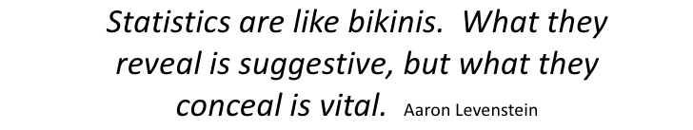
Some Quotes….
“ “People can come up with statistics to prove anything, 14% of people know that” Homer Simpson

Slide 3
Accessing our prior knowledge
Why is the recognition of prior attainment important at…
a national level (i.e within Wales)
a regional level (i.e. within consortia/local authorities)
a school level (i.e. at each transition/between year groups/within year groups)
an individual level (i.e. for each pupil)
Notes:
Supporting individuals
Providing appropriate educational provision/opportunities
Considering appropriate support from other agencies
ALSO
Accountability:
Governors
Head teacher & SLT
Consortium – colour coding
Estyn - judgements

Slide 4
Pre-Donaldson World

Slide 5
Asesu Statudol - Statutory Assessment
Asesiad sylfaenol gyda Proffil Cryno y Cyfnod Sylfaen yn ystod 6 wythnos gyntaf plentyn yn y Derbyn
Diwedd Cyfnod Sylfaen (B.2) asesiadau athro yn erbyn deilliannau’r cyfnod sylfaen (Proffil Llawn)
Diwedd CA2 (B.6) asesu yn ôl disgrifiadau lefel y cwricwlwm cenedlaethol
Profion rhifedd a darllen cenedlaethol i blant B.2-6. Rhieni i dderbyn y canlyniadau.
Ysgolion i roi adroddiad ‘naratif’ ar sgiliau rhifedd a llythrennedd disgyblion mewn perthynas â’r Ff.Ll.Rh. (h.y. sut maent yn defnyddio rhifedd ar draws y cwricwlwm)
Baseline Assessment using the compact Foundation Phase Profile within a child’s first 6 weeks in Reception
End of Foundation Phase (Y.2) teacher assessments against Foundation Phase Outcomes (Full Profile)
End of key stage 2 (Y.6) teacher assessments against national curriculum level descriptors
Annual numeracy and reading national tests for children in years 2-6. Parents receive their child’s results
Schools give a ‘narrative’ report on learners’ numeracy and literacy skills in relation to the LNF (i.e. How numeracy/literacy is used across the curriculum)
Notes:
Gwybodaeth am asesu’r CS ar wefan Llywodraeth Cymru:
http://gov.wales/topics/educationandskills/foundation-phase/foundation-phase-profile/?skip=1&lang=cy
Info on FP assessment on Welsh Government Website:
http://gov.wales/topics/educationandskills/foundation-phase/foundation-phase-profile/?skip=1&lang=en
Fideo Llywodraeth Cymru yn esbonio trefniadau asesu CS a defnyddio’r Proffil:
https://www.youtube.com/watch?v=kwH5xGHAgRU&feature=youtu.be
WG video explaining FP assessment arrangements and use of the Profile
https://www.youtube.com/watch?v=xfWghefLmHo&feature=youtu.be

Slide 6

National Tests
Literacy
Numeracy
From Year 2 to Year 9 (transitions)
Data Analysis & Reporting
Comparisons
So what?

Slide 7
Estyn & Consortia Visits
Identify trends in progress: across Wales, within schools
Make comparisons: over time and between schools
Recognise progress of school in relation to others and self
Comment on school’s response to data

Slide 8
Attainment and Poverty
There is a strong statistical link between poverty and low educational attainment. In general, learners from poorer families do not achieve as well as their peers ... There is no simple explanation for this link between deprivation and underachievement or an easy solution to breaking it.
(Estyn, 2014, p.2)
Notes:
Deprivation =
FSM
SEN
Persistent absence from school
Living in a deprived area
2 out of 5 children living in Wales are affected by at least one of these factors.

Slide 9
Recognising Prior Attainment
Why is it important to recognise pupils’ prior attainment?
How do teachers achieve this? (short, mid and long term)
How do trainees achieve this within a PTE? (Forms, sections of forms…)

Slide 10

Transitions
What information do teachers pass on?
How?
Why?
What do the ‘receiving teachers’ do with the information?

Slide 11
General principles – Egwyddorion Cyffredinol
Trends in performance over time
Tueddiadau mewn perfformiad dros amser
Consider a range of analyses
Ystyried ystod o ddadansoddi

Slide 12
Trends in performance over time-
Tueddiadau mewn perfformiad dros amser
Foundation Phase Indicator FPI
Dangosydd Cyfnod Sylfaen DCS
(Dat. Mathemateg/Mathematical Dev, Lang Dev, Dat. Iaith, Personal and Social Development/ Dat. Personal a Chymdeithasol)
Core subjects and CSI
Pynciau Craidd a DPC
(Mathematics/Mathemateg, Science/Gwyddoniaeth, English/Saesneg, (WM) Welsh/Cymraeg)

Slide 13
Cyfnod Sylfaen Foundation Phase | Cwricwlwm Cenedlaethol National Curriiculum
Deilliant Efydd (6-12mis) Outcome Bronze ( 6-12 months)
Deilliant Arian (12-18 mis) Outcome Silver (12-18 months)
Deilliant Aur (18-24) Outcome Gold 18-24 Months)
Deilliant 1 Cyfnod Sylfaen Outcome 1 Foundation Phase
Deilliant 2 Cyfnod Sylfaen Outcome 2 Foundation Phase
Deilliant 3 Cyfnod Sylfaen Outcome 3 Foundation Phase
Deilliant 4 Cyfnod Sylfaen Outcome 4 Foundation Phase | Lefel 1 Cyfnod Allweddol 2 Level 1 Key stage 2
Deilliant 5 Cyfnod Sylfaen Outcome 5 Foundation Phase | Lefel 2 Cyfnod Allweddol 2 Level 2 Key stage 2
Deilliant 6 Cyfnod Sylfaen Outcome 6 Foundation Phase | Lefel 3 Cyfnod Allweddol 2 Level 3 Key stage 2
 | Lefel 4 Cyfnod Allweddol 2 Level 4 Key stage 2
 | Lefel 5 Cyfnod Allweddol 2 Level 5 Key stage 2
 | Lefel 6 Cyfnod Allweddol 2/3 Level 6 Key stage 2/3
The target for year 2 is that most pupils will have achieved outcome 5 key areas.
Y targed ar gyfer bl 2 yw bod y disgyblion wedi cyrraedd deilliant 5 yn meysydd allweddol.
The target for year 6 is that most pupils will have achieved level 4 in the core subjects.
Y targed ar gyfer bl 6 yw bod y disgyblion wedi cyrraedd level 4 yn pynciau craidd
Outcomes / Deilliannau
It is expected that a child moves two levels from one key stage to the next.
Disgwylir i bob plentyn i symud 2 lefel o un cyfnod allweddol i’r nesaf.

Slide 14
Starting Point – Man Cychwyn
Mae’r Proffil wedi ei ddatblygu fel dull asesu cenedlaethol ar gyfer pob plentyn i sefydlu llinell sylfaen yn y chwe wythnos gyntaf ar ôl cyrraedd y Flwyddyn Derbyn a chafodd ei wneud yn statudol o fis Medi 2015 ymlaen. Mae’n asesu gallu a datblygiad plant mewn pedwar Maes Dysgu:
The Profile has been developed as a national assessment of all children to establish a baseline within the first six weeks of entry into Reception Year and was made statutory from September 2015. It assesses children’s abilities and development in four Areas of Learning:
Datblygiad Personol a Chymdeithasol, Lles ac Amrywiaeth Ddiwylliannol
Sgiliau Iaith, Llythrennedd a Chyfathrebu
Datblygiad Mathemategol
Datblygiad Corfforol.
Personal and Social Development, Well-being and Cultural Diversity
Language, Literacy and Communication Skills
Mathematical Development
Physical Development.
https://www.youtube.com/watch?v=xfWghefLmHo&feature=youtu.be

Slide 15
What testd? Pa brofion?

Slide 16
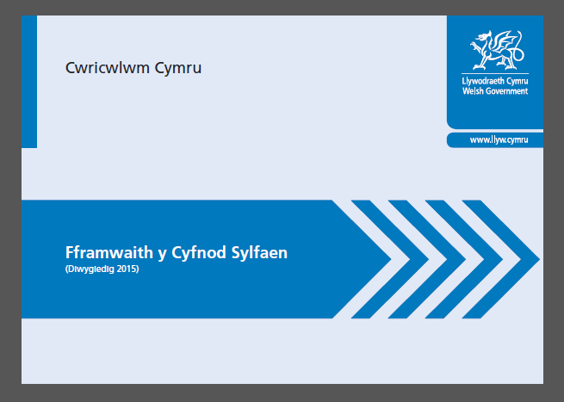



Dogfennau / Documents
Cyfnod Sylfaen Cymraeg / Welsh Medium FP:
http://learning.gov.wales/resources/collections/foundation-phase?lang=cy
CS Saesneg / English Medium Foundation Phase:
http://learning.gov.wales/resources/collections/foundation-phase?lang=en
Cyfnod Allweddol 2 Cymraeg / Welsh Medium KS2:
http://learning.gov.wales/resources/collections/key-stages-2-4?lang=cy
CA2 Saesneg / English Medium Key Stage 2:
http://learning.gov.wales/resources/collections/key-stages-2-4?lang=en

Slide 17

Profion Arall - Other Tests

Slide 18
Identifying characteristics of outcomes/levels within work
For the work samples you are given:
Identify what characteristics of outcomes/levels may be evident in each piece – be able to provide a short justification for this
Using the principles of ‘best-fit’ decide upon a Outcome (FP) / Level (KS2)

Slide 19
Link to your Assignment
Looking at data, such as an outcome or level is one means of analysis.
Within your assignment you are asked to analyse a child’s learning in mathematics and language with recommendations for ensuring progress.
Work again within your pairs to give recommendations for each child i.e. how this child can be supported to make progress

Slide 20
Post-Donaldson World

Slide 21
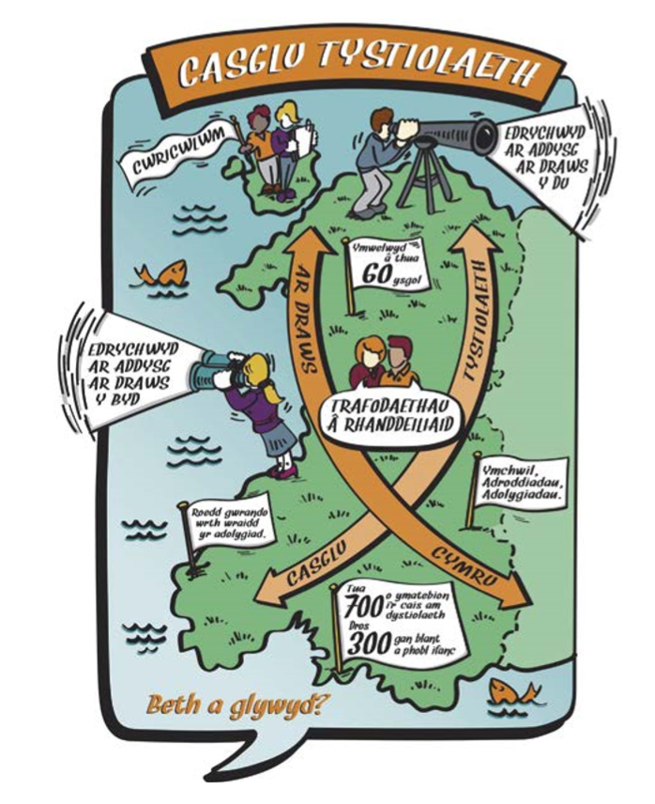
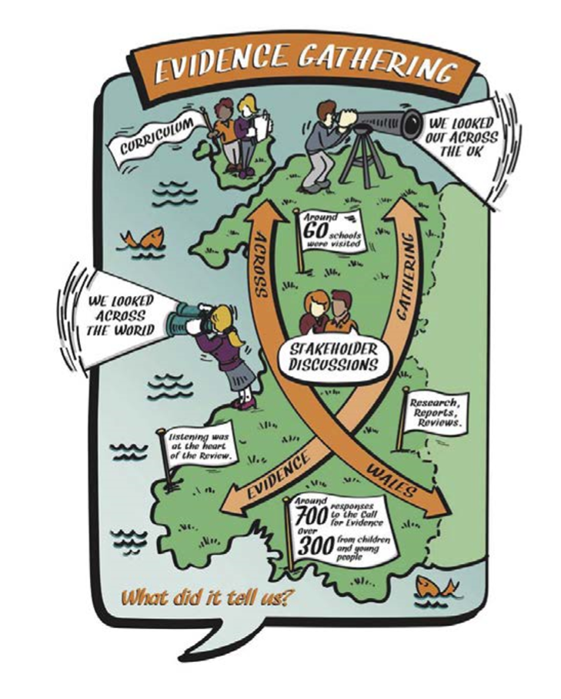
Ffocws ar Gymru – Focus on Wales

Slide 22
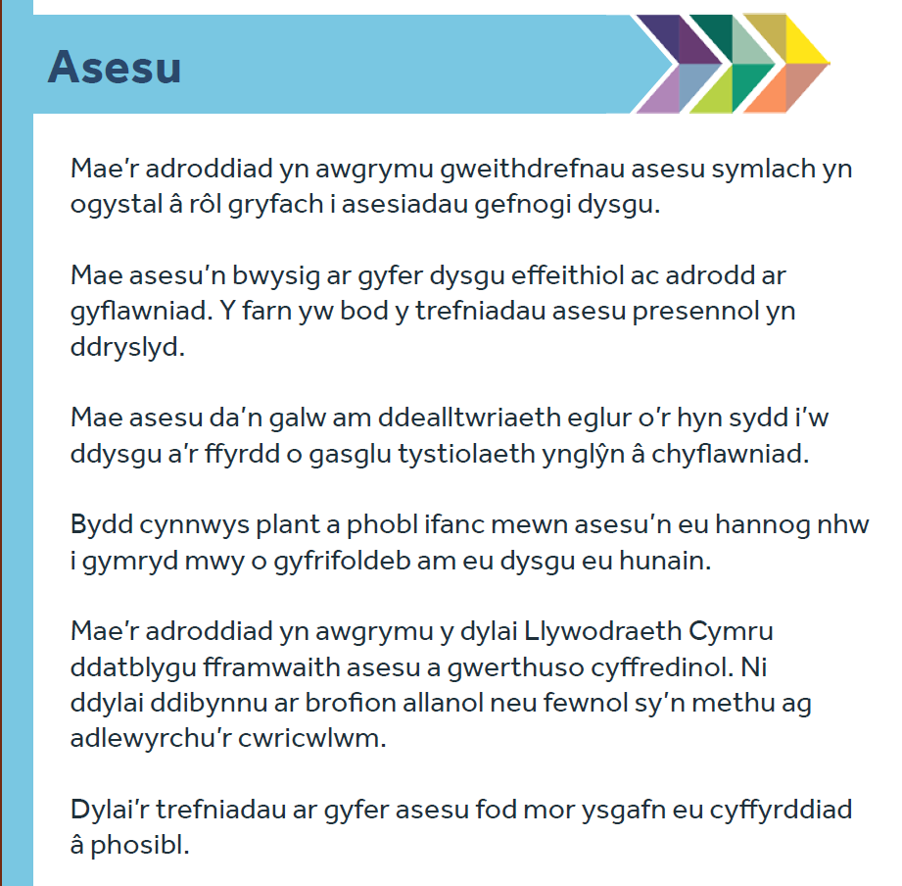
Asesu ac Adroddiad Dyfodol Llwyddiannus
https://llyw.cymru/sites/default/files/publications/2018-03/dyfodol-llwyddiannus-crynodeb-o-adroddiad-yr-athro-graham-donaldson.pdf

Slide 23
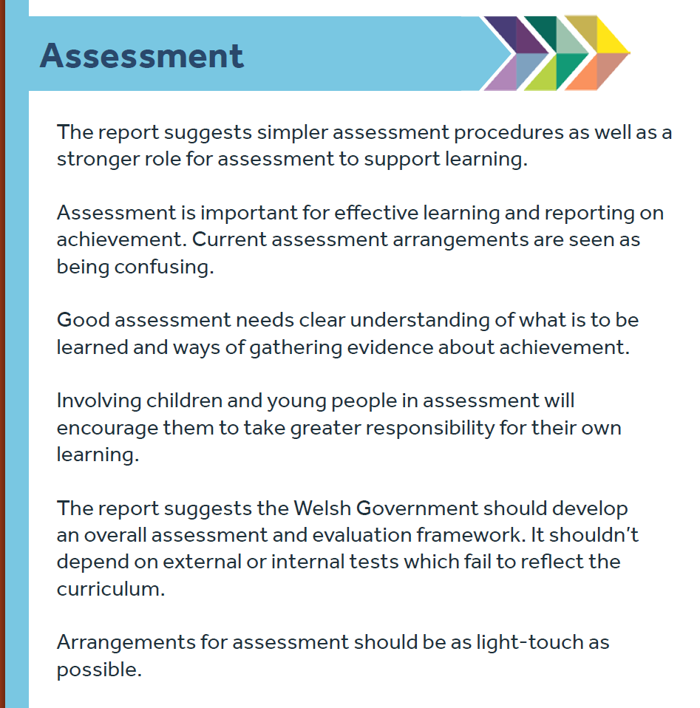
Assessment and the Successful Futures Report
https://gov.wales/sites/default/files/publications/2018-03/succesful-futures-a-summary-of-professor-graham-donaldsons-report.pdf

Slide 24
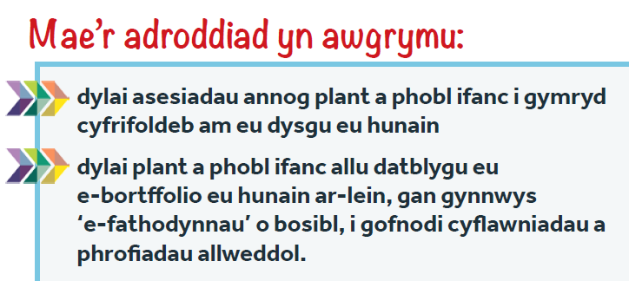
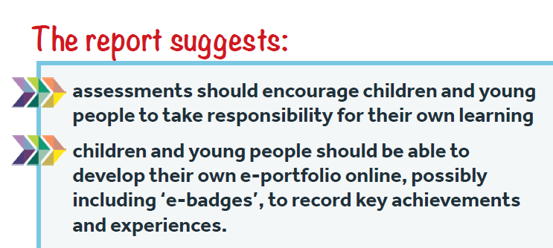

Slide 25
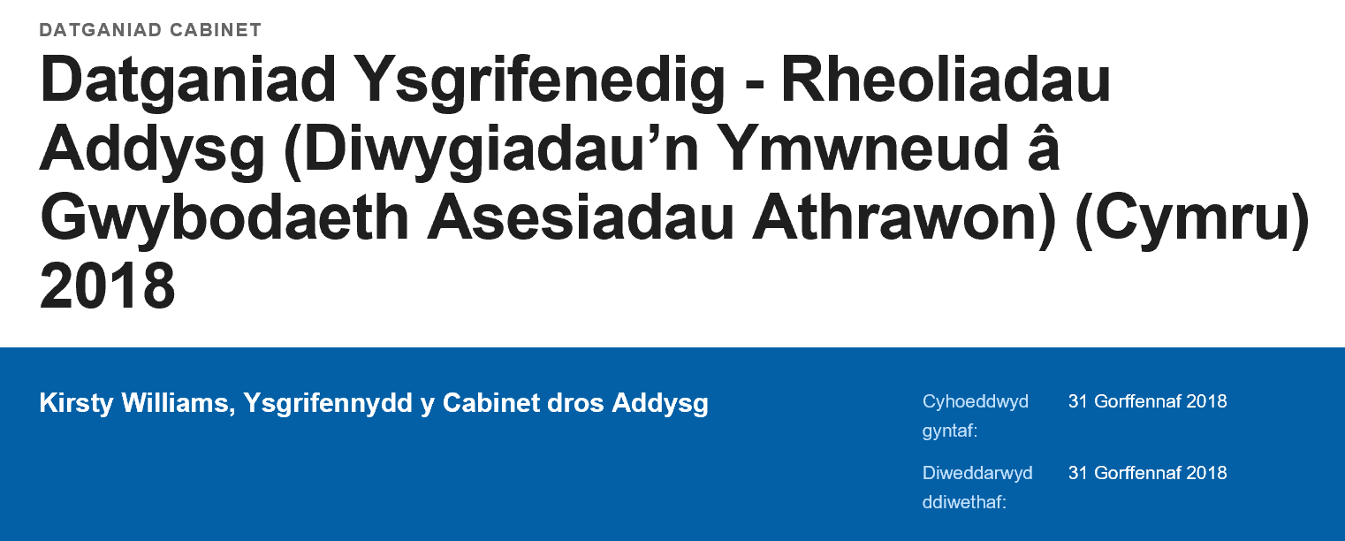
Datblygiadau cyfredol - Current developments
https://llyw.cymru/datganiad-ysgrifenedig-rheoliadau-addysg-diwygiadaun-ymwneud-gwybodaeth-asesiadau-athrawon-cymru?_ga=2.19432305.830236634.1569930168-233607502.1543914796

Slide 26
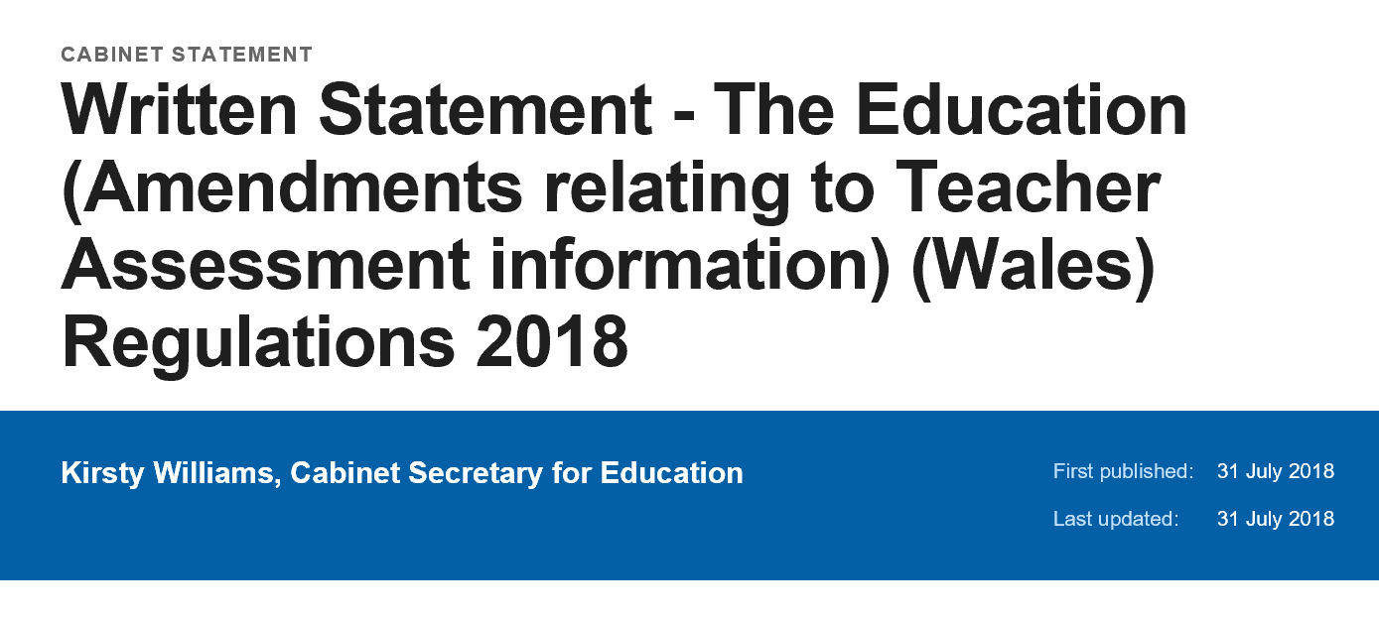
Datblygiadau cyfredol - Current developments
https://gov.wales/written-statement-education-amendments-relating-teacher-assessment-information-wales-regulations

Slide 27
Dulliau Casglu Data…?
Data
Capture Methods…?
Notes:
Link to WG statement

Slide 28
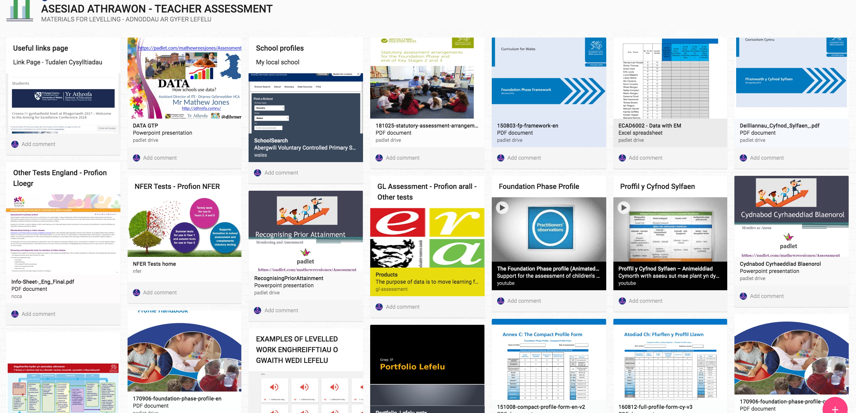
https://padlet.com/mathewreesjones/Assessment

Slide 29


https://hwb.gov.wales/cwricwlwm-cymru-2008/cyfnod-sylfaen/proffil-y-cyfnod-sylfaen-canllawiau-i-ymarferwyr/
https://hwb.gov.wales/curriculum-for-wales-2008/foundation-phase/foundation-phase-profile-guidance-for-practitioners/

Slide 30


