Slide 1



Title: Supporting Independence in Older Adults Living at Home: Are Current UK Care Models Truly Empowering?
Name: Kiran naaz
Student number: 2309152
Module code: BMHP6027
Lecturer name: Kennedy Obohwemu
Date

Slide 2
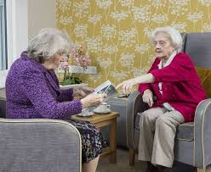
Introduction
Ageing
Process of growing older with gradual reduction in physical and mental well-being (WHO, 2024).
Challenge
Older adults wish to maintain independence at home despite ageing, loss of functional abilities, and mental changes.
Focus
Discuss UK care models' impact on autonomy and well-being of older adults at home.
Topics Covered:
Care provisions, ageing theories, policy/legislation, technological advances, practical examples, improvement suggestions.
Notes:
Introduction
Due to the ageing population in the UK, the problem of effective care delivery to older adults is gaining more significance. According to WHO (2024), Ageing can be defined as the process of growing older, where physical and occasionally mental well-being reduces gradually and demands a change in the care and assistance offered to elderly individuals. A large percentage of the elderly, especially when they are at home, want to have as much independence as they can; however, they have to deal with the many changes that come with ageing, loss of functional abilities, mobility difficulties and mental changes.
This presentation discusses the effect of existing UK care models on the independence and empowerment of adults living at home and evaluates the effectiveness of these models on autonomy and well-being. Among the topics addressed will be a summary of the care provisions, ageing theories, policy and legislation, technological advances, practical examples, and suggestions on how the care can be improved.

Slide 3
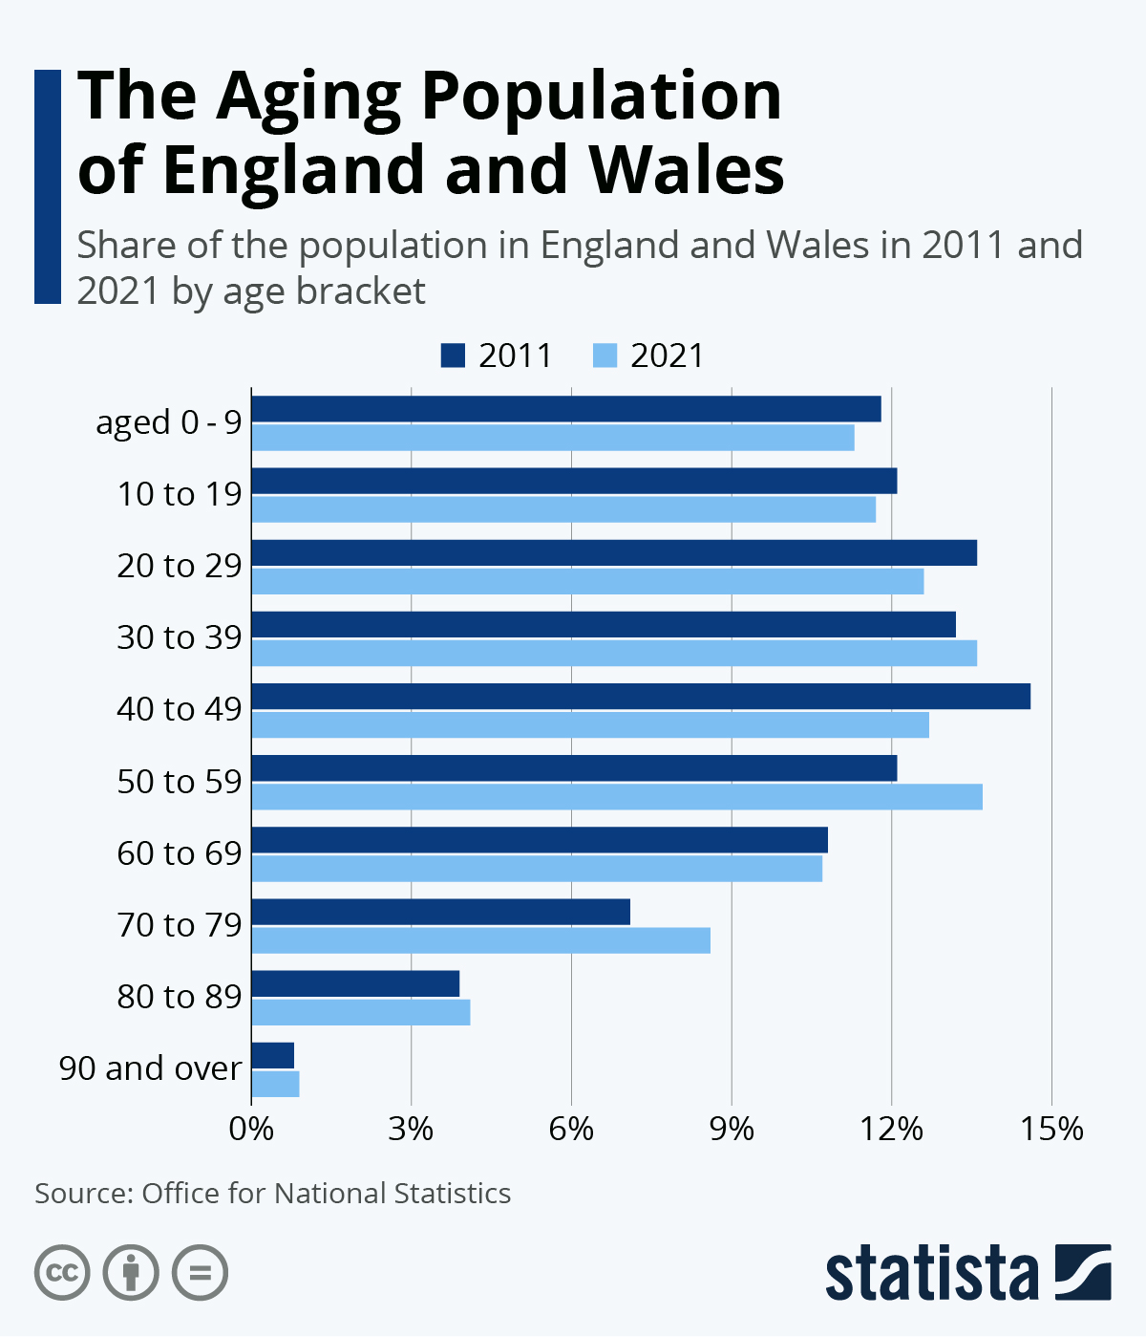
The Ageing Population and Its Impact
UK Ageing Trends
65+ expected to rise from 19% (2022) to 21% by 2030 (ONS, 2022).
Older Adults at Home
Increasing demand for home-based care to maintain independence.
Care Needs:
Activities of Daily Living (ADLs): Personal hygiene, cooking, mobility.
Social support to prevent isolation and enhance mental health (Edemekong et al., 2025).
Benefits of Independence:
Control over life, dignity, cost-effective.
Improves physical and mental health (Park & Kang, 2023).
Notes:
The Ageing Population and Its Impact
The UK demographic patterns indicate that the population is rapidly ageing. The Office for National Statistics (ONS) suggests that the proportion of people aged 65 and over in the UK is expected to increase from about 19% in 2022 to around 21% by 2030, with the fastest growth among those aged 80 and above (ONS, 2022). This change has far-reaching impacts on health and social care services, particularly in cases where older adults are willing to age in place- stay at their own homes as long as possible.
Elderly individuals residing at home have various care requirements that are important in ensuring their autonomy. These encompass support on activities of daily living (ADLs) like personal hygiene, cooking, medication administration and mobility and support on social interactions to avoid isolation and support mental health (Edemekong et al. 2025). The significance of independence at home cannot be pointed out in a single dimension. It enables the elderly to be in control of their lives, gives them a feeling of dignity, and is usually cheaper than institutional care environments. In addition, older adults are able to stay physically and mentally healthy due to home care services, which offer a personalised service that is adjusted to their changing needs (NIA, 2023).
Home-based support also contributes greatly to the overall well-being of the older adults. Research by Park and Kang (2023) has revealed that elderly individuals who enjoy proper care and access to the social support systems have improved health, psychological and life satisfaction rates. Similarly, it is essential to evaluate the extent to which the existing care models in the UK can help older adults be self-reliant without negatively affecting their quality of life.

Slide 4



Theoretical Frameworks
Activity Theory:
Promotes mental and physical activity for well-being (Teles & Ribeiro, 2021).
Encourages social connections, hobbies, and community involvement.
Disengagement Theory:
Aging leads to natural withdrawal from social/physical activities (Zhang & Lin, 2021).
Can lead to isolation and limit empowerment.
Continuity Theory:
Older adults seek continuity in roles and routines (Atchley, 1989).
Supports maintaining familiar environments and routines.
Notes:
Theoretical Frameworks
The Activity Theory proposes that older adults can be healthier through mental and physical activity by keeping them active and social. This theory states that the more active an individual is, then they have greater their sense of well-being and purpose (Teles and Ribeiro 2021). In a home care setting, the Activity Theory places more emphasis on the need to sustain social connections, hobbies and community to retain functional capacities
Contrarily, Disengagement Theory holds that when people age, they instinctively turn away from social and physical activities, and the process is regarded as an unavoidable and even desirable outcome of ageing (Zhang and Lin, 2021). However, although some degree of disengagement can be observed, the fact that the theory emphasises moving out of society can be problematic when implemented in the models of care because it can lead to the process of supporting isolation in older people instead of empowering them.
Continuity Theory, formulated by Atchley (1989), indicates that older adults work towards continuity in their lives by adjusting their roles and activities in a way that indicates the past experiences in their lives. This theory has given significance to the need to help older adults to sustain current routines and roles within their community to advance their sense of continuity and personal control. Continuity Theory care models are aimed at helping older adults to remain independent by enabling them to transform their living environments in accordance with the needs they have.

Slide 5


Policy and Legislation
Care Act (2014):
Emphasizes person-centred care, independence, and well-being.
Local authorities must design services that meet older adults’ care needs.
Equality Act (2010):
Prohibits age-based discrimination, ensuring equal access to services.
NHS Long Term Plan (2019):
Focuses on integrated care systems and community-based services for older adults.
Implementation Challenges:
Funding cuts, staff shortages, and unequal service delivery (Ng et al., 2021).
Notes:
Policy and Legislation
The UK has several major legislations that have influenced the care environment of the elderly, and these policies directly affect the home care services. The Care Act (2014) is regarded as an important act that highlights the role of a person-centred approach, independence, and well-being protection of the elderly population. The Act also dictates that the local authorities have to examine the care needs of older persons and make sure that they can design services to suit care needs, providing the individuals with the freedom to take charge of their care plans.
Similarly, the Equality Act (2010) prohibits any discrimination according to age and guarantees equal access for older adults to services, such as health and social services. This will play a significant role in making sure that the older individuals do not find themselves relegated to care models and still enjoy equal opportunities regarding receiving quality care and maintain independence.
The NHS Long Term Plan (2019) is the plan for the future direction of the health and social care system, and it should be mentioned that the integrated care systems and community-based services play an essential role in it. This plan will make older people who live at home have more support through an enhanced availability of primary care, digital health tools and community services.
However, as much as these policies have helped in the creation of a more human-oriented and accessible care system, there are still problems in the implementation of these policies. As identified by Ng et al. (2021) Funding cuts, staff shortages, and disproportional delivery of services, in most cases, restrain the efficacy of these policies in enabling older adults. These challenges should be overcome to make sure the models of care actually empower people and enable them to be self-reliant in the long-term perspective.

Slide 6

Evaluation of Current Care Provisions
Domiciliary Care:
Assists with personal hygiene, meal prep, mobility (SCIE, 2020).
Irregular quality, task-based focus, limits autonomy.
Reablement Services:
Short-term assistance to regain independence (Clotworthy et al., 2021).
Short duration, resource limitations.
Key Issue
Need for more unified, person-centred, and holistic home care services.
Notes:
Evaluation of Current Care Provisions
Domiciliary care and reablement services are the two major models of supporting older adults living at home in the UK. Domiciliary care is the service offered to persons at their own homes, including helping them in bathing, dressing and meal preparation (SCIE, 2020). On the contrary, Reablement services are directed towards assisting people regain their independence through short-term assistance in an effort to enhance the capacity of the individual to cope with daily tasks.
As much as these care models have assisted many older adults to remain independent, they do not come without limitations. For instance, domiciliary care services might be irregular as regards quality, whereby some people may receive poorly or excessively standardised care, unaware of their needs (Ouyang et al. 2025). In other instances, the emphasis on basic needs can be counterproductive to the empowerment of older adults since it does not encourage independence or participation in productive tasks.
Reablement services are also not limited by the resources available, and they prove to be short-term, which limits their potential to increase independence since they help older adults to regain skills and confidence (Clotworthy et al. 2021). Similarly, issues of understaffing, high turnover rates and inadequate funding may be used to restrain the performance of both models.
These problems raise the question of a more unified, person-based strategy of home care integrating the features of domiciliary care and reablement services. Care and support services should be integrated to provide a broader range of needs of older adults and enable them to obtain holistic support that will empower them to live independently.

Slide 7



Challenges to Maintaining Independence
Key Challenges:
  Frailty, dementia, social isolation, and poverty.
  Carer burden affecting ability to support autonomy.
Activity Theory Link:
  Maintaining social engagement and well-being is essential for independence.
Notes:
Evaluation of Current Care Provisions
Domiciliary care and reablement services are the two major models of supporting older adults living at home in the UK. Domiciliary care is the service offered to persons at their own homes, including helping them in bathing, dressing and meal preparation (SCIE, 2020). On the contrary, Reablement services are directed towards assisting people regain their independence through short-term assistance in an effort to enhance the capacity of the individual to cope with daily tasks.
As much as these care models have assisted many older adults to remain independent, they do not come without limitations. For instance, domiciliary care services might be irregular as regards quality, whereby some people may receive poorly or excessively standardised care, unaware of their needs (Ouyang et al. 2025). In other instances, the emphasis on basic needs can be counterproductive to the empowerment of older adults since it does not encourage independence or participation in productive tasks.
Reablement services are also not limited by the resources available, and they prove to be short-term, which limits their potential to increase independence since they help older adults to regain skills and confidence (Clotworthy et al. 2021). Similarly, issues of understaffing, high turnover rates and inadequate funding may be used to restrain the performance of both models.
These problems raise the question of a more unified, person-based strategy of home care integrating the features of domiciliary care and reablement services. Care and support services should be integrated to provide a broader range of needs of older adults and enable them to obtain holistic support that will empower them to live independently.

Slide 8



Technological Innovations in Home Care
Telecare & Remote Monitoring:
  Health monitoring and emergency alerts for elderly individuals (Abdulmalek et al., 2022).
  Provides peace of mind for families.
Assistive Technologies:
  Smart homes (fall detectors, voice-activated systems) to enhance independence (Kruithof et al., 2025).
  Automation of home functions for ease of use.
Limitations:
  Digital exclusion due to lack of tools or knowledge (Seifert et al., 2021).
  Risk of isolation if not combined with social care.
Notes:
Technological Innovations in Home Care
The technological changes can make a major contribution to the autonomy of home-based elderly. Two important innovations that enable healthcare professionals to monitor the health of patients remotely and provide caregivers with warning signs of change of state or emergencies are telecare and remote monitoring (Abdulmalek et al. 2022). The technologies used can offer both the elderly and their families some sense of peace as they do not have to visit each other regularly.
Similarly, there are also assistive technologies (e.g., smart homes, like fall detectors, voice-activated systems) that can allow older people to live more easily by controlling their surroundings and increasing their safety and independence. For example, the smart home technologies can be used to automate lighting, heating and other functions in their homes, which allows older adults to have control over their homes (Kruithof et al. 2025).
However, these technologies also have their limitations. The issue of digital exclusion is still a major obstacle to consider since numerous older adults might lack the tools needed and the ability to utilise them properly (Seifert et al. 2021). Furthermore, these technologies can facilitate the development of independence, but on the other hand, they may induce feelings of isolation unless these technologies are combined with social care services.

Slide 9

Case Study: Age UK Home Care Services
Age UK Services:
  Non-profit providing befriending, telephone support, and home visits (Age UK, 2024).
  Aimed at reducing isolation and supporting independence.
Key Takeaway: Community-based care models that combine practical care with social support can empower older adults.
Notes:
Case Studies
An example of how community-based programs can empower older adults is the case study of the home care services offered by Age UK. Age UK (2024) is a non-profit organisation that provides various types of services such as befriending, telephone support, and homework. These services are aimed at assisting the elderly to stay independent and minimise their sense of isolation. Okinawa, Japan, in which the elderly live longer than in any other country in the world, has provided a case study that illustrates how an approach based on the community, in which healthcare is combined with social support and family engagement, can enable the elderly to stay independent long into their old age (Branislava Ćurčić-Blake et al. 2025). These cases show the significance of the combination of practical care and social support to promote independence. They also emphasise the possibilities of community-based care models to enable and empower older adults in a way that is not always possible in the institutional setting.

Slide 10

Case Study: Okinawa, Japan
Okinawa’s Approach:
  Community-driven care combined with social support and family involvement.
  Older adults in Okinawa live longer and stay independent due to this integrated model (Ćurčić-Blake et al., 2025).
Key Takeaway: The importance of social connection and community-based care in maintaining independence.
Notes:
Case Studies
An example of how community-based programs can empower older adults is the case study of the home care services offered by Age UK. Age UK (2024) is a non-profit organisation that provides various types of services such as befriending, telephone support, and homework. These services are aimed at assisting the elderly to stay independent and minimise their sense of isolation. Okinawa, Japan, in which the elderly live longer than in any other country in the world, has provided a case study that illustrates how an approach based on the community, in which healthcare is combined with social support and family engagement, can enable the elderly to stay independent long into their old age (Branislava Ćurčić-Blake et al. 2025). These cases show the significance of the combination of practical care and social support to promote independence. They also emphasise the possibilities of community-based care models to enable and empower older adults in a way that is not always possible in the institutional setting.

Slide 11



Are Current Models Truly Empowering?
Current Models:
  Domiciliary care and reablement services show mixed results in fostering true independence.
Challenges:
  Task-based care, service fragmentation, staff shortages.
  Limited long-term empowerment due to short-term focus (Ouyang et al., 2025).
Critical Issue
  Policies exist, but implementation gaps affect empowerment and autonomy.
Notes:
As much as these care models have assisted many older adults to remain independent, they do not come without limitations. For instance, domiciliary care services might be irregular as regards quality, whereby some people may receive poorly or excessively standardised care, unaware of their needs (Ouyang et al. 2025). In other instances, the emphasis on basic needs can be counterproductive to the empowerment of older adults since it does not encourage independence or participation in productive tasks.

Slide 12

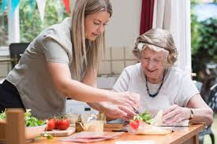

Recommendations for Improvement
Increase Resources:
  More funding for home care services.
  Flexible services that address varying needs (Saina Sehatkarlangrodi et al., 2025).
Expand Reablement Services:
  Extend service duration for long-term impact.
  Improve accessibility and integration.
Address Digital Exclusion:
  Provide digital training and access to technology (Bertolazzi et al., 2024).
Promote Social Engagement:
  Integrate social support into home care services to reduce isolation.
Notes:
Recommendations
Certain changes may be made to the existing UK care models in order to empower older adults who live at home. The policy reforms should be done to provide more resources to home care services and make sure that they are flexible enough to address the varying needs of older persons (Saina Sehatkarlangrodi et al. 2025). The increase of reablement services may offer long-term assistance to older adults, which will aid them in maintaining or regaining autonomy.
Home care models should also incorporate technological advances to supply remote monitoring and assistive technology and devices, but they must be met with training and support so that older adults are not disadvantaged because of digital exclusion (Bertolazzi et al. 2024). Moreover, models of care are supposed to prioritise the increased role of social engagement to fight the feeling of isolation and enhance well-being, which is an essential element of independence.

Slide 13

Conclusion
Summary:
  Current UK home care models provide some support but lack long-term empowerment.
  Policy reforms and improved technological integration are needed.
  True empowerment requires balancing caregiving with promoting autonomy and dignity.
Notes:
Conclusion
Existing UK care models in older adults who live at home are not as empowering, and in most cases do not encourage long-term independence. Although policies and technological advancements have gone a long way, issues of funding constraints, shortage of staff, and digital inequalities are still there. With the aid of policy changes and improved technologies, a more person-centred and integrated approach to home care is required so that older adults can indeed live independently and with dignity. The future of home care will be determined by the possibility of balancing between caregiving and empowerment so that older adults are helped to retain their autonomy and obtain the care they require.

Slide 14
References
Abdulmalek, S., Nasir, A., Jabbar, W. A., Almuhaya, M. A. M., Bairagi, A. K., Khan, M. A.-M. and Kee, S.-H., 2022. IoT-Based Healthcare-Monitoring System towards Improving Quality of Life: A Review. Healthcare, 10 (10), 1993. Available from: https://pmc.ncbi.nlm.nih.gov/articles/PMC9601552/.
Age UK, 2024. Befriending services | Combating loneliness. Ageuk.org.uk. Available from: https://www.ageuk.org.uk/services/befriending-services/.
Atchley, R. C., 1989. A Continuity Theory of Normal Ageing. The Gerontologist, 29 (2), 183–190.
Bertolazzi, A., Quaglia, V. and Bongelli, R., 2024. Barriers and facilitators to health technology adoption by older adults with chronic diseases: an integrative systematic review. BMC Public Health, 24 (1), 506. Available from: https://pubmed.ncbi.nlm.nih.gov/38365698/.
Branislava Ćurčić-Blake, Futenma, Y., Willcox, D. C., Parisa Esmaeili Tazangi, Nido Dipo Wardana, Ueda, Y. and Aleman, A., 2025. Difference between Okinawan and Dutch older adults in prefrontal brain activation. Frontiers in Ageing Neuroscience, 17.
Clotworthy, A., Kusumastuti, S. and Westendorp, R. G. J., 2021. Reablement through time and space: a scoping review of how the concept of ‘reablement’ for older people has been defined and operationalised. BMC Geriatrics, 21 (1).
Department of Health and Social Care, 2014. Care Act 2014: supporting implementation. GOV.UK. Available from: https://www.gov.uk/government/publications/care-act-statutory-guidance.
Edemekong, P. F., Bomgaars, D. L. and Levy, S. B., 2025. Activities of Daily Living (ADLs). NCBI. Available from: https://www.ncbi.nlm.nih.gov/books/NBK470404/.
GOV.UK, 2010. Equality Act 2010. Legislation.gov.uk. Available from: https://www.legislation.gov.uk/ukpga/2010/15/contents.
Kruithof, K., Ruehle, R. C., Dörenberg, V., van Etten-Jamaludin, F. and Frederiks, B., 2025. Digital assistive technologies to support community-dwelling older adults: an interpretative synthesis of experienced benefits and harms. SSM - Qualitative Research in Health, 8, 100584.
National Institute on Ageing, 2023. Ageing in place: Growing older at home. National Institute on Ageing. Available from: https://www.nia.nih.gov/health/aging-place/aging-place-growing-older-home.
Ng, S.-I., Lim, X.-J. and Hsu, H.-C., 2021. The Importance of an Age-Friendly City on Older People’s Continuity and Life Satisfaction. International Journal of Environmental Research and Public Health, 18 (14), 7252. Available from: https://www.mdpi.com/1660-4601/18/14/7252.
NHS England, 2019. NHS Long Term Plan. NHS England. Available from: https://www.longtermplan.nhs.uk/.
ONS, 2022. Population projections - Office for National Statistics. Ons.gov.uk. Available from: https://www.ons.gov.uk/peoplepopulationandcommunity/populationandmigration/populationprojections.
Ouyang, Y., Cheng, C., Sun, Q., Chen, L. and Wang, L., 2025. Formal caregivers’ knowledge, attitudes, and challenges in end-of-life care for people with advanced dementia: a qualitative study in a Chinese nursing home. BMC Nursing, 24 (1).
Park, J. H. and Kang, S.-W., 2023. Social Interaction and Life Satisfaction among Older Adults by Age Group. Healthcare, 11 (22), 2951–2951.
Saina Sehatkarlangrodi, Manaf Zargoush, Longo, C. J. and Somayeh Ghazalbash, 2025. Shaping older adults’ care policy: a scoping review of key determinants in post-acute and community reintegration transitions. BMC Health Services Research, 25 (1).
Seifert, A., Cotten, S. R. and Xie, B., 2021. A Double Burden of Exclusion? Digital and Social Exclusion of Older Adults in Times of COVID-19. The Journals of Gerontology: Series B, 76 (3).
Social Care Institute for Excellence, 2020. Role and principles of reablement. SCIE. Available from: https://www.scie.org.uk/integrated-care/intermediate-care-reablement/role-and-principles-of-reablement/.
Teles, S. and Ribeiro, O., 2021. Activity Theory. Encyclopedia of Gerontology and Population Ageing, 36–44.
World Health Organisation, 2024. Ageing and health. World Health Organisation. Available from: https://www.who.int/news-room/fact-sheets/detail/ageing-and-health.
Zhang, X. and Lin, H., 2021. Disengagement Theory. Encyclopedia of Gerontology and Population Ageing, 1471–1476.

