Slide 1
Introduction to Business
Group Presentation
Victoria Francis (2329070)
Charmaine Vickers-Silby (2321095)
Corine Stroe (2223870)
Kiren Nisar (2220781)

Slide 2
Objectives Outcome
Explain Scottish Power organisation’s internal and external operating environment
Provide an understanding of how the organisation functions within the internal and external environment

Slide 3

Introduction
Scottish Power works as a subsidiary energy company in the UK, which is owned by the publicly traded company Spanish Iberdrola Group.
Generates electricity and gas
Source renewable electricity from their own windfarms
It is regarded to be the first integrated company that invests to produce green electricity and clean energy.
(ScottishPower, 2024)
Notes:
Scottish Power works as a subsidiary energy company in the UK, which is owned by the publicly traded company Spanish Iberdrola Group. It generates electricity and gas and transmits and supplies it to millions of consumers in the world. It mostly emphasises generating renewable energy and it operates significantly on wind energy in the hope of creating more clean energy in the future (ScottishPower, 2024). It is regarded to be the first integrated company that invests to produce green electricity and clean energy. Apart from this, the organisation operates to generate power and create energy networks as well as retail energy.

Slide 4
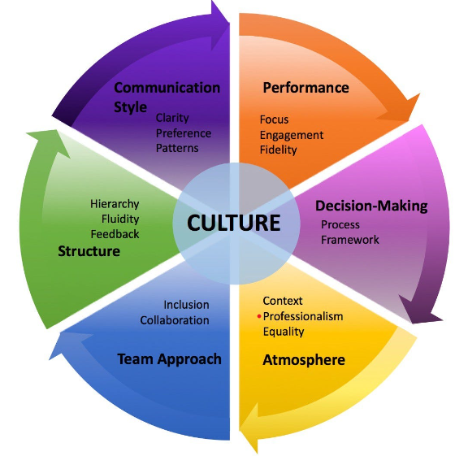
The Organisational Structure, Size, And Function Of Scottish Power.
The organisational structure is divided into three major sections, energy networks, generation, and retail.
Almost 5,700 employees work in the organisation to provide the best services to its consumers.
The main function of Scottish Power is to provide reliable as well as sustainable energy to households while maintaining its commitment towards reaching a low-carbon economy.
(ScottishPower, 2024)
Notes:
Scottish Power can be regarded as a publicly traded company as it is a subsidiary of the Spanish Iberdrola Group. The organisational structure is divided into three major sections, energy networks, generation, and retail. Almost 5,700 employees work in the organisation to provide the best services to its consumers.
The function of the generation section revolves primarily around wind power, and renewable energy, and produces over 3.5 GW renewable energy. The energy network helps in managing the distribution of electricity and its transmission across Southern and Central Scotland along with some parts of England and Wales. It helps in ensuring that all parts of the country can access a reliable supply of electricity. The retail section of the organisation helps distribute gas and electricity to households across the country.
The main function of Scottish Power is to provide reliable as well as sustainable energy to households while maintaining its commitment towards reaching a low-carbon economy.

Slide 5
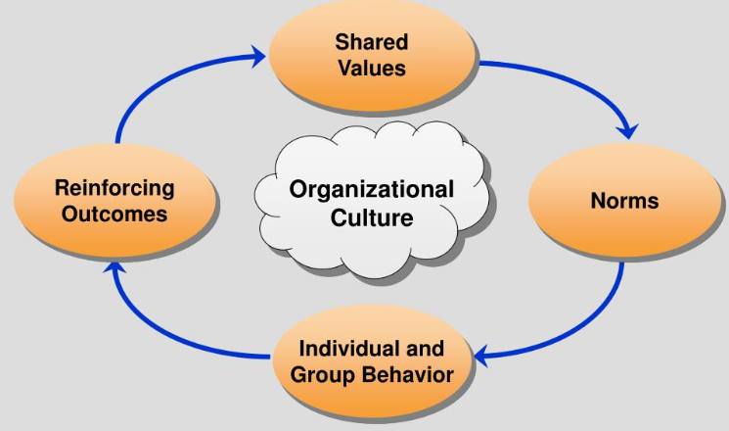
Organisational Culture of Scottish Power
The organisational culture of Scottish Power is developed on innovation and sustainability, and it is customer-oriented.
It is committed to providing renewable energy and helping the UK to transition to a low-carbon and green future.
Its commitment towards the environment and society can be seen through its investment in wind power.
The well-being of the employees as well as their training and development are the priority of Scottish Power.
(ScottishPower, 2024)
Notes:
The organisational culture of Scottish Power is developed on innovation and sustainability, and it is customer-oriented. It is committed to providing renewable energy as well as environmental stewardship helping the UK to transition to a low-carbon and green future. Its commitment towards the environment and society can be seen through its investment in wind power and other resources that help in generating renewable energy.
Innovation is deeply embedded in the values of Scottish Power, which drives continuous improvement and its adaptation to digital transformation. The organisation emphasises moving forward and fostering a positive work environment where the employees are responsible. These employees are empowered towards the development of more innovative solutions to meet the challenges.

Slide 6
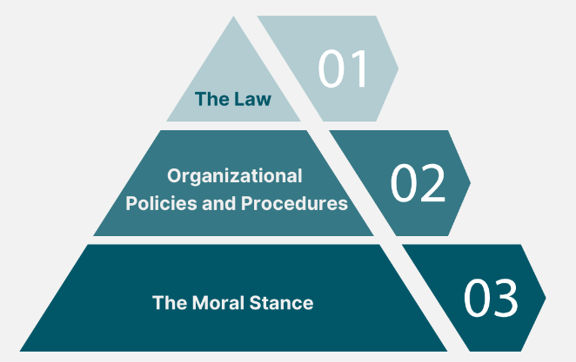
Ethics of Scottish Power
The ethics of Scottish Power is based on transparency, sustainability as well as fulfilment of social responsibilities.
It always upholds strict guidelines to ensure adherence to ethical practices and corporate governance.
Scottish Power prioritises fair pricing, maintaining customer welfare, and ensuring transparency in the operational process.
The organisation tries its best to take care of employee well-being and provide a safe, positive, and supportive work culture.
(ScottishPower, 2024)
Notes:
The ethics of Scottish Power is based on transparency, sustainability as well as fulfilment of social responsibilities. As it is committed to reducing the environmental impact and carbon emissions, it is already showing its consideration for sustainability practices. It always upholds strict guidelines to ensure adherence to ethical practices and corporate governance.
Scottish Power prioritises fair pricing, maintaining customer welfare, and ensuring transparency in the operational process. The organisation tries its best to take care of employee well-being and provide a safe, positive, and supportive work culture. By integrating ethical practices, the organisation wants to positively contribute to the growth of society while ensuring business growth.

Slide 7
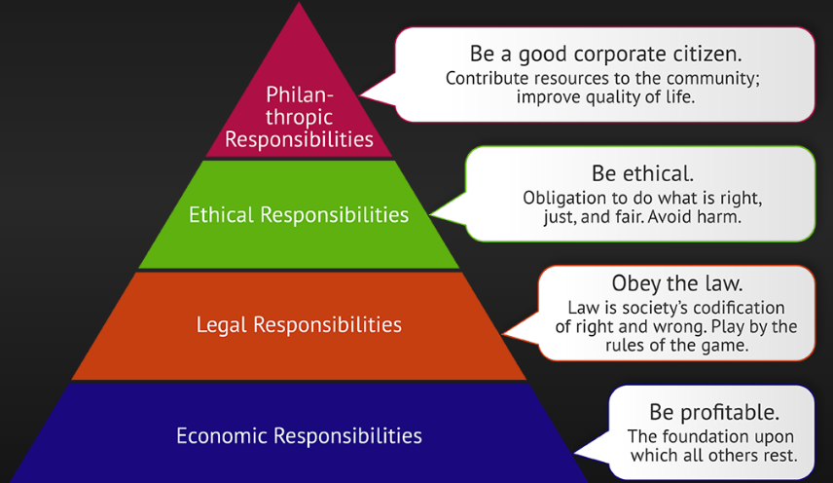
Corporate Social Responsibility of Scottish Power
It emphasises creating green and clean energy to reduce the impact on the environment.
The organisation also invests in community development such as children's education and social welfare.
It emphasises giving value to feedback to engage the stakeholders more in the operational process and improve their services.
Scottish Power is bent on delivering the best service to its consumers, hence, it always offers the best deals at affordable prices to keep the consumers satisfied.
(ScottishPower, 2024)
Notes:
Scottish Power understands the value of fulfilling its corporate social responsibilities to achieve sustainable growth and a competitive advantage in the market. It emphasises creating green and clean energy to reduce the impact on the environment. Apart from this, the organisation also invests in community development such as children's education and social welfare. It emphasises giving value to feedback to engage the stakeholders more in the operational process and improve their services. Most significantly, the organisation is bent on delivering the best service to its consumers, hence, it always offers the best deals at affordable prices to keep the consumers satisfied.

Slide 8




INTERNAL AND EXTERNAL FACTORS
Scottish Power's success is driven by a skilled workforce and advanced technology, enhancing efficiency and customer service.
Challenges include internal bureaucracy and outdated infrastructure, and external factors such as regulations. competition, and economic conditions. J. (2012).

Slide 9

PESTLE A. (2022).
Government regulations and policies can impact Scottish Power's operations, while economic factors and exchange rates can affect profits.
Public attitudes towards renewable energy and energy conservation can shape the company's image. Technological developments can provide a competitive edge or pose a threat.
Legal issues in the energy sector must be considered, along with sustainable development efforts for a greener future.

Slide 10
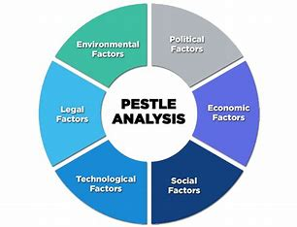
Scottish Power PESTLE investigation
The PESTLE breakdown aids in understanding opportunities and threats within a company and is used in multiple settings and by stakeholders.
Politically - The UK's exit from the EU affects factors such as trade agreements and tariffs. These can impact operations and costs.
Economically - Market conditions, energy prices and the investment climate influence factors in particular consumer spending, pricing strategies and growth opportunities.
Socially - Consumer attitudes increase demand for renewable energy whilst demographic changes affect consumption patterns and with corporate responsibility stakeholders expect engagement in these sustainable practices.
Technologically - Latest innovation namely smart grids and cybersecurity increase competitiveness, energy distribution and secure management.
Legally - There are legal health and safety laws, challenges and regulatory compliances that the company must adhere to.
Environmentally - Due to climate change there is a raise in needs to meet sustainability goals and manage resources adequately.
Scottishpower Annual Report and Account 2021}

Slide 11
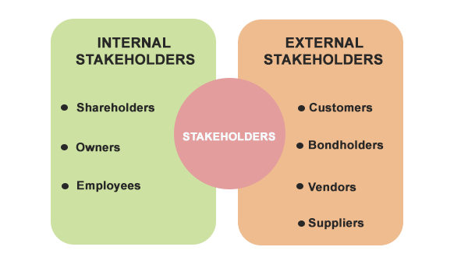
Analysis of Stakeholders
A stakeholder is a member of a party in which a business would fail to run without.
Stakeholders are often categorized into two main groups : internal and external
Internal
External
The management team specialize in planning strategically and achieving financial targets.
Shareholders are interested in returning investment and seeing profitability.
Employees would require safe conditions and fair wages as they are the source of operations.
The customers will require affordable energy and prefer renewable sources.
The surrounding media also influence public perception which can impact the company's reputation.
Environmental groups further will argue for better practices and monitor the company's environmental impact.
{Scottishpower Annual Report and Account 2021}

Slide 12
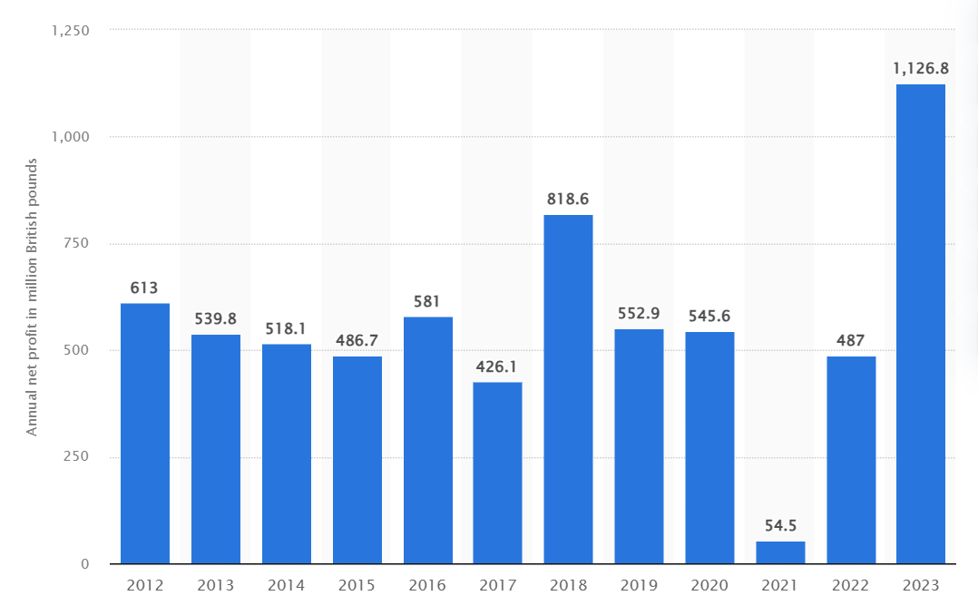
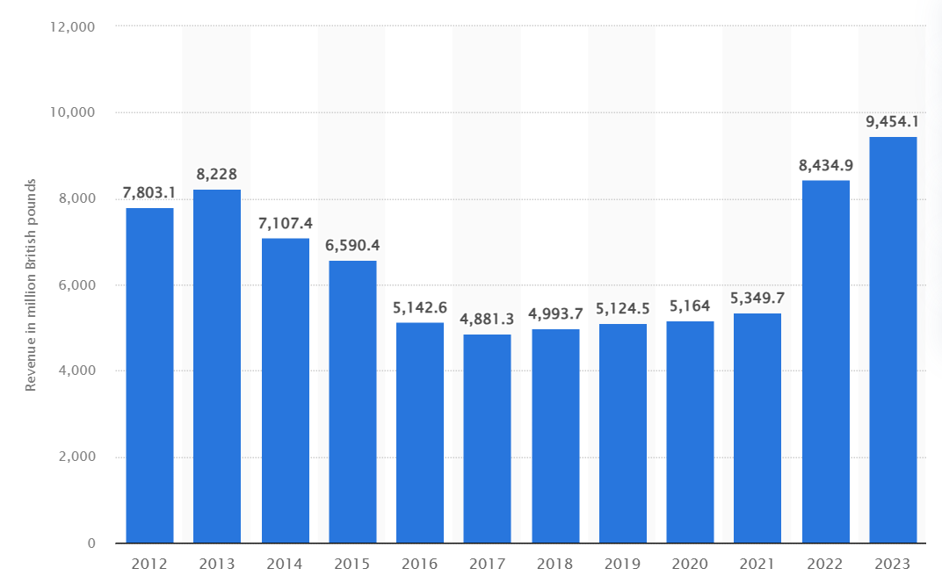
Finances of Scottish Power
Net Porofit
2012 revenue: £7,803.1 million – strong foundation with may have been focus on efficiency and renewables.
2013 revenue: £8,228 million - 54 % increase, could have been driven by renewable energy investments.
2019 revenue: £5,124.5 million 84.5%, decrease may have been due to market conditions and asset divestment.
2023 revenue: Revenue: £9.454 million 84.5% increased can have fueled by renewable expansion and strategic partnership.
"Electricity provider ScottishPower UK Plc generated over one billion British pounds in net profits in its 2023 financial year" figure in 2023 £1, 126.8 . (Statista Research Department 2024).
2018 to 2021 decreased in 93.3% . Could be due to increased operational cost, market down turns, or strategic investments.
2021 to 2023 increased d by 1, 966.6% reflects successful cost management, strategic business initiatives, and market recovery
(Statista, 2024)
Revenue

Slide 13
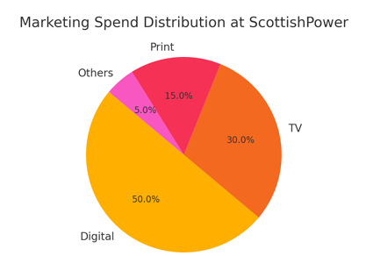
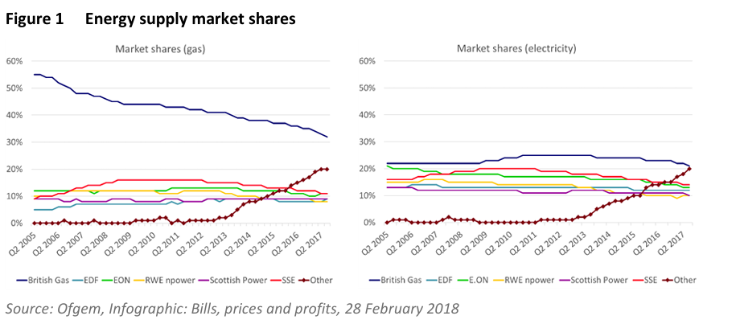
Marketing of Scottish Power
The pie chart illustrates the marketing spend distribution across different channels.
Digitial marketing accounts for 50% of the spend, TV for 30%, print for 15%, and others for 5 %.
This allocation reflects the increasing importance of digital channels in reaching and engaging customers. (Scottish Power 2023)
The domestic retail energy market has experienced a rapid shift in recent years, with the number of active domestic suppliers increasing from 12 to 16, and independent suppliers' combined market shares growing from less than 1% to over 20%.
(Creating a level playing field in the GB retail energy market CLIENT: ScottishPower, 2018)
Scottish Power (2023)

Slide 14

Human Resources
ScottishPower places a strong emphasis on human resources, with policies aimed at employee engagement, diversity, and development.
Employee engagement activities include regular training sessions, community engagement programs, and corporate events.
The company's commitment to diversity is evident in its inclusive hiring practices and support for underrepresented groups.
Development programs focus on continuous learning and career growth opportunities for employees.
(Work and Skills, 2023)
These policies help in maintaining a motivated and skilled workforce, which is crucial for the company's success.
ScottishPower was awarded for the high standards of its training activities & their relevance to organisation requirements at the fifth annual HR Network (Scotland) National Awards 2011, held on 17th November.
(ScottishPower, 2011)

Slide 15
REFERENCES
Bilcliff, A., Clark, C., Cole, M., Dubey, K., Ghibaldan, S., Hannon, M., ... & Wright, A. (2022). Report on the Business Plan of Scottish Power Energy Networks for the RIIO-ED 2 Price Control.
Creating a level playing field in the GB retail energy market CLIENT: ScottishPower. (2018). Available at: https://www.scottishpower.com/userfiles/file/Baringa_Report_Level_playing_field_in_the_GB_retail_energy_market.pdf [Accessed 23 Jul. 2024].
Everett, R., Boyle, G., Peake, S., & Ramage, J. (2012). Energy systems and sustainability: power for a sustainable future. Oxford University Press.
Salter, S., MacGregor, K., & Jones, C. (2006). Scottish Energy Review.
ScottishPower. (2011). ScottishPower Scoops award at HR Networks (Scotland) Award. [online] Available at: https://www.scottishpower.com/news/pages/scottishpower_scoops_award_at_hr_network_scotland_awards.aspx.
Scottish Power, (2024). About the organisation. Available at: https://www.scottishpower.com/pages/about_us.aspx Accessed on: 20th June
Scottish Power, (2024) The organisation’s corporate social responsibility initiatives. Available at: https://www.scottishpower.com/pages/corporate_social_responsibility.aspx Accessed on: 20th June
Scottish Power, (2024). The corporate social responsibility programs of Scottish Power. Available at: https://www.iberdrola.com/documents/20125/41890/general_sustainable_development_policy.pdf Accessed on: 20th June
ScottishPower. (n.d.). Annual Report and Accounts. [online] Available at: https://www.scottishpower.com/pages/annual_report_and_accounts.aspx.
Scottishpower.co.uk. (2021). Available at: https://www.scottishpower.co.uk/about-us.
Statista. (2023). Revenue of Scottishpower UK Plc and it’s subsidiaries from financial year 2012 - 2023. [online] Available at: https://www.statista.com/statistics/540495/scottishpower-revenue/.
statista (2024). Net profit of ScottishPower UK Plc and it’s subsidiaries from financial year 2012 - 2023. [online] Statista. Available at: https://www.statista.com/statistics/1119809/scottishpower-net-profit.
Work and Skills (2023a). Work and Skills. [online] ScottishPower. Available at: https://www.scottishpower.com/pages/work_and_skills.aspx [Accessed 23 Jul. 2024].

