Slide 1
BA (HONS) LEADERSHIP AND MANAGEMENT SKILLS FOR THE WORKPLACE
KNOWLEDGE AND INFORMATION MANAGEMENT SKILLS FOR THE WORKPLACE
WAQAR ALI
2027054
BMSW5106
DR ESSA BAH
PRESENTATION ON CRTICICAL EVALUATION ON AMAZON AND EMIRATES

Slide 2
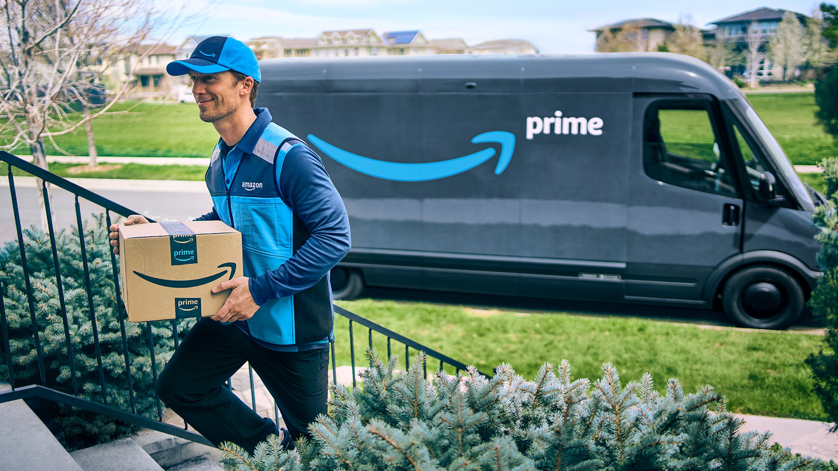
Amazon are a global giant brand and have sophisticated knowledge management system in place that allow efficient data storage, retrieval and sharing that data among employees worldwide.
Amazon uses machine learning and Artificial intelligence to analyse vast amounts of data for decision making.

Slide 3
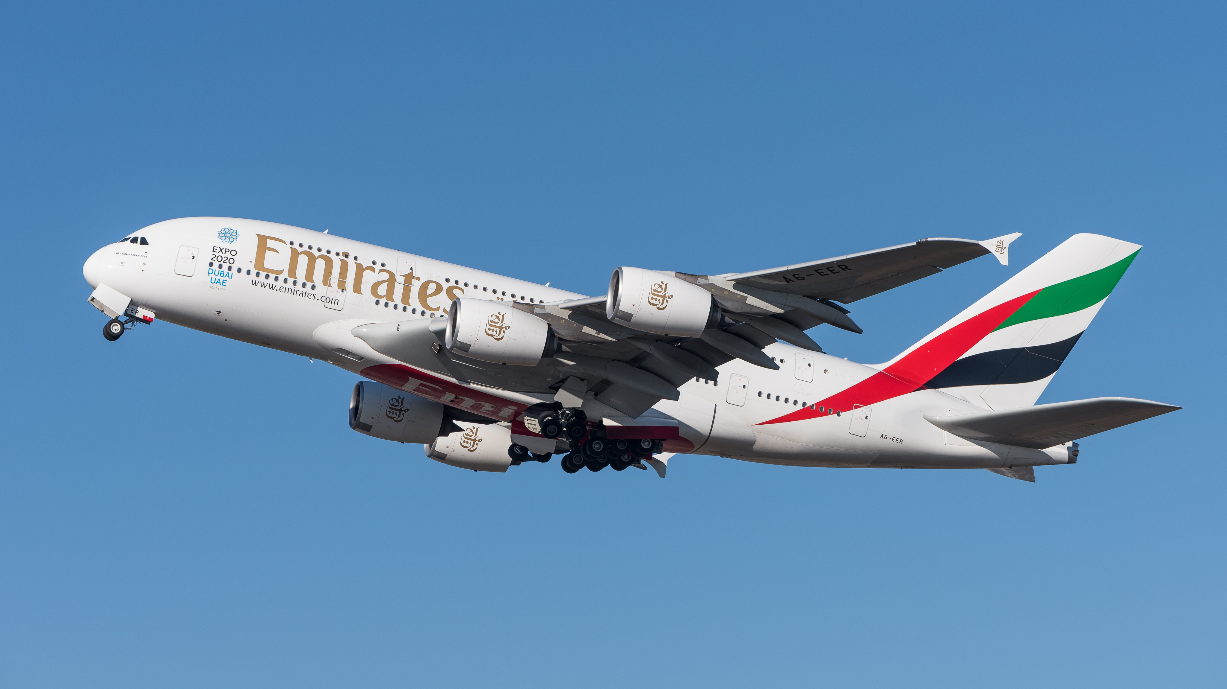
Comparably Emirates airlines is arguably the number 1 airline in the world, they place huge importance on knowledge management systems to enhance operational efficiency and provide excellent customer service. Emirate heavily relies on the data they store which allows them to disseminate information related to flight schedules, passenger preferences and safety protocols within the business.
Emirates knowledge management allows them greater operational efficiency in their industry.

Slide 4


Amazon and Emirates development of their knowledge Management Systems allows them to fully be ready for the future of their respective industries,
For Amazon and Emirates to develop robust futures it is essential for them both to focus on innovation and customer experience, as well as sustainability and digital transformation.

Slide 5
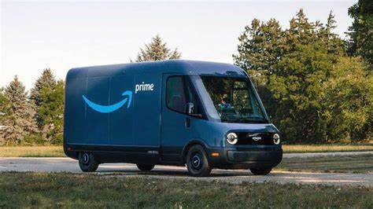

Continued Innovation: Amazon should continue heavy investment in research and development to innovate its products and services, such as expansion of its existing smart device portfolio, growing its delivery network, and improving its cloud computing service.
Customer Focus: by prioritizing the customer experience with personalized recommendations, improving delivery speed and providing fantastic customer service.
Sustainability: By increasing its focus on sustainability by reducing its carbon footprint, implementing eco-friendly packaging and investment in renewable energy.
Digital Transformation: Embracing digital trends keeps Amazon ahead of their industry, by using data analytics, artificial intelligence and machine learning to maximize performance.

Slide 6
Fleet Modernization: By Investing in modern airplanes and upgrading its current fleet this will allow better fuel efficiency, reduction in emissions, and enhance passenger comfort.
Customer Experience: continuing to prioritize the customer experience by offering tailor made services, cutting-edge in-flight media and seamless travel experiences.
Sustainability: focusing on sustainable initiatives with the implementation of fuel-efficient practices, reducing waste and exploring alternative fuel sources to minimize environmental impacts.
Digital transformation: embracing digital transformation by enhancing its online booking platform, data driven marketing and using new technologies to streamline operations and have better efficiency.

Slide 7
Implementation of these recommendations would mean that Amazon and Emirates could continue to position themselves for huge future growth and remain competitive in their separate industries and meet the ever-evolving needs and expectations of their customers.
I THANK YOU FOR LISTENING TODAY AND WELCOME ANY QUESTIONS YOU MAY HAVE FOR ME
WOODGROVE BANK
WAQAR ALI 2027054

