Slide 1
Module Title: Psychology in Health and Social care
Module Number: LCHS 4010(LON)
Assignment No: ASSIGNMENT 1
Student Name: Elsie Grubat
Student ID: 2508285
Lecturer’s Name: Peace Ukachukwu
I confirm that I have used AI tools to source images and or for proofreading this work ( such as Grammarly, dated 07/07/2026). I confirm that I have not presented any AI generated materials as my own work.
I confirm I have copies of my drafts, notes, and other resources I used which I may be asked to provide in evidence.

Slide 2

INTRODUCTION
As Trainee Early Years support worker
Isaac a 4 year old pre-operational stage (2-7 years)
He lives with his mother primary care giver
His mother experiencing post natal depression
Transitioning childcare arrangements

Slide 3
Isaac’s Case
Delay in communication language
Limited engagement in learning activities
Difficult alongside with other peers
Limited social interactions
Disrupted childcare experiences
Delay in language
Reserved playing independently
Difficult sleeping, “clingy”

Slide 4

Piaget’s Cognitive Development Theory
Concept:
Learning through play
Discovery
Exploration
Hands- on experiences
Piaget believed that children are active learners who construct their own knowledge by interacting with their environment. His theory focuses on how the child thinking develops as he grows. Through the processes of four stages. Sensorimotor stage(birth-2 years), Pre-operational stage(2-7 years), Concrete operational stage (7-11 years) and Formal operational stage (11 years and above).
Little acorns Nursery school(2023).
(Piaget, 1952).

Slide 5
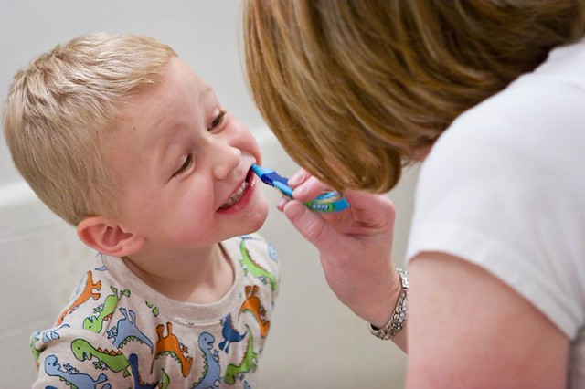
Applying Piaget’s Cognitive Development Theory
Isaac’s Development and well being
Disrupted childcare arrangements
Low confidence
Difficulty adapting new environment
Delayed in language development
Difficulty forming relationship with peers
Limited social interaction

Slide 6
Environmental Factors( Nurture)
Secure and responsive interactions with carers, parents and key persons.
Child develop confidence, emotional security positive and emotional outcomes.
Develop social through interactions with adults and peers
Play experiences, develop language and understanding the world and communication.
Transition to Isaac:
Involve adjusting from home to nursery.
These changes cause anxiety and affect emotional wellbeing.
To support Isaac by building positive relationship, trust to make him secure and confident.
Positive transition experience can encourage his growth and development.
(NHS, 2025) (DFE, 2023).
…

Slide 7
Strategies and interventions to help Isaac
Targeted strategies and interventions!
Builds confidence through low pressure and exploration
Action. Set up calm, open ended toys for e.g. soft pay
Use play as the main learning tool Use symbolic play
-supports language through sensory experience
-Attention and concentration. Seat Isaac away from distractions
Social and emotional development- build a positive relationship through carer, support peer interactions through group activities

Slide 8
Biological factors (nature)
Temperament
Speech delay
Early brain development
Environmental Factors (Nurture)
Transitioning
Quality of caregiving
Attachment
Every child is unique and develops at their own pace. By secure, building confidence and positive environment helps children achieve a positive Physical, social and emotional Development. (DFE, 2025).

Slide 9
Strengths of Piaget’s Cognitive Development Theory:
Active learner
Children develop their understanding through play, exploration.
Children develop their thinking and understanding through stages
Weaknesses:
Limited attention on social and cultural activities.
Underestimate children’s learning abilities
Limited in adaptability, children do not always progress through them in the same way.
(Piaget, 1952).

Slide 10
CONCLUSION
Piaget’s Cognitive Development Theory is a fundamental framework for explaining how children develop, structure and learning through play. The Theory demonstrates that cognitive growth occurs through four progressive stages. In the case of Isaac, understanding his developmental stage helps identify appropriate learning that support his cognitive needs by providing secure relationship, positive interactions, effective scaffolding and an enabling positive learning environment. However, considering both nature and nurture, practitioner can help Isaac to overcome challenges, support his positive learning.

Slide 11
Reference List
Image: https://assets.com/magazine-attachments/s3fs-public/stles/twitter_image_card_large/public/2026-06/free-children-early-jpg?itok=9y3uwaSd
Piaget, J (1952) The origins of Intelligence in Children. New York: International Universities Press.
NSPCC(2021) Attachment and Child Development. Available at: https://learning.nspcc.org.uk/child-health-development/attachment-early-years(Accessed: 10 July 2026).
Department for Education(DFE) (2023) Development Matters London Available at: https://www.gov.uk/government/publictions/development-matters--2 (Accessed: 10 July 2026).
NHS (2025) Early Learning and Development-Best start in Life. Available at: https://www.nhs.uk/best-start-in-life/early-learning-development (Accessed: 10 July 2026).

Slide 12
Department for Education(DFE) (2023) Development Matters London Available at: https://www.gov.uk/government/publictions/development-matters--2 (Accessed: 10 July 2026).
Department for Education (DFE) (2025) Early Years Foundation Stage (EYFS)Statutory Framework. Available at: https://www.gov.uk/government/publications/early-years-foundation-stage-framework --2 (Accessed: 11 July 2026).
NHS (2025) Early Learning and Development-Best start in Life. Available at: https://www.nhs.uk/best-start-in-life/early-learning-development (Accessed: 10 July 2026).
Kalkowski, K. (2025) “Neuropsychology of cognitive processes and executive functions in the light of Piaget’s theory,” Neuropsychiatria i neuropsychologia, 20(1–2), pp. 69–76. Available at: https://doi.org/10.5114/nan.2025.150004.
Play Archives | Little Acorns Nursery School image1 https://www.littlecornsnursery.school/category/activities-for-children/play/

