Slide 1
Toxic Childhoods: impact of trauma
Heidi Holland

Slide 2
WHAT AM I?
An NNEB who worked in Romania
An experienced youth worker
A manager of targeted youth services for young people struggling in all aspects of ‘mainstream’ life
Health, wellbeing & engagement coordinator in a specialist behavioural provision
Regional manager of residential and education services for children looked after
Community Regeneration Coordinator
I'm not an expert in trauma….just an experienced practitioner who has been lucky enough to support young people through a range of challenges, barriers and rollercoasters…without really considering any of them as ‘trauma’

Slide 3



Sue palmer(????)- examples of toxic childhood
Sue Palmer argues that a toxic mix of technological and cultural changes are having a negative impact on the development of a growing number of children, identifying six main ways in which childhood has become increasingly toxic:
The decline of outdoor play – linked to increased childhood obesity.
The commercialisation of childhood – linked to children being exploited by advertisers.
The ‘schoolification’ of early childhood – which reduces independence.
The decline of listening, language and communication skills – because of shortened attention spans.
Screen saturation – reduces face to face interaction.
Tests, targets and education – increases anxiety among children

Slide 4
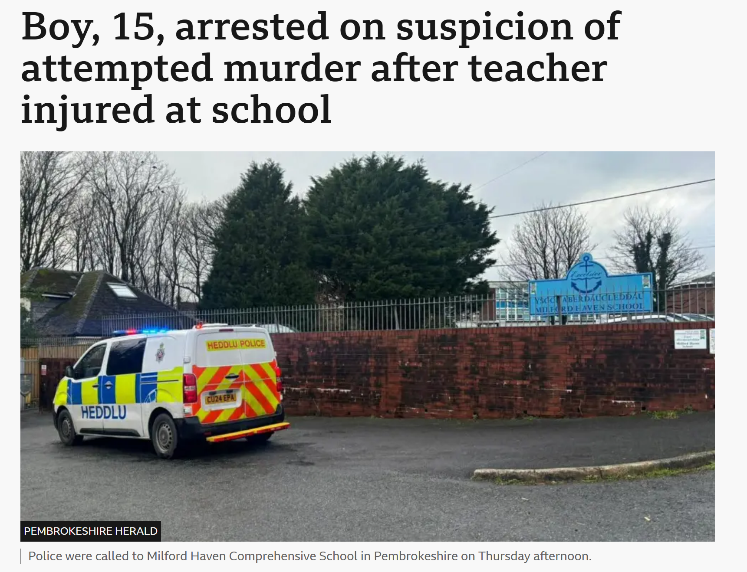
BREAKING NEWS….traumatic incident
Incident in Milford Haven School
Thursday 5th February
3.20pm
Supt Chris Neve said they were “responding to reports of the assault of a teacher by a pupil brandishing a weapon. The teacher's injury is not a stab injury. A lockdown was implemented but has now been lifted," he said.

Slide 5
WHAT IS TRAUMA?
Going through very stressful, frightening or distressing events can be called trauma
These events can happen at any age & cause long-lasting harm
These events can happen to anyone
Difficult to measure- one person’s trauma is another person’s normal- everyone has different thresholds in life…what is acceptable/ not acceptable
Going through further trauma can also cause you to start being affected by past experiences or make existing problems worse
Children who have experienced trauma & loss can often engage in behaviours that lead to misunderstandings

Slide 6
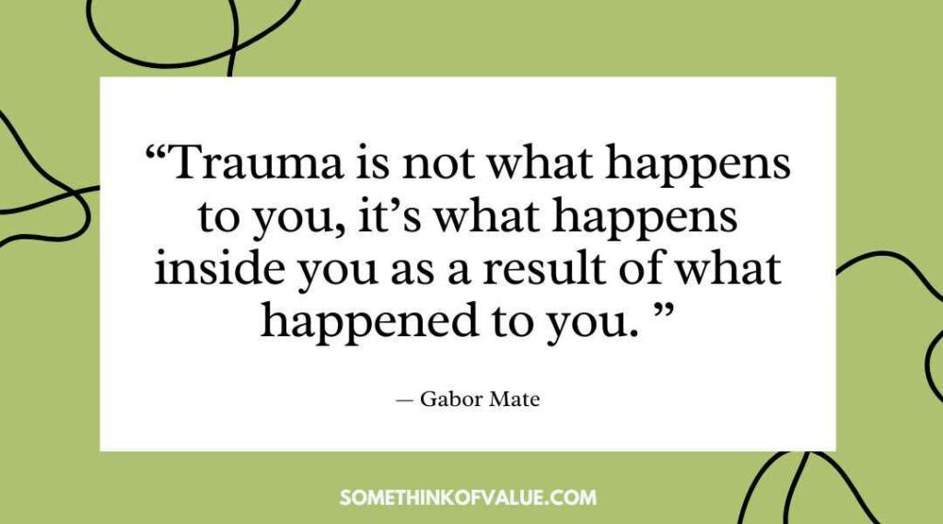

Slide 7

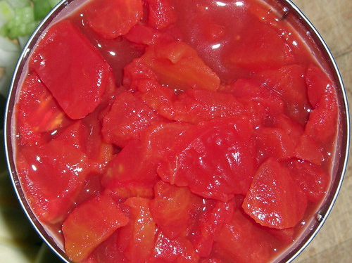
What does this picture say to you?

Slide 8
TO ME IT IS TRAUMA….Flashbacks….FEELINGS

Slide 9
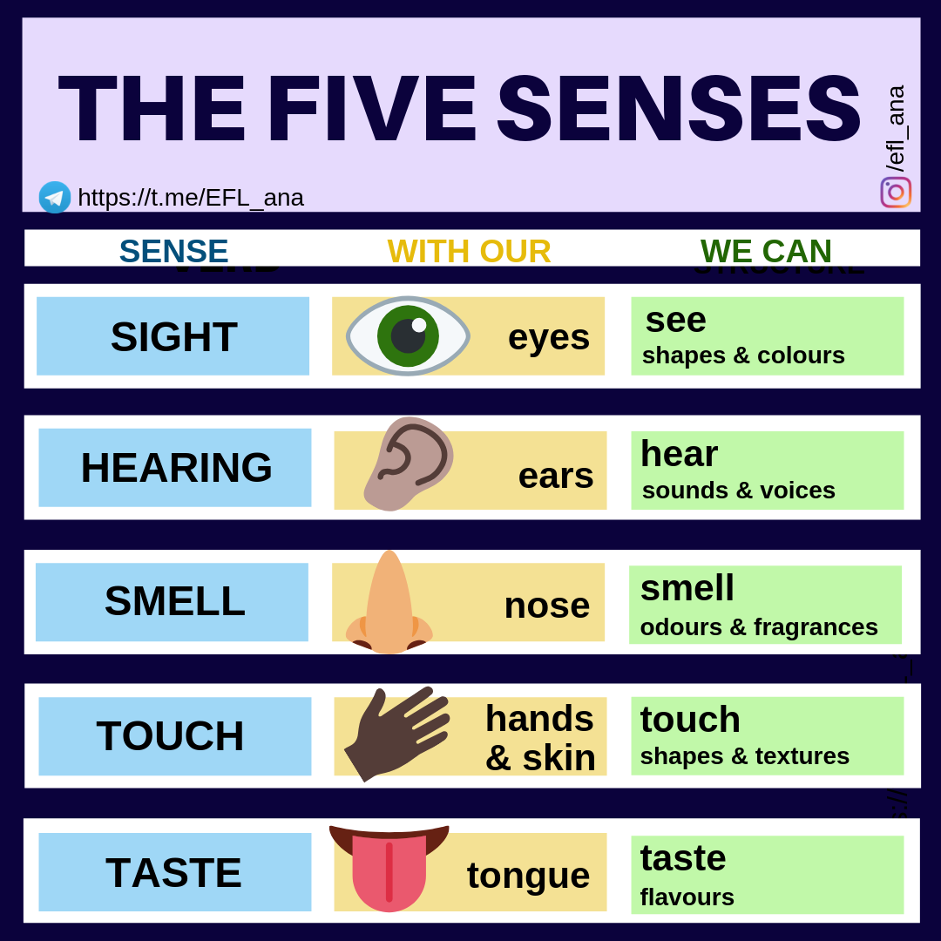

Your Senses
The 5 senses can be a trigger for memories- a certain sound, smell or taste can remind us of a certain place, occasion or emotion
Take a couple of minutes to find a piece of music that evokes a memory……happy times, sad times, funny things, certain people
Share it with the group if you feel you can or want to
This Photo by Unknown Author is licensed under CC BY-SA-NC

Slide 10
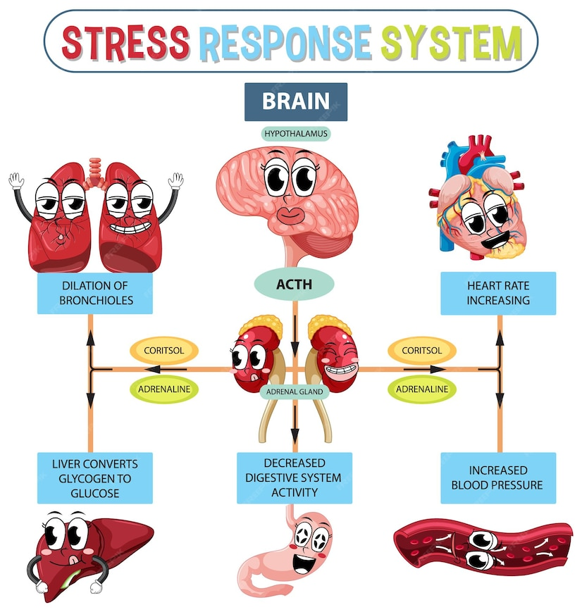
Reactions to extreme stress
Physical reactions/ responses to stress can be felt in all parts of the body
Brain hurts
Heart starts pounding
Breathing is affected
Tummy has butterflies
Blood pressure goes up
Face goes red
Sweaty palms

Slide 11
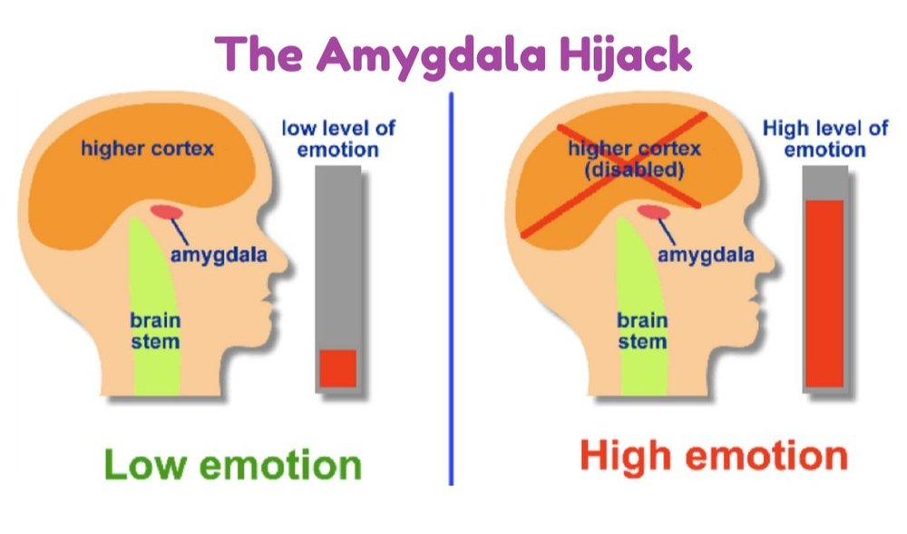
Stress response system
Thinking brain (Higher Cortex) assesses a situation using reasoning, problem-solving & decision-making
But the thinking brain is a bit weak and goes off-line if can’t find a solution to the threat so it takes a back seat
The amygdla in the emotional brain senses threat and sets off the alarm
Emotional brain takes over & instinct kicks in- coping mode activated
Fight, flight, freeze or fawn

Slide 12
STRESS RESPONSE SYSTEM
An experience becomes traumatic when it overwhelms our system for responding to stress
It could also be caused by micros traumas- seemingly minor everyday stressors or emotional wounds that may feel insignificant in isolation but can accumulate into a trauma tower or ‘the straw that breaks the camel’s back’
The emotional brain continues to sound the alarm & send messages to fight, flight, freeze or fawn…even after the threat has passed
If the brain feels it is under constant threat it keeps the emotional part on constant high alert…
People experiencing stress may have reactions that appear ‘over the top’
Thinking brain is under-developed if the emotional brain is on high alert….reduces capacity to learn, engage & flourish

Slide 13
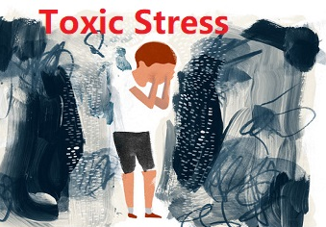
Toxic stress
Everyone experiences stress- learning to cope with it is part of life
Think about the last week….has anything caused you stress? How did you respond?
Toxic stress is extreme & long-lasting and without the buffer of secure relationships and attachment healthy stress responses will be under-developed, impacting on mental and physical health
If a young person has not developed healthy stress responses they will have less resilience to future stress- what would prevent them developing resilience?

Slide 14
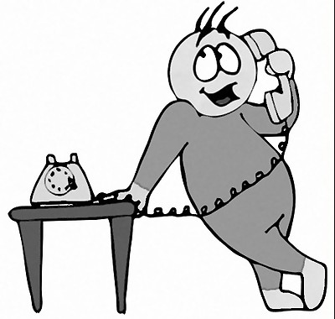
Let me introduce FL
Referral received by phone from a local authority- previous good relationship with the placement officer
“Need a placement quickly for a 13 year old lad who has got in with the wrong crowd, query County Lines”
He could be accommodated him; he was a good match and the placement was in a rural setting with an experienced team
Initial thoughts were this would be an ideal setting for him to be supported

Slide 15
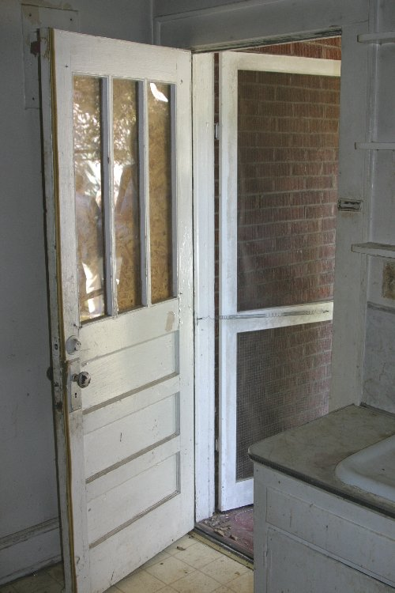
FL ARRIVES
FL driven to the placement by agency social worker on a glorious June day- agency social worker had very little knowledge of his background
FL met the manager in the kitchen around the large communal table which was the ethos of the home- everyone ate together around the table at mealtimes
He positioned himself next to the back door & kept his big parka coat on with hood up
Based on the stress response system how is the young person feeling? What will his response be?

Slide 16

Stress response
He was unfamiliar with the house & inadvertently sat with his back to the rest of the room- although he can clearly see an exit, he had no idea of any approaching danger
A new person approached from behind with cakes to welcome him
High alert mode activated- eyes to the door, eyes to the new person, eyes to the social worker, eyes to the door again
Coat on, ready to flee- exit route within reach
It quickly became apparent that the initial referral for a young person who had ‘got in with the wrong crowd’ was far more serious

Slide 17
HIS TRAUMA RESPONSE
Remember…an experience becomes traumatic when it overwhelms your system for responding to stress
He reverted to his default behaviour- flight -when he experienced stress
His brain had been hard-wired to flight mode when he reached levels of arousal & was unable to regulate
He had been used to being on high alert -he was frequently pressured to carry drugs, climbing out of his bedroom window at night, jumping on trains to places he had never heard of, witnessing friends being stabbed
His trigger was a stranger approaching him from behind which set his alarm off & put him into flight mode
The thinking brain does help shut off the alarm & helps us to calm down eventually but young people who have experienced a lot of trauma need to develop resilience to stress

Slide 18
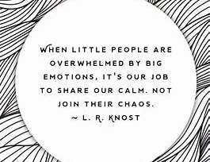
How can we work with trauma & stress?
Use low arousal approaches to young people who are showing increased arousal and stress levels
Be mindful that our responses may trigger further escalation or crisis/ incidents; young people who have experienced trauma often engage in behaviours that lead to misunderstandings
Remember that all behaviour is a form of communication

Slide 19
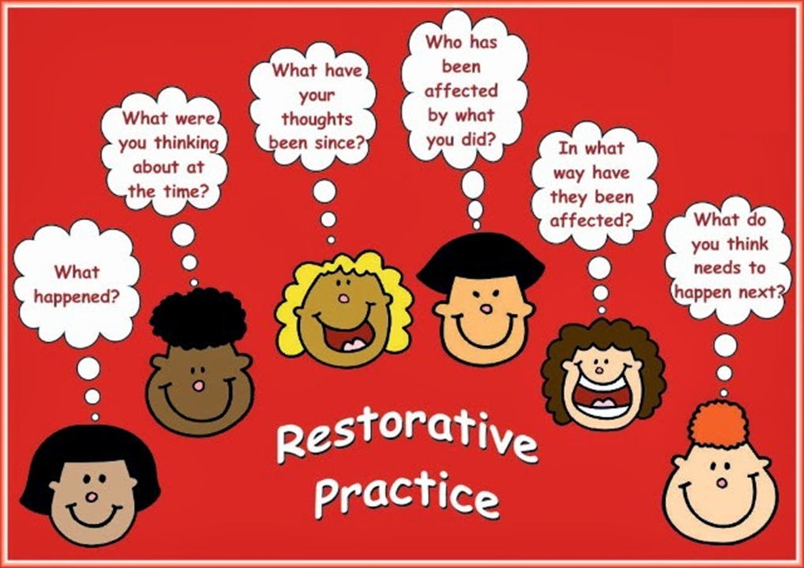
Restorative approaches
Restorative approaches (RA) embeds day-to-day skills involved in preventing and pre-empting conflicts and harm. It builds and maintains relationships and community, as well as reacting/ responding when things go wrong
Designed to prevent harm happening, through building connection, trust, empathy, and understanding of others.
Common misconception that restorative approaches are soft couldn’t be further from the truth; holding people to account for their actions is one of the toughest things we can do. This is what a restorative approach promotes: Accountability, responsibility, valuing others, and communicating effectively

Slide 20
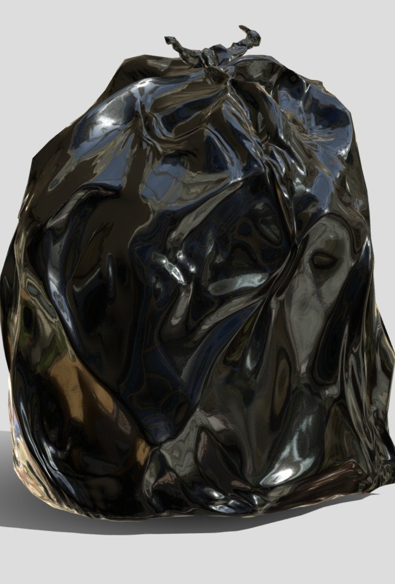
Let me introduce LB
Young person LB attended a specialist behavioural school & was in foster care following a traumatic childhood
From October- February he experienced 8 placement breakdowns but would still attend school everyday
One morning I took a phone call to as he had experienced another placement breakdown- he was en route to school but had all his belongings in black plastic bags with nowhere to go at the end of the school day
Meeting planned for 11am to agree a new placement
All staff informed of situation before he arrived
Their response was……catastrophic! Not low arousal, not mindful of triggers, not mindful of what his behaviour was telling us….HE WAS SCARED….AGAIN

Slide 21
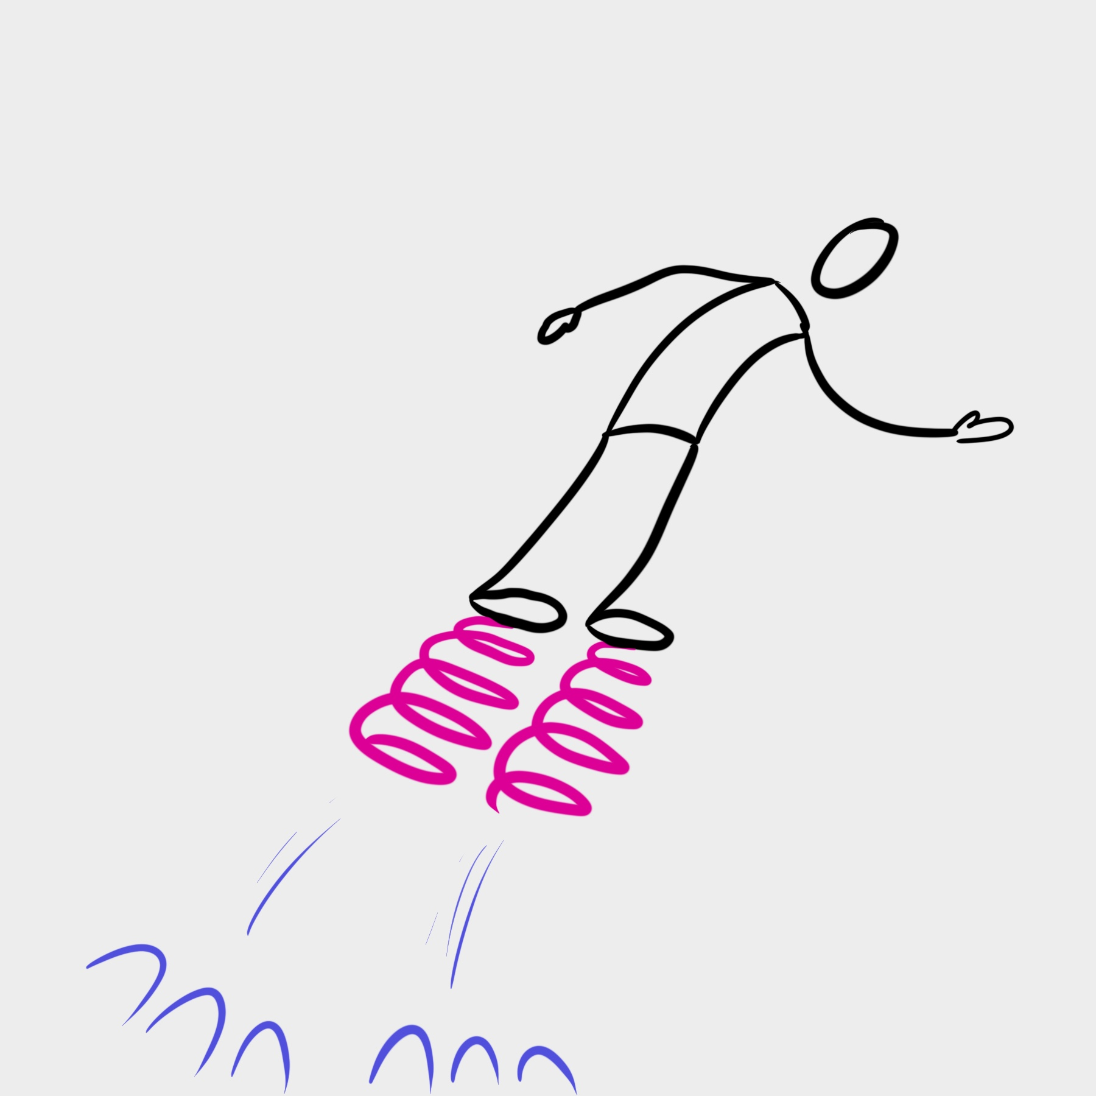
Watch out for……
Getting caught up in the emotion of an incident or a young person’s behaviour towards you
Allowing your intuitive response to override your rational response
Connecting their behaviour with your feelings- learn how to respond to insults, ‘threats’ & horrible comments that feel very personal but are not
Inconsistencies in your response- don’t expect young people to know that you have had a bad morning too!
Your resilience- if you're not in the best place to deal with the situation there is no shame in standing aside for someone better equipped to take over

Slide 22

Let me introduce BC
Ethos of the provision was to greet the young people on arrival every morning at the door
Smiley face, ‘good morning’ and sometimes an individual acknowledgment….about the football scores last night, acknowledging the haircut etc etc
No matter what had happened the day before everyone had a positive greeting at the start of the day

Slide 23

UNCONDITIONALITY
BC was an 8-year-old busy, feisty boy
Every morning he was greeted ‘Good morning!’
Regardless of the day previously or any update received from home he was greeted the same every morning
No matter how tough the day before had been for BC or any of the staff there was a consistent, simple greeting every day for him
But every morning BC responded with…..“ F#@K OFF!”

Slide 24
EMERGING PATTERN
The low arousal approach every morning by staff was consistent, demonstrated he was valued and liked without any mention of the previous day actions which may provoke shame and embarrassment
The pupil started to understand he would receive the same reaction every day regardless of which staff were present
Eventually the impact of this was evident when he walked in one morning and responded with, ‘F@#K OFF, HEIDI!’
Small steps, little victories build relationships

Slide 25

Reflection
We didn’t know what his morning had looked like before he got to school
We did know how chaotic home life was- dad was absent, mum was a heroin addict and no longer cared for him & his brother, gran was trying her hardest to care for them
Mum frequently broke into the house to steal belongings & money
But our approach was consistent- always the same- security for him when he arrived every day- whatever chaos was at home it was different in school
We had to pick our battles- if we had taken his greeting to us literally & personally what would the rest of the day look like for him? What would the rest of the day look like for us?

Slide 26
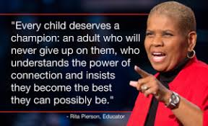
Relationships are key
When young people have experienced trauma it is usually associated with a key/ significant relationship….or lack of
Building relationships with young people is key….and meaningful work cannot occur unless that is in place
But young people may be resistant to relationships….don’t take it personally …it is their way of avoiding further painful experiences
Once you have a relationship you can invest in making them feel secure- consistency, ‘grounding’, safety, care, empathy

Slide 27
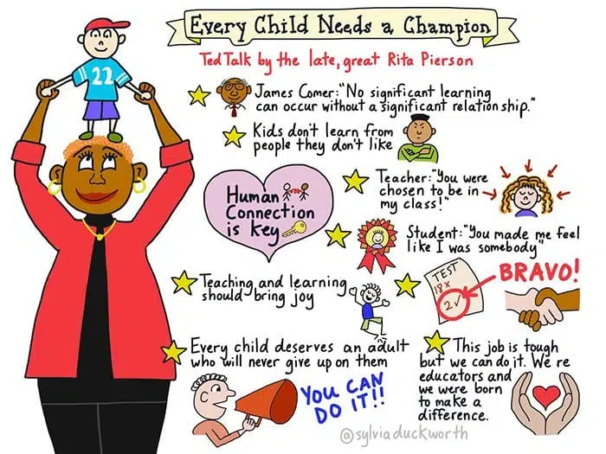
“We know why kids drop out. We know why kids don’t learn. It’s either poverty, low attendance, negative peer influences. We know why. But one of the things that we never discuss or we rarely discuss is the value and importance of human connection. Relationships.”
Rita Pierson
Rita Pierson TED Talk - Every Child Needs A Champion

Slide 28

Bad relationships
Sometimes in their quest to find the relationships and attachment they are missing young people may form attachments to the wrong people
Without resilience to resist advances they may be vulnerable…
….and an easy target for those who want to exploit them
Back to FL….adopted parents, both professionals, showered with material goods
He just wanted to feel wanted
And the County Lines gang moved in & gave him what he needed….respect, confidence, faith in his ability & a purpose

Slide 29

Toxic stress
Toxic stress feels like a heavy load, overflowing with more things being added every day
When you work with young people who feel like this it is your job to work with them and reload their lorry…move it, redistribute it, unload it, teach them how to stack it
Prioritise what needs to be in their load…and what can be discarded
Encourage them to place individual stresses in a row rather than a pile- much easier to manage

Slide 30

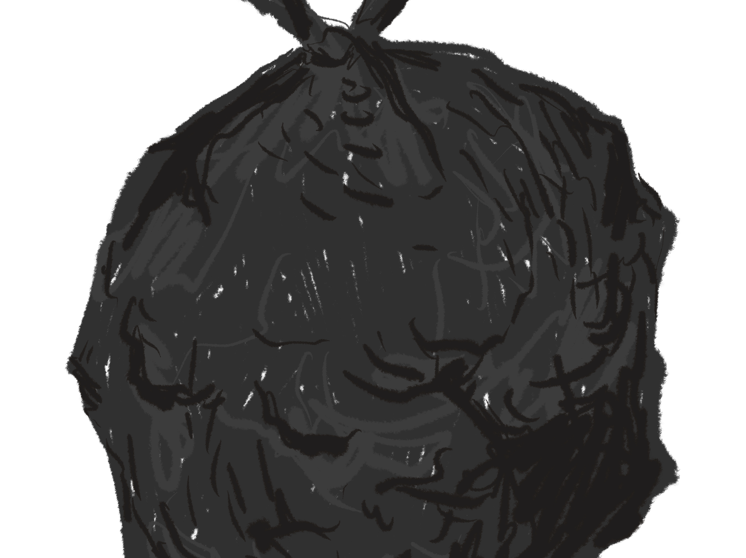
Back to LB….
So he took his black bag and moved to a residential home an hour away
It was decided that he should still attend school because of the relationships he had formed- everyone else was struggling to understand him or his barriers- he trusted no one
He was too dysregulated to engage in anything- emotional brain was on overdrive, thinking brain was on holiday
Allowing him to ‘check in’ at school every day was his safe space, his relationship with his key worker was the only constant in his life
So he arrived every morning…was greeted by his key worker…then absconded
Police were called every day….he was located by phone…and would agree to come back at a set time
What did we do with his overloaded lorry?

Slide 31

Unloading the lorry
We greeted him the same way every day
The cook made sure he had breakfast waiting on arrival- anxiety stopped him eating at the home
The cook also gave him packed lunch to take with him when he ‘absconded’
I agreed a time frame with him & check-ins throughout the day- he had to phone every hour
He knew that staff would at some point drive through town to have a visual check on him
We worked with the police and social worker to put this in place to alleviate any pressure on him & them
He learnt to trust, talk & try when things were difficult….by restacking his lorry load

Slide 32
summary
We cannot eradicate (TR)ACEs, stress or trauma but we can minimise the impact of them by ensuring we use:
Our response
Consistency
Communication
Empathy
Relationships
Advocacy
…..and that we don’t make assumptions!

Slide 33
BREAKING NEWS….
Incident in Milford Haven School
Thursday 5th February
3.20pm
Supt Chris Neve said they were responding to reports of the assault of a teacher by a pupil brandishing a weapon.
The teacher's injury is not a stab injury. A lockdown was implemented but has now been lifted," he said.
Who are the key people experiencing trauma in this incident?

Slide 34
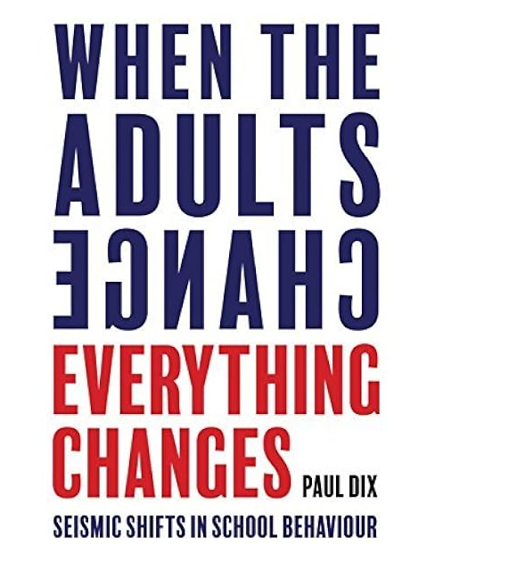

Paul dix: when the adults change everything changes
“Emotionally mature adults are flexible enough to change,
to be present in the toughest moments and to judge slowly.
They are patient, encouraging and kind.
Through the fog of anger, they keep everyone safe; in the calm light of day they build rapport and emotional currency.
Their expectations are always high and they will never drop their own standards because of the poor behaviour of others.
The adults who work with the most difficult behaviours are always in control of themselves before they attempt to take control of others”

Slide 35
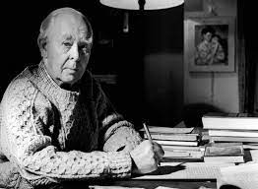
This isn’t new stuff……
‘Children are not slates from which the past can be rubbed by a duster or sponge, but human beings who carry their previous experiences with them & whose behaviour in the present is profoundly affected by what has gone before’
(Bowlby, 1951)

