Slide 1
Creative Movement- Autonomy Resource

Slide 2

What Is Creativity?
The process of having original ideas that have value
(Robinson & Aronica 2015)
Creativity is “the process of having original ideas that have value” (Robinson, 2014).
Notes:
Robinson states that intelligence is essentially creative, and that our lives are 'shaped by the ideas we use to give them meaning'

Slide 3
Why Creativity Is Important For Children
General Creativity
To problem solve and discover original ideas
(Sternberg 2006)
General
Cognitive intuition & analytical thinking. (Sternberg 2006)
Specific (KS2: Upper Primary)
Social & affective development (Kochkorbaevna 2022)
Notes:
General
Anna Craft 2001
"Small C" = day-day real world creativity to problem solve/resourcefulness
"Big C" = creative planning & work
Specific
Siddall 2010 p.10
"Develop skills in interaction, team-work, problem solving" as well as "verbal and non-verbal communication of ideas and emotions"

Slide 4
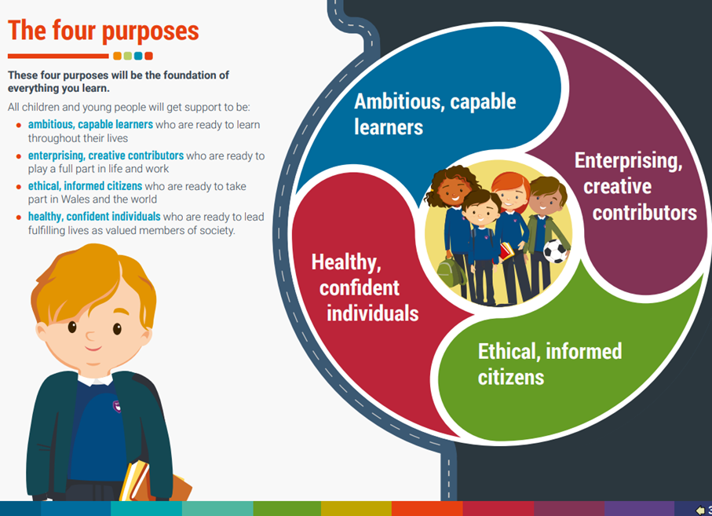
New Curriculum
Enterprising Creative Contributors:
New knowledge to create new ideas/products.
Creative problem solving
Taking responsibility
Expression of ideas and emotions
Develop with or through others
(Yr Adran Plant, Addysg, Dysgu Gydol Oes a Sgiliau Department for Children, Education, Lifelong Learning and Skills Key Stages 2-4 Physical education in the National Curriculum for Wales, n.d.)
Notes:
Robinson
Craft (Little "c")
3&4) Siddall
5) Existentialism (Slusher 1963)

Slide 5
Creative Movement Analysis: Labans Pillars
Movement Type | Product
Action | What can my body do?
Spatial | Where can my body move?
Dynamics | How can my body move?
Relationships | With what or whom can I move?
Notes:
Laban (1948 & 1966)
General principles of movement.
Bradely 2008 p.12
"meaningful movement"
Curriculum
Movement knowledge = Potential for ideas (Robinson link between intelligence and creative ideas)

Slide 6
Creative Environment
Supportive Environment
freedom of choice
Opportunities for open discussion of possibilities
In relation to skills & the curriculum...
Existentialism
Development of skills
In relation to environment & Labans pillars...
Reflective
Opportunity
Enabling
Varity of opportunities
Encouraging
Inspiring
Skills Of Creativity
Imagination
Safe
Reflective
Supporting
Critical thinking
Reflecting
Trial & Error
Problem Solving
Adaption
Opportunity to work alone or with peers
(Compton, 2007; Lin, 2010; Newton and Newton, 2014)
(Maker et. Al 2008)

Slide 7
Why The Need For Resources?
Why Do Kids Need Stimulation?
The starting point or incentive for creative movement (Stein 2014)
One size does not fit all children (Baer 2016)
Why Do Kids Need Help With Creativity?
Each child has unique knowledge and skills (Smith & Smith 2010)
Difference between IQ and CQ (Bronson & Merryman 2010)
Notes:
IQ = intelligence, Flynn effect—each generation, scores go up 10 points. (Enriched environments making smarter kids).
CQ = creativty, reverse trend to Flynn effect- generations have become less creative.

Slide 8
The Resource
WHO
Key Stage 2
WHAT
Interactive movement story board planner
WHY
Use autonomy to heighten engagement thereby stimulate greater motivation & creativity

Slide 9

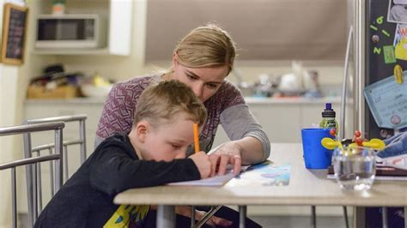
The Resource: Who?
Key Stage 2 (Ages 7-11)
The Crisis:
Home Schooling Inequalities (Bayrakdar & Guveli 2020)
Covid Sedentary (Yelizarova et. al 2022; Piestrzyński 2021)
Learning Plateau Domains PE (Banner & Mistry 2020; Neville et. al 2020)
Notes:
Home School Inequalities:
-Parents lifestyle/work commitments take away education time
-Parents lack of or imbalanced/biased education preventing physical education development
COVID Sedentary:
-Daily exercise below Gov guidelines
-Lack of variation (no to little garden or equipment to develop basic motor competence like being able to climb up soemthing or crawl across soft surfaces)
Learning Plateau:
-4 DOMAINS: Physical, cognitive, affective and social
-How many of those domain could be developed during pandemic isolation?

Slide 10
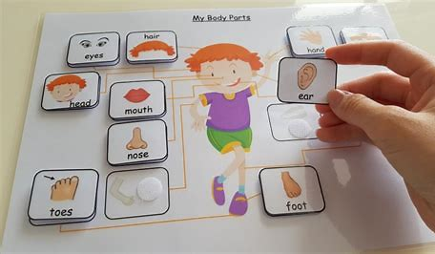
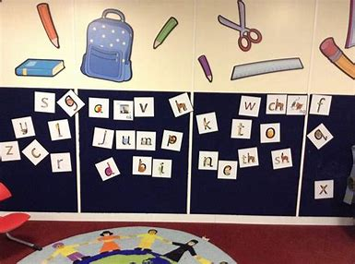
The Resource: What?
Interactive Story Board
Making their own film/play using creative movement!
Velcro options provide groups with autonomy over themes and actions-
Notes:
Classroom example- tried and tested method.
Hand round practical resource during this time...

Slide 11
The Resource: What?
Interactive Story Board: The Planner Example
(Same strucutre for all 4 of Labans Pillars on the resource)
Weight
Direction
(Add Option)
(Add Option)
Effort
Pathways
Flow
(Add Option)
(Add Option)
Notes:
(Add Option) = Velcro option cards with possible solutions e.g. for Flow (Add Option) solutions- bound/or/free
BUT...
The bound/free movement the create/come up with. Providing direction for the pupils to create creative actions & put into sequence for their story.
Promoting creatvity through creating movement types
Promoting creativty in how moves sequenced e.g. how theytransition

Slide 12

The Resource: What?
Interactive Story Board: The Control
Pause
Play
Skip
Eject
Rewind
Fast-forward
(Griggs and Petrie 2017)
Notes:
Future Improvements: Framing e.g. telly, outdoor theatre etc... how change movement/performance?
Pause = stop/freeze
Play = continue moving
Skip = move to next exercise
Eject = eject disc (jump up and fall at end)
Rewind = repeat previous action doing it backwards
Fast-forward = move through actions quicker
Affect on motor skills... (ref)

Slide 13
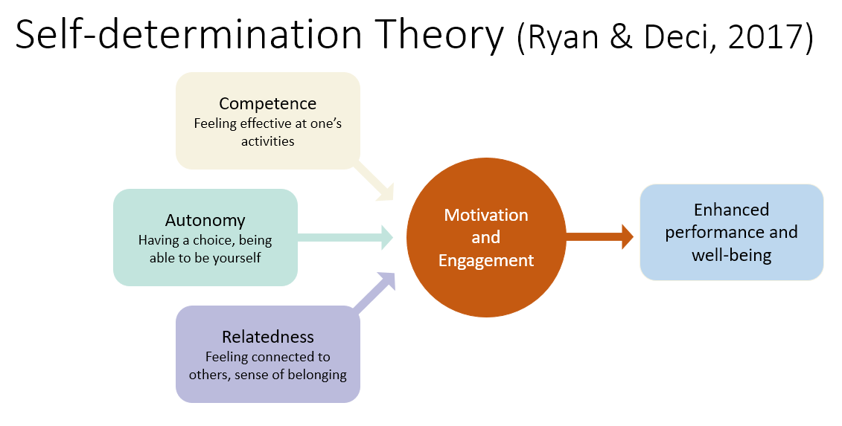
The Resource: Why?
Autonomy:
-Perception of choice & control (Deci & Ryan 1985)
-Not totally independent and children may require external direction (Deci & Ryan 2000)
Motivation:
-Experiences from/of autonomy develops self-determined motivation (Reeve 2006)
-Students are motivated by extent of autonomous learning (Ntoumanis, 2001, 2005; Vallerand & Losier, 1999)
Notes:
Physical Education Philosophy:
PE is not enjoyed by all, motivation to learn in class tends to wane as children reach adolescence (Mowling, et. al, 2004). Students who lack motivation are more likely to feel unsatisfied with their learning experiences becoming disengaged in class (Ntoumanis, et. al 2004). Autonomy support is a powerful mechanism in student motivation because it facilitates self-determination- Motivation to life a life course (Whitehead 1993)
SDT:
Self-determination is a viewpoint of motivation among individuals who possess a desire to improve themselves by engaging in behaviors that they deem important or meaningful for personal development (Deci & Ryan, 2000)
Environment:
Autonomy-supportive environment focuses on instruction that supports students’ feelings of volition, control, and choice.
Autonomy:
Choice, initiative, problem solving, and other experiences that support students’ autonomy and can foster self-determined motivation (Reeve, 2006).
Motivation:
Self-determined students are motivated to learn because they possess an internalized desire to do so.

Slide 14

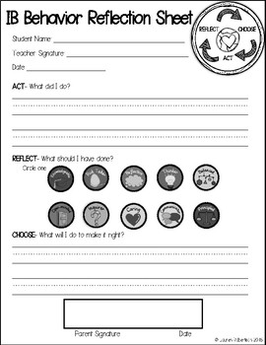


The Resource: Future Improvements
Stimulus Packs
New creative ways to stimulate/incentivise the movement story-
Auditory:
Music & Sound Affects
Visual:
Film & "Outside the window"
Tactile:
Objects
(bring own or "find" in environment)
Reflective Practices
To further stimulate new ideas, learn through others and improve on their personal performance (York-Barr et. al 2005)-
Notes:
Stimulus:
(Refer to)- Not totally independent and children may require external direction (Deci & Ryan 2000)
Reflective Practices:
Relate to curriculum

Slide 15
Summary
Creativity
An important life skill that is developed (Robinson 2014)
Curriculum
Required to teach and enable creativity. Hence teacher must create resources that stimulate and promote creativty.
Resource
Promotes autonomy to increase engagement & motivation (Deci & Ryan 1985). Greater motivation is a stimulant of creativty (Feldhusen & Goh 1985)

Slide 16
References
Baer, J. (2016). Creativity doesn't develop in a vacuum. New directions for child and adolescent development, 2016(151), 9-20.
Bayrakdar, S., & Guveli, A. (2020). Inequalities in home learning and schools' provision of distance teaching during school closure of COVID-19 lockdown in the UK (No. 2020-09). ISER Working Paper Series.
Bradley, K. K. (2008). Rudolf Laban. Routledge.
Bronson, P., & Merryman, A. (2010). The creativity crisis.
Benner, A. D., & Mistry, R. S. (2020). Child development during the COVID‐19 pandemic through a life course theory lens. Child Development Perspectives, 14(4), 236-243.
Compton, A. (2007). What does creativity mean in English education?. Education 3–13, 35(2), 109-116.
Craft, A. (2001). Little c creativity. Creativity in education, 45.
Deci, E. L., & Ryan, R. M. (1985). Intrinsic motivation and self-determination in human behavior. New York: Plenum.
Deci, E. L., & Ryan, R. M. (2000). The “what” and “why” of goal pursuits: Human needs and the self-determination of behavior. Psychological Inquiry, 11, 227-268.
Deci, E. L., & Ryan, R. M. (2004). Handbook of self-determination research. Rochester, NY: The University of Rochester Press

Slide 17
References
Feldhusen, J. F., & Goh, B. E. (1995). Assessing and accessing creativity: An integrative review of theory, research, and development. Creativity Research Journal, 8(3), 231-247.
Griggs, G. and Petrie, K. (2017). Routledge Handbook of Primary Physical Education. Routledge.
hwb.gov.wales. (n.d.). Physical education in the national curriculum for Wales - Hwb. [online] Available at: https://hwb.gov.wales/curriculum-2008/key-stages-2-to-4/physical-education-in-the-national-curriculum-for-wales/ [Accessed 18 Jan. 2023].
Kochkorbaevna, K. B. (2022). The Role and Importance of People's Oral Creativity in the Development of Primary School Student Speech. International Journal of Innovative Analyses and Emerging Technology, 2(4), 57-61.
Lavin, J. (Ed.). (2008). Creative approaches to physical education: Helping children to achieve their true potential. Routledge.
Lin, Y. S. (2010). Drama and possibility thinking–Taiwanese pupils’ perspectives regarding creative pedagogy in drama. Thinking Skills and Creativity, 5(3), 108-119.
Maker, C. J., Jo, S., & Muammar, O. M. (2008). Development of creativity: The influence of varying levels of implementation of the DISCOVER curriculum model, a non-traditional pedagogical approach. Learning and Individual Differences, 18(4), 402-417.
Mowling, C. M., Brock, S. J., Eiler, K., & Rudisill, M. (2004). Student motivation in physical education: Breaking down barriers. Journal of Physical Education, Recreation & Dance, 75(6), 40-45, 51.

Slide 18
References
Neville, R. D., Lakes, K. D., Hopkins, W. G., Tarantino, G., Draper, C. E., Beck, R., & Madigan, S. (2022). Global changes in child and adolescent physical activity during the COVID-19 pandemic: a systematic review and meta-analysis. JAMA pediatrics.
Newton, L. D., & Newton, D. P. (2014). Creativity in 21st-century education. Prospects, 44(4), 575-589.
Ntoumanis, N. (2001). A self-determination approach to the understanding of motivation in physical education. British Journal of Education Psychology, 71, 225-242.
Ntoumanis, N. (2005). A prospective study of participation in optional school physical education using a self-determination theory framework. Journal of Educational Psychology, 97, 444-453.
toumanis, N., Pensgaard, A., Martin, C., & Pipe, K. (2004). An idiographic analysis of amotivation in compulsory school physical education. Journal of Sport and Exercise Psychology, 26, 197-214.
Perlman, D. and Webster, C.A. (2011). Supporting Student Autonomy in Physical Education. Journal of Physical Education, Recreation & Dance, 82(5), pp.46–49. doi:10.1080/07303084.2011.10598628.
Piestrzyński, W., Stasiuk, I., Sarzała, D., Iedynak, G., Marzec, A., Hudyma, N., ... & Mykhalska, Y. (2021). Physical activity and sense of security in schoolchildren during the covid-19 lockdown period. Journal of Physical Education and Sport, 21, 3075-3084.

Slide 19
References
Pickard, A., & Maude, P. (2014). Teaching physical education creatively. Routledge.
Reeve, J. (2006). Teachers as facilitators: What autonomy-supportive teachers do and why their students benefit. The Elementary School Journal, 106(3), 225-236
Robinson, K., & Aronica, L. (2015). Creative schools: Revolutionizing education from the ground up. Penguin UK.
Rudolf von Laban (1966). Choreutics. London : Macdonald & Evans.
Rudolf von Laban (1948). Modern Educational Dance.
Siddall, J. (2010). Dance in and beyond schools: An essential guide to dance teaching and learning. Youth Dance England.
Slusher, H. S. (1963). Existentialism and Physical Education. Physical Educator, 20(4), 153.
Smith, J. K., & Smith, L. F. (2010). Educational creativity. The Cambridge handbook of creativity, 250-264.
Stein, M. I. (2014). Stimulating creativity: Individual procedures. Academic Press.
Sternberg, R. J. (2006). The nature of creativity. Creativity research journal, 18(1), 87.
Vallerand, R. J., & Losier, G. F. (1999). An integrative analysis of intrinsic and extrinsic motivation in sport. Journal of Applied Sport Psychology, 11, 142-169.

Slide 20
References
Whitehead, M. (1993,). Physical literacy. In International Association of Physical Education and Sport for Girls and Women Congress. Melbourne.
Yelizarova, O., Stankevych, T., Parats, A., Polka, N., Lynchak, O., Diuba, N., & Hozak, S. (2022). The effect of two COVID-19 lockdowns on physical activity of school-age children. Sports Medicine and Health Science, 4(2), 119-126.
Yr Adran Plant, Addysg, Dysgu Gydol Oes a Sgiliau Department for Children, Education, Lifelong Learning and Skills Key Stages 2-4 Physical education in the National Curriculum for Wales. (n.d.). [online] Available at: https://hwb.gov.wales/api/storage/7b01cf26-9974-4c3d-bb1f-ee79e111b448/physical-education-inthe-national-curriculum.pdf.

