Slide 1
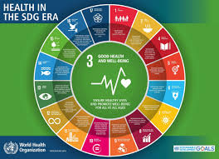
Health, Wellbeing and Sustainable Development (BMHP6030)
Presented by
Student name: Adeola Victoria Kolawole
Student ID: 2246896

Slide 2
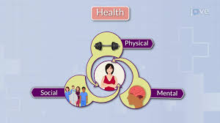
Key Concepts of Health
Health is physical, mental, and social wellbeing beyond the absence of sickness (World Health Organization, 1948).
Physical health means suitable functioning of the body and absence of disease.
Mental health means cognitive and psychological well-being, plus resilience and management.
Social health means capacity to create constructive interactions and familiarise to social circumstances.
The significance of the above is that, it is foundational for total welfare and quality of life (World Health Organization, 1948).

Slide 3
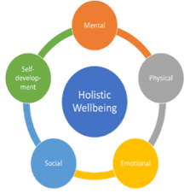
Key Concepts of Wellbeing
Wellbeing is a complete strategy about physical, mental, emotional, and social health (Dodge et al., 2012).
Wellbeing incorporates various dimensions of life pleasure, gladness, and quality of life.
Wellbeing inspires resilience, management of stress, and self-care.
Wellbeing backings sustainable lifestyles and long-standing health results (Dodge et al., 2012).

Slide 4
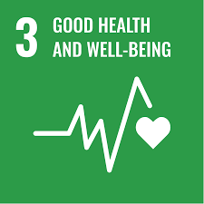
Key Concepts of Sustainable Development
Sustainable development means meeting current demands deprived of compromising the capability of future generations to encounter their personal demands (United Nations, 2015).
Sustainable development balances economic, social, and ecological urgencies.
Sustainable development is connected to healthcare over SDG 3: Good Health and Wellbeing.
Sustainable development encourages long-standing people health and resource stewardship (United Nations, 2015).

Slide 5
Relevance of Health, Wellbeing and Sustainable Development in Modern Healthcare
Relevance states to the implication of health, wellbeing, and sustainable development in modern healthcare policies.
Health, wellbeing, and sustainable development in modern healthcare are gradually documented in global health approaches and SDGs.
They drive preventative care, mental health advantages, and community-based interventions.
For example: WHO’s Sustainable Development Goals lead unified policy scheduling (WHO, 2023).

Slide 6
Integration of Health and Wellbeing Approaches
Integration includes merging holistic health and wellbeing strategies to provide inclusive care.
Through Integration of Health and Wellbeing Approaches, physical, mental, and social health are addressed jointly.
For example: the WHO’s Health in All Policies framework; and Integrated Care Systems in the UK.
The benefit is that they decreased clinic admissions, enhanced patient pleasure, and healthier preventive care results (Bach et al., 2019).

Slide 7
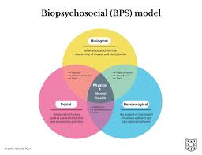
Theoretical Perspectives: Biopsychosocial Models
Biopsychosocial models reflect biological, psychological, and social aspects in health and wellbeing (Engel, 1977).
It promotes holistic analysis and planning for treatment.
For example: Mental health care merging treatment, medicine, and social support.
It supports patient-centred care and long-standing health results.

Slide 8
Policy and Governance
Policies are formal approaches and guidelines that guide healthcare practices, and governance states to by what method these policies are applied.
The NHS Long Term Plan emphasises prevention, early intervention, and integrated care to enhance health and wellbeing while diminishing inequities. It allocates resources to community services, mental health assistance, and digital innovation to establish a more sustainable healthcare system.
The Soft Drinks Industry Levy incentivises manufacturers to decrease sugar levels in their goods, aiding in the combat against obesity and associated ailments like type 2 diabetes.
These projects collectively enhance sustainable development by advancing population health, decreasing long-term healthcare expenditures, and fostering healthier lives for present and future generations (Marmot, 2015).

Slide 9
Service Delivery
Service delivery is the delivery of healthcare facilities to people and communities.
Examples: Incorporation of wellness plans, telehealth, and community health initiatives.
Case illustrations: Clinics applying holistic care models with multidisciplinary teams.
Advantages: Enhanced patient results, pleasure, and cost-effectiveness

Slide 10
Public Health Initiatives
Public health initiatives are planned energies to enhance health of people over prevention and health promotion.
This includes: Promotion of healthy lifestyles, immunisation campaigns, and helpful surroundings.
The effects: Decreases disease problem, enhances societal wellbeing, and improves equality.
Examples of National campaigns such as Change4Life, NHS Health Check, and Better Health promote healthy eating, physical activity, and early disease detection.
Examples of Local: Local councils run initiatives targeting smoking cessation, mental wellbeing, and obesity reduction, often tailored to community needs, reducing health inequalities and improving population health outcomes across diverse regions in the United Kingdom.

Slide 11
Equity and Access
Equity in healthcare certifies reasonable access to facilities regardless of socio-economic or demographic issues.
Through equity and access: inequalities happen in access, quality, and results.
Initiatives: Common healthcare, directed interventions for vulnerable people (Braveman et al., 2011).
Goal: Make sure all people achieve best health and wellbeing.

Slide 12
Conclusion
Health, wellbeing, and sustainable development are co-dependent.
Incorporation of care enhances results, equity, and social wellbeing.
Policies, governance, and public health initiatives are vital for holistic healthcare provision.

Slide 13
References
Bach, T., Sharma, S. & Huxley, P. (2019) Integrated care for health and wellbeing. London: Routledge.
Braveman, P., Egerter, S. & Williams, D. (2011) ‘The social determinants of health: Coming of age,’ Annual Review of Public Health, 32, pp. 381–398.
Dodge, R., Daly, A., Huyton, J. & Sanders, L. (2012) ‘The challenge of defining wellbeing,’ International Journal of Wellbeing, 2(3), pp. 222–235.
Engel, G. (1977) ‘The need for a new medical model: A challenge for biomedicine,’ Science, 196(4286), pp. 129–136.
Marmot, M. (2015) The health gap: The challenge of an unequal world. London: Bloomsbury.
United Nations (2015) Transforming our world: The 2030 Agenda for Sustainable Development. New York: United Nations. Available at: https://sdgs.un.org/2030agenda [Accessed 28 Feb 2026].
World Health Organization (1948) Preamble to the Constitution of the World Health Organization. Geneva: WHO.
World Health Organization (2023) Sustainable Development Goals and health. Geneva: WHO. Available at: https://www.who.int/health-topics/sustainable-development-goals [Accessed 28 Feb 2026].

