Slide 1
AN ANALYSIS OF CUSTOMER RELATIONSHIP MANAGEMENT OF ASDA
by [Mohammed Shakath Ali 1708771]
BMSW5103
Understanding and engaging in the customer experience
Marketing ethics and sustainability at ASDA
Lecturer : Dr. Olu Adegbite

Slide 2
introduction
The customer experience of consumers using ASDA and other UK supermarkets determine the loyalty and level of satisfaction. Marketing and customer experience are closely related because to achieve positive feedbacks on marketing and customer experience, customer problems need to be solved (Quazi, 2010). If customers are not pleased about a particular product then the management of supermarkets needs to solve the problems so that customers may be loyal and satisfied. The analysis of customer experience is necessary for ASDA and other UK supermarkets to know the specific areas that need improvement. The emerging issues need to be addressed to deal with the rising population. Customer experience can be assessed in terms of ethical trading and the sustainability of the supermarket to satisfy the customers’ needs (Quazi, 2010).

Slide 3
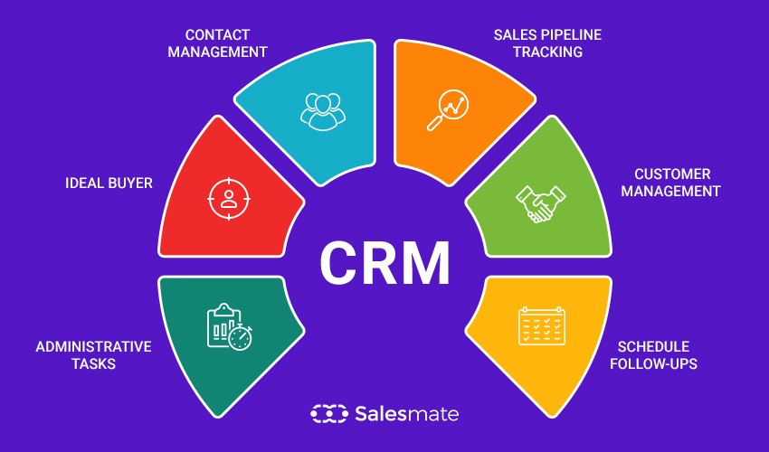

Slide 4
What is meant by CRM
CRM is an abbreviation for Customer Relationship Management. It’s a system used to build and manage customer relationships.
A CRM system helps businesses manage all the interactions it has with customers and potential customers. With a CRM system, customer preferences are recorded, and customer activity can be tracked. So every time they are spoken to, regardless of who they talk to, customers get a fully personalized and consistent experience.
CRM software helps organizations streamline their processes and workflows so that every part of the business is on the same page. Sales and marketing teams, especially, rely on CRM to create collaboration and improve their productivity.
The overall aim is to provide more engaging customer experiences, increase customer loyalty and retention, and drive business growth and profitability.
Notes:
4

Slide 5
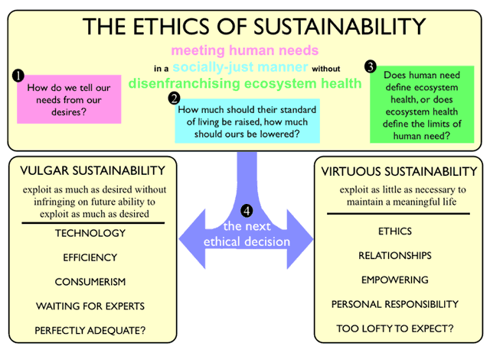

Slide 6
Ethics and sustainability
Companies cannot be sustainable without being ethical. Ethics and sustainability go hand in hand because being sustainable implies that decisions are made with future generations in mind and with the implications of any activity made by an organization.
If companies around the world start to worry about sustainability issues caused by pressure from certain business or special interest groups, sooner or later they will have to inculcate a culture of decision-making and reduce any conflict of corruption or bribery.
An ethical business does not give more weight to an economic value over a social or environmental value and makes decisions based on the wellbeing of all of its interest groups, not only of its owners or shareholders.

Slide 7
Ethics and sustainability
Sustainability can now be a branding strategy, companies must take seriously their impact, the demands of interest groups, and instill values and principles in all their organizational culture.
a socially responsible business must treat its workers well and that begins at home; sell healthy and lasting products thinking of the consumer; work on its environmental management; be transparent and invest socially in a systematic way.
Sustainability could mean stagnation or stasis but most often it is used to imply balance and accepts the need for innovation and dynamism.

Slide 8
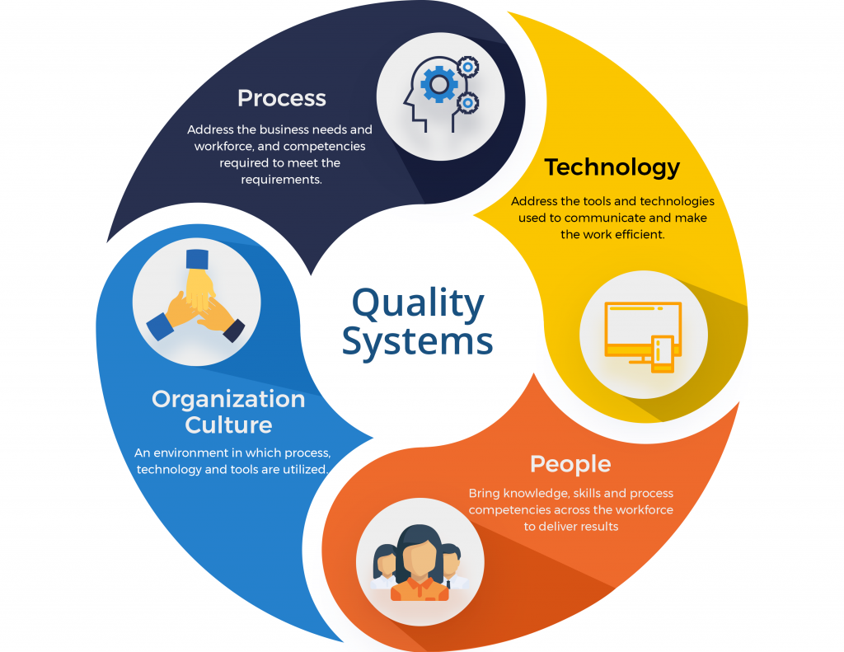

Slide 9
Quality systems
A “Quality System” is your organization's blueprint: it identifies your business model and processes, provides details about how your people will work together to get things done, and establishes specifications for performance — so you can tell if you're on track… or not. It's a living, breathing system.
The purpose of a quality management system is to ensure every time a process is performed, the same information, methods, skills and controls are used and applied in a consistent manner.

Slide 10
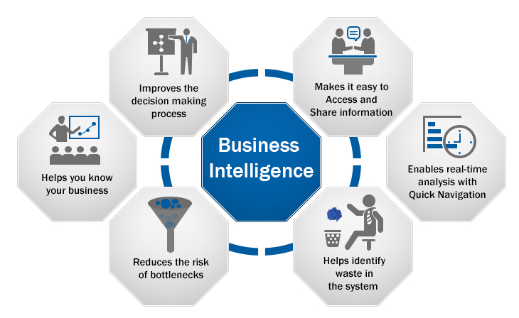

Slide 11
Business intelligence
he term Business Intelligence (BI) refers to technologies, applications and practices for the collection, integration, analysis, and presentation of business information. The purpose of Business Intelligence is to support better business decision making.
The purpose of business intelligence in a business is to help corporate executives, business managers, and other operational workers make better and more informed business decisions. Companies also use business intelligence to cut costs, identify new business opportunities, and spot inefficient business processes.

Slide 12
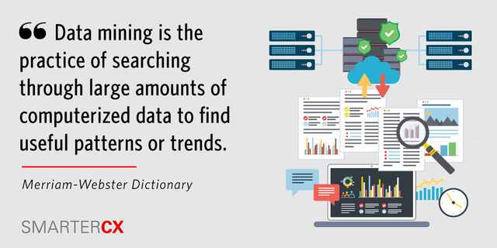

Slide 13
Data mining
definition of 'Data Mining' Definition: In simple words, data mining is defined as a process used to extract usable data from a larger set of any raw data. It implies analyzing data patterns in large batches of data using one or more software. ... Data mining is also known as Knowledge Discovery in Data (KDD).
Data mining is the practice of automatically searching large stores of data to discover patterns and trends that go beyond simple analysis. Data mining uses sophisticated mathematical algorithms to segment the data and evaluate the probability of future events.

Slide 14
Strength | Weakness
Opportunities | Threats

