Slide 1

EcoWear Clothing Ltd
Sustainable Fashion for a Better Future
Business Plan Presentation
Programme: Business and management
Module: LCLM4006
Student: Cristina Nestian

Slide 2
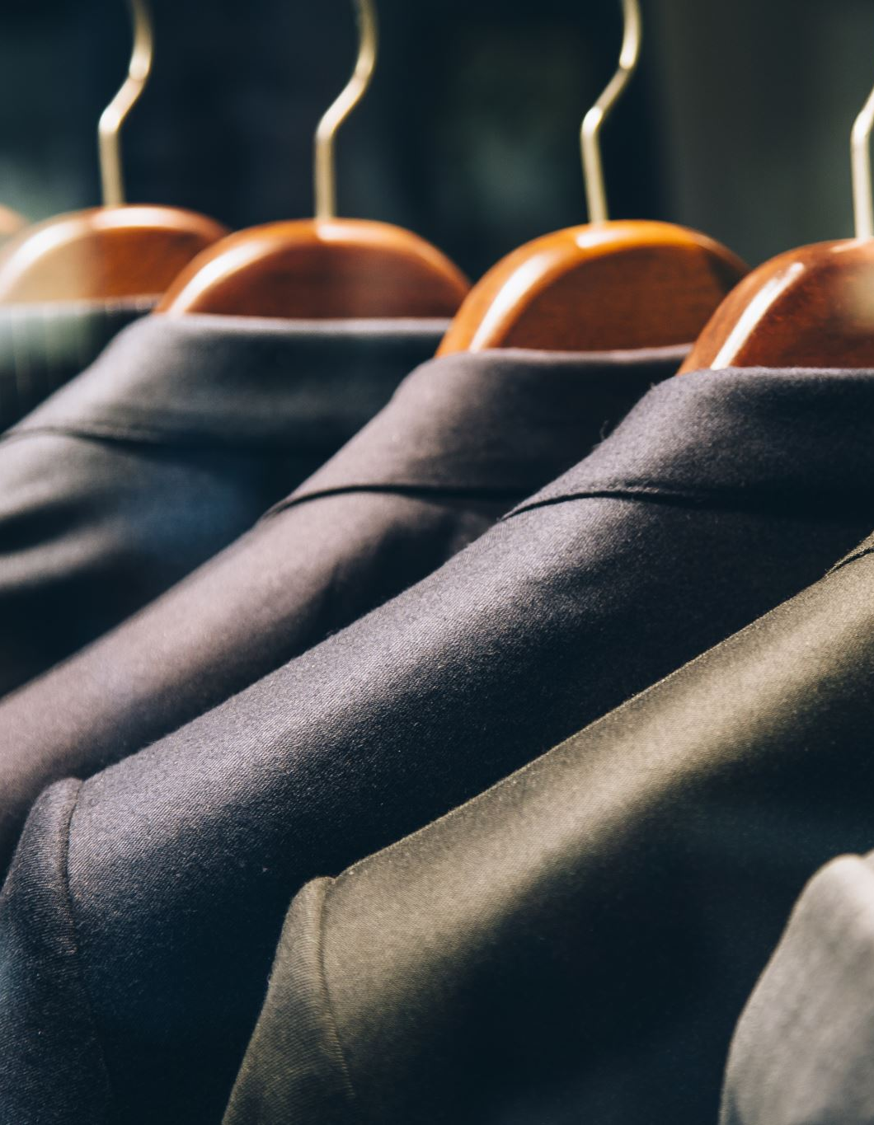
Business Overview
About EcoWear Clothing Ltd
EcoWear Clothing Ltd is a start-up sustainable clothing company.
Offers affordable, fashionable and environmentally friendly clothing.
Target customers are young adults aged 18–35.
Products are made from:
  Organic cotton
  Recycled fabrics
  Sustainable materials
Business mainly operates through:
  Online store
  Pop-up shops across the UK
  Unique Selling Points
Affordable sustainable fashion
Ethical manufacturing
Eco-friendly packaging
Clothing recycling reward programme
2% of annual profits donated to charities helping homeless people.
Legal Structure
Private Limited Company (Ltd)
Management Structure
Managing Director
Marketing Manager
Operations Manager
Finance Manager
Customer Service Team

Slide 3
PESTLE Analysis:

Slide 4
Political
Political Factors
Government policies promoting sustainability create opportunities for EcoWear Clothing Ltd. The UK government encourages businesses to reduce carbon emissions, increase recycling, and adopt environmentally friendly practices. Regulations on ethical sourcing and worker protection also support businesses that use responsible manufacturing processes.
Impact on EcoWear:
Supports sustainable business growth.
Increases consumer trust through ethical production.
Opportunity to benefit from government sustainability initiatives.

Slide 5
Economic
Economic Factors
Economic conditions such as inflation and rising production costs can increase the price of sustainable materials like organic cotton. During periods of economic uncertainty, consumers may spend less on clothing. However, demand for affordable sustainable fashion continues to grow among environmentally conscious consumers.
Impact on EcoWear:
Higher costs of raw materials.
Need to keep prices competitive.
Opportunity to attract customers looking for affordable eco-friendly clothing.

Slide 6
Social
Social Factors
Consumers, particularly those aged 18–35, are becoming increasingly aware of environmental issues and prefer brands that support sustainability and ethical manufacturing. Many customers also value businesses that contribute to local communities and charities.
Impact on EcoWear:
Growing demand for sustainable fashion.
Increased customer loyalty through ethical business practices.
Positive brand image through charity donations and recycling programmes.

Slide 7
Technological Factors
Advances in e-commerce, digital marketing, and social media allow EcoWear to reach customers across the UK without opening physical stores. Online shopping platforms, secure payment systems, and customer data analytics improve efficiency and customer experience.
Impact on EcoWear:
Lower operating costs through online sales.
Better customer engagement via Instagram, TikTok, and Facebook.
Improved inventory and sales management.

Slide 8
Environmental Factors
Environmental protection is at the core of EcoWear’s business model. The fashion industry is responsible for significant waste and pollution, creating demand for businesses that use recycled fabrics, organic cotton, and eco-friendly packaging.
Impact on EcoWear:
Strong competitive advantage.
Supports the company’s sustainability mission.
Appeals to environmentally conscious customers.

Slide 9
Legal Factors
EcoWear must comply with UK laws relating to consumer protection, employment rights, business registration, data protection (UK GDPR), and product safety. As a Private Limited Company (Ltd), the business also benefits from limited liability while meeting Companies House requirements.
Impact on EcoWear:
Protects customers and employees.
Builds credibility with investors.
Ensures legal compliance and reduces business risk.

Slide 10
SWOT Analysis
Strengths
Unique eco-friendly business concept.
Energy-generating gym equipment reduces electricity costs.
Wide range of services including personal training, group classes, and nutrition advice.
Strong focus on customer wellbeing and sustainability.
Weaknesses
High start-up costs.
New business with no established customer base.
Initial marketing costs may be high.
Opportunities
Growing demand for sustainable businesses.
Increasing awareness of health and fitness.
Partnerships with schools, universities, and local businesses.
Opportunity to expand to new locations and launch a fitness app.
Threats
Competition from established gyms.
Rising inflation and operating costs.
Economic downturns reducing customer spending.
New competitors entering the market.

Slide 11
Marketing Strategy 1
Social Media Marketing
Main platforms:
Instagram
TikTok
Facebook
Activities:
Influencer collaborations
Short videos
Fashion reels
Customer reviews
Sustainable lifestyle content
Benefits
Low-cost marketing
High engagement
Direct communication with customers

Slide 12
Marketing Strategy 2
Customer Loyalty & Sustainability Programme
EcoWear Recycling Rewards
Customers receive discounts when they return unwanted clothes.
Benefits:
Encourages recycling
Builds customer loyalty
Supports sustainability
Increases repeat purchases
Additional promotions:
Student discounts
Seasonal sales
Email marketing

Slide 13
Funding Requirements
Total Investment Required:
£80,000
Expected Outcome
Launch within 6 months
Build strong online presence
Reach UK-wide customers
Expense | Amount
Website & E-commerce | £10,000
Initial Stock | £30,000
Marketing | £15,000
Equipment & Packaging | £8,000
Staff Costs | £12,000
Legal & Business Registration | £5,000

Slide 14
Conclusion
Why Invest in EcoWear?
Growing sustainable fashion market
Affordable eco-friendly clothing
Strong online business model
Ethical manufacturing
Community support
High growth potential

Slide 15
THANK YOU!

Slide 16

References
Armstrong, G. and Kotler, P. (2023) Marketing: An Introduction. 15th edn. Harlow: Pearson.
Burns, P. (2022) Entrepreneurship and Small Business. 6th edn. London: Red Globe Press.
Kotler, P., Keller, K.L. and Chernev, A. (2022) Marketing Management. 16th edn. Harlow: Pearson.
Porter, M.E. (2008) The Five Competitive Forces That Shape Strategy. Harvard Business Review, 86(1), pp. 78–93.
Statista (2024) Revenue of the apparel market in the United Kingdom. Available at: https://www.statista.com (Accessed: 13 July 2026).
Department for Environment, Food & Rural Affairs (DEFRA) (2023) Waste prevention programme for England. Available at: https://www.gov.uk/government/organisations/department-for-environment-food-rural-affairs (Accessed: 13 July 2026).
WRAP (2023) Textiles and Clothing Sustainability. Available at: https://wrap.org.uk (Accessed: 13 July 2026).
Mintel (2024) UK Ethical Fashion Market Report. Available at: https://www.mintel.com (Accessed: 13 July 2026).
Dibb, S., Simkin, L., Pride, W.M. and Ferrell, O.C. (2020) Marketing: Concepts and Strategies. 8th European edn. Andover: Cengage Learning.
Gov.uk (2024) Set up a private limited company. Available at: https://www.gov.uk/limited-company-formation (Accessed: 13 July 2026).

