Slide 1
MACHINE LEARNING-BASED DETECTION OF
FAKE PRODUCT REVIEWS IN E-COMMERCE PLATFORMS
A Comparative Study — Research Proposal Presentation
ACFA7004 — Research Methods and Professional Development
Mohammed Nawaf | 2541121
MSc Computing | Lecturer: Dr Aliyu Sambo
July 2026

Slide 2
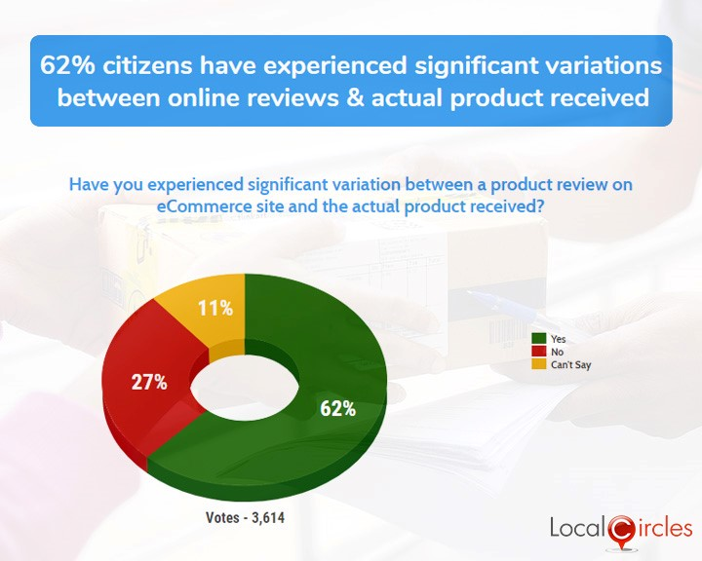
Research Context: Why This Matters
Online reviews are now the dominant substitute for physical product inspection on platforms such as Amazon and Alibaba
This dependence has created a profitable incentive to manipulate reviews at scale
62%
of consumers report a significant gap between the online review and the actual product received
n = 3,614 respondents | LocalCircles consumer survey, 2022 [16]
Consumer-reported gap between review and product received. Source: LocalCircles, 2022 [16].

Slide 3
Background: How the Threat Has Evolved
1
2
3
2008
2017
2022
Jindal & Liu
Yao et al.
Salminen et al.
Analysed 5.8 million Amazon reviews; built the first opinion-spam taxonomy
RNNs auto-generate fake reviews that evade statistical detectors and posting-rate red flags
GPT-2 generates synthetic reviews nearly indistinguishable from genuine ones
78% AUC
Detectors evaded
20,000 vs 20,000
[1]
[8]
[10]
The threat has evolved: human deception → coordinated crowdsourced spam → autonomously generated language-model spam

Slide 4
Research Problem
90.5%
BERT accuracy on the curated Ott corpus [12]
Most comparative studies benchmark only on pre-2015 datasets (Ott [2]; Yelp [4],[6])
Mukherjee et al.: fake and genuine Yelp reviews use almost identical vocabulary — content-based methods alone do not generalise [4]
71–73%
Same models on real-world, noisy Yelp data [12]
No existing study tests classical ML, deep learning, and transformer models together against human-written, behavioural, and AI-generated fake reviews in one comparison.
→ a 15–18 percentage-point gap that remains unexplained

Slide 5
Literature Review Summary
Theme | Key Work | Contribution
Content-based | Ott et al. [2] | ~90% accuracy on hotel reviews — but domain-specific
Behaviour-based | Mukherjee et al. [4] | Reviewer patterns outperform vocabulary on Yelp
Deep learning | Kennedy et al. [12] | Fine-tuned BERT outperforms all classical models
Adversarial | Aghakhani et al. [9] | FakeGAN-generated spam defeats existing detectors
The gap: no unified, multi-dataset comparison spans content-based, behaviour-based, deep-learning, and adversarial-generation threats together.

Slide 6
Research Aim and Objectives
AIM: To comparatively evaluate classical machine learning, deep learning, and transformer-based approaches for detecting fake e-commerce reviews — including AI-generated ones — to identify which generalises most robustly.
1
2
3
Build the Dataset
Implement the Models
Evaluate and Compare
Assemble a labelled, multi-source dataset: Ott corpus [2] + Yelp filtered set [4],[6] + Salminen's GPT-2 reviews [10]
Compare six classifiers — LR, SVM, Random Forest, CNN, LSTM, BERT — under identical conditions [7],[12]
Statistically test whether transformers close the human-vs-AI-generated detection gap [12]

Slide 7
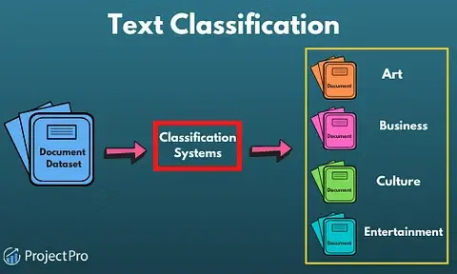
Methodology: Research Design and Pipeline
Research Design
Quantitative, experimental design — comparing measurable classifier performance rather than building a case-specific artefact [7],[12]
Text-Classification Pipeline
1
Clean review text
2
Tokenise
3
Represent (TF-IDF / embeddings / WordPiece)
4
Classify: genuine vs. fake
General text-classification pipeline (relabelled for this study: Review Dataset → Classification System → Genuine / Fake).

Slide 8
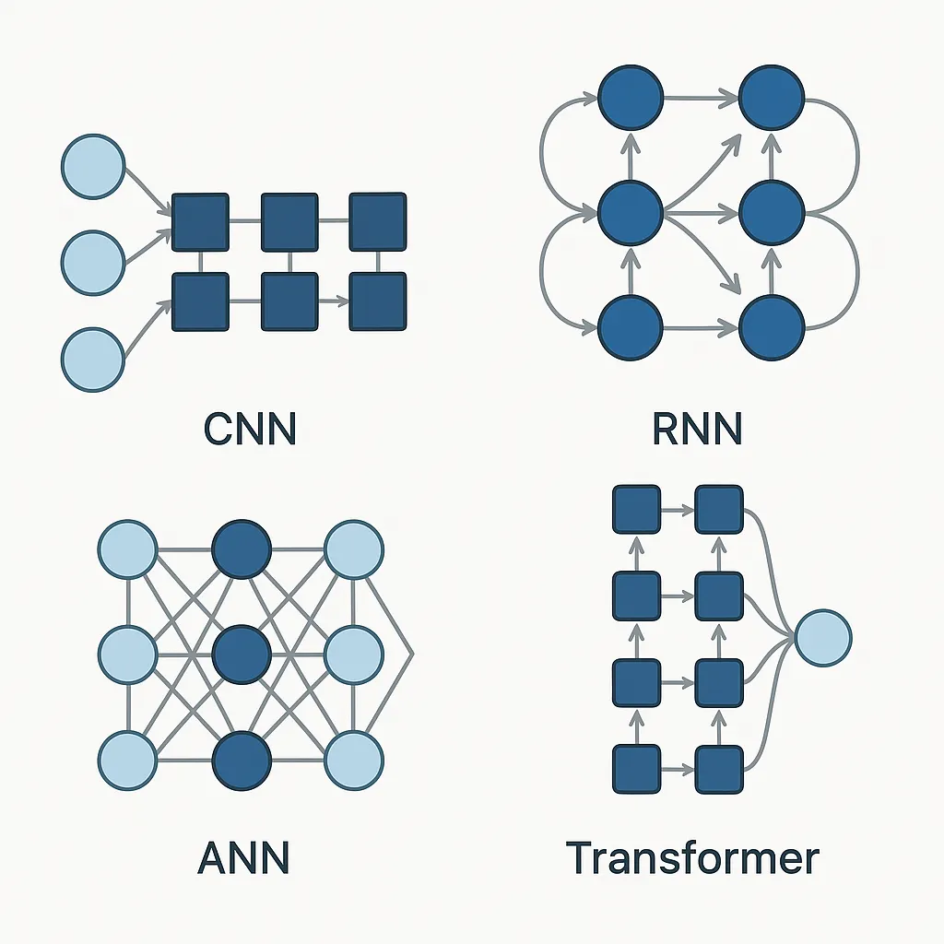
Methodology: Models Compared
Classical baselines
Logistic Regression, SVM (linear kernel) [7],[12]
Ensemble baseline
Random Forest [7]
Deep learning
CNN, LSTM — 1 layer, 10 units [12]
Transformer
Fine-tuned BERT-base-uncased [12],[15]
CNN and RNN-family (LSTM) vs. Transformer (BERT) architectures mapped to this study's models.
BERT hyperparameters follow Kennedy et al.: lr 2e-5, batch size 16, 3 epochs [12]

Slide 9
Data and Evaluation
1
2
3
Ott et al. Corpus
Yelp Filtered Set
Salminen GPT-2 Set
800 deceptive + 800 genuine hotel reviews — gold-standard baseline
Large-scale, real-world reviews with Yelp's own fraud-filter labels
20,000 genuine + 20,000 AI-generated Amazon reviews
[2]
[4],[6]
[10]
Evaluation Metrics
Accuracy
Precision
Recall
F1-Score
AUC-ROC
Validation: 5-fold + bootstrap (small Ott corpus) and 10-fold cross-validation (combined dataset) [12]

Slide 10
Project Planning: 12-Week Timeline
1
2
3
4
5
6
7
8
9
10
11
12
Literature & data acquisition
Preprocessing & splitting
Classical baselines (LR, SVM, RF)
Deep learning (CNN, LSTM)
BERT fine-tuning
Full evaluation suite
Statistical analysis
Write-up & submission prep
BERT fine-tuning (week 8) is highlighted as the most computationally intensive phase.

Slide 11
Project Impact and Limitations
IMPACT
LIMITATIONS
Informs which model family e-commerce platforms should prioritise when trading off accuracy against compute cost
BERT is more accurate [12],[15] but far costlier to deploy at Amazon-scale review volumes than logistic regression
Extends comparative literature beyond legacy, pre-LLM benchmarks
Ott corpus is small (1,600 reviews) relative to modern deep-learning data needs
Yelp's own filter labels are not perfectly accurate — possible label noise
Fine-tuning BERT across three separate datasets is computationally expensive within the project timeframe

Slide 12
References
[1] N. Jindal and B. Liu, "Opinion spam and analysis," in Proc. WSDM '08, 2008, pp. 219–230, doi: 10.1145/1341531.1341560.
[2] M. Ott, Y. Choi, C. Cardie, and J. T. Hancock, "Finding deceptive opinion spam by any stretch of the imagination," in Proc. ACL-HLT, 2011, pp. 309–319.
[4] A. Mukherjee, V. Venkataraman, B. Liu, and N. S. Glance, "What Yelp fake review filter might be doing?," in Proc. ICWSM '13, 2013, pp. 409–418, doi: 10.1609/icwsm.v7i1.14389.
[6] S. Rayana and L. Akoglu, "Collective opinion spam detection: Bridging review networks and metadata," in Proc. KDD '15, 2015, pp. 985–994, doi: 10.1145/2783258.2783370.
[7] M. Crawford, T. M. Khoshgoftaar, J. D. Prusa, A. N. Richter, and H. Al Najada, "Survey of review spam detection using machine learning techniques," J. Big Data, vol. 2, art. 23, 2015.
[8] Y. Yao, B. Viswanath, J. Cryan, H. Zheng, and B. Y. Zhao, "Automated crowdturfing attacks and defenses in online review systems," in Proc. CCS '17, 2017, pp. 1143–1158.
[9] H. Aghakhani, A. Machiry, S. Nilizadeh, C. Kruegel, and G. Vigna, "Detecting deceptive reviews using generative adversarial networks," in Proc. IEEE SPW, 2018, pp. 89–95.
[10] J. Salminen, C. Kandpal, A. M. Kamel, S.-G. Jung, and B. J. Jansen, "Creating and detecting fake reviews of online products," J. Retailing and Consumer Services, vol. 64, art. 102771, 2022.
[12] S. Kennedy, N. Walsh, K. Sloka, A. McCarren, and J. Foster, "Fact or factitious? Contextualized opinion spam detection," arXiv:2010.15296, 2020.
[15] D. Refaeli and P. Hájek, "Detecting fake online reviews using fine-tuned BERT," in Proc. ICEBI '21, 2021, pp. 76–80.
[16] LocalCircles, "Fake Product Review Ratings on eCommerce Sites — Survey," 2022. [Online]. Available: localcircles.com/a/press/page/fake-product-review-ratings-on-ecommerce-sites-survey

