Slide 1
Parallelisation techniques for simulation of tissue photonics
Tim Bashford

Slide 2
Context
Major change to the structure of consumer-grade CPUs in late ‘90s/early 2000s.
  Moore’s Law.
  Transistors no longer getting significantly smaller.
  CPUs generally not getting “faster”, only more parallel.
Changes to how we write code.
  Parallel code adds a significant layer of abstraction.
  No longer sufficient to just write maths as code and wait for Moore’s law to catch up.

Slide 3
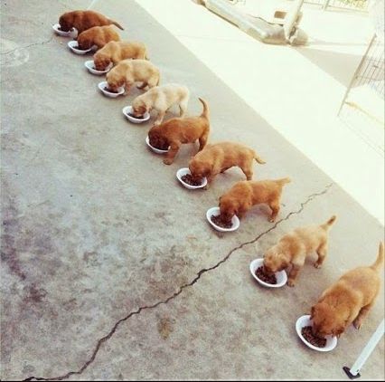
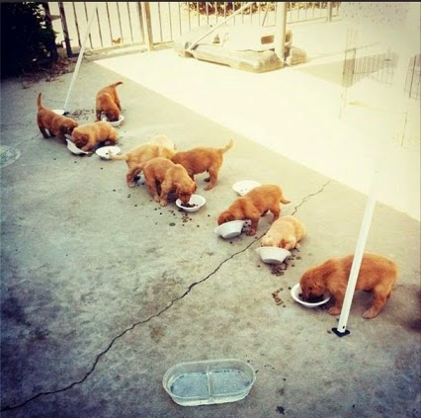
Multithreaded programming explained (with puppies)

Slide 4
Context
Now, more than ever, we need to be active participants in writing optimised code.
  Moore’s Law won’t catch up without parallelism.
  Unparallelisable problems might be entirely out of reach without other optimisations.
This presentation will focus on tissue photonics problems, and specifically their optimisation.

Slide 5
Clinical agenda
Light-based therapies are increasingly popular, from cancer therapies to acne treatment.
  An imprecise science – many different factors to account for when irradiating skin.
  Too much energy results in a (potentially severe) burn, too little is an ineffective treatment.
There is a clinical desire to be able to simulate the result of these therapies before “hitting the button”.
  Must be able to simulate quickly enough for realistic clinical treatment. 5-10 minutes established as a “reasonable” time.

Slide 6
Computational models
Only recently have CPUs become sufficiently fast to move into 3D.
Computational models within the research group solve for steady state radiative transport, then add a time-dependent thermal term.
We have two radiative solvers:
  3D Monte Carlo model – written by me.
  Dual Reciprocity Boundary Element Method – written by Dr Ala Al-Hussany
And one thermal solver:
  Transient Thermal Boundary Element Method – written by Dr Arnaud Marotin.
Much of the work done is in the context of laser hair depolation.

Slide 7
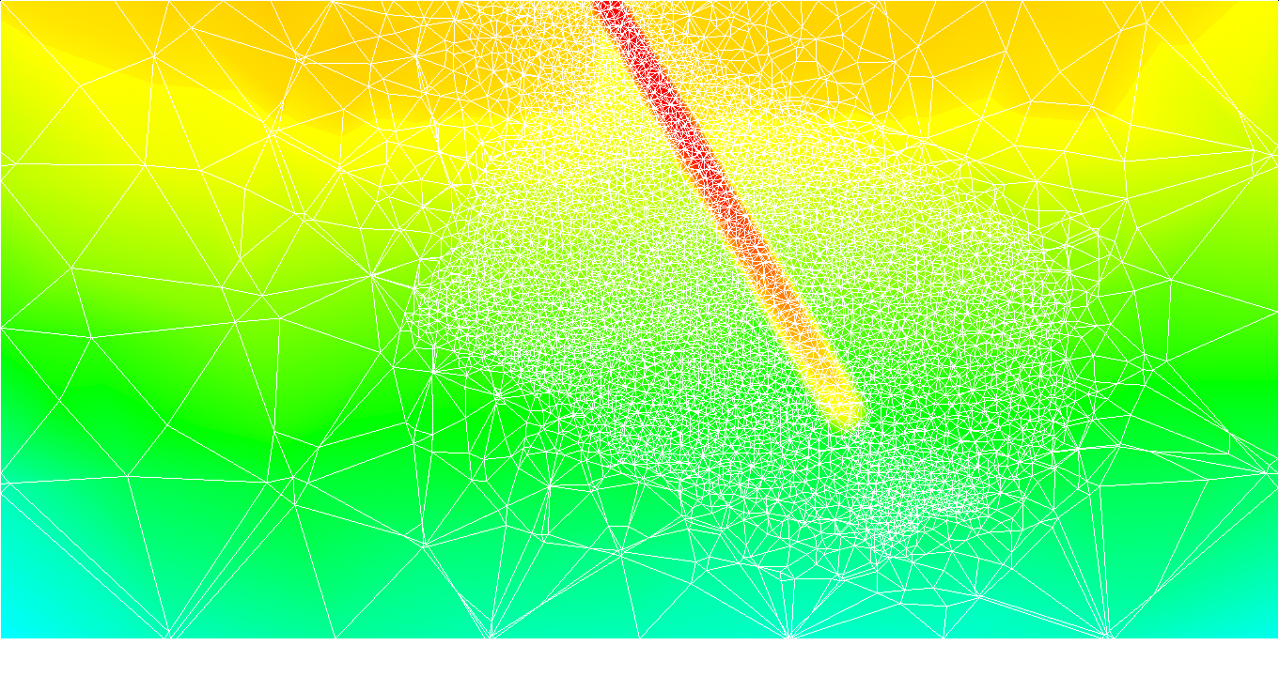
Simulation output (results?)

Slide 8
The problem
The results generated by these models are extremely good – qualitatively and quantitatively.
  Not what this presentation’s about.
These models are slow. The DRBEM, in its original state took 71 days to complete, the Monte Carlo 60 days, TTBEM 6 days.
  Time requirement not viable for research, let alone clinical work. The clinical threshold for a simulation is ~10 minutes.
  Required a fundamental re-assessment of how each model operates.
Parallelise, optimise.
  Take a step back from the maths, focus on the computer science.

Slide 9
Solutions
Parallelism firstly achieves a near-linear improvement in time taken.
  By running the DRBEM (71 days) on a machine with 16 cores, we achieve a time of ~4.5 days – far better, still a long way from 10 minutes.
  Optimisation work needed. Investigate where the code is slow, and consider resolutions.
Some optimisations are obvious. Replaced a non-parallelisable Gauss-Jordan matrix inversion routine with a parallelisable LU decomposition routine.
Some are less so. Micro-optimisations are a much-maligned approach to achieving performance improvements in regularly repeated code.

Slide 10
Code example
for(int L=0;L<MTOT;L++)
{
for(int I=0;I<MTOT;I++)
{
int b=L*MTOT+I;
FDash[b]=0.0;
HUGQF[b]=0.0;
for(int J=0;J<MTOT;J++)
{
int k1=L*MTOT+J;
int k2=I+J*MTOT;
FDash[b]+=Hij[k1]*UDash[k2];
HUGQF[b]+=Gij[k1]*QDash[k2];
}
}
}
In this example, MTOT = ~29,000. This code is repeated 243,890,000,000,000 (~2.4 x 10¹⁴ times).
This takes approximately 21 hours to complete.
There is, however, a flaw in how this maths was translated into code.
These large matrices are flattened, and stored in 1D. In doing so, the two matrices UDash and QDash are accessed by column. This has a major impact on cache hit rate.

Slide 11
Code example
When fetching data from main memory (RAM), the CPU doesn’t just take one piece – it takes a small block of the next few pieces of data too.
Let’s say we have a block of memory, and we want to read the value in location 7:
0
1
2
3
4
5
6
7
8
9
10
11
12
13
14
15
16
17
18
19
20
21
22
23
24
The CPU will actually copy a small block next to 7 to its “cache”: there’s a good chance we’ll want to use
this data in subsequent calculations, and by taking this block, we can access it quickly. So we might actually
take elements 7 through 10.
0
1
2
3
4
5
6
7
8
9
10
11
12
13
14
15
16
17
18
19
20
21
22
23
24

Slide 12
Code example
Now let’s consider this when applied to a matrix. We flatten our matrix out, so:
0
1
2
3
4
5
6
7
8
9
10
11
12
13
14
15
16
17
18
19
20
21
22
23
24
Becomes:
0
1
2
3
4
5
6
7
8
9
10
11
12
13
14
15
16
17
18
19
20
21
22
23
24
This works out nicely if we’re accessing our data by row.

Slide 13
Code example
But what if we’re accessing our data by column?
0
1
2
3
4
What we want to cache
5
6
7
8
9
What we actually cache
10
11
12
13
14
15
16
17
18
19
20
21
22
23
24
Becomes:
0
1
2
3
4
5
6
7
8
9
10
11
12
13
14
15
16
17
18
19
20
21
22
23
24
Suddenly, we aren’t caching much, if any data at all – this is a huge performance hit.

Slide 14
Solution
Change the structure of the data – break from the original maths and transpose the matrices around their pivots, and access by row.
  We’re only reading from them, so this transformation can be reversed later.
Now:
0
1
2
3
4
0
5
10
15
20
5
6
7
8
9
1
6
11
16
21
10
11
12
13
14
2
7
12
17
22
15
16
17
18
19
3
8
13
18
23
20
21
22
23
24
4
9
14
19
24
Becomes:
0
5
10
15
20
1
6
11
16
21
2
7
12
17
22
3
8
13
18
23
4
9
14
19
24

Slide 15
After all that…
for(int L=0;L<MTOT;L++)
{
for(int I=0;I<MTOT;I++)
{
int b=L*MTOT+I;
FDash[b]=0.0;
HUGQF[b]=0.0;
for(int J=0;J<MTOT;J++)
{
int k1=L*MTOT+J;
int k2=I+J*MTOT;
FDash[b]+=Hij[k1]*UDash[k2];
HUGQF[b]+=Gij[k1]*QDash[k2];
}
}
}
for(int L=0;L<MTOT;L++)
{
for(int I=0;I<MTOT;I++)
{
int b=L*MTOT+I;
int k1=L*MTOT;
FDash[b]=0.0;
HUGQF[b]=0.0;
for(int k2=(I * MTOT);k2<(I*MTOT);k1++, k2++)
{
FDash[b]+=Hij[k1]*UDash[k2];
HUGQF[b]+=Gij[k1]*QDash[k2];
}
}
}
Cache hit rate ~55%.
Cache hit rate ~96%.
~21 hours.
~40 minutes.

Slide 16
When all else fails, compromise.
The DRBEM operates by calculating from each field point to each other field point.
Uses an interpolating function to represent the volume term, we can separate the number of internal poles from the volume elements.
  Has an interesting feature – we can tune its accuracy, in proportion to the time it takes.
  The algorithm is O(N³) time complexity, so a modest reduction in accuracy can yield a significant improvement in time taken.
Meshes tend to be most dense around the region of interest, and extremely coarse elsewhere.
  By taking a histogram of element size, and selecting the smallest elements only, we end up with a good estimate of the number of elements to select.
  In our mesh of 29,000 elements, using 10,000 elements we get a ~0.6% MSE, but reduce the time taken to calculate by 850%.

Slide 17
Results
Optimisation techniques have yielded a significant improvement in time taken for each method:
Method | Serial unoptimised | Serial optimised | Parallel optimised
Monte Carlo | ~2 months | ~1 hour | ~4 mins
DRBEM | ~2 ½ months | ~10 hours | ~40 mins
TTBEM | ~6 days | ~2 hours | ~7 mins
This gives a combined time of ~11 minutes.
  Very close to the clinical threshold – now we can wait for Moore’s Law (or the company can buy a faster CPU)!

Slide 18
Conclusions
It’s no longer sufficient to turns maths into code.
Only parallel code will get meaningfully faster as computer hardware advances – at least for the foreseeable future.
Compromise can be good – as long as you can quantify it.

Slide 19
Future work
The DRBEM shows significant promise, and may eventually overtake the Monte Carlo model.
  Fast multipole method – use a multi-level multipole expansion series to combine near-field sources in the Green’s function.
TTBEM singularity challenge.

