Slide 1





HOW THE BRAIN REALLY WORKS:
SIX PRINCIPLES FOR FACILITATION AND LEARNING
Rachelle Williams

Slide 2



TAKE-A-STAND
Using a scale of sitting to standing -
How confident do you feel you understand how the brain learns?
Low: Stay sitting
Mid: Half Stand
High: Stand

Slide 3
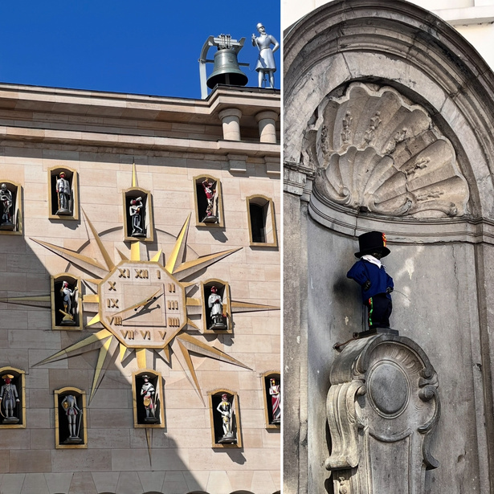
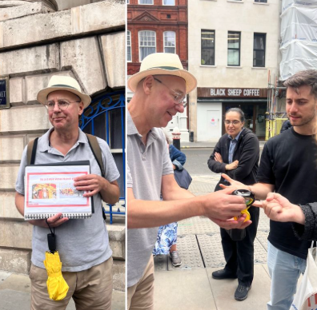
A STORY ON WALKING TOURS
Notes:
You'll notice techniques used by the walking tours in London and Estonia, using engaging techniques
TBR has made me a better learner - there noticed everyone else switching off during the walking tour in brussels - it was very factual based - whereas I was able to stay engaged - taking notes to keep my brain engaged

Slide 4
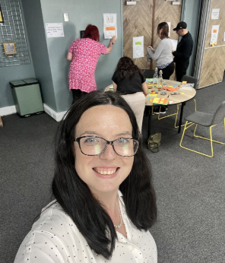


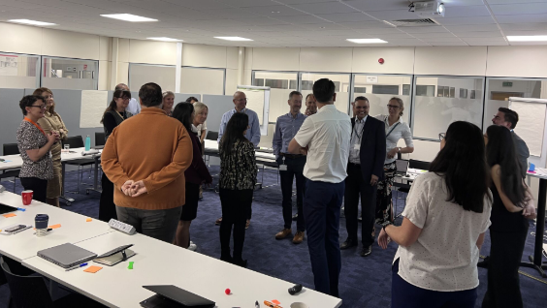

QUICK INTRO

Slide 5

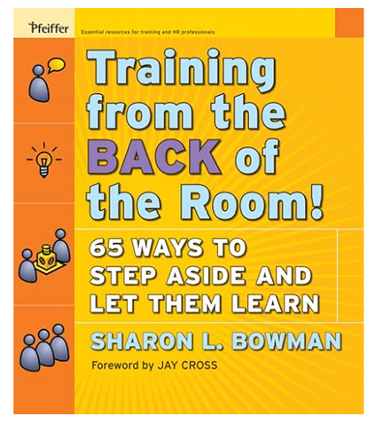






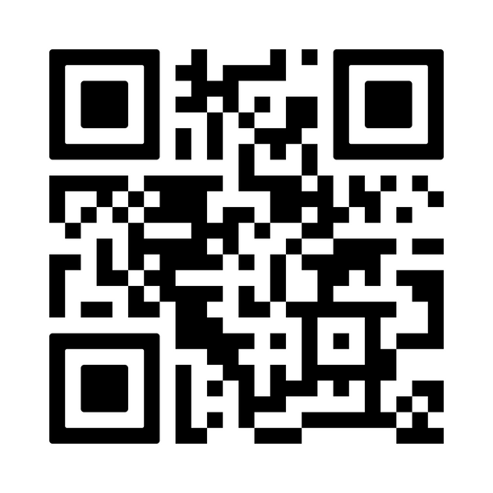
WE’LL BE COVERING 6 BRAIN SCIENCE PRINCIPLES
To help engagement with workshops, training, facilitation and even your own learning

Slide 6


BEGIN PREPARING YOUR TEMPLATE FOR THIS SESSION

Slide 7

IMAGES OVER WORDS

Slide 8

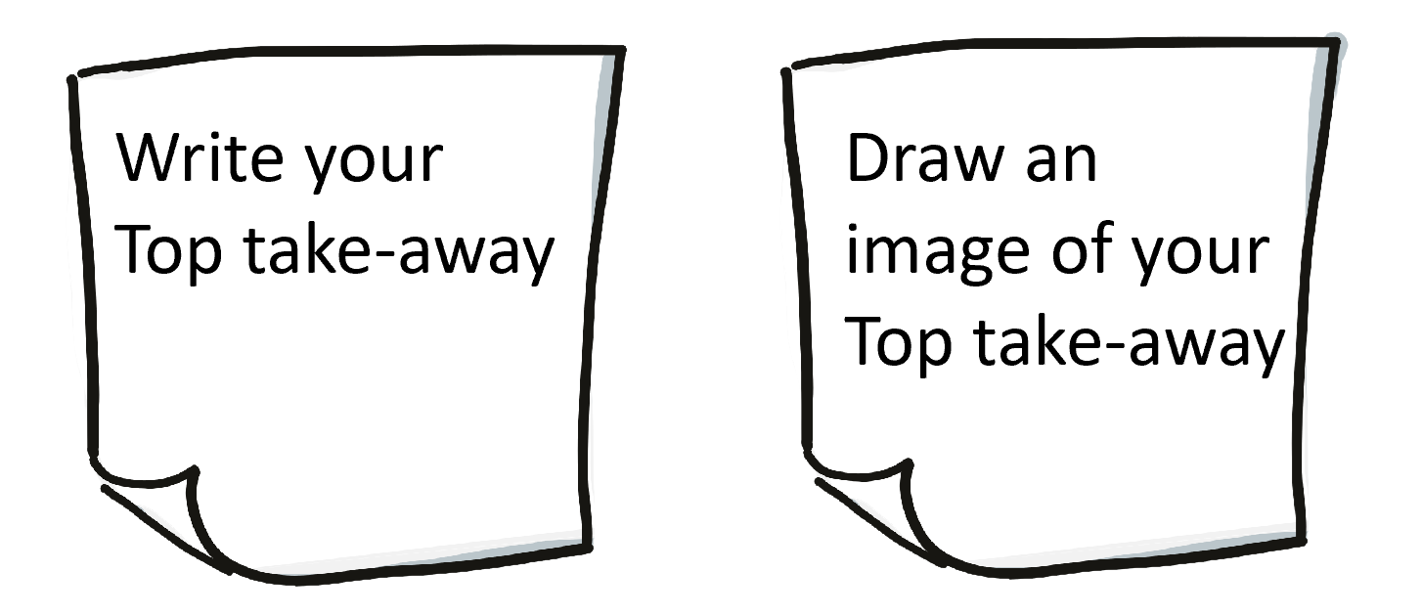
IMAGES OVER WORDS
Quick Draw: Draw a basic lightbulb using “U, Z, M, O” letters
Draw on a Post-it note

Slide 9

TALKING OVER LISTENING

Slide 10


TALKING OVER LISTENING
In pairs: discuss what’s one time talking through something helped

Slide 11


DIFFERENT OVER THE SAME
CHANGE ANYTHING!!

Slide 12

DIFFERENT OVER THE SAME
Shout out - 10 examples of how can you implement this?

Slide 13

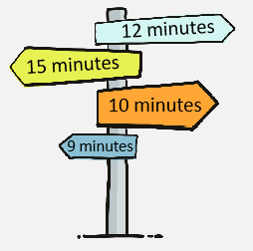
SHORT OVER LONG
Use the ten-minute “rule” - every 10-ish minutes, learners do something (write, talk, stand)

Slide 14
SHORT OVER LONG
Standing survey: for the questions asked, Stand if you agree
Notes:
Question:
“Stand if you agree you learn better in short bursts rather than one long session.”
“Stand if you agree it’s easier to remember a short TikTok/Reel than a one-hour youtube video.”
"Stand if you agree you’ve stayed more engaged with today’s short activities than you would with a long lecture.

Slide 15
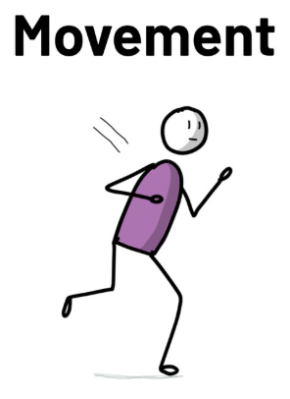
MOVEMENT OVER SITTING

Slide 16
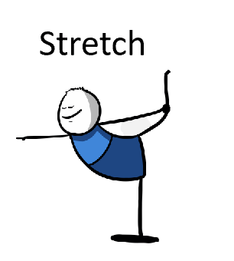
MOVEMENT OVER SITTING
TAKE A STAND AND HAVE A STRETCH

Slide 17

WRITING OVER READING

Slide 18
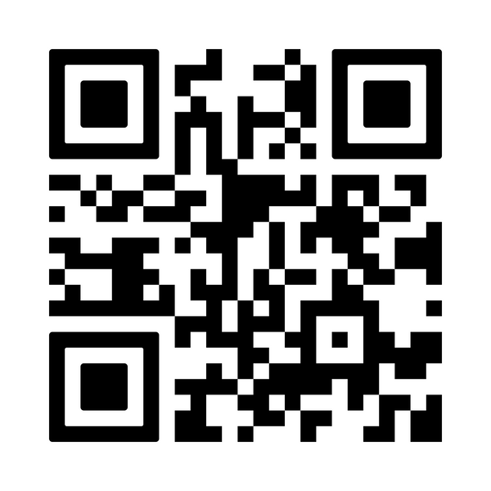
WRITING OVER READING
The 6 learning principles
QUICK DRAW
PAIR SHARE
SHOUT OUT
STANDING SURVEY
QUICK STRETCH
QUICK WRITE

Slide 19
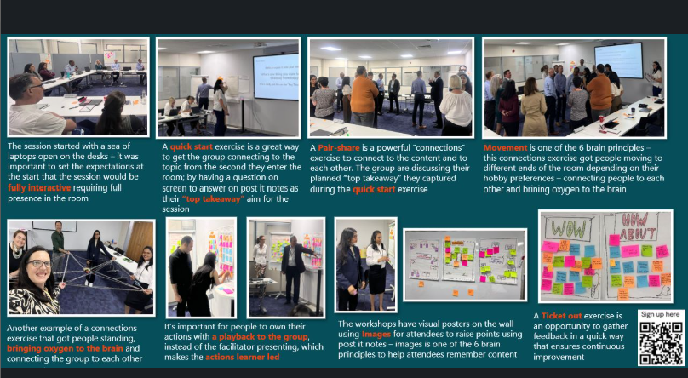
USE IN FACILITAITON

Slide 20
CAPTURE YOUR TOP TAKE-AWAY

Slide 21



THANK
YOU
&
Q&A
What is TBR Brochure
The 6 learning principles
rachelleawilliams
rachelle@furnellprojects.co.uk

