Slide 1
Electromagnetic
Radiation
(ACDC5009)
Lecture - 16

Slide 2
Content
Introduction
Laser

Slide 3
Learning Outcome
The student upon completion of the lecture will be able to:
Describe the functions of laser

Slide 4
Laser
The optical source is often considered to be the active component in an optical fiber communication system.
Its fundamental function is to convert electrical energy in the form of a current into optical energy (light) in an efficient manner which allows the light output to be effectively launched or coupled into the optical fiber.

Slide 5
Laser
Three main types of optical light source are available.
(a) wideband ‘continuous spectra’ sources (incandescent lamps);
(b) monochromatic incoherent sources (light-emitting diodes, LEDs);
(c) monochromatic coherent sources (lasers).

Slide 6
Laser
In the early stages of optical fiber communications the most powerful narrowband coherent light sources were necessary due to severe attenuation and dispersion in the fibers.
Therefore, gas lasers (helium-neon) were utilized initially.
However, the development of the semiconductor injection laser and the LED, together with the substantial improvement in the properties of optical fibers, has given prominence to these two specific sources

Slide 7
Laser
The laser is a device which amplifies light – hence the derivation of the term LASER as an acronym for Light Amplification by Stimulated Emission of Radiation.
The operation of the device may be described by the formation of an electromagnetic standing wave within a cavity (or optical resonator) which provides an output of monochromatic, highly coherent radiation.
By contrast the LED provides incoherent light output

Slide 8
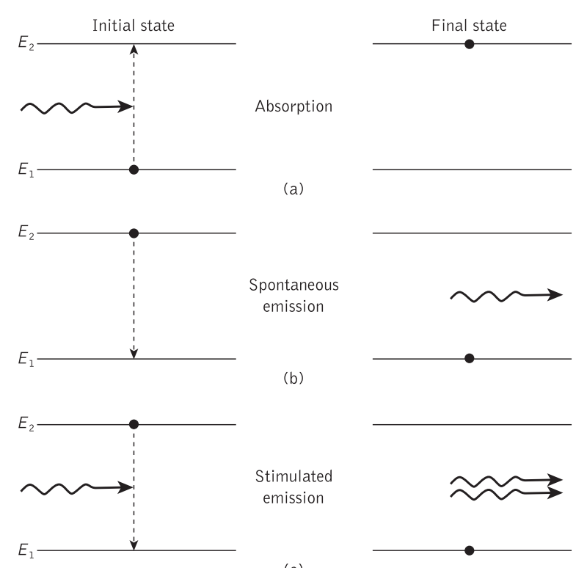
Laser

Slide 9
Laser
A two energy state or level atomic system where an atom is initially in the lower energy state E1 . When a photon with energy (E2 − E1 ) is incident on the atom it may be excited into the higher energy state E2 through absorption of the photon. This process is sometimes referred to as stimulated absorption.
Alternatively, when the atom is initially in the higher energy state E2 it can make a transition to the lower energy state E1 providing the emission of a photon at a frequency.

Slide 10
Laser
This emission process can occur in two ways:
by spontaneous emission in which the atom returns to the lower energy state in an entirely random manner;
by stimulated emission when a photon having an energy equal to the energy difference between the two states (E2 − E1 ) interacts with the atom in the upper energy state causing it to return to the lower state with the creation of a second photon

Slide 11
Laser
The random nature of the spontaneous emission process where light is emitted by electronic transitions from a large number of atoms gives incoherent radiation. A similar emission process in semiconductors provides the basic mechanism for light generation within the LED

Slide 12
Laser
It is the stimulated emission process, however, which gives the laser its special properties as an optical source.
Firstly, the photon produced by stimulated emission is generally of an identical energy to the one which caused it and hence the light associated with them is of the same frequency.
Secondly, the light associated with the stimulating and stimulated photon is in phase and has the same polarization.
Therefore, in contrast to spontaneous emission, coherent radiation is obtained. Furthermore, this means that when an atom is stimulated to emit light energy by an incident wave, the liberated energy can add to the wave in a constructive manner, providing amplification.

Slide 13
Laser
Population inversion
Under the conditions of thermal equilibrium the lower energy level E1 of the two-level atomic system contains more atoms than the upper energy level E2 . This situation, which is normal for structures at room temperature.
To achieve optical amplification it is necessary to create a nonequilibrium distribution of atoms such that the population of the upper energy level is greater than that of the lower energy level. This condition, which is known as population inversion

Slide 14
Laser
In order to achieve population inversion it is necessary to excite atoms into the upper energy level E2 and hence obtain a nonequilibrium distribution. This process is achieved using an external energy source and is referred to as ‘pumping’.
A common method used for pumping involves the application of intense radiation (e.g. from an optical flash tube or high-frequency radio field). In the former case atoms are excited into the higher energy state through stimulated absorption

Slide 15
Laser
Population inversion, however, may be obtained in systems with three or four energy levels. The energy-level diagrams for two such systems, which correspond to two nonsemiconductor lasers, are illustrated in Figure 6.3. To aid attainment of population inversion both systems display a central metastable state in which the atoms spend an unusually long time. It is from this metastable level that the stimulated emission or lasing takes place.
The three-level system (Figure 6.3(a)) consists of a ground level E0 , a metastable level E1 and a third level above the metastable level E2

Slide 16
Laser
with suitable pumping the electrons in some of the atoms may be excited from the ground state into the higher level E2 . Since E2 is a normal level the electrons will rapidly decay by nonradiative processes to either E1 or directly to E0 . Hence empty states will always be provided in E2 . The metastable level E1 exhibits a much longer lifetime than E2 which allows a large number of atoms to accumulate at E1 Over a period the density of atoms in the metastable state N1 increases above those in the ground state N0 and a population inversion is obtained between these two levels.

Slide 17
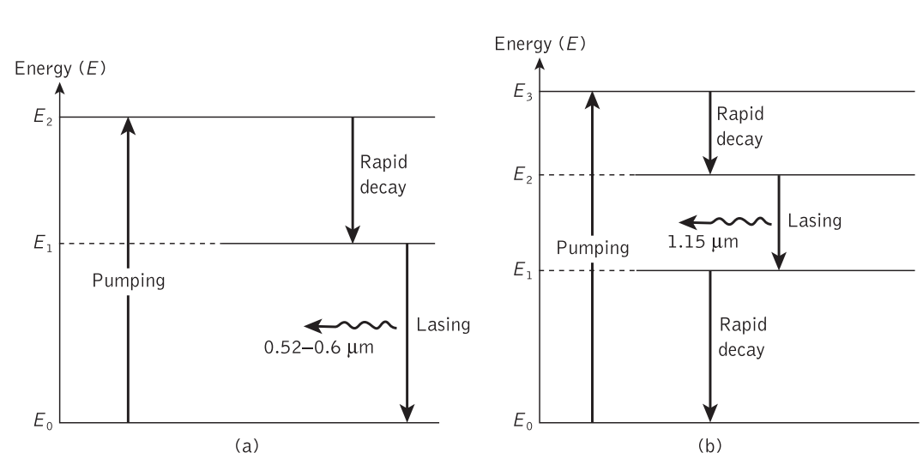
Laser

Slide 18
Laser
Light amplification in the laser occurs when a photon colliding with an atom in the excited energy state causes the stimulated emission of a second photon and then both these photons release two more. Continuation of this process effectively creates avalanche multiplication, and when the electromagnetic waves associated with these photons are in phase, amplified coherent emission is obtained. To achieve this laser action it is necessary to contain photons within the laser medium and maintain the conditions for coherence. This is accomplished by placing or forming mirrors (plane or curved) at either end of the amplifying medium.

Slide 19
Laser
Optical Emission from semiconductors
semiconductor at a temperature above absolute zero where thermal excitation raises some electrons from the valence band into the conduction band, leaving empty hole states in the valence band. These thermally excited electrons in the conduction band and the holes left in the valence band allow conduction through the material, and are called carriers. For a semiconductor in thermal equilibrium the energy-level occupation is described by the Fermi–Dirac distribution function

Slide 20
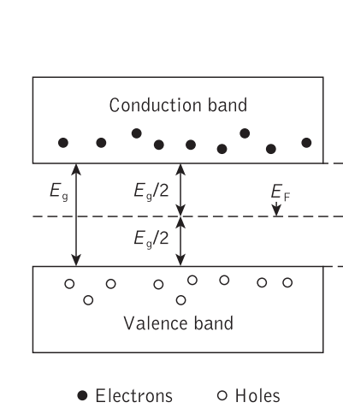
Laser

Slide 21
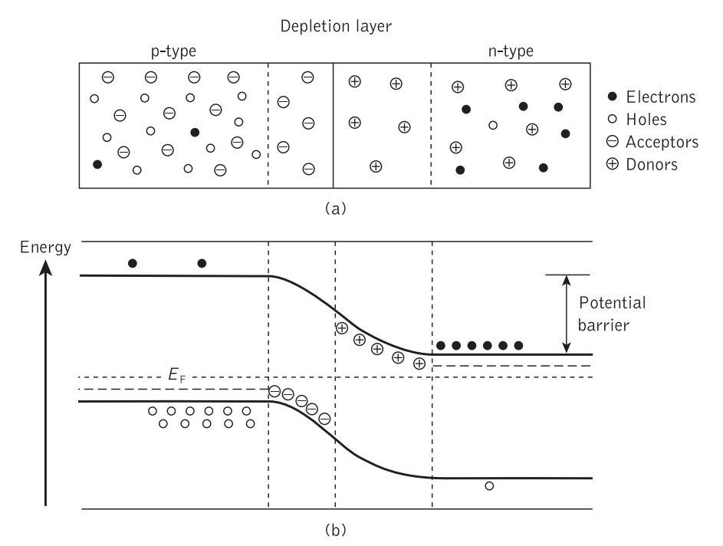
Laser

Slide 22
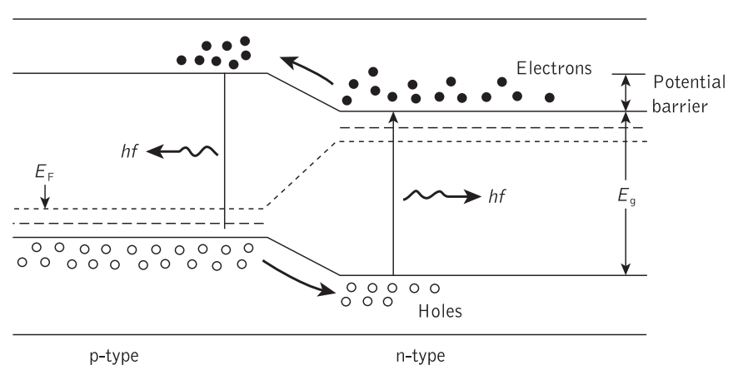
Laser

Slide 23
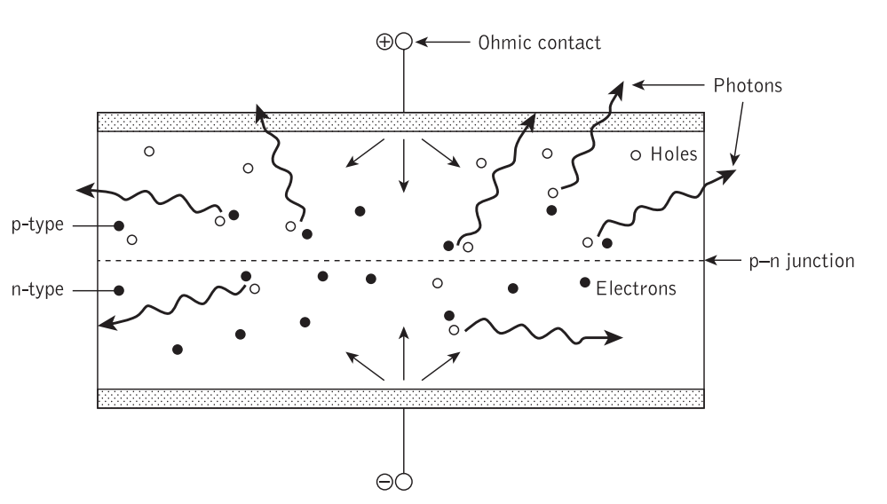
Laser

Slide 24
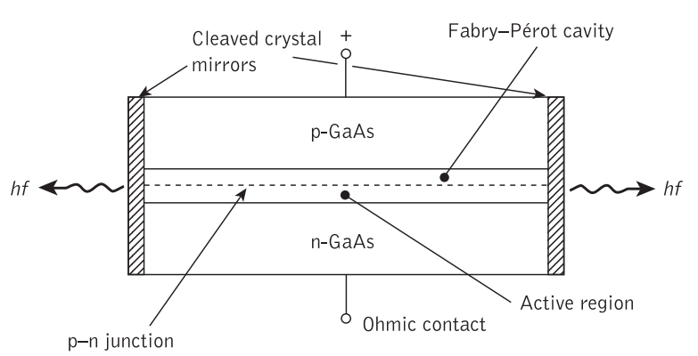
Laser

Slide 25
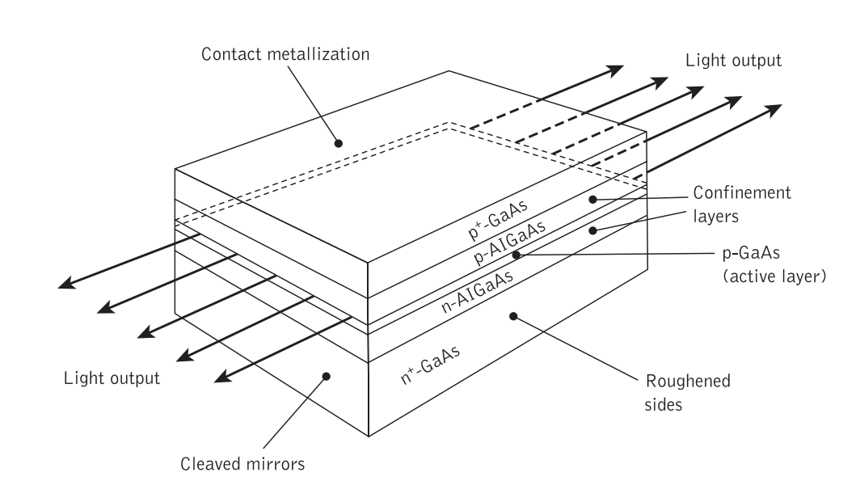
Laser

Slide 26
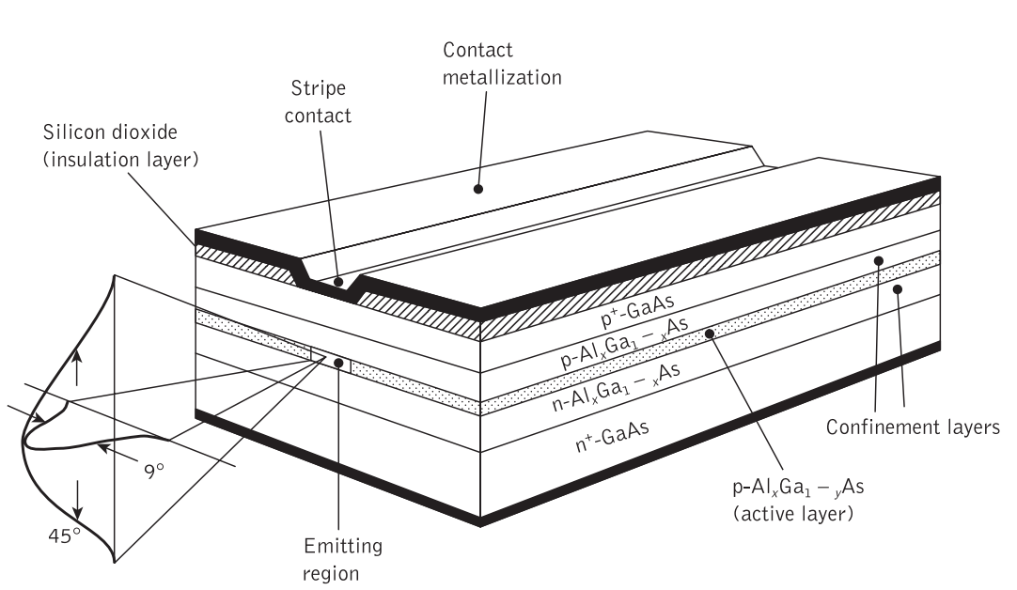
Laser

Slide 27
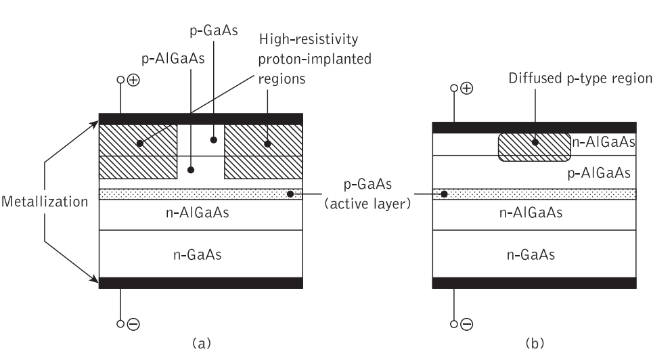
Laser

Slide 28

Thank You

