Slide 1
Notes:
Webinar 3: 07.11.17

Slide 2

Notes:
Webinar: a seminar conducted over the internet.

Slide 3


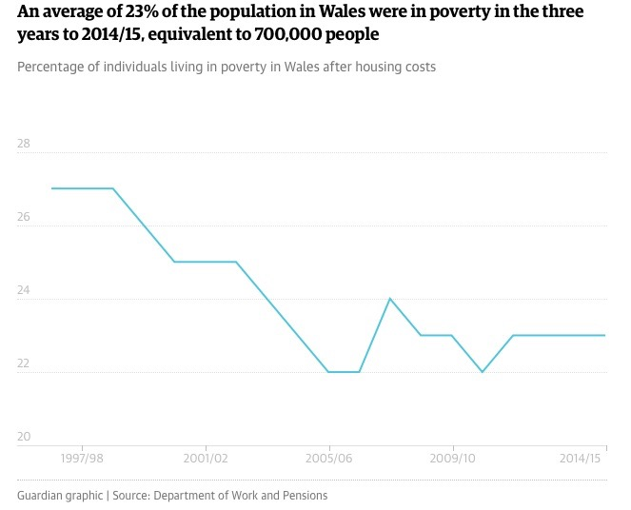

Looking abroad: what can we learn
from the international community
Notes:
Last week:
“How the world’s most improved school systems keep getting better”
20 school systems from across the globe – a statistical model that enables accurate comparison of very different systems.
The Appendix sets out the numbers:
Criteria for selecting systems: ‘promising starts’ and ‘sustained improvers’
Metric based on 1995 TIMSS score
Normalising assessment scales – accounting for variance on assessment scales.
Creating a Universal scale score and rating each country as poor, good, great or excellent.
School systems interventions database.
This week: the enduring impact of poverty in Wales

Slide 4
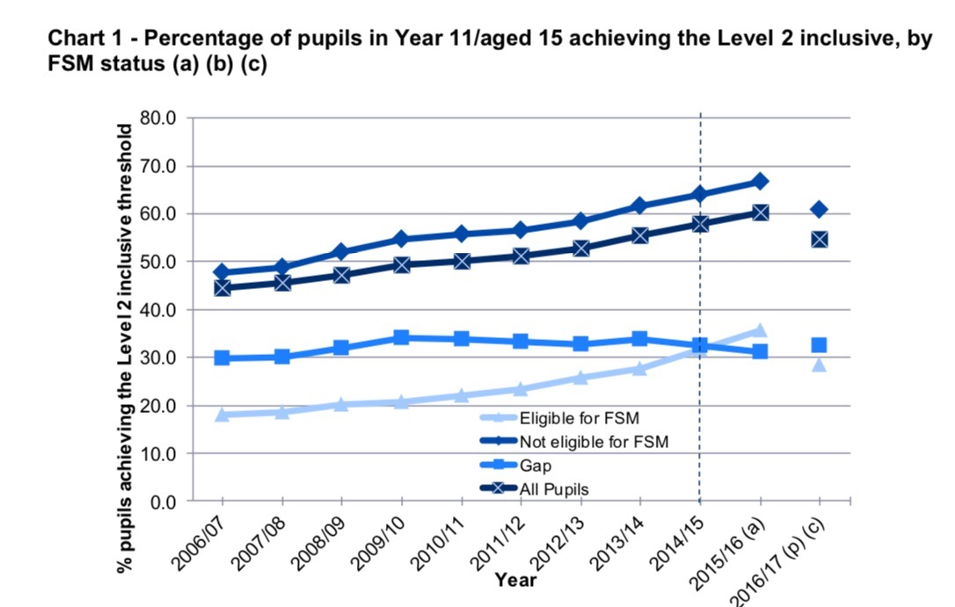
Looking abroad: what can we learn
from the international community
Notes:
Last week – a quick look at quantitative data and how it provides a foundation for a line of enquiry:
“How the world’s most improved school systems keep getting better”
20 school systems from across the globe – a statistical model that enables accurate comparison of very different systems.
The Appendix sets out the numbers:
Criteria for selecting systems: ‘promising starts’ and ‘sustained improvers’
Metric based on 1995 TIMSS score
Normalising assessment scales – accounting for variance on assessment scales.
Creating a Universal scale score and rating each country as poor, good, great or excellent.
School systems interventions database.
The picture in Wales: Foundation Phase to Key Stage 3; Key stage 4 L2 inclusive and FSM.
School Categorisation
Estyn Inspection
Performance of pupils in England: Attainment 8 and Progress 8.
Key issues:
Accurate data essential but context and paradigm give the data meaning. Evidence that the use of data for school performance measures distorts behaviour – regression to the benchmark; current debate over early entry for GCSE.

Slide 5

2017
Gap between FSM and non FSM is 32.3 points

Slide 6

Notes:
”Almost every country in the world has undertaken some form of school system reform in the past two decades…”
Wales is in the midst of its own now.
Four issues:
Intervention: A integrated set of interventions to drive reform: 1. Stage specific: e.g. Poor: literacy and numeracy; and cross stage, improve low skill teachers; Good to excellent: Peer-based learning; cross system collaboration 2. Cross stage: curriculum and standards; rewards and remuneration for teachers; data systems; national policy.
Contextualising: Navigating the challenges of context; gaining stakeholder support; mandating vs persuasion. Drivers: pace of change; degree of negotiation; degree of winners/losers; credibility of leaders
Sustaining: Changing how teachers think about teaching: collaborative practices; mediating layer; architecting tomorrows leadership.
Ignition: How do we get started? 2010 PISA Make best use of a crisis; sustaining leadership – 6 years +

Slide 7

A fund designed to support Wales’ poorest pupils is having a “positive impact” and “plays an important role” in helping to break the link between poverty and low attainment, a new report has found.
Notes:
Case study schools were using sophisticated data systems to identify individual pupils to receive additional support via PDG-funded interventions. The PDG has helped to instigate improvements in the way some case study schools collect and use data.
All schools monitored pupil-level data against individual targets. A few schools explained that they had not previously monitored eFree School Meal pupils separately, or that they had not previously monitored the impact of specific interventions.
There are examples of schools making spending decisions, and changing the way in which interventions operate, on the basis of the data they have collected to improve effectiveness.
The case studies suggest that the biggest impact of the PDG on staffing has been to increase the number and the skills of Teaching Assistants (TAs) employed by schools. TAs are often trained on implementing and evaluating the impact of the interventions they deliver and as a result are becoming highly skilled members of the school staff. The PDG has led to an increase in the size of the school staff in virtually all case study schools.
The way the PDG is spent by schools appears to have evolved over the grant’s lifetime. Several case study schools explained they had initially invested in resources and establishing data monitoring systems to track pupils’ progress using the funds, but that funds are now concentrated on the delivery of interventions, and specifically on funding staff time to deliver them.

Slide 8

https://educationendowmentfoundation.org.uk/evidence-summaries/teaching-learning-toolkit
Higgins, S., Katsipataki, M., Kokotsaki, D., Coleman, R., Major, L.E., & Coe, R. (2014). The Sutton Trust-Education Endowment Foundation Teaching and Learning Toolkit. London: Education Endowment Foundation.

Slide 9

Notes:
The two factors with the strongest evidence of improving pupil attainment are:
teachers’ content knowledge, including their ability to understand how students think about a subject and identify common misconceptions
quality of instruction, which includes using strategies like effective questioning and the use of assessment
Specific practices which have good evidence of improving attainment include:
challenging students to identify the reason why an activity is taking place in the lesson
asking a large number of questions and checking the responses of all students
spacing-out study or practice on a given topic, with gaps in between for forgetting
making students take tests or generate answers, even before they have been taught the material
Common practices which are not supported by evidence include:
using praise lavishly
allowing learners to discover key ideas by themselves
grouping students by ability
presenting information to students based on their “preferred learning style”

Slide 10

Challenges in studying teaching
and teacher effectiveness:
    Definition
    Perspective
    Characterisation
    Measurement
    Theorisation
Notes:
TABLE 1: CHALLENGES IN STUDYING TEACHING AND TEACHER EFFECTIVENESS AND SOME RELATED QUESTIONS
Challenges
The Definition challenge
How are we going to define effective teaching?
Should it be restricted to teaching in the classroom only?
Is effectiveness best viewed in relation to the teacher’s influence on student academic outcomes?
What other educational outcomes do we look at?
When do we look at the outcomes?
The Perspective challenge
Who are best placed to judge teacher effectiveness?
How do they define what constitutes effective teaching?
The Characterisation challenge
What makes a teacher highly effective?
What do they do to make their teaching effective?
What does their teaching look like?
How can we characterise effective teaching?
How can we measure its relative effects?
The Measurement challenge
How can we measure effective teaching?
What instruments do we use?
What sources of evidence should we look at?
What evidence should we give more weight to?
The Theorisation challenge
How can we organise research evidence on effective teaching in a holistic fashion?
How do the models explain the contingencies of effective teaching?
How do the models address the problem of differential teacher effectiveness and its consequences?

Slide 11
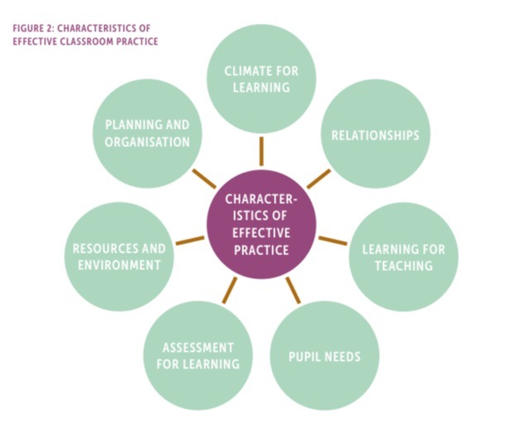
Notes:
There is a need to:
adopt a broader definition of teacher effectiveness that emphasises the promotion of students’ academic, and other kinds of educational, outcomes
understand that effective teaching is not automatically guaranteed through teacher training, professional development or long years of experience
recognise that teachers may vary in their effectiveness over time (across years) and in achieving different kinds of student outcomes and in teaching different groups of students or in different school contexts
disseminate and study relevant research and, where available, inspection evidence on effective teaching practices and evaluate their applicability in different classes and school contexts
identify and disseminate examples of successful practice from case studies of the work of effective teachers, effective departments and effective schools, through appropriate guidance and learning networks
pay attention to the influence of other factors in the school, the education system, the community and the culture that can support or that may hinder effective teaching
encourage evidence-informed teacher collaboration and self-reflection as strategies to enhance effectiveness and achieve consistency in improving effectiveness in all aspects of teaching
encourage monitoring and observation using appropriate research-based protocols to support professional learning and the development of effective practices among teachers and among subject departments
incorporate the students’ perspectives and experiences to promote positive school and classroom climates that engage and motivate learners.

Slide 13

Assessment
What matters for Leadership?
Notes:
Your issues???????

