Slide 1

Thermal Energy
Allan Nantel
October 2025

Slide 2

Definition of Heat
Heat ( H or Q in text books) is a form of energy
(also called ‘thermal energy’)
Heat is energy in transit due to differences in temperature between two systems,
It flows from a higher- temperature object to a lower-temperature object.
The hotter an object is, the faster of the motion of the molecules inside it.
HEAT is ‘the total energy of motion of all particles within the substance being heated’, that is the total kinetic energies of all the particles.
Unit of Heat: Joule (J) or Watts
You will also come across the units:
Calorie : where 1 cal = 4.187 Joules
Kilowatt hour : where 1 kWh = 3.6 MJoules
British Thermal Unit (BTU) – where 1 BTU = 1.055 kJoules
(Where 1W = 1 J/s)

Slide 3
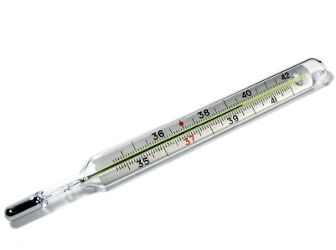
Definition of ‘Temperature’
Temperature is not the same thing as Heat.
Temperature is the condition of a body that determines whether HEAT will flow from it.
TEMPERATURE is the measure of the AVERAGE heat (or ‘thermal energy’) of the molecules inside a substance.
When we say an object has a temperature of 100 C, we don’t mean that every single molecule has that exact thermal energy. The molecules are moving with a range of energies. When we average the energies we obtain that object’s temperature.
Units : Degree CELSIUS
or Degree FAHRENHEIT
or Degree KELVIN

Slide 4
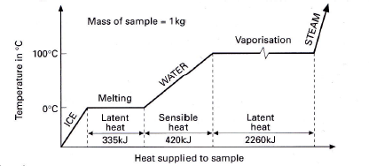
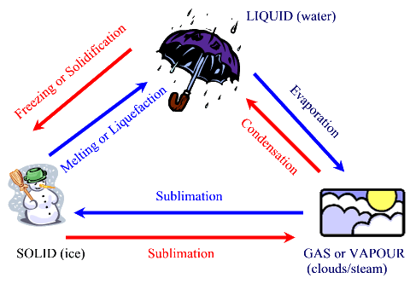
SENSIBLE HEAT: Is the heat energy absorbed or released from a substance during
a change of temperature.
LATENT HEAT: Is the heat energy absorbed or released from a substance
during a change of state, with no change in temperature.
For example: Water remains at 100°C while boiling. The heat added to keep the water boiling is latent heat, also the heat added to keep the water melting is latent heat.

Slide 5
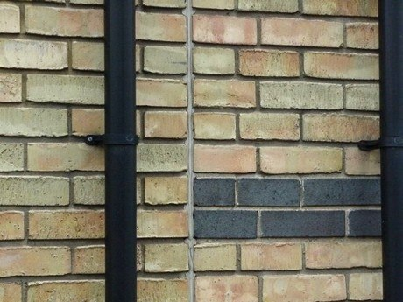
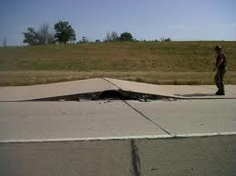
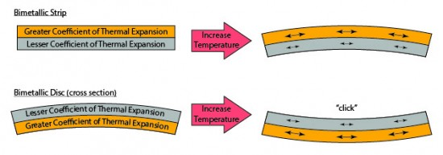
The Expansion of Solids by heating may cause serious practical problems…For example:
The expansion of railroad tracks, bridges, or the concrete in a roadbed
Rails are laid, gaps between the ends of the rails provide for expansion
(prevents buckle and de-railing)
In bridge construction: Expansion joints allow for changes in the length of the bridge.
Concrete roadbeds are built with spaces between the sections of concrete to allow
for expansion, brick walls are another example (10mm gap every 8m approx.)
Different materials expand at different rates when they are heated. For example, when a piece of iron and a piece of aluminum of equal size are heated together, we find that the aluminum expands more than twice as much as the iron (Bi-metal strip).

Slide 6
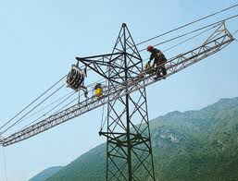
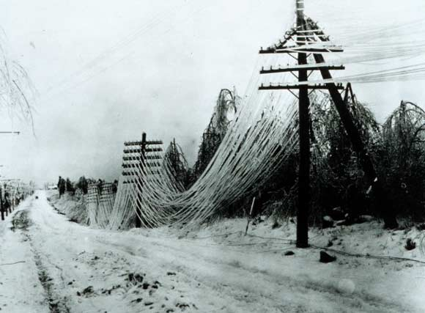
The Contraction of Solids, by cooling, may also present problems.
Telephone and electrical wires are strung loosely to prevent their snapping as
contraction takes place during the colder times of the year.

Slide 7
The 3 Temperature Scales
1. Fahrenheit Scale
Gabriel Fahrenheit modified Ole Rømer’s scale (1701) in 1724 and used Mercury as
liquid in device which increased Rømer’s range of measurement.
Used the temperature of the human body as 100 on scale.
Adjusted the scale so the melting point and boiling point of water were whole
numbers, and difference was 180.

Slide 8
2. Celsius Scale
First proposed by the Swedish Astronomer Anders Celsius in 1742
He set it up as 100º as the freezing point and 0º as boiling point.
Swedish Botanist Carolus Linnaeus is among many scientist who switched the direction of
the scale around in 1744
From 1744 until 1948, it was called the ‘Centigrade’ scale
Name changed to Celsius due to conflicts in translations with measures of angles.
(1 centigrade = 1/10,000 of a right angle)
1954 reformatted to directly match Kelvin Scale
Correctly written as degrees Celsius

Slide 9
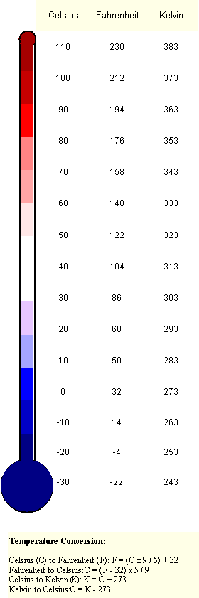
3. Kelvin Scale
The Kelvin scale, named after its originator, Lord Kelvin, is based on absolute temperatures.
Scientists refer to -273°C as ‘absolute zero’, a temperature that had never been attained, but a temperature below ‘absolute zero’ has been achieved by physicists at the Ludwig-Maximilians University, Munich. Researchers have created an atomic gas in the laboratory that has exceeded these negative Kelvin values (2013)
Absolute zero, -273°C, is also called 0 Kelvin ( 0 K ).
Since the Kelvin scale begins with absolute zero (-273° C), we use the following formula to convert the Celsius scale to the Kelvin scale:
Degrees Kelvin = Degrees Celsius + 273 degrees
Thus, 100° C is equivalent to 373 K

Slide 10
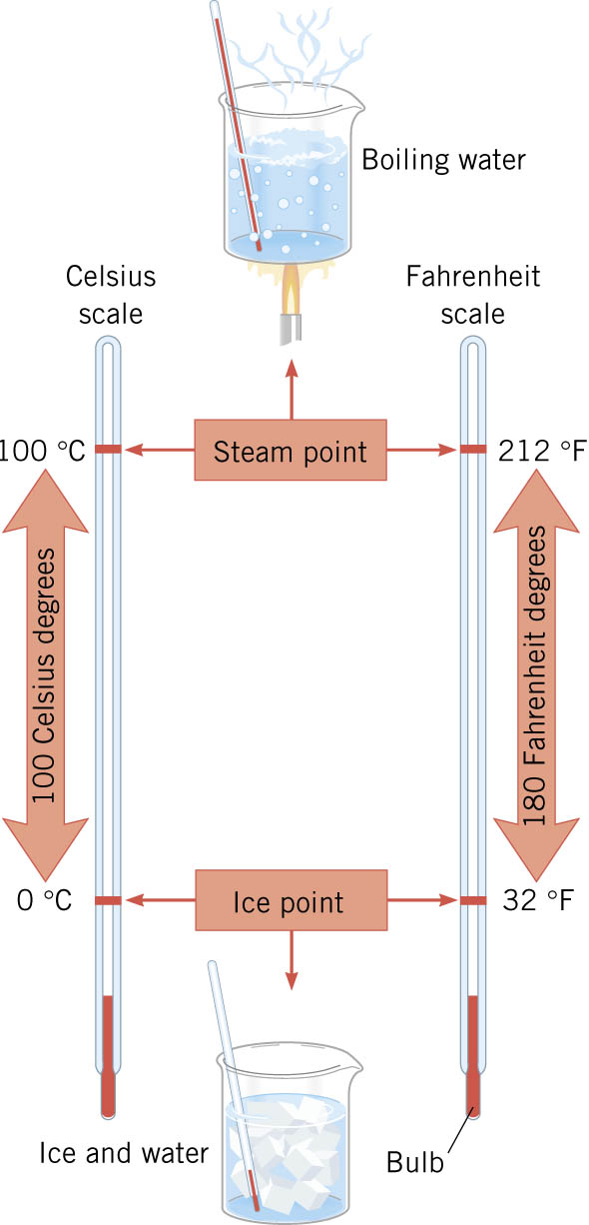
Temperatures are reported largely in degrees
Celsius or degrees Fahrenheit.
Fahrenheit to Celsius | (°F - 32) x ⁵/₉ = °C
Celsius to Fahrenheit | (°C × ⁹/₅) + 32 = °F
Kelvin = Degrees Celsius + 273 degrees
COPY DOWN

Slide 11
Conversions
Fahrenheit to Celsius | (°F - 32) x ⁵/₉ = °C
Celsius to Fahrenheit | (°C × ⁹/₅) + 32 = °F
Kelvin = Degrees Celsius + 273 degrees
Why 32?
Why the 9/5 or 5/9 ?
There are 180 divisions between the freezing and boiling point of water on the Fahrenheit scale, and only 100 on the Celsius scale.
So ....each Celsius division is 9/5 as large as a Fahrenheit division.

Slide 12
1. Example: Convert 26° Celsius (a nice warm day) to Fahrenheit
Celsius to Fahrenheit
(°C × ⁹/₅) + 32 = °F
First: 26° × 9/5 = 234/5 = 46.8
Then: 46.8 + 32 = 78.8° F
2. Example: Convert 98.6° Fahrenheit (normal body temperature) to Celsius
Fahrenheit to Celsius
(°F - 32) x ⁵/₉ = °C
First: 98.6° - 32 = 66.6
Then: 66.6 × 5/9 = 333/9 = 37° C
3. What is this value of ° C on the KELVIN scale?
= 37 + 273 = 310 Kelvin

Slide 13
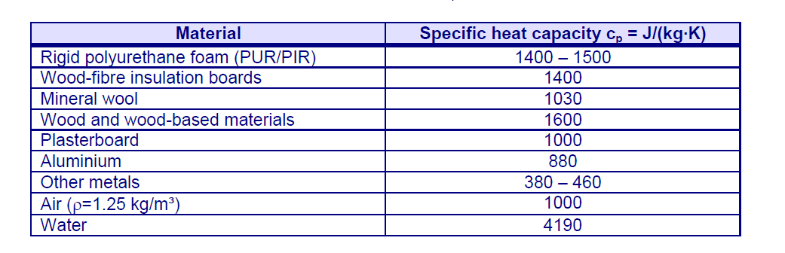
Specific heat capacity
The same mass of different materials can hold different quantities of heat. The heat capacity of a material is measured by a ‘specific’ value...that is specific to that material.
The Specific Heat Capacity is how much heat energy is required to increase the temperature of 1 kg mass of that material by 1 degree Kelvin or 1 degree Celsius.
Specific heat capacity is measured in J/ kg ° K or J/ kg ° C
Notice that water has a particularly high specific heat capacity.
This makes water useful for storing heat energy, and for transporting it around the home
using central heating pipes and for general temperature regulation and control.

Slide 14
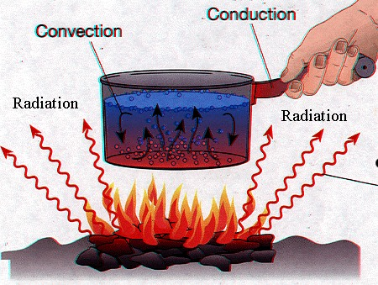
Methods of TRANSFER of HEAT
When a metal spoon is placed in a bowl of hot soup, the entire spoon soon becomes hot because the heat travels from the soup to the bowl-shaped part of the spoon, and then to the handle.
When ice is placed in warm water, the ice soon melts.
Both of these examples show that heat travels from one body to another. When objects are at different temperatures, heat is transferred from the warmer object to the cooler object until both objects are at the same temperature (equilibrium).
Heat transfer can occur through one of 3 methods:
1. Conduction
2. Convection
3. Radiation

Slide 15
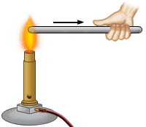
1. CONDUCTION
When one end of a rod is heated, the molecules in that end of the rod vibrate faster and strike other nearby molecules, causing them to vibrate faster. In this manner, the increased molecular motion is transferred from one end of the rod to the other, permitting the heat to travel through the rod.
Substances that allow heat to pass through them are called Conductors
Substances that do not readily allow heat to pass through them are called Insulators
CONDUCTION is heat transfer by PHYSICAL CONTACT
The ‘Thermal Conductivity’
of a material is a measure of its ability to conduct heat.

Slide 16
1. CONDUCTION (CONTINUED)
Gases are generally poor conductors of heat because their molecules are farther apart than are the molecules in solids
Therefore, neighbouring molecules in a gas are less affected by the increased motions of heated molecules, and consequently heat is not conducted rapidly through them.
WHERE CAN WE SEE THIS FACT BEING USED TO ADVANTAGE IN CONSTRUCTION?
Substances like wood or plastic are poor conductors of heat.
The clothing we wear to modify our comfort levels is also a poor conductor of heat,
enabling us to retain body warmth or give it up by removal of layers.
Porous material is generally less well conducting because it contains layers of trapped air
which do not permit heat transfer easily.
Cavity Walls…..Double glazed Windows…..Air entrapped Insulation.

Slide 17
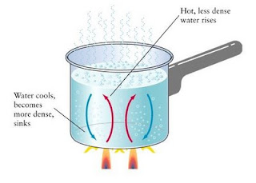
2. CONVECTION
Although gases and liquids are poor conductors of heat, heat is transferred through them by the process of convection.
Convection is the transfer of heat due to the motion of the liquid or gas itself.
For example, when a pan of water is heated the water layer closest to the heat source is warmed slowly by
conduction.
As the water becomes warmer, it expands, becomes less dense, and rises.
This brings heat to the upper layer.
At the same time, cooler water from the upper portion of the beaker moves down, takes the place of the rising water,
and becomes heated itself.
When warm enough, this water rises and carries heat upward.
As these processes continue, heat that enters the bottom of the pan is distributed throughout the pan
until all the water is at the same temperature.
The moving water in such a case is said to have set up a ‘Convection Current’.
How can we can link this process to heating in our buildings for comfort?

Slide 18
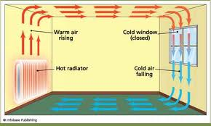
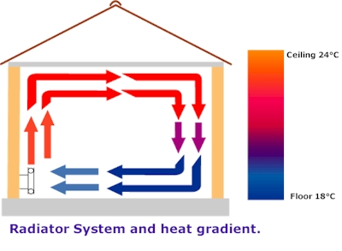
2. CONVECTION (CONTINUED)
Heat is transferred through gases by Convection.
It is by this means, in part, that a stove or a radiator heats a room. Heat from the radiator warms the air above it, causing the air to expand, become less dense, and rise. The cooler air that moves in to take the place of the warmed air is also soon warmed. As this air rises, a convection current is established.
The convection current continues to distribute heat throughout the room until the entire room is warm, and it is in equilibrium temperature.
‘Thermal Buoyancy’

Slide 19
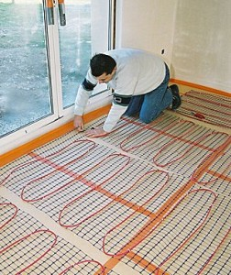
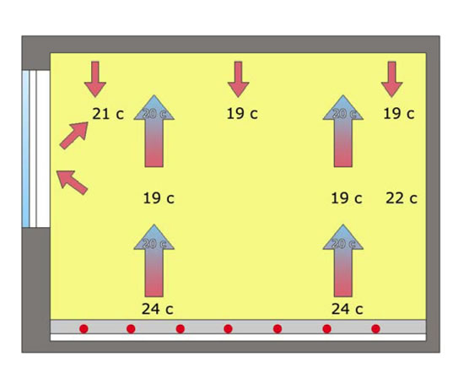
How do you think Under-floor heating compares to radiator heating for efficiency and comfort?

Slide 20
3. RADIATION
We know that light energy and heat energy travel from the sun to the earth through space, which is an
almost perfect vacuum.
These forms of energy, travelling without the aid of molecular collisions, are transferred from the sun
to the earth by radiation, that is, by means of rays, or waves.
You can understand this method of heat transfer by standing a short distance from an open fire or
by placing your hand a little to one side of a hot radiator.
Since neither source of heat is being touched, you cannot receive heat by conduction.
Since warm air rises vertically from the heat source, the heat cannot reach you by convection.
The heat that is transferred to you from the fire or radiator reaches you by radiation.
In warm climates, light colours which reflects the radiant heat of the sun are cooler than dark
colours which quickly absorbs the radiant heat.
Bodies that are shiny and smooth do not absorb heat readily…
Instead, these bodies reflect heat (Walt Disney Building, Los Angeles)

Slide 21
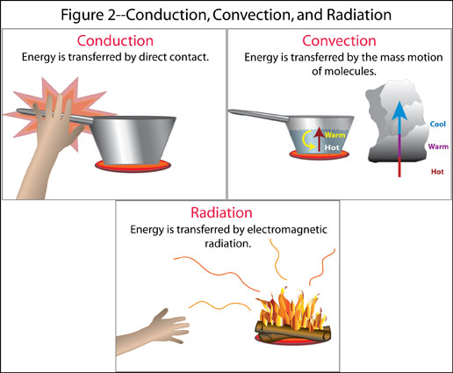
HEAT FLOW - SUMMARY
CONDUCTION
Conduction is the transfer of energy through solid matter from particle to particle. Heat is conducted through a solid material much the same way electricity is. (Direct Touch)
Conduction is slowed by insulation.
CONVECTION
Convection is the transfer of heat energy through a gas or liquid by movement of currents. Heat is carried by the fluid. When warm air comes out of a radiator, it rises. This action is called Thermal Buoyancy. As it cools, it falls. This rising and falling movement is called Convection Current.
Convection can be interrupted by a physical barrier.
(Movement of Hot Air / Liquid)
RADIATION
Radiation is electromagnetic waves which directly transport heat energy (and light) through space. It is radiated through space to our planet without the aid of fluids or solids. Heat energy transferred through radiation can be interrupted by a material which reflects it. (Heat through radiated waves)

Slide 22
What ‘user centered’ issues do we have with regard to provision of heating, in relation to design, environmental control and use of a space?

Slide 23
Insulation : Consider your own home.
1.Why Insulate?
List 5 Reasons
2. Where do you think insulation is
most efficiently incorporated into
the building fabric , and why ?
10 minutes

Slide 24
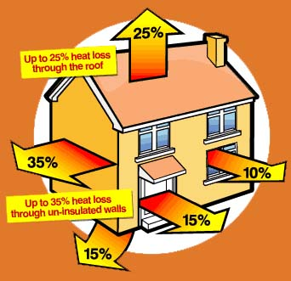
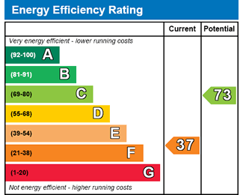
Insulation : Why Insulate?
The main benefits include:
1. Reduce gas & electricity bills
2. Reduce your home’s carbon footprint
3. Keep your house warmer in winter
4. Keep your house cooler in summer
5. Improve your home’s energy efficiency rating
6. Increase the value of your home
Winter heat losses and Summer heat gains.
When you sell your home you will need to get an Energy Performance Certificate (EPC). These help the buyer to see how efficient your home is – the building will be given a rating from A-G.
‘A’ represents the most energy-efficient properties and ‘G’ the worst. The EPC will also advise you on what improvements would be best to help to cut carbon emissions and fuel bills.
If you’re selling a property in England or Wales, you must get an EPC.

Slide 25
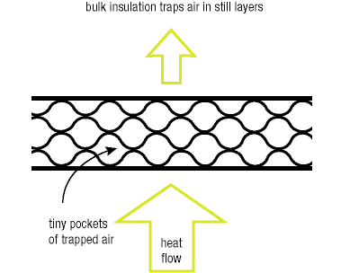
Principle of insulation – A resistance to flow
Resistance to heat flow is achieved using either ….
Bulk insulation
Reflective insulation
Bulk insulation –employs air
entrapment
Bulk insulation traps millions of tiny pockets of still air within its structure. These air pockets provide the resistance to heat flow.
Bulk insulation reduces radiant, convective
and conducted heat flow
Bulk insulation and heat flow
Notes:
Every time HEAT ENERGY HITS ONE OF THESE MEDIUMS IT ENCOUNTERS A RESISTANCE TO HEAT FLOW.
PARTICULARLY EFFICIENT IF A MIXTURE OF SOLID AND GAS

Slide 26
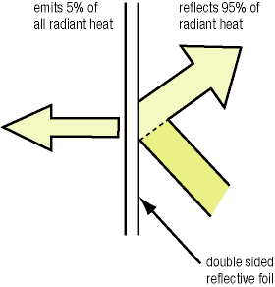
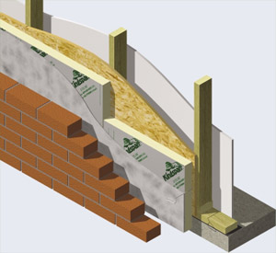
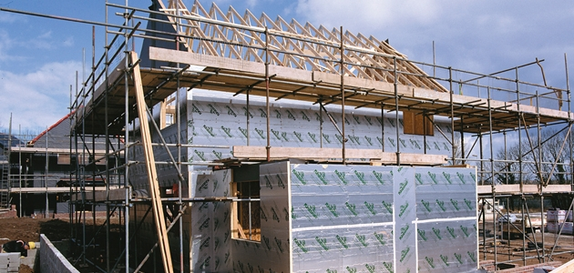
Reflective insulation
Reflective insulation works by reducing the radiant heat transfer across an enclosed space, e.g. between bricks and plasterboard in an insulated brick veneer wall.
Reflective foil in walls or under the roof reflects radiant heat away from the interior in summer, and retains heat internally during the winter. It works most effectively in conjunction with a still air layer (enclosed air space) of at least 25 mm.
Reflective insulation needs to remain clean and dust-free for best performance.
Reflective insulation and heat flow
Kingspan Board

Slide 27
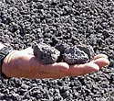
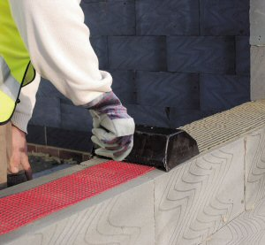
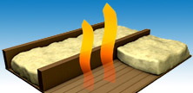
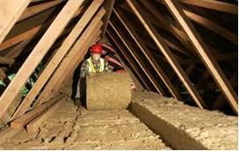
Types of thermal insulators
The common types of thermal insulators used in construction are grouped as follows :-
Rigid pre-formed materials
Flexible materials
Slag derived aggregate
Aerated concrete block
Fiberglass quilts

Slide 28
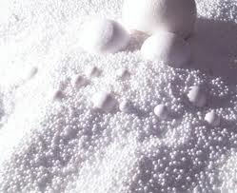
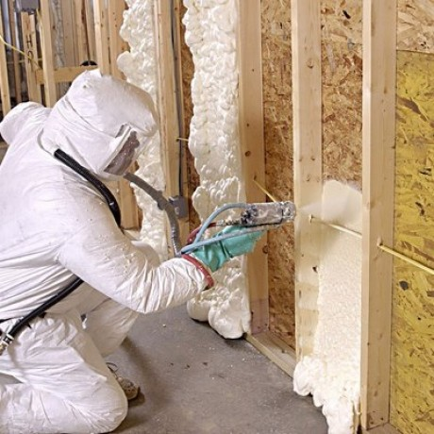
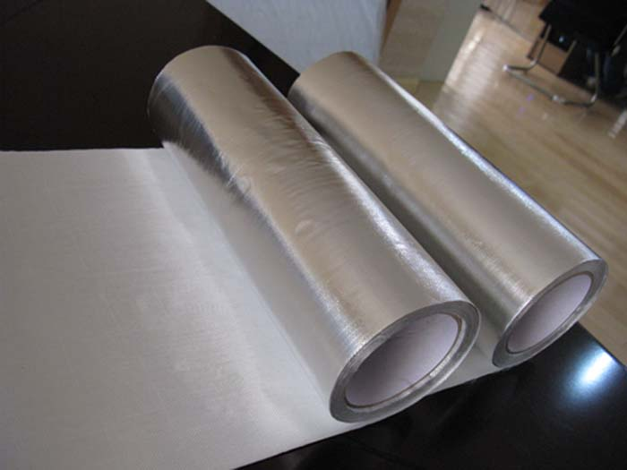
Loose fill materials
Materials formed on site
Reflective materials
Expanded polystyrene granules
Foamed polyurethane
Aluminium foil

Slide 29
How insulation performance is measured
1. R value – Thermal Resistance to Flow
All insulation materials are rated for their performance in restricting heat transfer. This is expressed as the R value, also known as thermal resistance or resistivity.
The R value is a guide to its performance as an insulator—
The higher the R value, the greater the insulating effect.
R values are expressed using the metric units m² K / W
(1 WATT = 1 Joule / second)
where:
m² refers to one metre squared of the material of a specified thickness;
K refers to a one degree temperature difference (Kelvin or Celsius) across the
material;
W refers to the amount of heat flow across the material in Watts.
Products which have the same R value will provide exactly the same insulating effect as each other (provided they are correctly installed)

Slide 30
2. U Value – Thermal Transmittance
The U value measures the transfer of heat through a building element,
and indicates the amount of heat energy that will flow through one square metre of a structure, when the temp difference between their faces is 1 degree.
Whereas the R value measures the resistance to heat transfer
(‘thermal resistance’)
U value measures the flow of heat transfer (‘thermal transmittance’)
The U value is expressed in units of W/m² K
U values are often used in technical literature, especially to indicate the thermal
properties of glass and to calculate heat losses and gains.
The U value is the reciprocal of the R value, R=1/U or U=1/R
U = 1 or U = 1 (if we consider composites)
R Σ R
For example, with an R value of 2.0, the U value is 1/2 or 0.5
R and U values are dependant on the thickness of the material.

Slide 31
Heat power loss – The transfer of energy
1.
To find the heat power loss through any area of a composite structure for any
temperature difference between the faces, the U value is multiplied by the
area and the temperature differences on either side of the layer.
Heat Loss = U value x Area X Temperature difference.
P = U x A x (θ₁ – θ₂)
Units = Watts
2.
The power loss from an enclosure due to conduction through the fabric is
obtained by adding together the individual heat losses from:
walls
floors
ceilings
doors
windows etc.

Slide 32
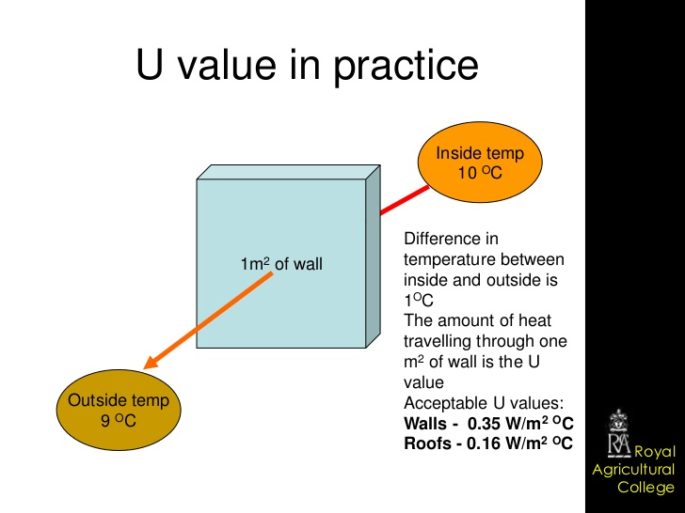
Heat Loss = U value x Area X Temperature difference.
P = U x A x (θ₁ – θ₂)

Slide 33
Example 1:
Calculate the heat power loss from a sealed flat-roofed kitchen 12m x 10m x 3m high when the internal temperature is 22 degrees C and the external temperature is -3 degrees C.
The U values : Floor 1.5 W m² K
Roof 3.0 W m² K
Walls 2.5 W m² K
P = U x A x (θ₁ – θ₂)
1 WATT = 1 Joule / second
Note : Be careful with the area of the walls.

Slide 34
ANSWER
Draw up a table:
Item U value Area Temp. Difference POWER LOSS
Floor 1.5 120 25 4500
Roof 3.0 120 25 9000
Walls 2.5 132 25 8250
21,750
Total Power Loss = 21,750 Watts
So.....the amount of heat that has to be supplied to this space every second is 21750 Joules or 21.75 KJ in order to maintain the required 22 degree Celsius internal temperature. (1 WATT = 1 Joule/second)

Slide 35
PART 2

Slide 36
3. Thermal conductivity
Thermal conductivity coefficient (λ) is a measure of the rate at which heat is conducted through a particular material under specified conditions.
Units : W/m K (Watts per metre Kelvin)
Measurement of thermal conductivity
The Coefficient of thermal conductivity (lambda λ (or k value)) is measured as the rate of heat flow in watts across a thickness of 1 m of material for a temperature difference of 1 degree Kelvin and a surface area of 1 m²
H = λ Α (θ₁ – θ₂)
t d
where
H/t = rate of heat flow (conductivity) between the faces (J/s=Watt)
λ = coefficient of thermal conductivity for that material (Watt/m K)
Α = cross sectional area of the sample (m²)
θ₁ – θ₂ = temperature difference between the faces (º C or º K)
d = distance between the faces (m)
Rate of Heat Flow =
x
x
(Conductivity)

Slide 37
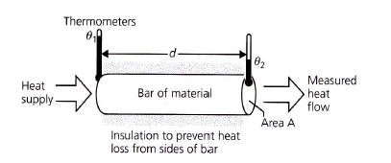
Conductivity
Rate of HEAT FLOW
H = λ Α(θ₁ – θ₂)
t d
= coefficient of thermal conductivity for that material
(Watt/m K)
=
(Conductivity)
Resistivity (r)
Resistivity (r) is the alternative index of conduction in materials and is the reciprocal of thermal conductivity.
r = 1 / λ
Similarly, the Units for resistivity are also the reciprocal to λ
And so are m K /W

Slide 38
Rate of Heat Flow (Conductivity)
=
H = λ Α(θ₁ – θ₂)
t d
EXAMPLE 2 :
What is the rate of heat energy conduction (heat flow) through a single pane of glass of thickness 5mm and dimensions 70cm x 30 cm when the temperatures of the glass surfaces are 21 degrees internally and 6 degrees externally.
The thermal conductivity of glass is 1.1 W /m K
Note : Be careful of units. Convert dimensions to Metres.

Slide 39
ANSWER
Rate of Heat Transmission
=
H = λ Α(θ₁ – θ₂)
t d
= 1.1 x ( 0.7 x 0.3) x ( 21 – 6 )
.005
= 693 WATTS
Brought from centimetres to metres because of the Units of Thermal Conductivity
Rate of Heat Transmission
=
693 joules per second.

Slide 40
Thermal conductivity values
Thermal conductivity values for building materials can vary due to the following :-
Manufacturing variations in density or thickness
  Different manufacturing batches may vary in thickness / density for brickwork,
  stone / concrete / insulation, hence affecting the thermal conductivity values
Changes in moisture content
  The presence of water in pores increases conduction and hence increases
  thermal conductivity values or decreases the insulation effects
Effects of time on insulating properties
  Some materials e.g. plastic based materials deteriorate in performance as
  they age.

Slide 41
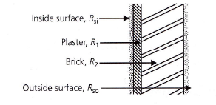
R-values -
Thermal Resistance
Thermal Resistance R is a measure of the opposition of heat transfer offered by a particular component in a building element.
Unit : m² K/W
There are 3 general types :-
Material resistances
Surface resistances
Airspace resistances
For composite elements, the total thermal resistance is the sum
of the thermal resistances of all components in a structural element.
E.g.
R_{T} = R _{si} + R₁ + R₂ + R _{so}

Slide 42
Resistances can be of three types
The resistance of each layer of material in the structure depends on the rate at which the material conducts heat and the thickness of that material. The resistance can be calculated:
R = d / λ
1. Material Resistances:
Where R = Thermal resistance of the component (m² K/W)
d = The thickness of the material (m)
λ=
Thermal conductivity coefficient of the material ( W / m K )
2. Surface Resistances:
Table 1 and 2 of EN ISO 6946 : 2017
Usually found by consulting standard table values.
2 Factors affecting are :- ??
Climatic effects – sheltered or exposed
Surface properties - polished or normal building material

Slide 43
3. Airspace Resistances:
Usually found by consulting standard values.
3 Factors affecting are :- ??
Width of the air space
Flow of air – whether the space is ventilated or un-ventilated
Lining of airspace – normal material surface or ‘reflective’ surfaces

Slide 44
Summary...
Lambda λ (Thermal Conductivity)
Thermal conductivity is the rate at which heat is transmitted through a material, measured in watts per square metre of surface area for a temperature gradient of one Kelvin per metre thickness - simplified to W/m K
The Lower the value, the better the thermal efficiency of the material in resistance.
R-Value (Thermal Resistance)
Thermal resistance is measured in m² K/W and is equal to the thickness of the material (in metres) divided by the conductivity coefficient of that material. The resistances of each material within an element are added together to determine the overall resistance of the element. The higher the R-value, the more efficient the insulation.
U-Value (Thermal Transmittance)
Thermal transmittance, commonly known as the U-value, is a measure of heat loss through a building material / component. It is expressed as watts per square metre, per degree Kelvin, W/m²K. The U-value is calculated from the reciprocal of the combined thermal resistances of the materials in the element, air spaces and surfaces, also taken into account is the effect of thermal bridges, air gaps and fixings. The lower the U-value, the lower the heat loss.
Note : Surfaces and cavities also provide thermal resistance and there are standard figures for
these resistances that must be taken into account when calculating overall U-values.

Slide 45
Example 3 – U value of composites
Calculate the U-value of a composite cavity wall with a 103mm thick brick outer leaf,
50 mm of clear cavity, 40 mm of insulation board, then a 115mm high performance
aerated concrete block inner leaf with a 15 mm layer of lightweight plaster.
Values of thermal conductivity for the ‘solid’ elements in W/m K are :-
Lightweight plaster 0.18
Aerated concrete block work 0.11
Insulation board 0.025
Brickwork 0.77
Standard thermal resistances are in m²K /W are :-
Internal surface 0.12
External surface 0.06
Cavity 0.18
Remember to convert your thicknesses to metres

Slide 46
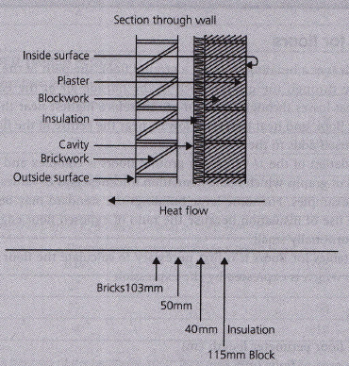
Answer
Step 1 Sketch a diagram indicating all parts of the construction and surface layers

Slide 47
Step 2 : Tabulate all information and where necessary, calculate thermal resistance using formula R = d/ λ
Note : Convert thicknesses to Metres
 | Thickness Layer d (m) | Thermal conductivity λ (W/m K) | R = d/ λ (m² K/W) | Resistance R (m² K/W)
Internal surface | n/a | n/a | Standard | 0.12
Lightweight plaster
Aerated concrete block
Polyurethane insulation board
Clear cavity | 0.050 | n/a | Standard | 0.18
Exposed brickwork
External surface | n/a | n/a | Standard | 0.06
 |  |  | Total resistance R_{T}

Slide 48
Answer
Step 2 Tabulate all information and where necessary, calculate thermal resistance
using formula R = d/ λ
 | Thickness Layer d (m) | Thermal conductivity λ (W/m K) | R = d/ λ (m² K/W) | Resistance R (m² K/W)
Internal surface | n/a | n/a | Standard | 0.120
Lightweight plaster | 0.015 | 0.18 | 0.015 / 0.18 | 0.083
Aerated concrete block | 0.115 | 0.11 | 0.115 / 0.11 | 1.045
Polyurethane insulation board | 0.040 | 0.025 | 0.040 / 0.025 | 1.600
Clear cavity | 0.050 | n/a | Standard | 0.180
Exposed brickwork | 0.103 | 0.77 | 0.103 / 0.77 | 0.133
External surface | n/a | n/a | Standard | 0.060
 |  |  | Total resistance R_{T} | 3.222

Slide 49
Answer
Step 3 Use the U-value formula
U = 1 / R_{T}
U = 1 / 3.222
U value for the whole wall = 0.310 W /m² K
The amount of heat energy that will flow through 1m² of this composite wall when the temperature difference between the faces is 1 degree K.

Slide 50
Example 4: Combining U values
Average U Values
To calculate the average U values, the general formula is as follows :-
U (average) = (A₁ x U₁) + (A₂ x U₂) +……
A₁ + A₂ +…
Where A₁ , A₂ etc are the areas with the U values U₁ ,U₂ etc

Slide 51
Example 4
A 3-bedroom semi detached house has a total window area of 20m² with a mixture
of 16m² double glazing and 4m² single glazing, The U values are
  1.8 W/m² K for the double glazing
  2.8 W/m² K for the single glazing
Calculate the average U value of the windows.
U (average) = (A₁x U₁) + (A₂ x U₂) +……
A₁ + A₂ +…
Step 1 : List your known values
Step 2 : Substitute into the formula above

Slide 52
Answer
A 3 bedroom semi detached house has a total window area of 20m² with a mixture
Of 16m² double glazing and 4m² single glazing, The U values are
  1.8 W/m² K for the double glazing
  2.8 W/m² K for the single glazing
Calculate the average U values of the windows.
Step | Calculation
Known values | U₁ = 1.8 W/m² K A₁= 16m²
 | U₂= 2.8 W/m² K A₂= 4m²
Unknown value | U (average) = ?
Use formula | A₁U₁ + A₂U₂ A₁ + A₂
Substitute in formula | (16 X 1.8 )+ (4 x 2.8) (16 + 4)
 | = 28.8+ 11.2 = 40 = 2 20 20
Therefore the average U values of windows are 2.0 W/m²K

Slide 53
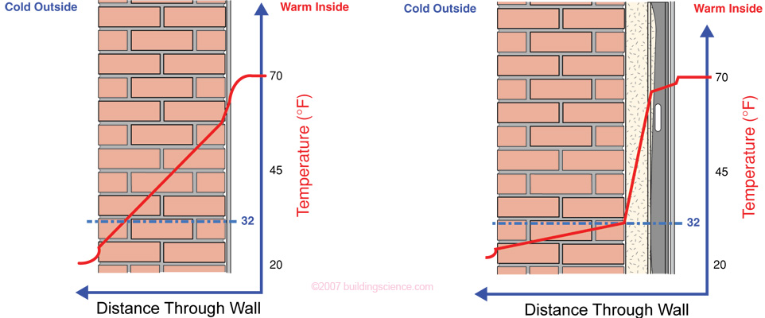
5. Temperature gradient
A temperature difference between the inside and outside of a wall or roof
causes a progressive change in temperature from the warm side to the cold side.
This Temperature Gradient changes uniformly through each component, provided
that the material is homogenous, and the temperatures remain constant .
Inside temperature
Boundary temperature
Temperature gradient
Outside temperature
Possible location of condensation and freezing planes

Slide 54
Temperature gradient
The temperature existing at any point in a wall under any given exterior and interior temperature conditions is of great significance in designing problem-free building enclosures. An ability to calculate the thermal gradient permits the designer to forecast the location of condensation and freezing planes in the wall, and to assess the suitability of any construction.
The formula below applies to calculating the temperature difference at boundary points :-
(θ = Theta)
θ = R
θ_{T} R_{T}
Where: Δθ = temperature difference across a particular layer
R = resistance of that layer
θ_{T} = total temp difference across the whole structure
R_{T} = total resistance of the whole structure
COPY DOWN

Slide 55
Example 5 -
A room has an external wall with a U value of 1.5 W/m²K
and contains air at 20ºC when the outside temperature is 5ºC .
The resistance of the internal surface layer ( a plaster) is 0.12 W/m²K.
Calculate the boundary temperature on the internal surface of the wall.
OUT
IN
θ = R
θ_{T} R_{T}
20ºC
5ºC
?
where Δθ = temperature difference across a particular layer
R = resistance of that layer
θ_{T} = total temperature difference across the structure
R_{T} = total resistance of the structure
COPY DOWN

Slide 56
Answer
A room has an external wall with a U value of 1.5W/m²K and contains air at 20ºC when
the outside temperature is 5ºC .
The resistance of the internal layer is 0.12W/m²K.
Calculate the boundary temperature on the internal surface of the wall.
Temperature drop across internal surface layer = Δθ = ?
Total temperature drop across wall = θ_{T} = 20-5 = 15ºC
Resistance of internal surface layer = R = 0.12
Total resistance of the wall = R_{T} = 1/U
= 1/1.5
= 0.667
Total resistance of the wall ???

Slide 57
Answer (contd.)
θ = R
θ_{T} R_{T}
Δθ = 0.12
15 0.667
Δθ = 0.12 x 15 = 2.699 say 2.7 degrees
0.667
Temperature drop across internal surface layer (the plaster) = 2.7ºC
So boundary temperature on the inside surface of the plaster is….
= 20ºC – 2.7ºC = 17.3ºC

