Slide 1
Effective Team Working and Communication
Student Name: ANGHELUS BORONICA
Student ID:2120839
Module Code:BMSW4002

Slide 2
Table of Contents
Introduction
Overview of the Organization
The Stakeholders of the Organization
The Benefits of Effective Communication
The Process of Using the Theories Relating to Models of Communication
The types of barriers
How to Improve Communication?
Conclusion
References

Slide 3
Introduction
This presentation includes the strategies for effective communication in the business setting of British American Tobacco Plc (Mathebula, 2022).
It presents the overview of the company and the stakeholders of it. It will show the benefits of effective communication in this company. It also discussed the process of using the theories that are related to model of communication.
At the end of the presentation, we have discussed the barriers of communication and the ways of improving it.

Slide 4

Overview of the Organization
The selected company is British American Tobacco PLC. Its characteristics are as below:
  The largest tobacco producing company
  A UK based multinational company.
  It produces cigarettes and other nicotine products and sells them.
  It established in the year 1902.
  Its headquarter is in the London, England.

Slide 5
The Stakeholders of the Organization
Shareholders
Shareholders
Employees
Contractors
Trade Unions
Suppliers
Business Partners
Farmers
Customers
Adult Consumers
Government
The leaders of key opinion
NGOs
Scientific Communities
Industries
Peer companies
Media and journalists
(Guffey and Loewy, 2014)

Slide 6
The Benefits of Effective Communication
There are numerous benefits of effective communication (Kaul, 2014). They are mentioned below:
It help to increase trust
It build up the team work environment
It make the relationship with the consumers better
It helps to increase the job satisfaction among the employees
It increases the productivity of the employees
It increases the engagement of the employees
It increases the problem solving capability
It enables the capability of handling the capability

Slide 7

The Process of Using the Theories Relating to Models of Communication
Communication model of Shannon Weaver.
Lasswell communication model.
Berlo communication model.
Barnlund communication model.
Schramm communication model.
(Sutter and Kieser, 2019)

Slide 8
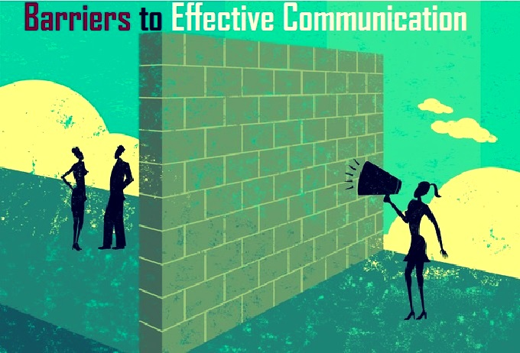
The Types of Barriers
Personal
Gender
Physical
Cultural
Fear
Criticism
Organizational
Linguistic inability
Physiological
(Al-Weshah and Al-Zubi, 2012)

Slide 9

How to Improve Communication?
Some effective ways of improving communication with the customers and the stakeholders (Kalogiannidis, 2020).
Try to build a better relationship with the customers
Be attentive to the customers
Engage with the reviews of the customers
Develop the standard of the customers service
Provide solution to the problems of the customers as soon a possible
Keep marketing with positive vibe

Slide 10
Conclusion
The whole presentation gives the idea of a business’s communication strategy and how it works effectively.
It has introduced the British American Tobacco Plc and its stakeholders. How the company is being benefitted by the effective communication is also discussed here.
The barriers of the effective communication of British American Tobacco Plc and how they have come solve them and improved their communication has been discussed in this presentation. Hope this presentation help one to get a clear idea about strategies for effective communication.

Slide 11
References
Kaul, A., 2014. Effective business communication. PHI Learning Pvt. Ltd..
Kalogiannidis, S., 2020. Impact of effective business communication on employee performance. European Journal of Business and Management Research, 5(6).
Conrad, D. and Newberry, R., 2012. Identification and instruction of important business communication skills for graduate business education. Journal of Education for Business, 87(2), pp.112-120.
Guffey, M.E. and Loewy, D., 2014. Business communication: Process and product. Cengage Learning.
Mathebula, P.W., 2022. British American tobacco PLC: an analysis of the group's pricing strategy across its key markets (Master's thesis, Faculty of Commerce).
Al-Weshah, G.A. and Al-Zubi, K., 2012. E-business enablers and barriers: empirical study of SMEs in Jordanian communication sector. Global journal of business research, 6(3), pp.1-15.
Hamilton, P.J., Process of Business Communication and barriers of Business Communication.
Sutter, M. and Kieser, A., 2019. How consultants and their clients collaborate in spite of massive communication barriers. International Journal of Business Communication, 56(2), pp.249-277.

Slide 12


