Slide 1
Modeling the Market Process:
A Review of the Basics
“There exists no more democratic institution than the market.”
J. A. Schumpeter (1883–1950)

Slide 2
Market Models: Fundamentals
Defining the Relevant Market
  A market refers to the interaction between consumers and producers to exchange a well-defined commodity
  Defining the market context is one of the more critical steps in economic analysis
Specifying the Market Model
  The form of the model varies with the objective of the prospective study and its level of complexity

Slide 3
Supply and Demand
An Overview
Primary objective of the supply and demand model is to facilitate an analysis of market conditions and any observed change in price
Sellers’ decisions are modeled through a supply function and buyers’ decisions are modeled through a demand function

Slide 4
Competitive Market for Private Goods
Private goods are commodities that have two characteristics: rivalry in consumption and excludability
A competitive market is characterized by:
  A large number of buyers and sellers with no control over price
  The product is homogenous or standardized
  The absence of entry barriers
  Perfect information

Slide 5
Demand
Demand refers to quantities of a good consumers are willing and able to buy at a set of prices during some time period, ceteris paribus (c.p.)
  The willingness to pay (WTP), or demand price, measures the marginal benefit (MB) from consuming another unit of the good
Law of Demand says there is an inverse relationship between price (P) and quantity demanded (Qd) of a good, c.p.

Slide 6

What is Marginal Benefit & Cost?

Slide 7

Marginal Benefits = Demand curve
Marginal Costs = Supply curve

Slide 8
Demand (continued)
Economic variables held constant when specifying demand include income, wealth, prices of related goods, preferences, and price expectations
Market demand captures the decisions of all consumers willing and able to purchase a good
  For a private good, market demand is found by horizontally summing individual demands

Slide 9
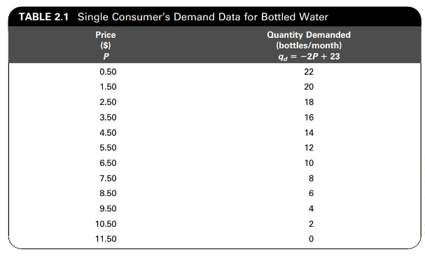
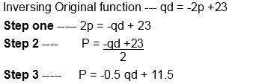
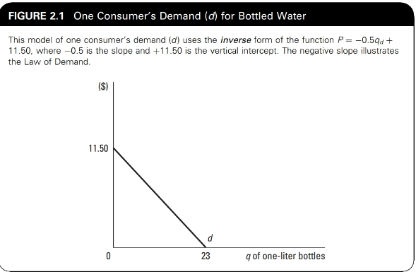
Modelling individual’s demand schedule
Notes:
Modelling Individual Demand
To illustrate the Law of Demand, Table 2.1 presents hypothetical data for an individual’s demand for one-liter bottles of water. The values show the utility- maximizing quantity decisions in a one-month period for prices ranging from $0.50 to $11.50 per bottle. Notice how the inverse relationship between quantity demanded and price holds throughout. Although these data give only a sampling of price- quantity pairs, an equation of the same relationship models all possible price- quantity responses for the consumer. In this case, the demand function is the linear relationship qd = −2P + 23, where qd signifies the quantity demanded of a single individual, and P is the price per one-liter bottle. Notice that if any of the P values from Table 2.1 are substituted into the right-hand side of the equation, the corresponding qd values are obtained. For example, if P = $3.50, then qd = −2(3.50) + 23 = 16.
By convention, the graph of demand uses the inverse form of the function, that is, P = f(qd). In this case, solving the demand equation for P in terms of qd gives P = −0.5qd + 11.50. The graph of this single consumer’s demand curve (d) is shown in Figure 2.1.
Inverse a function explained
In mathematics, a function is a process you apply to an independent variable x to get the dependent variable y. If you think of it as “going from” your x to arrive at your y, an inverse function goes the opposite way, from the result back to the original value. In a sense, an inverse function is the opposite of the original, “undoing” the process.
What is an Inverse Function? An inverse function is a function that will “undo” anything that the original function does. For example, we all have a way of tying our shoes, and how we tie our shoes could be called a function. So, what would be the inverse function of tying our shoes? The inverse function would be “untying” our shoes, because “untying” our shoes will “undo” the original function of tying our shoes.
The following examples use a algebra approach to inversing a function.
Example on how to get the inverse function on the slide and steps to do it.
Original function - qd = -2p +23
Step one ----- 2p = -qd + 23
Step 2 ---- P = -qd +23
2
Step 3 -----P = -0.5 qd + 11.5

Slide 10
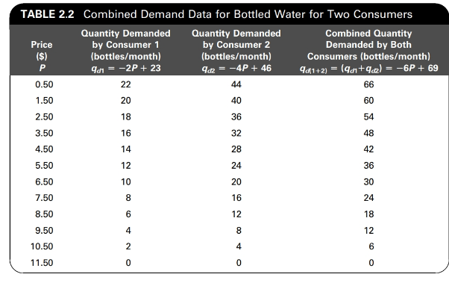
Combining consumer 1 & 2 Production Schedule
Notes:
Deriving Market Demand From Individual Demand Data For most applications in economics, the collective decision making of all consumers in a market is more relevant than that of a single consumer. Thus, the more appropriate concept is market demand, representing all consumers who are willing and able to purchase the commodity. Market demand is found by summing over the individual demand values. For private goods, we sum the quantities at each demand price, a procedure called “horizontal summing,” because quantity is conventionally plotted on the horizontal axis.2 Even though price is the same for all consumers, quantity decisions vary because of differences in other factors such as income, wealth, tastes, and expectations. For simplicity, we first illustrate this summing procedure by adding the demand of only one other consumer to the model specified previously. Individual demand data for two hypothetical consumers, Consumer 1 and Consumer 2, are given in Table 2.2 which is not included on the slide as the two functions of the individuals have been combined as have the equations that represent them, so this represents both combined. Notice that each consumer makes unique decisions about quantity because each has unique preferences, income, wealth, and so forth. The aggregate demand for these two individuals is found by summing the two quantity columns at each price levels.
The result is shown in the far right-hand column of the table. The same method can be applied to an algebraic model by adding each pair of corresponding terms in the two demand equations, as shown below.
Demand for Consumer 1: qd1 = −2P + 23
Demand for Consumer 2: qd2 = −4P + 46
Demand for Consumers 1 and 2: qd(1+2) = (qd1 + qd2) = −6P + 69

Slide 11
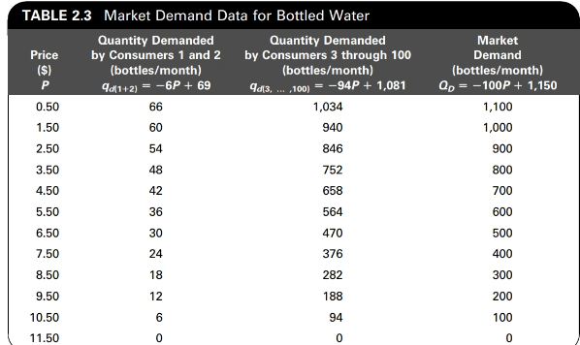
Market Demand Schedule
Notes:
Demand for Consumers 1 and 2: qd(1+2) = −6P + 69
Demand for Consumers 3 through 100: qd(3, ... ,100) = −94P + 1,081
Market Demand: qd(3, ... ,100) = −94P + 1,081 QD = −100P + 1,150

Slide 12
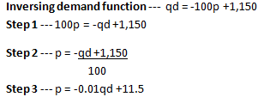
Market Demand
Bottled Water
Price
$11.50
P = –0.01Q_{D} + 11.5
D
1,150
Quantity
Notes:
Example on how to get the inverse function on the slide
qd = -100p + 1,150
Step 1 ----- 100p = -qd +1,150
Step 2 ------- P = -qd +1,150
100
Step 3 ------- P = -0.01qd + 11.5

Slide 13
Supply
Supply refers to the quantities of a good the producer is willing and able to bring to market at a given set of prices during some time period, c.p.
Economic variables held constant when deriving a supply curve include production technology, input prices, taxes and subsidies, and price expectations
Law of Supply says there is a direct relationship between price (P) and quantity supplied (Qs) of a good, c.p.
  Rising marginal cost (MC) supports this positive relationship (ΔTC/ΔQ)

Slide 14
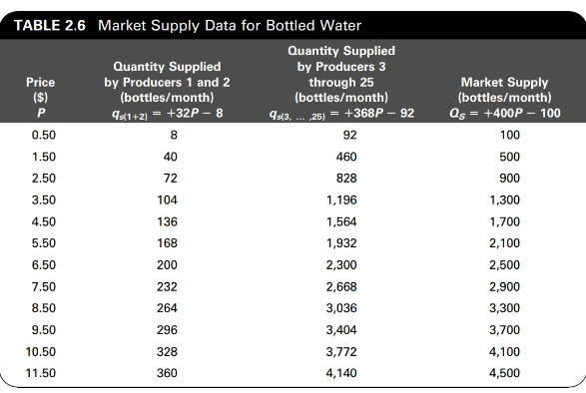
Supply (continued)
Market Supply captures the combined decisions of all producers in a given industry
  Derived by horizontally summing the individual supply functions
Notes:
To bring the supply relationship up to the market level, we sum output levels over all firms in the industry, assumed to total 25. The hypothetical market supply data are shown in Table 2.6. For each price, the combined supply decisions for Producers 1 and 2 are shown in the second column, the aggregated data for the remaining 23 producers are given in the third column, and the market quantity supplied (QS = Σqs) is given in the last. The corresponding supply equations are given below.
Supply by Producers 1 and 2: gs(1+2) = +32P - 8
+ Supply by Producers 3 through 25: gs(3, … ,25) = +368P - 92
= Market Supply: QS = +400P − 100

Slide 15
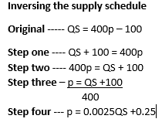
Market Supply
Bottled Water
Price
S =∑ MC
P = 0.0025Q_{S} + 0.25
0.25
Quantity
Notes:
Figure 2.4 on slide shows the graph of the market supply curve (S) in inverse form, which is P = +0.0025QS + 0.25. At each price, the horizontal distance between the vertical axis and S is exactly equal to the sum of the analogous horizontal intervals for each of the 25 individual supply (s) curves. Furthermore, because the competitive firm’s supply (s) is its MC curve, the market supply (S) curve is in turn the horizontal sum of the individual firms’ MC curves.

Slide 16
Market Equilibrium
Supply and demand together determine a unique equilibrium price (P_{E}) and equilibrium quantity (Q_{E}), at which point there is no tendency for change
  P_{E} arises where Q_{D} = Q_{S}
Model for bottled water
  D: P = –0.01Q_{D} + 11.5
  S: P = 0.0025Q_{S} + 0.25
  Equilibrium found where
  –0.01Q_{D} + 11.5 = 0.0025Q_{S} + 0.25, or
  where Q_{E} = 900 and P_{E} = $2.50
Notes:
Thus far, we have considered each side of the market separately to develop distinct models of economic decision making. To develop a model of price determination, we must con- sider supply and demand simultaneously to allow for the interaction of consumers and producers in the marketplace. The formal theory that price is simultaneously determined by supply and demand is one of the most significant in all of economic analysis.
Equilibrium Price and Quantity
Together, the forces of supply and demand determine a unique equilibrium price (PE ) at which point the market system has no tendency for change. Equilibrium, or market- clearing, price (PE) is the price at which quantity demanded by consumers, QD, is exactly equal to the quantity supplied by producers, QS (i.e., where QD = QS). Only at PE will the associated equilibrium quantity (QE ) be both the profit-maximizing production level for firms and the utility-maximizing consumption level for consumers.
Market equilibrium for our hypothetical bottled water market is shown on slide 16, where market supply and demand data are presented together. Notice that equilibrium price is $2.50, the only price at which QS equals QD of 900 units. This result also can be determined algebraically by solving the market demand and market supply equations simultaneously, as follows:
At equilibrium: QS = QD
Substituting: +400P − 100 = −100P + 1,150
Solving: 500P = 1,250 or PE = $2.50
Substituting into either equation: QE = 400(2.50) − 100, or −100(2.50) + 1,150 = 900

Slide 17
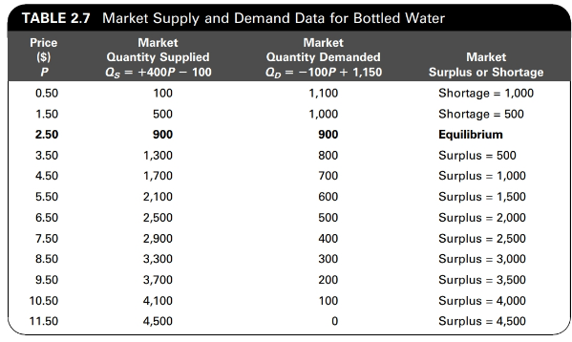
Market Equilibrium

Slide 18
Market Equilibrium
Bottled Water
Price
11.50
S
2.50
0.25
D
900
Quantity
Notes:
Graphically, we model market equilibrium by diagramming the market demand (D) and market supply (S) curves together. This is shown in Figure 2.5. Notice that equilibrium is shown as the point where D and S intersect, or where QD = QS.

Slide 19
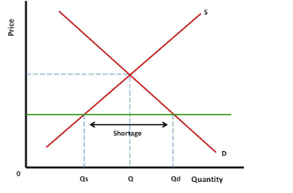
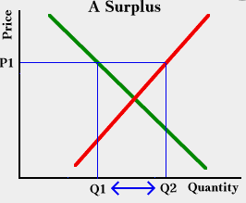
Market Adjustment to Equilibrium
Disequilibrium occurs if the prevailing market price is at some level other than the equilibrium level
  If actual price is below its equilibrium level, there will be a shortage
    Shortage: excess demand of a commodity equal to (Q_{D} – Q_{S})
  If actual price is above its equilibrium level, there will be a surplus
    Surplus – excess supply of a commodity equal to (Q_{S} – Q_{D})
Price movements serve as a signal that a shortage or surplus exists, whereas price stability suggests equilibrium

Slide 20
Efficiency Criteria
Notes:
Economic analysis is guided by specific criteria. One criterion deals with the proper allocation of resources among alternative uses, referred to as allocative efficiency. Another is concerned with economizing on resources used in production, called technical efficiency. Each of these criteria is relevant to all applied economic disciplines, including environmental economics. We begin with a discussion of allocative efficiency.

Slide 21
Allocative Efficiency
At the market level, allocative efficiency requires that resources be appropriated such that additional benefits to society are equal to additional costs incurred, or that MB = MC
  The value society places on the good is equivalent to the value of the resources given up to produce it
At the firm level, this efficiency is achieved at a competitive market equilibrium, assuming firms are profit maximizers
  We illustrate by analyzing profit maximization
Notes:
Find a video to include here to explain what Marginal Beenfits and Marginal cost are and that MB is actually MR really.

Slide 22
Profit Maximization
Total profit (π) = Total Revenue (TR) - Total Costs (TC)
  TR = P x Q
  TC is all economic costs, explicit and implicit
Profit is maximized where the relative benefits and costs of producing another unit of output are equal
  From the firm’s perspective, benefit is measured by TR and costs are measured by TC
   Profit is maximized where ΔTR/ΔQ = ΔTC/ΔQ, or where MR = MC, or where Mπ = 0
    MR = ΔTR/ΔQ, additional revenue from producing another unit of Q
    MC = ΔTC/ΔQ, additional cost from producing another unit of Q
    Mπ = MR – MC, additional profit from producing another unit of Q

Slide 23
Profit Maximization
Thus, the firm implicitly makes its profit-maximizing decisions according to the following rules:
The firm increases production as long as MR > MC or as long as Mπ > 0.
The firm contracts production as long as MR < MC or as long as Mπ < 0.
The firm achieves profit maximization where MR = MC or where Mπ = 0.

Slide 24
Profit Maximization
In competitive industries, firms face constant prices determined by the market, which means P = MR =(Demand Curve)
Therefore the competitive market equilibrium achieves allocative efficiency because:
  π maximization requires: MR = MC
  Competitive markets imply: P = MR
  So π maximization in competition means: P = MC, which defines allocative efficiency

Slide 25
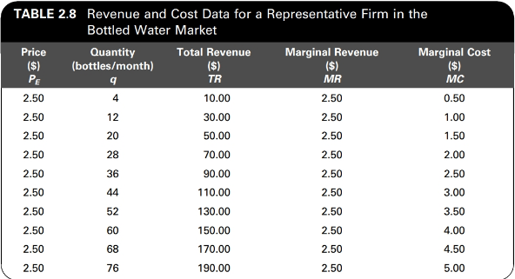
Profit Maximization
Bottled Water Market
$
MC
2.50
P = MR
0.25
q_{E} = 36
Quantity

Slide 26
Welfare Measures

Slide 27
Welfare Measures
Consumer Surplus (CS)
Consumer surplus is the net benefit to buyers estimated by the excess of marginal benefit (MB) of consumption over market price (P), aggregated over all units purchased
Graphically measured as the triangular area above the price and below the demand curve up to the quantity sold

Slide 28
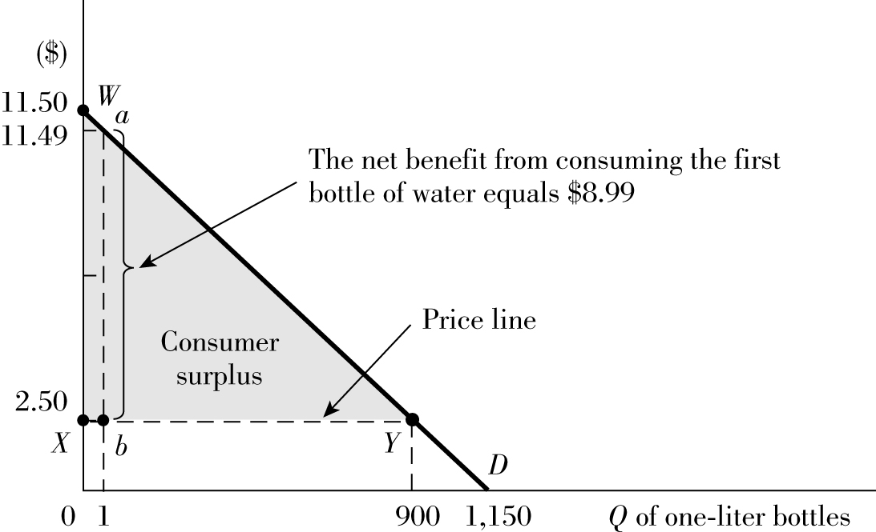
Consumer Surplus
Bottled Water Market
CS = $4,050.00
Notes:
To graphically illustrate consumer surplus, we reproduce in Figure 2.7 (on slide) the market demand for bottled water derived previously. Added to the diagram is a reference price line drawn horizontally at the equilibrium price level of $2.50. Notice that for every output level up to the equilibrium quantity of 900, the demand price is higher than the market price. So each unit purchased gives consumers a surplus benefit over and above what they had to pay for it. For example, for the first bottle of water, consumers are willing to pay $11.49 based on the market inverse demand function,5 but they actually have to pay only $2.50. That means they receive a net benefit from consuming this first unit of water equal to the excess of $11.49 over $2.50, or $8.99. Geometrically, this is measured as the vertical distance from the demand curve to the price line at Q = 1, shown in Figure 2.7 (on slide) as distance ab.
Since consumers receive a net benefit for every unit purchased up to the equilibrium point, this value must be aggregated over all units consumed to derive the measure of consumer surplus. Graphically, this is the triangular area above the price line and below the demand curve. In Figure 2.7, the consumer surplus for bottled water is the area of the triangle WXY. This makes sense because the entire area under the demand curve is a measure of total benefit from consumption (i.e., the aggregation of the marginal benefit from each unit of the good), and the rectangular area under the price line is the total expenditure on the good. Thus, the difference between the two is the net benefit to the consume.
The dollar value of consumer surplus can be found by calculating the area of the tri- angle that represents it in the graphical model. In Figure 2.7, the base of the triangle WXY is the horizontal distance from the vertical axis to the equilibrium quantity, or 900. The height is $9.00, which is the difference between the vertical intercept of the demand curve ($11.50) and the price line ($2.50). Thus, the dollar value of consumer surplus in this market is 1⁄2(900)($9.00) = $4,050.
The applicability of consumer surplus stems from the fact that its magnitude is related to equilibrium price and quantity. Any disturbance to market equilibrium will change the size of consumer surplus. And because this surplus measures consumer benefit, any change in its value can be used to assess the associated gain or loss to consumer welfare.

Slide 29
Welfare Measures
Producer Surplus (PS)
Producer surplus is the net gain to sellers of a good estimated by the excess of the market price (P) over marginal cost (MC), aggregated over all units sold
Graphically measured as the triangular area above the MC curve up to the price level over all units sold

Slide 30
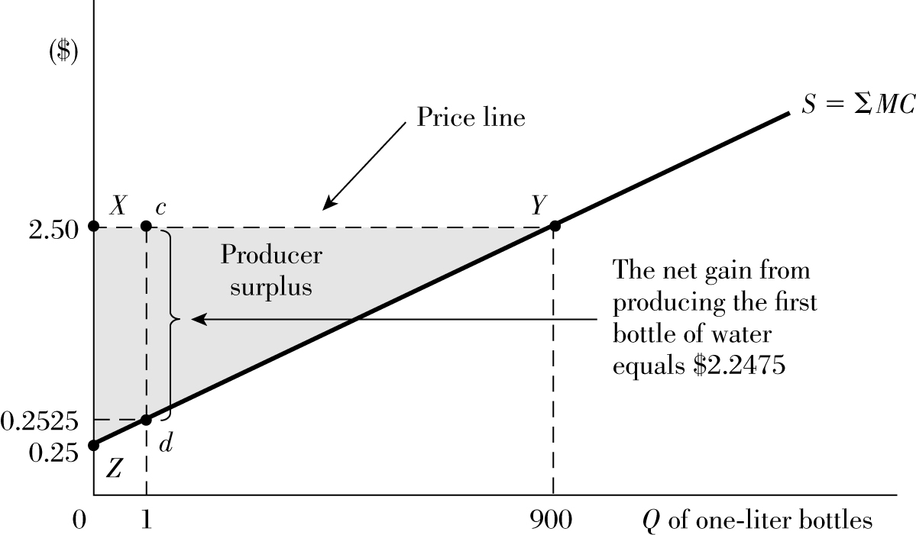
Producer Surplus
Bottled Water Market
PS = $1,012.50
Notes:
The diagram shows the competitive market supply for bottled water, which is also the MC curve, and a reference line drawn horizontally at the equilibrium price of $2.50. For every unit of output supplied up to the equilibrium point at 900 units, producers enjoy a surplus equal to the excess of P over MC. For example, for the first unit of bottled water produced, the MC is $0.2525 based on the market supply function.7 However, firms can sell this first bottle for $2.50. Thus, the net gain associated with this unit of output is the excess of $2.50 over $0.2525, or $2.2475. Geometrically, this gain is the vertical distance from the supply curve to the price line at Q = 1, labeled as distance cd in Figure 2.8.
Just as on the demand side, this net gain must be aggregated over all units sold up to the equilibrium quantity to find producer surplus. Graphically, this is the sum of all the vertical distances between the MC curve and the price line, or the triangular area bounded by the MC curve and the price line up to the equilibrium point. In Figure 2.8, this is the area of the triangle XYZ.
By using the same method as described for consumer surplus, we can quantify producer surplus by calculating its representative triangular area depicted in the graph. In Figure 2.8, the base of the triangle XYZ is 900, and its height is $2.25, found as the difference between the $2.50 price line and the vertical intercept of the supply curve, $0.25. Thus, producer surplus at equilibrium in the bottled water market is 1⁄2(900)($2.25) = $1,012.50. Notice that the magnitude of producer surplus, just like consumer surplus, is based on equilibrium price and quantity. Hence, any market disturbance will change its value and thus provide a way to assess any associated welfare gain or loss to firms.

Slide 31
Deadweight Loss (DWL)
Society’s welfare can be captured through the sum of Consumer Surplus and Producer Surplus
Comparing these measures before and after a market disturbance helps quantify how society is affected by that disturbance through Deadweight Loss (DWL)
DWL is the net loss of consumer and producer surplus due to an allocatively inefficient market event

Slide 32

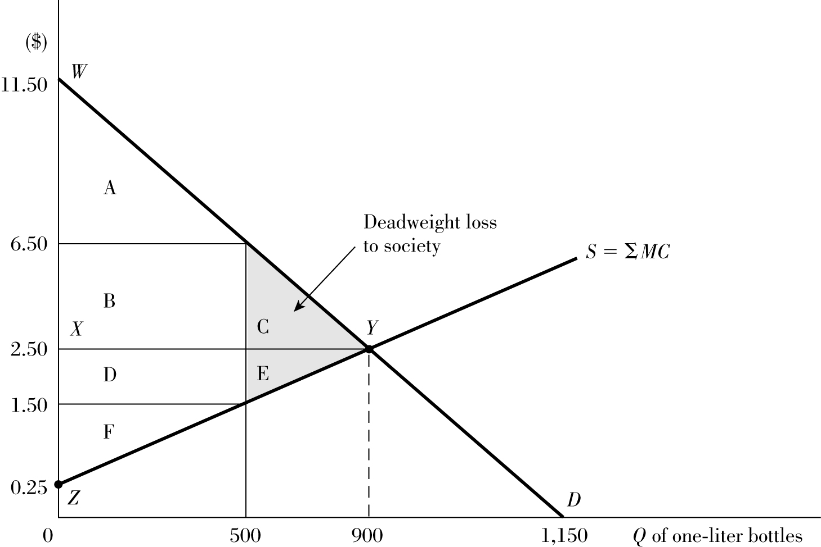
DWL of Price Regulated above P_{E}
Bottled Water Market
Policy forces price to $6.50
½(400) x (5.00) = $1,000
DWL = (C + E) = $1,000
Notes:
Now, we determine the comparable surplus values under the policy-determined price and quantity. At the $6.50 price, consumer surplus is reduced to triangular area A, valued at $1,250. This new value is $2,800 lower than it was before the policy, so we know that the policy generates a net loss to consumers. The producer surplus at the $6.50 price is area (B + D + F) valued at $2,812.50, found by summing the area of the rectangle (B + D) and the area of the triangle (F). Because this magnitude is $1,800 higher than the original surplus, we know that producers enjoy a net gain as a result of the policy.
Finally, consider the overall effect. The total surplus under the new policy is $1,250 + $2,812.50, or $4,062.50, which is $1,000 less than the original value. Although producers enjoy a net gain of $1,800, this gain is outweighed by the loss to consumers of $2,800. So the new pricing policy causes a decline in society’s welfare of $1,000. This change can be confirmed geometrically by looking at the areas representing surplus before and after the policy:
Change in consumer surplus: (A) − (A + B + C) = −(B + C)
+ Change in producer surplus: (B + D + F) − (D + E + F) = +(B − E)
Net loss to society: = −(C + E)
Area (C + E), valued at $1,000, is called the deadweight loss to society. Why? Because it was once a part of the surplus accruing to producers and consumers under allocatively efficient conditions, but as a result of the policy, it has been lost or unaccounted for. Notice that area B, although a loss to consumers, is a gain to firms. Thus, the value is redistributed from one market sector to another. Some may view this outcome as unfair, but the relevant point is that such transfers are not inefficient, because the amount is captured some- where within the market system. What is problematic is that the policy generates a loss to society as a whole because it forces P above MC, violating the allocative efficiency criterion.
Workings for how you get the DWL if you do it the long winded way without just working out the triangle area of C + E like we do on the slide
Triangle formula half base times height
Original Consumer surplus ($2.50)
1⁄2(900)*($9.00) = $4,050. (A+B+C)
New consumer surplus ($6.50)
½(500) * ($5.00) = $1,250 (A) You have lost (B&C) from the original surplus
Loss of consumer surplus $4,050 – 1,250 = $2,800
Consumer surplus $1,250 (Area A)
Original Producer Surplus ($2.50)
1⁄2(900)* ($2.25) = $1,012.50 (D+E+F)
New producer surplus ($6.50)
For area F the triangle of producer surplus
½(500) * ($1.25) = $312.5
For area B and D which is a rectangle 500 * $5 = $2,500
So for area B+D+F = $2,500
You have lost E but gained B Note. I do not know why quantity stays at 900 but it does
Producer Surplus $2,812.50 (Area D+F+B)
Loss of Surplus/DWL (Dead Weight Loss to Society)
Total Original surplus ($2.50)
$4,050 + 1,012.50 = $5,062.50
minus
Total New Surplus ($6.50)
$1,250 + 2,812.5 = $4,062.50
Loss of Surplus/DWL (Dead Weight Loss to Society) = $1,000 which is C + E

