Slide 1

ARA
BUSINESS PLAN

Slide 2

BUSINESS OVERVIEW
PRODUCT AND SERVICES
TARGET MARKET
COMPETITORS
MARKET STRATEGIES
MANAGEMENT TEAM
FINANCIAL PLAN
SWOT
PESTEL

Slide 3

A privately owned company catering to all age group and any gender. Company that believes in providing multiple alternative medicine therapies.
All the services provided can be enjoyed both individually as well as in group for certain treatments like meditation and yoga sessions.
The core value of this business is to introduce people to healthy way of living and look after their wellbeing by correcting life style and making living healthier.
1

Slide 4

2
Ara Health & Beauty Clinic provides a wide range of products, treatments and services for their clients, which includes the following:
Beauty Services:
Body Massage
Body Waxing
Face Threading
Facials
Steam Facials
Eyelash Extensions
Eyelash Tinting
Eyebrow Tinting
Eyebrow Shaping
Manicure
Pedicure
Health Services:
Acupressure
Aroma Therapy
Baby Massage
Colour Therapy
Hydrotherapy
Magnetic Therapy
Mud Therapy
Therapeutic Massages
Spa
Yoga, Exercise & Meditation

Slide 5
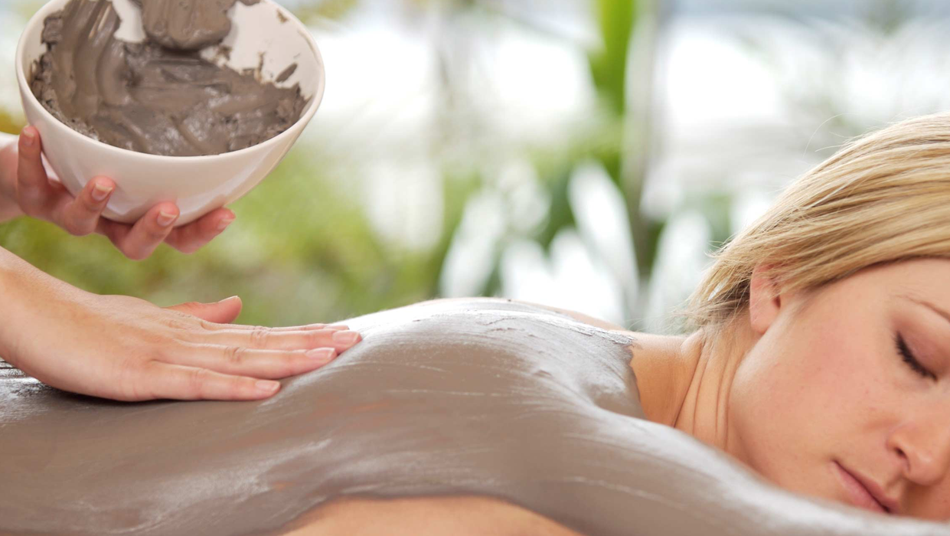
2
At Ara Health & Beauty we will be using a variety of products to carry out the treatments on our clients such as:
Aroma Therapy Oils (Body & Head)
Body Massage Oils & Creams
Baby Massage Oils & Creams
Warm Wax (Natural & Bio Friendly)
Hot Wax
Paraffin Wax
Facial Products i.e. Exfoliators, Cleansers, Tonners & Moisturisers
Hand & Foot Products i.e. Scrubs, Hand and Foot Creams
Eyelash Tinting Products
Natural & Organic Products
Towels, robes and slippers will be provided to the clients.
Ara Health & Beauty also provides door to door mobile service, so our clients can enjoy their treatments in comfort of their own home.
Ara Health & Beauty Clinic we intend to provide our clients with healthy food, drink/juice options and also healthy eating recipes can be provided for them.

Slide 6
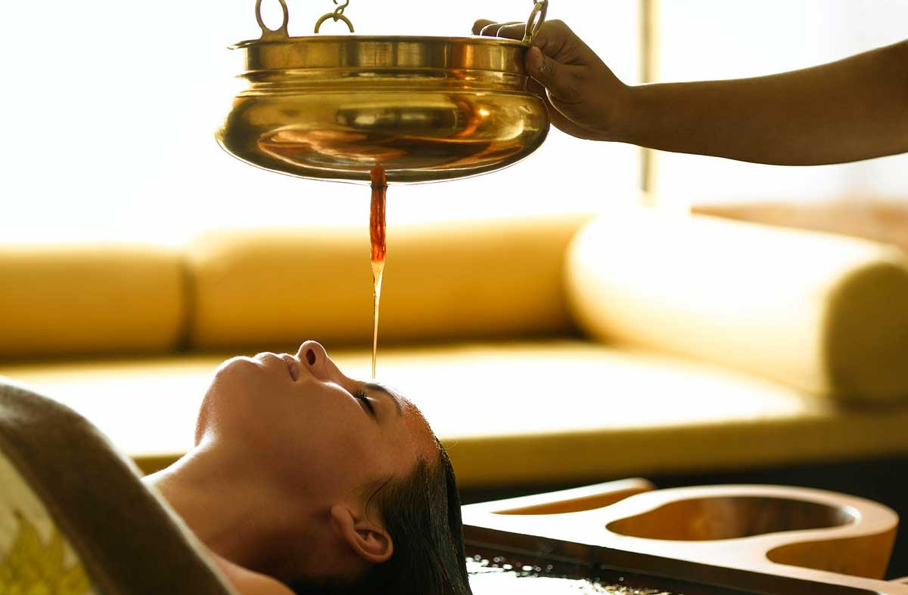
Ara Health & Beauty Clinic’s target market is:
From birth to the elderly
People from the local and surrounding areas
Any gender
Parent and baby massage service available
Under 16 can come accompanied by a parent or guardians for simple pamper session
Over 16 can book for any treatment or service
3

Slide 7
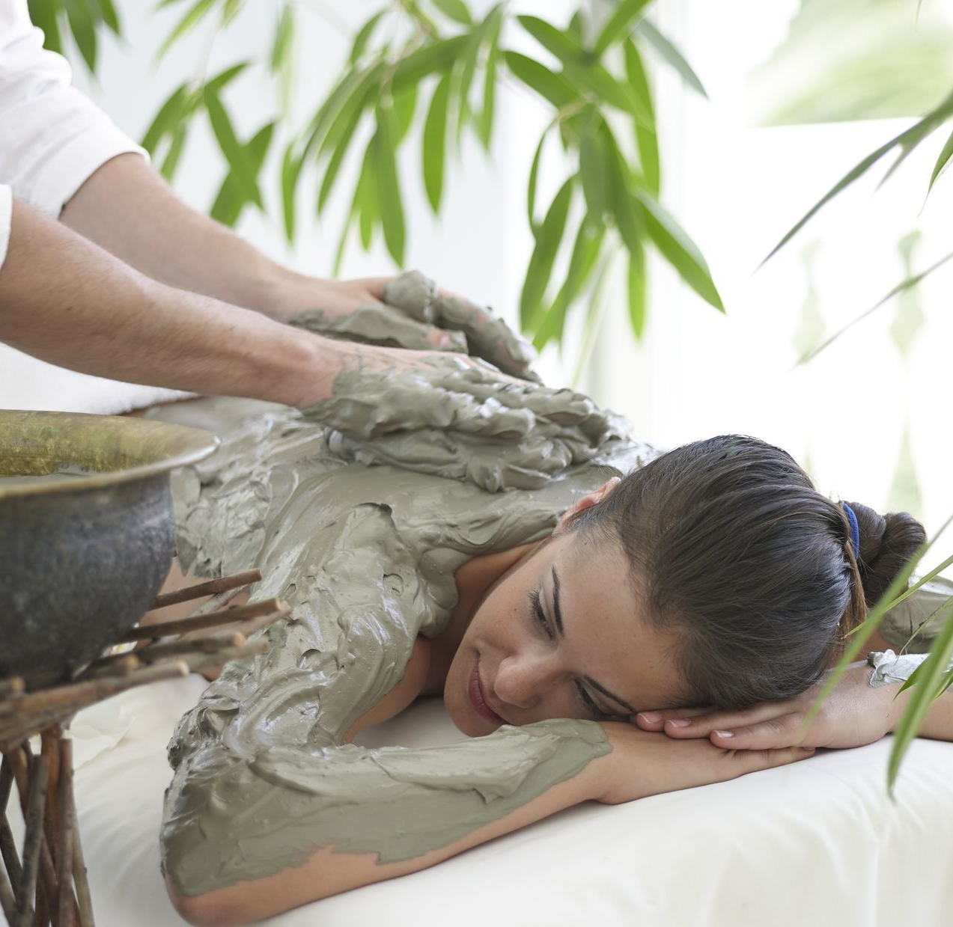
4
The competition for health and beauty are based on the following key points:
Prices/Costs on service
Range and quality of products
Range of therapy
Range of technique
Different package deals
Atmosphere of company
Customer service skills
Knowledge of field area
Different loyalty scheme
Overall experience and environment
Health & Beauty Clinic is an exceptional business which has all facilities for customers. With a Unique Selling Proposition (USP).
Ara health and beauty clinic’s, competitors are:
Simi’s hair and beauty salon
Beauty Sophia’s way
Thai massage therapy
All local beauty salons, spas,

Slide 8

5
To promote the business the following methods are:
Posting leaflet
Using social media services Facebook, Instagram, twitter
Create a web site for the company
Online booking services
Free text message reminders
Seasonal discounts
Loyalty benefits for existing customers
Membership
Offers and deals on packages
Keeping in mind low prices set
Creating portfolio of company services
Business cards
Samples and demonstration
Ara Health and Beauty Clinic. Strategies that will be used are the four P’s market plan; Price, Product, Promotion and Place. Rise positive brand awareness and recognition by 25% over first year, gain local press attention in the hometowns of facilities featured throughout the campaign. Benefits of using natural remedies and natural ingredients in the products.

Slide 9

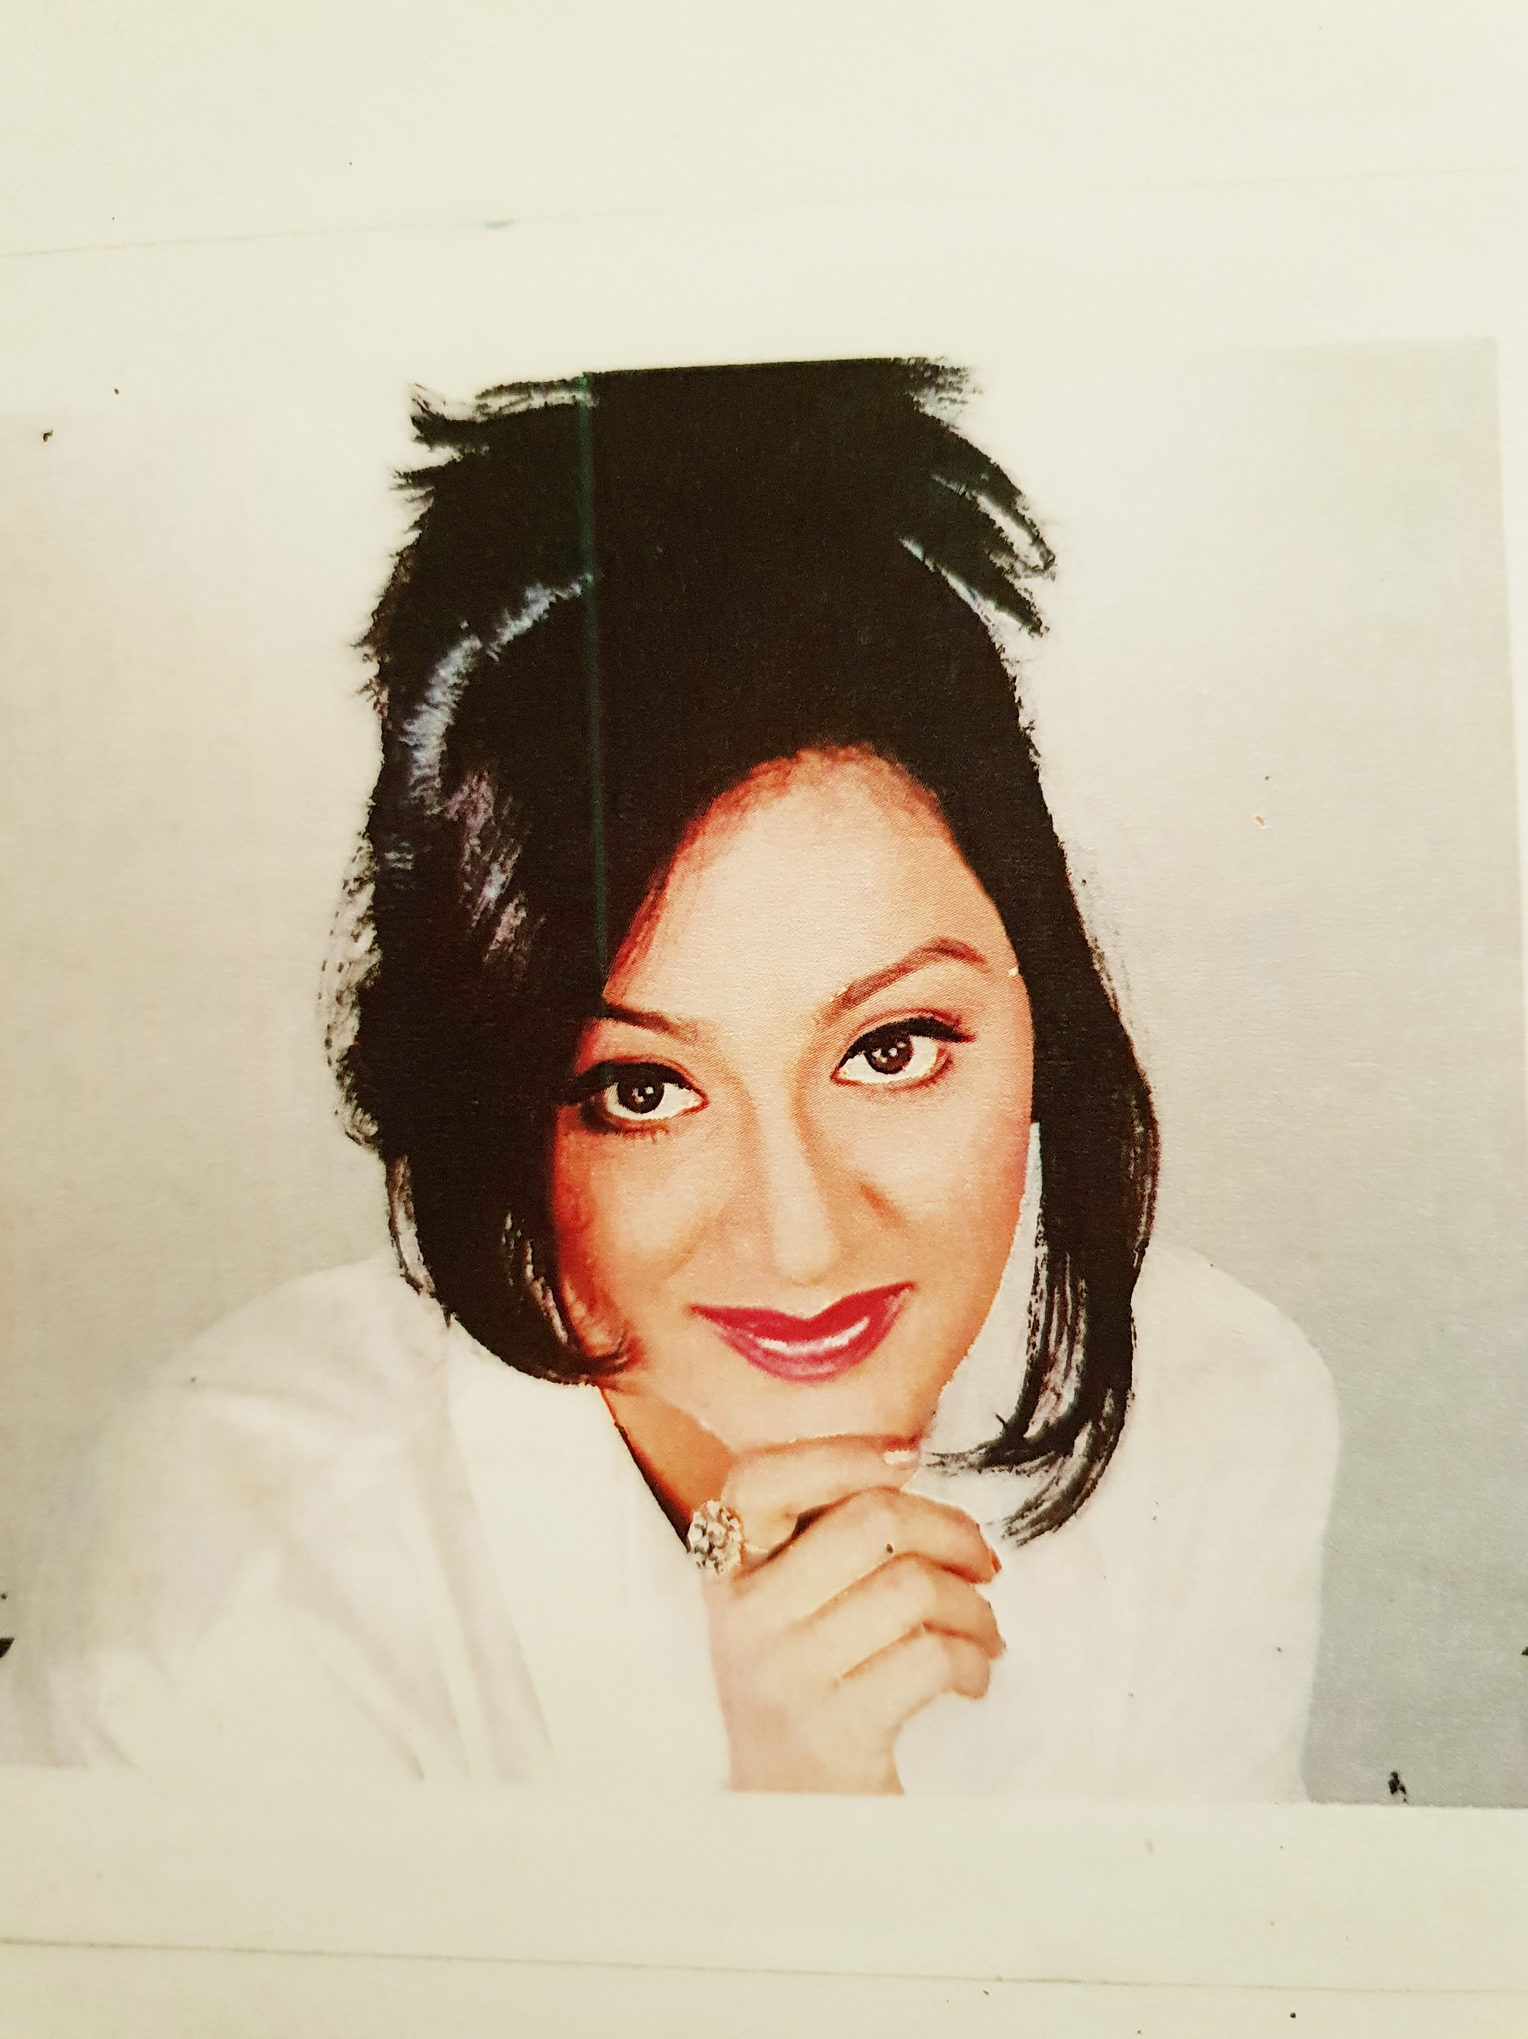
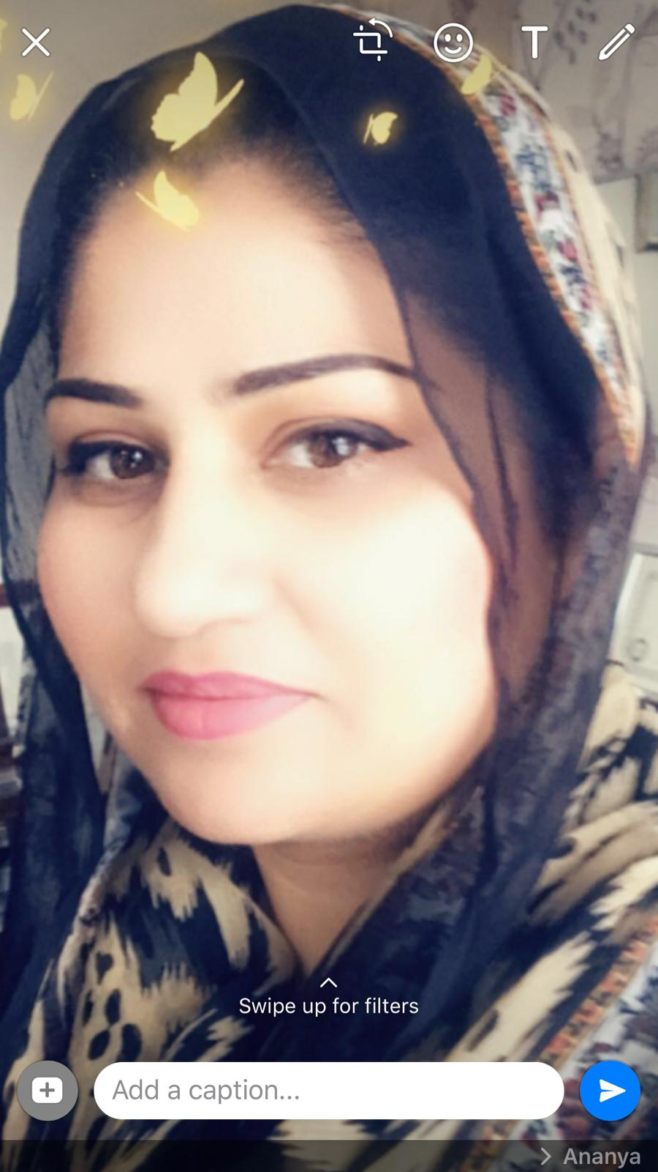
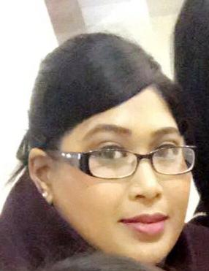
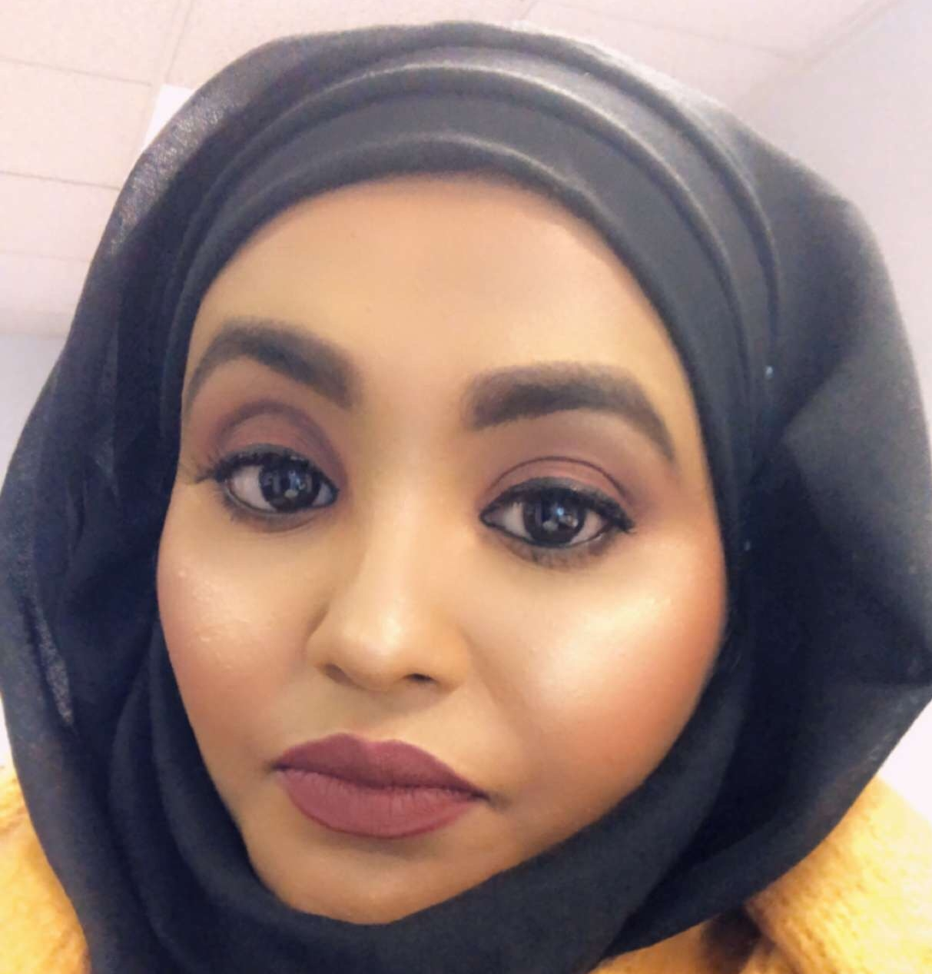
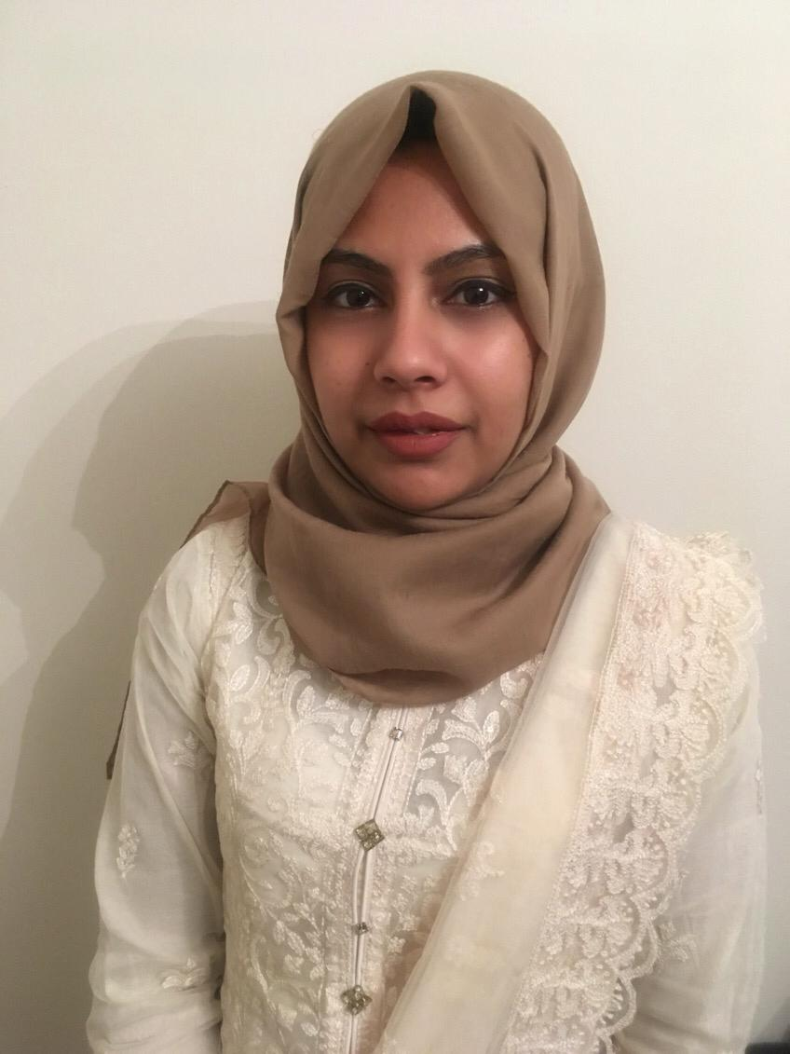
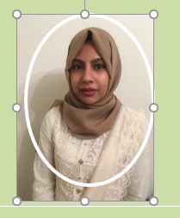
MANAGEMENT TEAM
DIRECTOR
DIRECTOR
DIRECTOR
DIRECTOR
ANANYA SANDHU
PARISA RAFI
HUSNARA BEGUM
RAZIA KHANOM
HENA SYED
SPECIALIST/ THERAPIST
FINANCE MANAGER
MARKETTING AND PR
BEAUTY THERAPIST
MANAGER

Slide 10
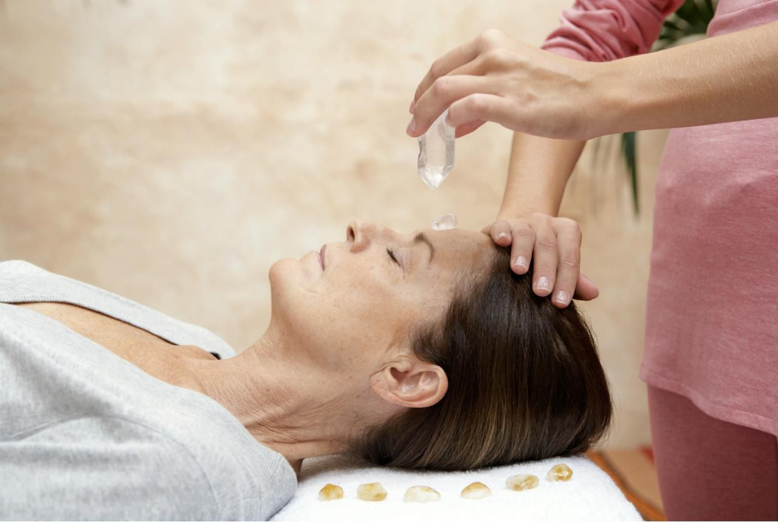
FINANCIAL
PLAN
We are investing £40,000 initially and by the end of the year estimating to make gross profit of £11,650 which is 29% of our total investment
Notes:
As a basic investing £40,000, to buy all the basic and mandatory stuff to start the business. We are hoping to achieve the target of incoming amount of £112,000. after all the expenses we are hoping to make a gross profit of £11,650.29% of our initial investment.

Slide 11
1
STRENGTH
3
OPPORTUNITIES
Good knowledge of the business
Big market
A large number of services, provided
Strong management team
Good customer service
Maintenance of high standards
Time management.
Franchising
Expansion
Working with other businesses
Bulk supply of the health products to the retail market
Providing yoga and meditation to institutes/organisations
2
WEAKNESS
4
THREATS
Financial constraints
Desired trained staff
Lack of extensive knowledge of the market
Environmental changes (extreme weather conditions)
Change in regulatory system
Extra precaution due to health and safety
8
Notes:
Strength : knowledge of the business as three of the directors are qualified in the field and experienced. Many services are provided under one roof. The management team is very professional .
Weakness: the finances are limited, need more staff who is fully trained, as the market is very big so there is a lot we need to learn.
Opportunities :because of the nature of the business there is a lot of potential to expend the business , like franchising ,supplying products to retail market etc
Threats : environmental changes like extreme weather conditions can effect the business. Rules and regulations are changing frequently, they can effect the business.

Slide 12

POLITICAL
Changing government rules and regulation for business
Introduce new instruction programmers for beauty cultural field through training Centre`
Huge taxes are applied on branded cosmetic
TECHNOLOGICAL
Use laser treatment for pimples
Use galvanic tools for facial treatments
Use head massages,
Use new skin whitening creams and technical machines
Use social media to promote business and give opportunities for customers to get appointments online
ECONOMICAL
Decreasing interest rates for business loans
Increasing cost of cosmetics
Personal incomes are not increasing
Increasing price of beauty cultural technical instruments
ENVIRONMENTAL
Indoor salon with its own waste is collected every week
Business away from city Centre no parking restrictions
LEGAL
The Business has taken care of the legal and regulatory part keeping health and safety in consideration
Personal insurance of the business has been covered
SOCIAL
Products and service available for age group
Higher demand during Eid and Diwali festivals
9

Slide 13

REFERENCES
Belbin, M. (2018). The Nine Belbin Team Roles. Available at: https://www.belbin.com/about/belbin-team-roles/ (Accessed: 28th November 2018)
Business Dictionary. (2018). Competitor. Available at: http://www.businessdictionary.com/ (Accessed: 19th December 2018)
Health and safety executive,(HSWA) 1974, (MHSWR) 1999, http://www.hse.gov.uk/violence/toolkit/legislation.htm ( Accessed : 8th January 2019)
Mariotti, S. and Glackin, C. (2015) Entrepreneurship and Small Business Management, 2nd Edition. Harlow: Pearson.
Maund, A. Schriek, M. and Tinkler, P. (2017) Certificate in Higher Education: Skills for the Workplace Student Yearbook. London: Sage Publications.
Morgan, P. (2016) The Business Student’s Guide to Study and Employability. London: Sage Publications.
PESTLE Analysis. (2015). Political Factors Affecting Business. Available at: https://pestleanalysis.com/political-factors-affecting-business/ (Accessed: 5th December 2018)
The Team Building Company. (2018). Forming - Storming - Norming – Performing. Available at: https://www.teambuilding.co.uk/theory/Forming-Storming-Norming-Performing.html (Accessed: 25th November 2018)
Ward, S. (2018). Target Marketing. Available at: https://www.thebalancesmb.com/target-marketing-2948355 (Accessed: 13th December 2018)
Notes:
Belbin, M. (2018). The Nine Belbin Team Roles. Available at: https://www.belbin.com/about/belbin-team-roles/ (Accessed: 28th November 2018)
Business Dictionary. (2018). Competitor. Available at: http://www.businessdictionary.com/ (Accessed: 19th December 2018)
PESTLE Analysis. (2015). Political Factors Affecting Business. Available at: https://pestleanalysis.com/political-factors-affecting-business/ (Accessed: 5th December 2018)
The Team Building Company. (2018). Forming - Storming - Norming – Performing. Available at: https://www.teambuilding.co.uk/theory/Forming-Storming-Norming-Performing.html (Accessed: 25th November 2018)
Ward, S. (2018). Target Marketing. Available at: https://www.thebalancesmb.com/target-marketing-2948355 (Accessed: 13th December 2018)
Health and safety executive,(HSWA) 1974, (MHSWR) 1999, http://www.hse.gov.uk/violence/toolkit/legislation.htm ( Accessed : 8th January 2019)
Mariotti, S. and Glackin, C. (2015) Entrepreneurship and Small Business Management, 2nd Edition. Harlow: Pearson.
Maund, A. Schriek, M. and Tinkler, P. (2017) Certificate in Higher Education: Skills for the Workplace Student Yearbook. London: Sage Publications.

