Slide 1
Management Functions:
Planning, Organising, Commanding, Coordinating, Controlling
LCBB4015
Week 3 – Session 1

Slide 2
Today’s LOs
By the end of this session, students will be able to:
Explain the origins of Classical Management Theory
Describe Henri Fayol’s five management functions
Apply Fayol’s functions to simple organisational scenarios
Recognise the relevance of Fayol’s ideas in modern organisations

Slide 3
Part 1
Henri Fayol and Administrative Theory

Slide 4
Henri Fayol
French mining engineer and senior industrial manager
Lived from 1841 to 1925
Served as Managing Director of Commentry-Fourchambault Mining Company
Successfully turned a struggling company into a profitable one
One of the first thinkers to study management as a separate discipline

Slide 5
Fayol’s Key Idea
Management is a universal activity
Present in business, government, military, hospitals, and education
All managers perform similar functions regardless of organisation type
Example:
  A hospital administrator and a factory manager both plan, organise staff, and control resources

Slide 6
Fayol’s Administrative Theory
Focuses on managerial activities, not shop-floor work
Emphasises order, authority, discipline, and coordination
Forms the basis of Classical Management Theory
Influenced later management thinkers and textbooks
Example:
  Clear reporting lines and defined roles in organisations reflect Fayol’s ideas

Slide 7
Part 2
Fayol’s Five Functions of Management

Slide 8
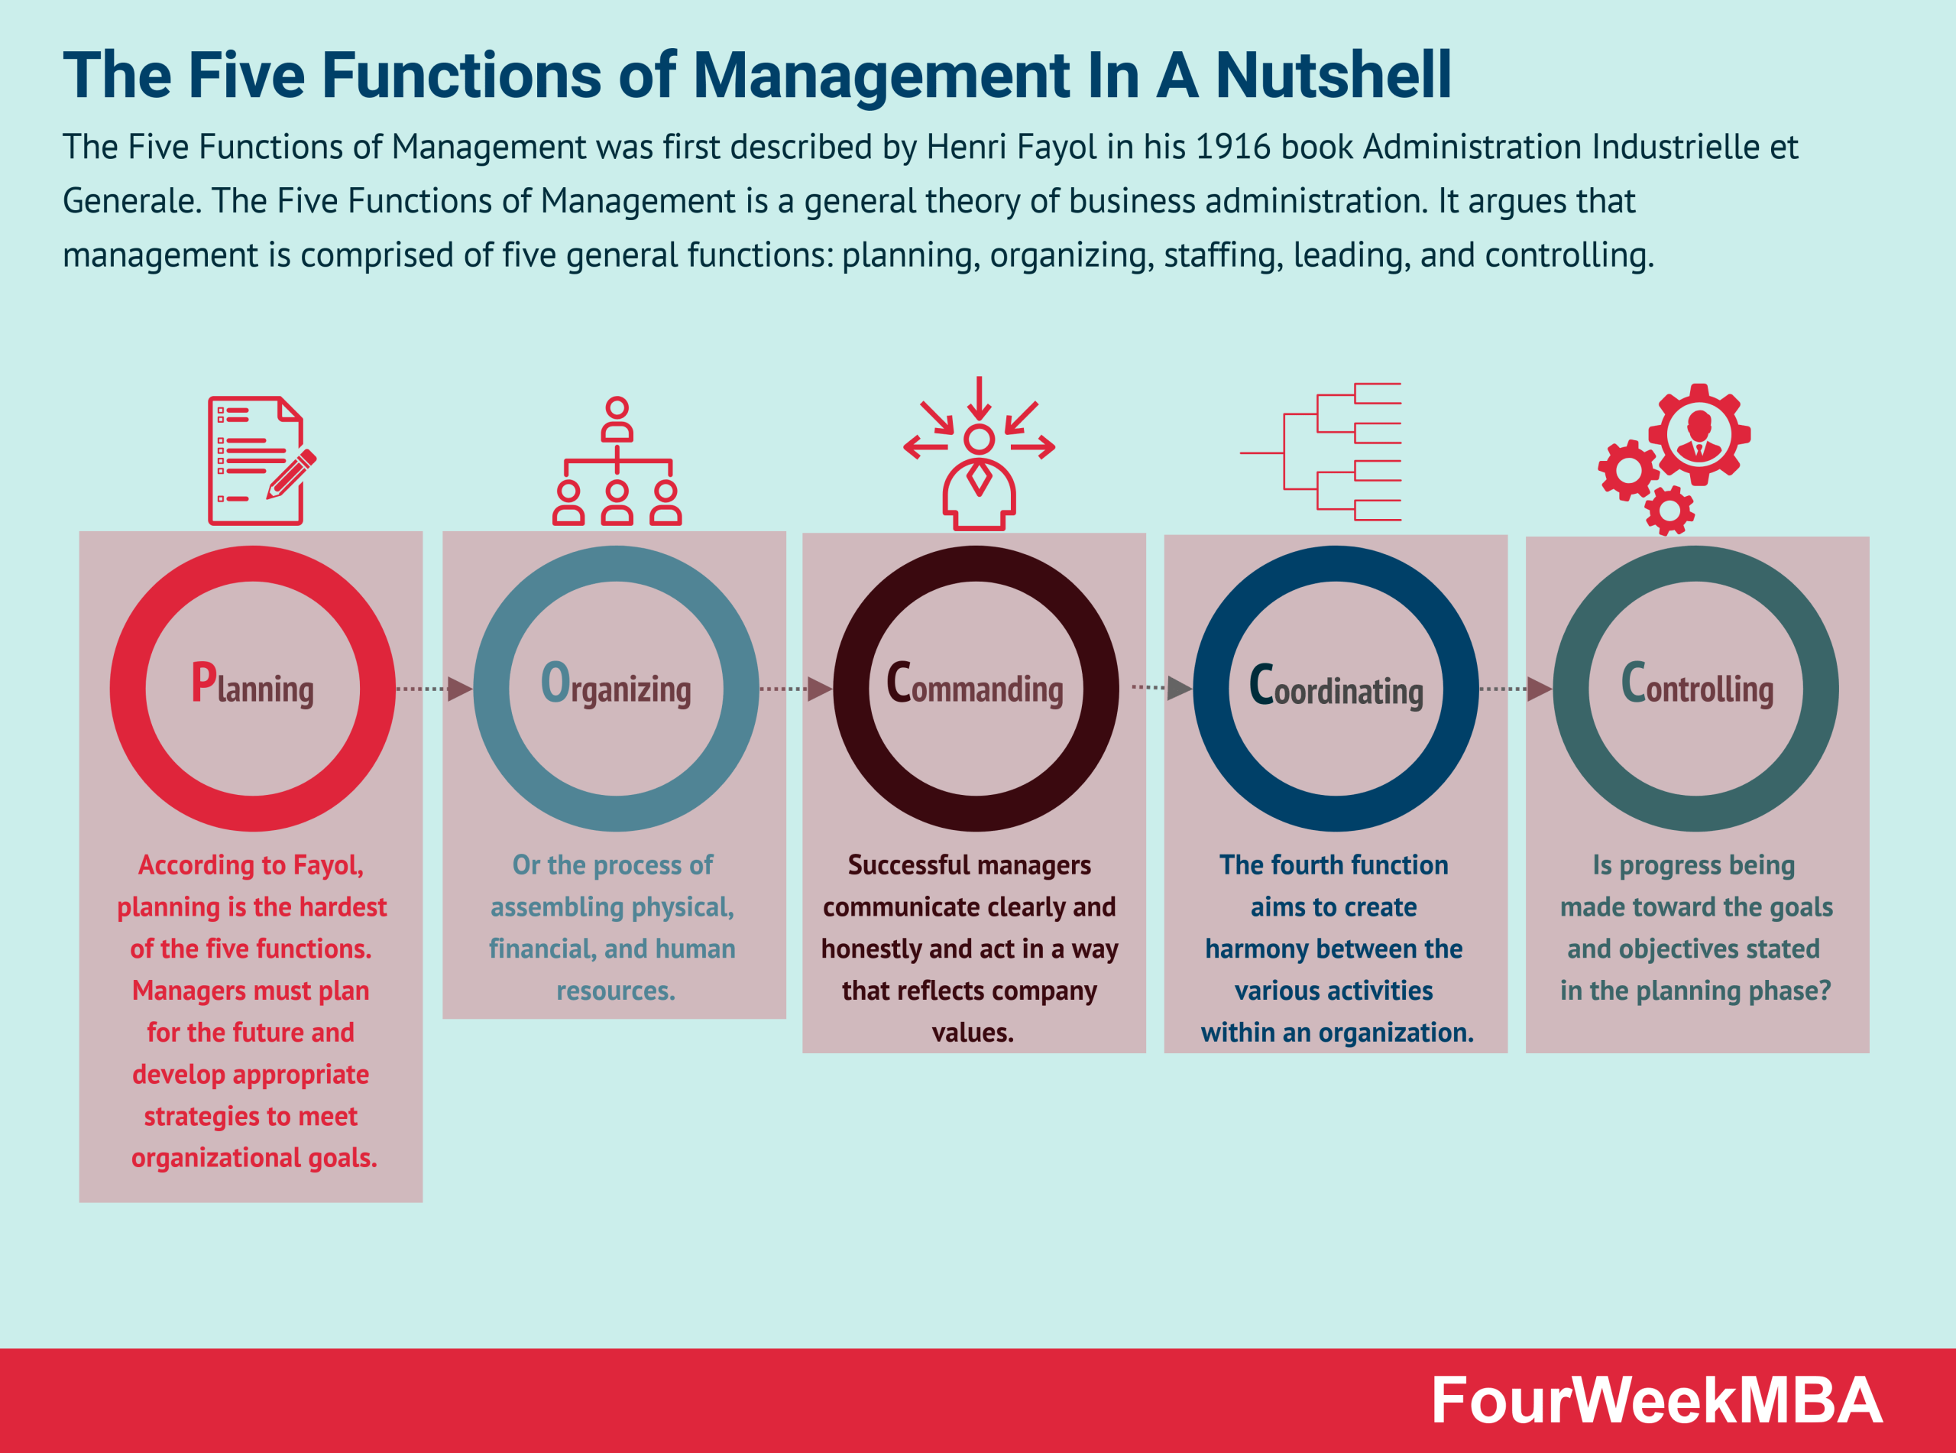

Slide 9
Planning
Deciding in advance what needs to be done
Setting goals, objectives, and targets
Forecasting future conditions
Selecting appropriate courses of action
Examples:
  Preparing annual business plans
  Setting sales targets for the next quarter
  Creating academic timetables in universities

Slide 10
Importance of Planning
Provides direction to employees
Reduces uncertainty and risk
Helps in the efficient use of resources
Acts as a basis for control
Example:
  Without a plan, departments may work at cross purposes

Slide 11
Organising
Arranging tasks, people, and resources systematically
Dividing work into manageable activities
Assigning duties and responsibilities
Establishing authority relationships
Examples:
  Creating departments such as HR, Marketing, and Finance
  Designing an organisational hierarchy
  Organisational charts, allocation of work, allocation of work

Slide 12
Commanding
Directing employees toward organisational goals
Giving clear instructions and guidance
Supervising performance
Motivating employees to perform better
Examples:
  A supervisor assigning daily tasks to workers
  A manager motivating a team before a project deadline
Commanding in Practice
  Clear communication
  Leadership presence
  Maintaining discipline

Slide 13
Coordination
Ensuring harmony among different activities and departments
Integrating efforts toward common objectives
Resolving conflicts between departments
Examples:
  Coordination between production and sales departments
  Aligning academic and examination schedules in universities

Slide 14
Controlling
Ensuring activities are performed according to plans
Setting performance standards
Measuring actual performance
Taking corrective action when deviations occur
Examples:
  Comparing actual expenses with the budget
  Evaluating employee performance through appraisals

Slide 15
Control Mechanisms
Performance appraisals
Financial audits
Quality checks

Slide 16
Fayol’s Functions and Modern Management Terminology
Planning → Strategic & Operational Planning
  Modern managers engage in strategic planning (long-term goals) and operational planning (short-term actions).
  Focus has shifted from rigid plans to flexible and adaptive planning.
  Still involves goal setting, forecasting, and decision-making.
Organising → Organisational Design & Resource Management
  Modern organising focuses on team-based structures, flatter hierarchies, and cross-functional teams.
  Emphasis on efficient use of human, financial, and technological resources.
  Job roles are more flexible than in Fayol’s time.

Slide 17
Fayol’s Functions and Modern Management Terminology
Commanding → Leading
  The term “commanding” is rarely used today because it sounds authoritarian.
  Modern management emphasises leadership, communication, and motivation rather than giving orders.
  Managers act as coaches and mentors.
Coordinating → Integration & Collaboration
  Coordination now involves collaboration across departments, teams, and even organisations.
  Technology (e.g., email and project management software) plays a key role.
  Still focuses on aligning activities toward common goals.

Slide 18
Fayol’s Functions and Modern Management Terminology
Controlling → Performance Management
  Control systems are more data-driven and continuous.
  Focus on performance measurement, feedback, and improvement rather than punishment.
  Includes KPIs, dashboards, and performance reviews.
Key Takeaways
  Modern management functions are not new ideas.
  They are evolved versions of Fayol’s original functions.
  Fayol laid the foundation for modern management practices.

Slide 19
Activity – Identify the Management Function
A teacher evaluates student performance after exams and adjusts teaching methods.
A manager corrects an employee’s work and provides guidance for improvement.
A company estimates its sales for the next six months and prepares a budget accordingly.
A startup founder decides who will handle customer service, production, and accounting.
A construction manager aligns the work of engineers, electricians, and plumbers.
A manager notices delivery delays and revises work schedules after reviewing performance reports.
A project leader assigns tasks, gives instructions, and reviews progress weekly.

Slide 20
Summary
Fayol defined management as a set of functions
Five functions provide a foundation for management practice
Modern theories build upon Fayol’s ideas

Slide 21
References
Cole, G.A and Kelly, P. Phil (2020) Management theory and practice. Ninth edition / Gerald A. Cole, Phil Kelly. Andover: Cengage Learning.
Needle, D. Burns, J. (2019) Business in context: an introduction to business and its environment. Seventh edition. Andover: Cengage Learning.
Robbins, S.P., Coulter, M.K. and Randel, A. (2021) Management. Global edition. Harlow, England: Pearson Education.

