Slide 1

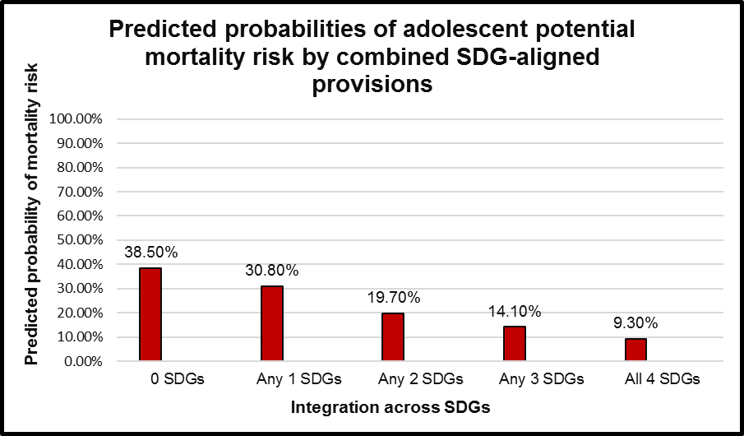
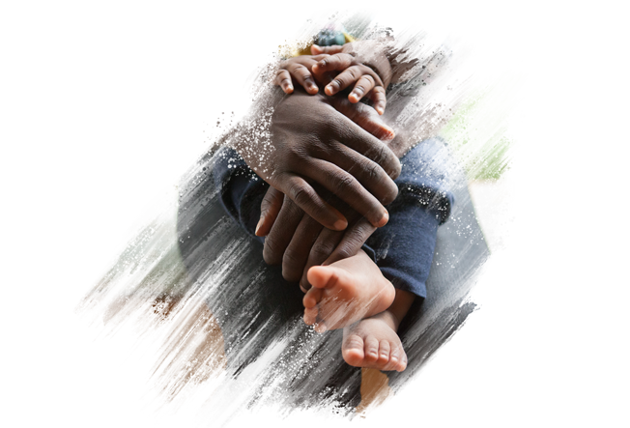

Frontline Aids, set up in 1993, is a global humanitarian organisation that specialises in HIV/AIDS treatment, sexual health services, gender equality and reproductive rights. The organisation works under two main beliefs (2019).
That the lives of all human beings are of equal value.
That everyone has the right to access the HIV information and services they need for a healthy life.
Frontline Aids are on the cutting edge of HIV/AIDS research, one of their recent publications investigated whether Sustainable Development Goals (SDGs) reduced the mortality rate of those living with HIV in Sub-Saharan Africa. Potential morality risk was measured by either viral suppression failure, or from symptomatic untreated tuberculosis, or both.
The SDG aligned provisions for this research were 1 & 2 (no poverty or hunger), 3 (a caregiver who is healthy), 8 (a member of the household in employment) and 16 (protection from abuse and violence).
Research
In 2017, Frontline Aids helped 1.6 million people access HIV treatment, care and support.
900,000 people in marginalised communities helped.
Campaigned for universal access to HIV services in 36 countries.
Two million people reached with integrated HIV and sexual and reproductive health and rights services.
Provided two million people with sexual and reproductive health and rights services.
Supported 600,000 people with programmes addressing discrimination.
85% of community-based organisations who received a grant from Frontline Aids achieved financial targets.
Statistics (FA, 2019)
Human Immunodeficiency Virus, commonly known as HIV, is a virus that attacks the immune system by destroying CD4 and T cells, white blood cells that are vital for fighting infections (NIAID, 2019). If untreated, HIV can gradually lead to AIDS (Acquired Immunodeficiency Syndrome).
HIV is spread through contact with an infected persons select bodily fluids such as semen, blood, vaginal and anal fluids and pre seminal fluids (USDHHS, 2018).
What is HIV?
Frontline Aids work globally to prevent the transmission of HIV, by developing tailor made prevention programmes alongside the local communities. They achieve this through the combination of three prevention strategies;
What do Frontline Aids do? (FA, 2019)
The chart above shows the predicted probability of mortality of HIV patients when different quantities of SDGs are integrated. The results show that as the number of integrated SDGs increased, the predicted mortality of HIV patients decreased. (Cluver, et al., 2018).
Biomedical - condoms, sterile syringes and accessible HIV medication
Behavioural – education on preventative behaviours
Structural – challenging legislation and enabling social change
References:
Cluver, L., Pantelic, M., Orkin, M., Toska, E., Medley, S., & Sherr, L. (2018). Sustainable Survival for adolescents living with HIV: do SDG-aligned provisions reduce potential mortality risk? Journal of the International AIDS Society, 1-6.
Frontline Aids. (2019). HIV Prevention. Retrieved from Frontlineaids.org: https://frontlineaids.org/were-on-the-frontline-of/hiv-prevention/
Frontline Aids, (2019). Who we are? Retrieved from https://frontlineaids.org/who-we-are/
NIAID. (2019). HIV/AIDS. Retrieved from National Institute of Allergy and Infectious Diseases: https://www.niaid.nih.gov/diseases-conditions/hivaids
U.S Department of Health and Human Services. (2018, November 6). HIV/AIDS: The Basics. Retrieved from Aidsinfo: https://aidsinfo.nih.gov/understanding-hiv-aids/fact-sheets/19/45/hiv-aids--the-basics/
Bobby Farmer
1702887

