Slide 1
Problem-solving and decision-making
Presented By: Vasile Daniel Baiculescu
Student ID: 2015926

Slide 2
Nature and Impact of the Problem
In comparison with other countries, Employees in the UK are more dissatisfied with their jobs.
The United Kingdom is 7th out of 20 in terms of job dissatisfaction
Job dissatisfaction increases turnover
Job dissatisfaction can decrease the productivity of business organisations
Job satisfaction has a positive relation with customer experiences
Notes:
Employee job dissatisfaction occurs when a worker is not satisfied with his position. This might be due to a variety of occupational and emotional factors, including lack of growth, inadequate management, and more. Most people's waking hours are taken up by work, and as a result, most individuals have preconceived notions about what their employment should be like. There are emotions of discontent, anger, and a loss of interest in the work when these standards are not realised. In addition to lowering productivity and enthusiasm, job dissatisfaction may harm an organization's financial performance. It is more difficult for workers to be efficient and provide high-quality services if they are not interested in their job.
Job dissatisfaction has become a major area of concern in the United Kingdom as the case study suggests that the United Kingdom is ranked 7th out of 20 countries in terms of job dissatisfaction making it the top country among European nations for having the highest rate of job dissatisfaction. There can be multiple factors contributing to job dissatisfaction in the United Kingdom. Analysing these factors can provide information regarding the resolution of a complex problem in the United Kingdom. Job dissatisfaction does not only influence business organisations and their productivity, but it is having adverse influences on the economic wellbeing and development of the United Kingdom since business organisations in the country are not contributing effectively to the economic development of the UK, owing to the problem of job dissatisfaction.

Slide 3
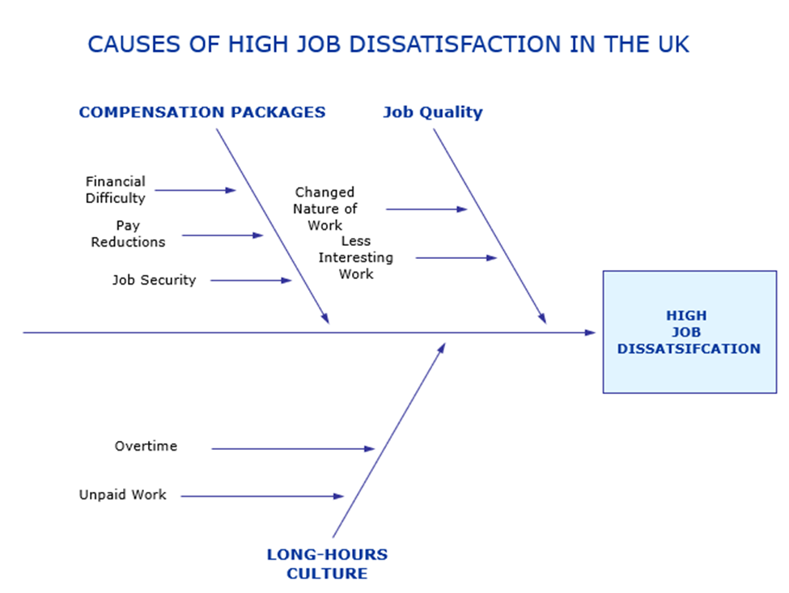
Cause-and-Effect Analysis of the Problem
Notes:
There are multiple factors that can contribute to enhance the job dissatisfaction in the United Kingdom. First of all, the long hours culture in the United Kingdom can be a major cause of high job dissatisfaction in the country. the case study suggests that much of the work of employees in the country is unpaid and employees have to stay at their workplaces for long to perform their duties. Work-life balance plays a key role in employees’ job satisfaction. It is essential for business organisations to reduce the workload to enhance the satisfaction of employees. On the other hand, the case study suggests that around 48% of employees in the United Kingdom take overtime, but the majority of these employees does not get paid by their employers.
Furthermore, the quality of work is another contributing factor for the job dissatisfaction in the United Kingdom. Due to the recent financial circumstances, companies have changed their operations in the UK for their sustainability, which is having adverse influences on the satisfaction of workers. The roles of employees working at different positions have changed, but their training and development needs were ignored by most business organisations. Additionally, the case study illustrates that most workers in the country have concerns regarding their pay reductions and compensation packages. All these factors can be considered as the most prominent causes of job dissatisfaction in the United Kingdom.

Slide 4
Pestle Analysis of Factors Contributing to the Problem
Political Powers in the UK play a major role in employment legislation
Recent financial crisis has pushed organisations to reduce the salaries
Work-life balance contributes to the problem
Technology can contribute to job insecurity for workers
Employment legislation can play a role in enhancing job satisfaction
Environmental factors can change the nature of work
Notes:
Pestel analysis is a useful tool that can be used to determine the factors that can contribute to the development of a problem. Legislation takes place in the parliament of the United Kingdom, suggesting that fundamental wages of workers in the country are decided by the political powers of the country. The current basic wage for workers in the United Kingdom is 8 pounds per hour which is considered to be lower than other European countries. the recent financial crisis has adversely influenced the business of numerous organisations, resulting in pay reductions and unemployment for workers. Social factors also contribute to the development of job dissatisfaction as a problem.
Work-life balance has become important for workers in the United Kingdom since most workers in the country prefer the jobs that may provide them with an opportunity to spend their time with their families. The United Kingdom is considered to be an advanced country when it comes to technology. However, the technological advancements of the United Kingdom are also having adverse influences on the perspectives of employees since they believe that technology will take on their positions in future and they may lose their jobs. the employment laws in the United Kingdom influence the human resource management practises of business organisations. legal framework can play a crucial role in the development of laws that may reduce job dissatisfaction in employees. Furthermore, the environmental concerns of business organisations have been contributing to changing the nature of jobs in the country.

Slide 5
The Alternative Solutions to the Problem
Ensuring the Paid Overtime
Reduction of Working Hours
Introduction of Training and Development Programs
Increasing Basic Wage
Notes:
According to utilitarianism theory, it is important to make decisions that are based on the happiness and satisfaction of others. Ensuring the paid overtime can be an alternative solution to the problem of job dissatisfaction. However, this approach cannot resolve the issue of work life balance of employees. reduction of working hours can be an effective solution to the problem since it may enhance the satisfaction and happiness of employees in the United Kingdom. However, it can be hard for business organisations to reduce their working hours since they have been adversely influenced by the recent financial crisis. introduction of training and development programme can be costly for business organisations, but it is essential to introduce such programmes to overcome the gap between the required skills of employees and the future work. Another solution to this problem can be an increase in the basic salaries of employees but it may not be applicable across the country since most organisations are still struggling after the recent financial crisis. The most appropriate approach or decision in this scenario will be the introduction of the training and development programmes across the country so that employees can enhance their skills and careers Without having concerns and dissatisfaction regarding their jobs.

Slide 6
References
Iliffe, S. (2019) ‘Job dissatisfaction,‘burnout’and alienation of labour: undercurrents in England’s NHS’, Journal of the Royal Society of Medicine, 112(9), pp. 370–377.
Iliffe, S. and Manthorpe, J. (2019) ‘The unexpected return of alienation: job dissatisfaction,’burnout’and work estrangement in the NHS’, Renewal, 27(4), pp. 50–60.
Naz, S. and Sharma, H. (2017) ‘Job satisfaction among different working organizations: A literature review’, Research Journal of Social Science and Management, 7(6), pp. 29–37.
Reymen, I. et al. (2017) ‘Decision making for business model development: a process study of effectuation and causation in new technology‐based ventures’, R&D Management, 47(4), pp. 595–606.
Senek, M. et al. (2020) ‘Determinants of nurse job dissatisfaction-findings from a cross-sectional survey analysis in the UK’, BMC nursing, 19(1), pp. 1–10.
Thumiki, V. R. R. (2017) ‘Ishikawa (Fishbone) analysis for understanding root cause of entrepreneurial failure in Sultanate of Oman’, Ahead International Journal of Recent Research Review, pp. 135–137.
Vasan, M. (2018) ‘Impact of Job Stress on Job Satisfaction among the Pharmaceutical Sales Representatives’, Research Journal of Pharmacy and Technology, 11(9), pp. 3759–3764.
Vordermark, J. S. (2019) ‘Problem-Solving and Decision-Making’, in An Introduction to Medical Decision-Making. Springer, pp. 37–42.

