Slide 1


BMTP5019
Operations
Management for Tourism, Leisure and Events
Effective Recruitment and Training Strategies

Slide 2
HR Theories for Advisory Operational Plans
Service–Profit Chain
Human Capital Theory
Psychological Contract
Motivation Theories
High-Performance Work Systems (HPWS)
Talent Management Theory

Slide 3
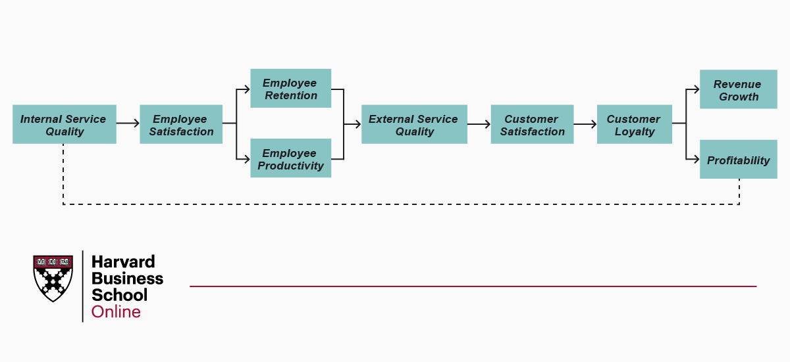
Service–Profit Chain
• Employee satisfaction improves service quality
• Better service increases customer satisfaction
• Satisfied customers become loyal
• Customer loyalty increases profit
Example
In a hotel or tourism business:
Well-trained and motivated staff
Better guest service
Higher guest satisfaction
More repeat customers and revenue

Slide 4
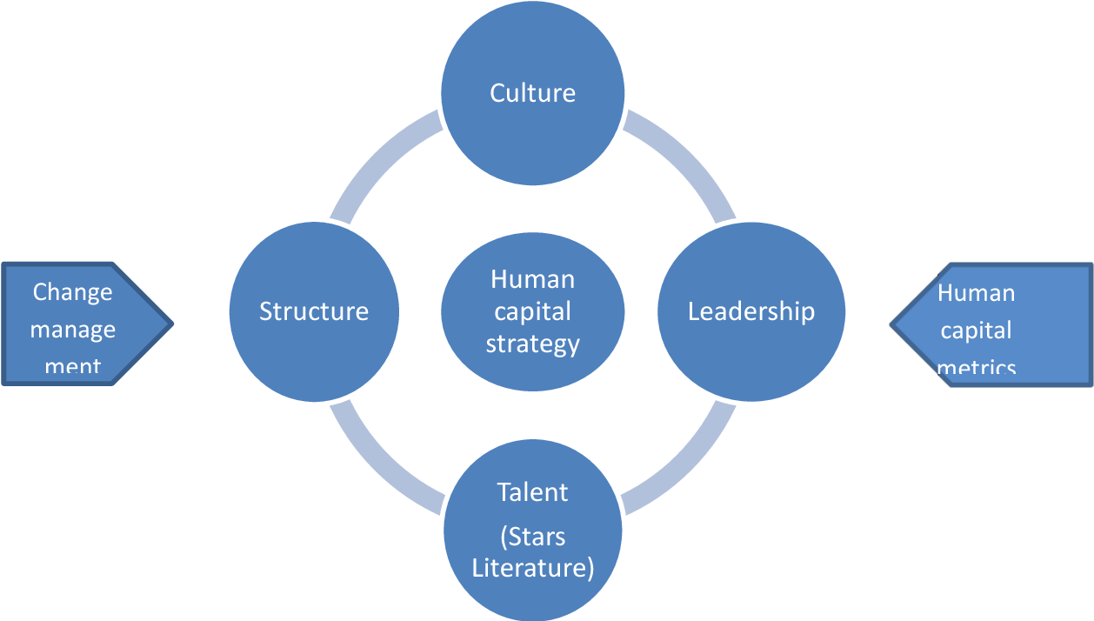
Human Capital Theory
• Employees’ skills and knowledge are valuable assets
• Organisations invest in education and training
• Skilled employees improve productivity
• Development leads to better organisational performance
Example
A tourism company investing in:
language training
customer service training
digital booking systems training
This improves service quality and business performance.

Slide 5
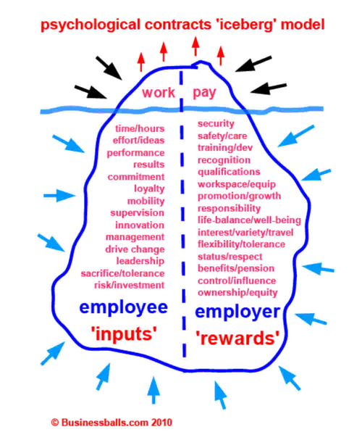
Psychological Contract
• Unwritten expectations between employer and employee
• Employees expect fairness, development, and respect
• Employers expect loyalty, commitment, and performance
• Breaking expectations may reduce motivation and increase turnover
If an organisation promises career development but does not provide training, employees may feel the psychological contract is broken, leading to:
lower motivation
higher turnover

Slide 6
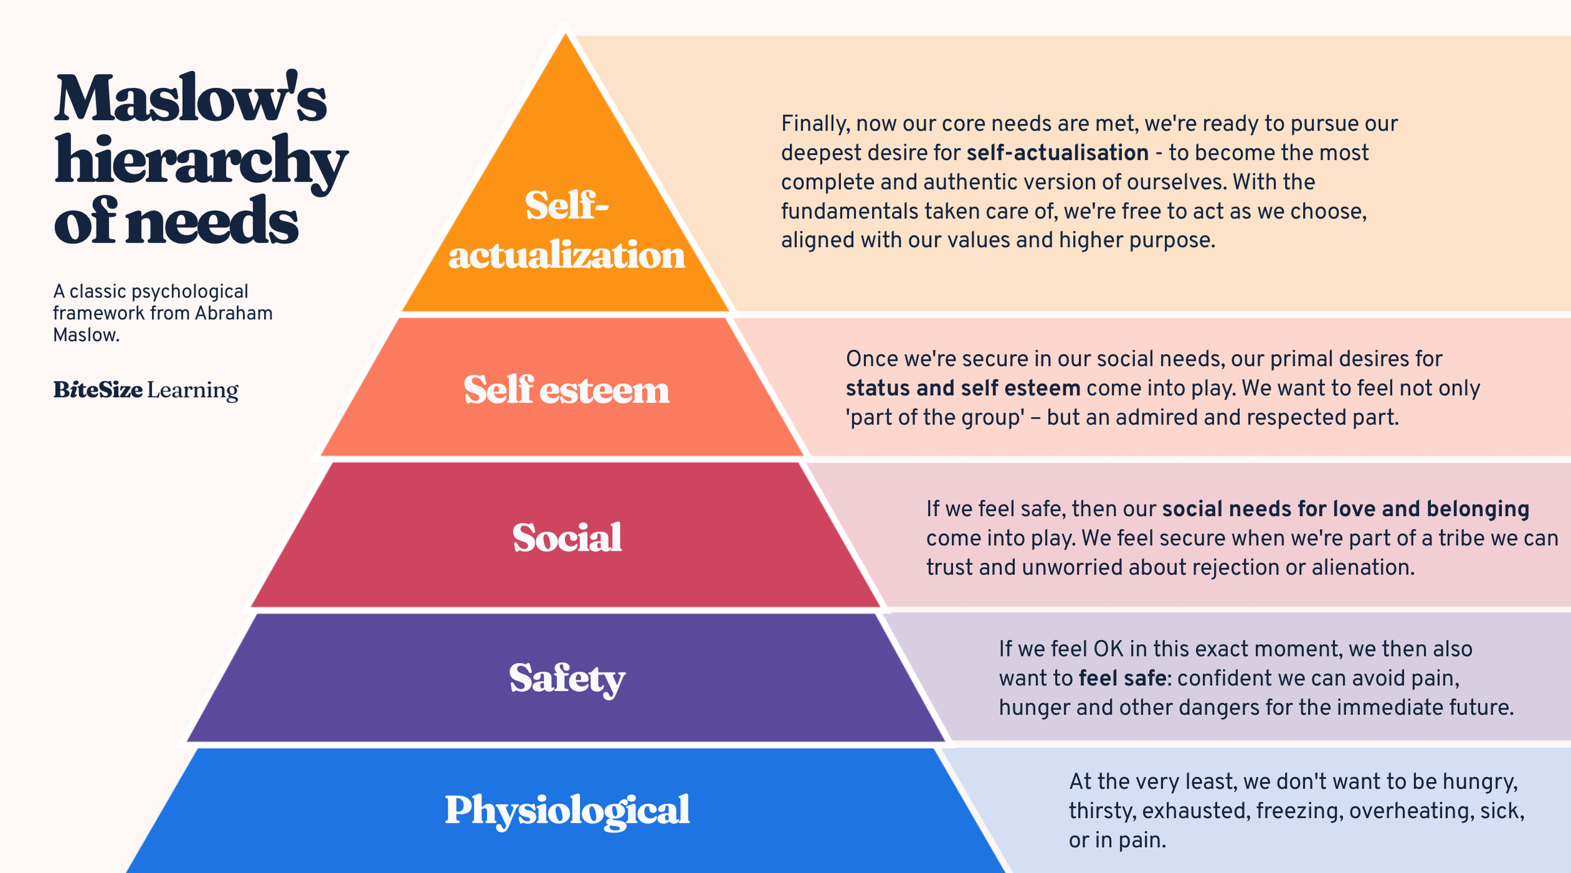
Motivation Theories
Maslow: Employees have different levels of needs
Herzberg: Hygiene factors vs motivators
Self‑Determination: Autonomy, competence, relatedness
Motivation improves engagement and productivity
Employees have five levels of needs:
Physiological (salary, basic needs)
Safety (job security)
Social (team belonging)Esteem (recognition)
Self-actualisation (personal growth)

Slide 7
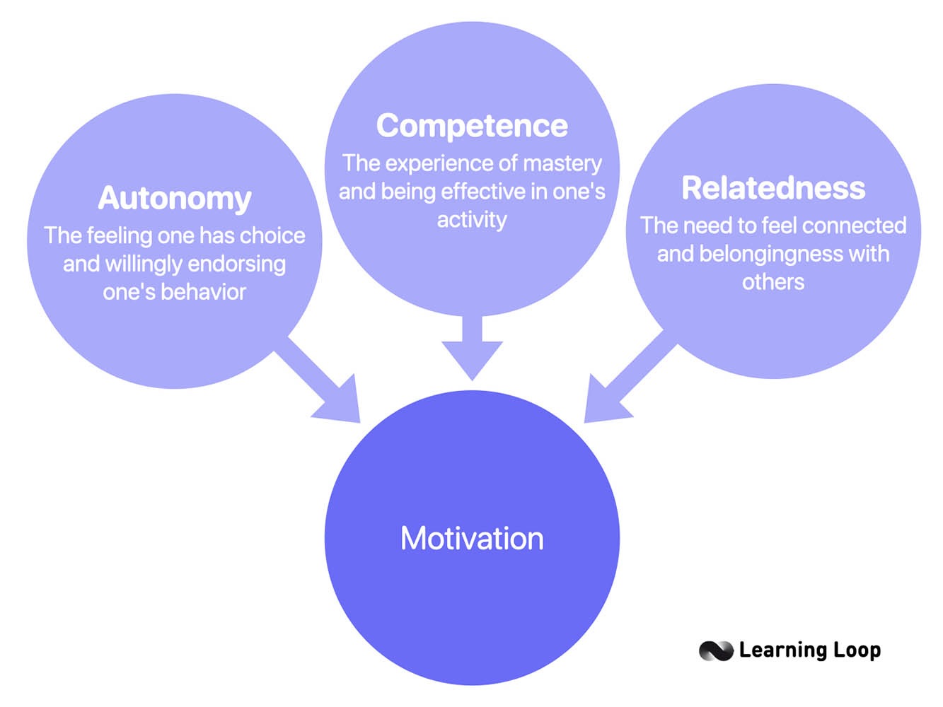
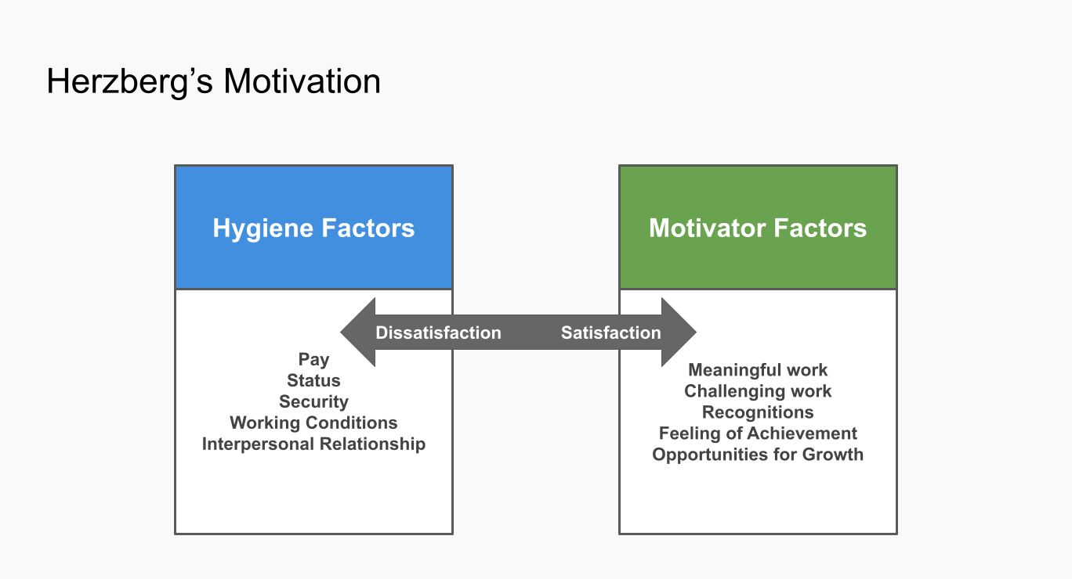
Herzberg’s Two-Factor Theory
Two types of factors influence motivation:
Hygiene Factors
salary
working conditions
company policy
Motivators
achievement
recognition
responsibility
career growth
Self-Determination Theory
People are motivated when three needs are met:
Autonomy – control over work
Competence – ability to succeed
Relatedness – connection with others

Slide 8
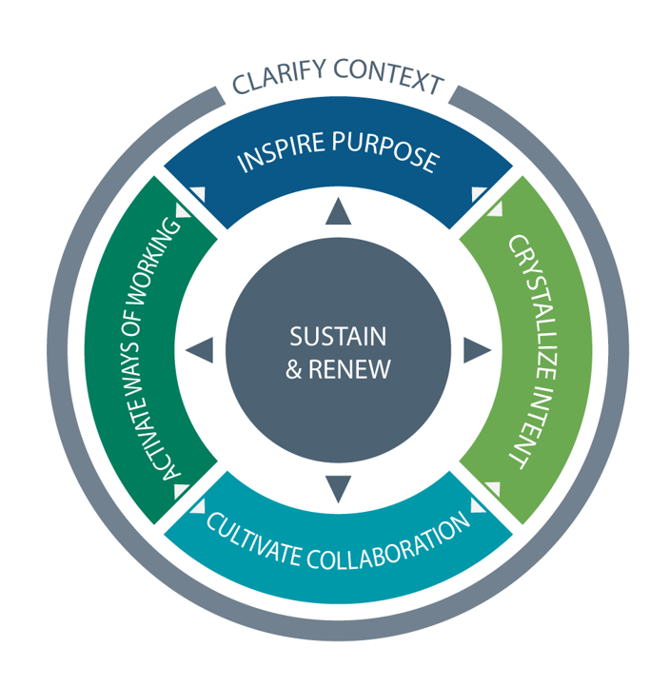
High‑Performance Work Systems (HPWS)
• Integrated HR practices improve performance
• Selective recruitment
• Training and development
• Performance-based rewards
• Employee involvement and teamwork
When these HR practices work together, they create highly productive and engaged employees.

Slide 9
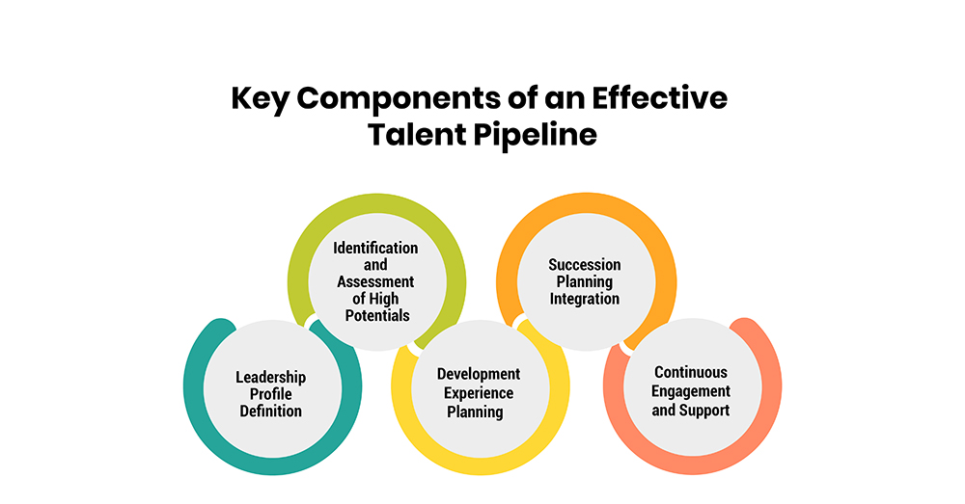
Talent Management Theory
Talent Management Theory focuses on attracting, developing, and retaining talented employees.
Organisations must strategically manage talented employees to remain competitive.
Talent Management Process
Talent attraction (recruitment)
Talent development (training & mentoring)
Talent retention (career opportunities & rewards)
Example
A hospitality company identifies high-potential employees and provides:
leadership training
mentoring programmes
promotion opportunities

Slide 10
Advisory Operational Plan in HR
Selecting an HR Area for an Advisory Operational Plan
Prepared for Management Decision-Making

Slide 11
What is an Advisory Operational Plan?
• Identifies a problem or opportunity
• Uses theory and evidence to justify decisions
• Recommends clear, realistic actions
• Written for management decision-makers

Slide 12
Advisory Operational Plan (Core Section)
This is the main deliverable.
Include:
Objectives (what the plan aims to achieve)
Key actions / strategies
Who is responsible
Timeline
Resources required
Expected outcomes

Slide 13
Assignment Task
Using your chosen project (hotel / resort / tourism business),
Select ONE HR area and develop an Advisory Operational Plan.
Focus on identifying an issue and recommending practical solutions for management.

Slide 14

1. Recruitment
Focus: How an organisation attracts and selects employees.
Possible issues:
• Slow hiring process
• Difficulty attracting skilled candidates
• Lack of diversity
Using digital recruitment tools

Slide 15

2. On-Boarding / training
How new employees are introduced and integrated.
Possible issues:
• High early employee turnover
• Lack of structured orientation
Mentors / team leaders
Trainnng programmes
Example :
Create a structured 30‑day onboarding programme with mentoring.

Slide 16

3. Talent Development
Focus: Developing employee skills and career growth.
Possible issues:
• Skills gaps
• Lack of leadership pipeline
Low employee engagement
Example recommendation:
Introduce continuous learning and leadership training programmes.
Teambuilding opportunities

Slide 17
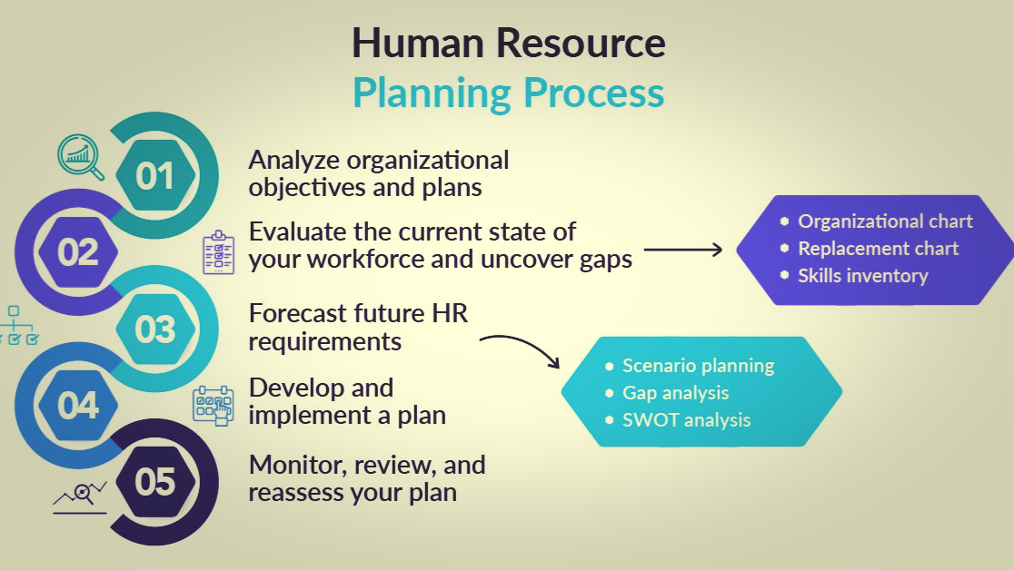
4. Workforce Planning
Focus: Ensuring the organisation has the right number of employees with the right skills.
Possible issues:
• Staff shortages during peak periods
• Poor scheduling
High overtime costs
Example recommendation:
Use forecasting tools and seasonal staffing strategies.

Slide 18
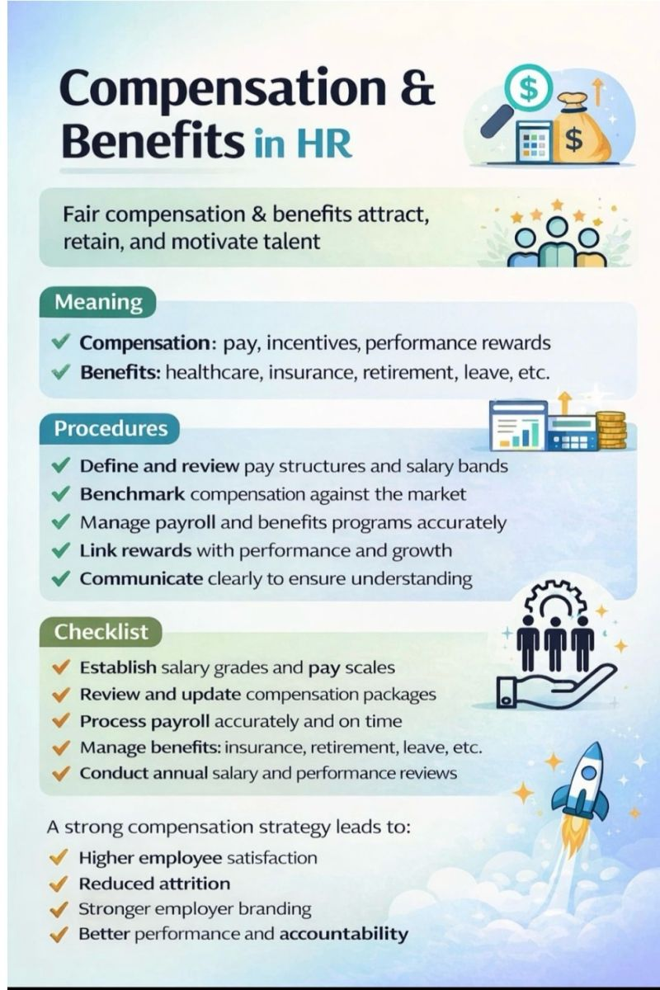
5. Compensation & Benefits
Focus: Employee pay, rewards, and benefits.
Possible issues:
• Low retention due to pay
• Uncompetitive benefits
Lack of performance incentives
Example recommendation:
Introduce performance-based bonuses and flexible benefits.

Slide 19

6. Performance Management
Focus: Monitoring and improving employee performance.
Possible issues:
• Lack of feedback
• Unclear performance goals
Infrequent reviews
Example recommendation:
Implement quarterly performance reviews and goal tracking.

Slide 20
Choosing the Right Topic
Easier topics: Recruitment, On-Boarding, Performance Management
More strategic topics: Workforce Planning, Talent Development
Best for retention discussions: Compensation & Benefits

