Slide 1

Myers-Briggs Type Indicator

Slide 2
What is the Myers-Briggs Type Indicator
The Myers-Briggs Type Indicator (MBTI) is a popular personality test that is meant to indicate how some people may view themselves or the world as well as how they make their decisions
The MBTI is designed to designate 4 categories:
Introversion or Extraversion
Sensing or Intution
Thinking or Feeling
Sensing or Judgement

Slide 3
Its Creation and Theory
Created in 1944 by Katharine Cook Briggs and her daughter Isabel Briggs Myers.
The theory behind as stated before were to put the personality into four categories
The way it puts them together is with 16 different 4 letter categories

Slide 4
The Categories
ISTJ – Quiet, Serious, Practical and Realistic
ISFJ – Quiet, Friendly, Responsible and Conscientious
INFJ – Seeks understanding with ideas, Conscientious and organised.
INTJ – Independent, Motivated and Organised
ISFP – Quiet, Sensitive and Kind
ESTJ – Practical, Realistic, Decisive and Organised
ENTJ – Decisive, Assumes leadership, Forceful and Well read

Slide 5
The Test
The test I took was on the website 16personalities.com
There were a total of 60 questions all of which correlated with the four categories listed
I took the test myself and I had my brother also the the test with varying results.
It was structured as multiple choice going from Strongly agree to Strongly Disagree

Slide 6
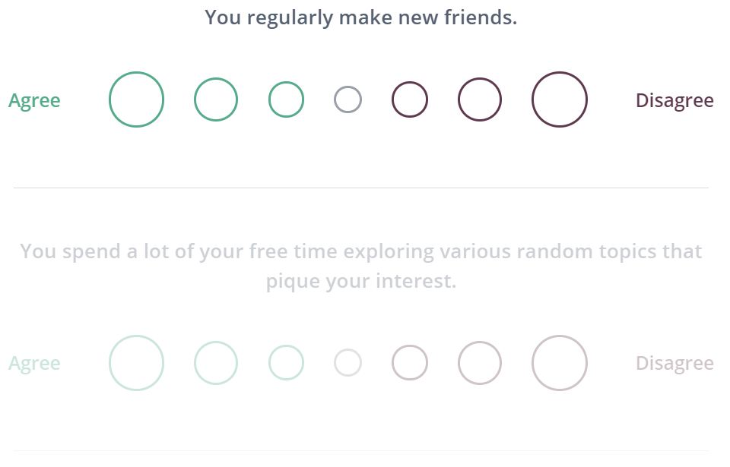
The Test

Slide 7
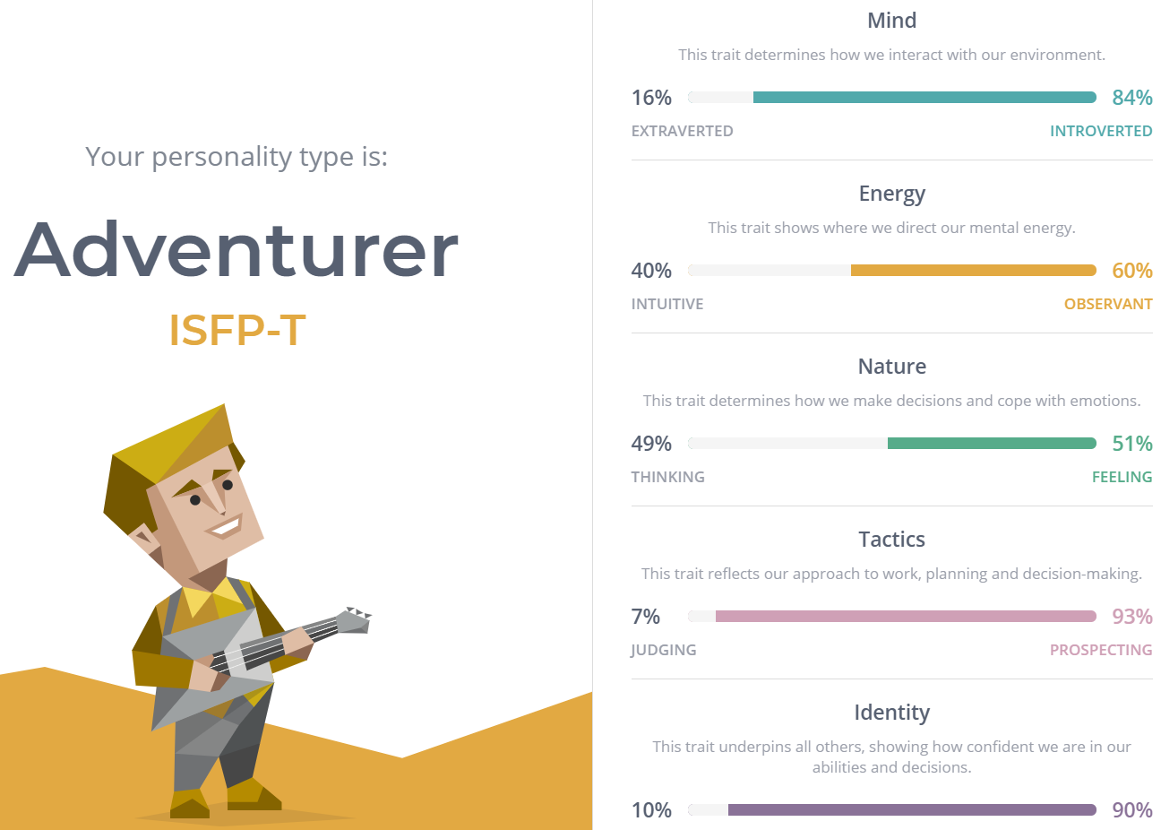
My Result

Slide 8
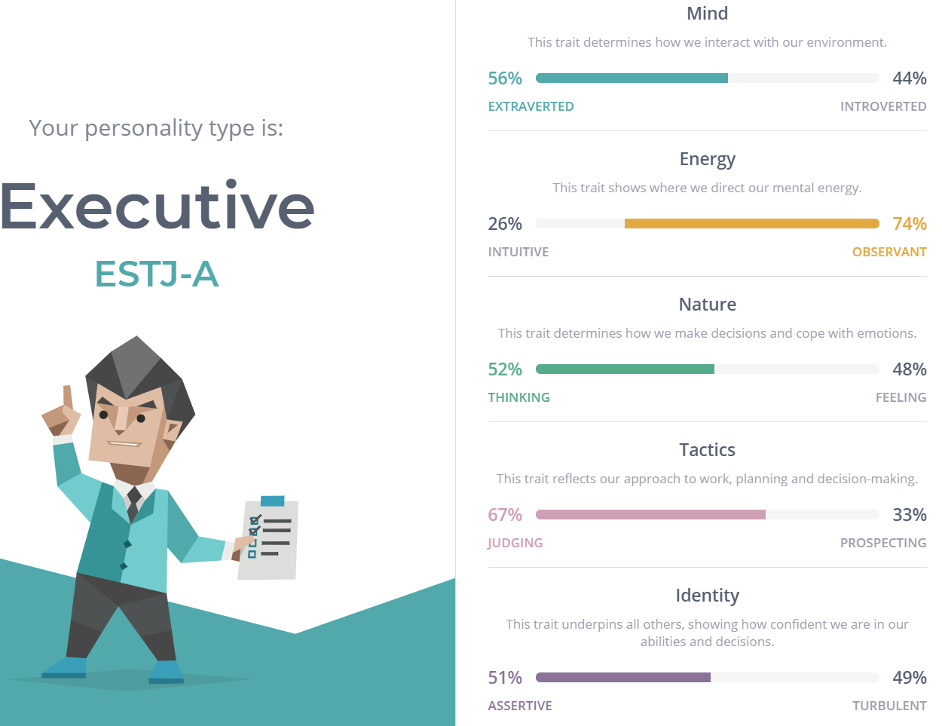
My Brother’s Result

Slide 9
Connection To Big Five
Possibly one of the most glaring flaws of the MBTI is that while it was clearly inspired by the five personalities (Extaversion, Openness, Agreeableness Conscientiousness and Neuroticism) it only has connections to four of the of the five.
The one it doesn’t have a connection to is Neuroticism as the test doesn’t factor in emotional stability which is usually the main indicator for certain personality disorders.

Slide 10
Flaws
It’s vague
Everything is relatable
Should never be used professionally
It’s easy to fake

Slide 11
References
16Personalities. 2021. Free personality test | 16Personalities. [online] Available at: <https://www.16personalities.com/free-personality-test> [Accessed 1 June 2021].
Grant, A., 2013. Goodbye to MBTI, the Fad That Won’t Die. [online] Psychology Today. Available at: <https://www.psychologytoday.com/us/blog/give-and-take/201309/goodbye-mbti-the-fad-won-t-die>.
McCrae, R. and Costa, P., 1989. Reinterpreting the Myers-Briggs Type Indicator From the Perspective of the Five-Factor Model of Personality. Journal of Personality, 57(1), pp.17-40.
Myersbriggs.org. n.d. The Myers & Briggs Foundation - The 16 MBTI® Types. [online] Available at: <https://www.myersbriggs.org/my-mbti-personality-type/mbti-basics/the-16-mbti-types.htm>.

