Slide 1

Social Epidemiology and Public Health Development
Measuring, Monitoring and Control of Disease

Slide 2
Learning outcomes
Upon successful completion of this module, you should be able to:
▪ Understand different approaches and strategies used to measure, monitor and control the incidence of disease in communities
▪ Investigate the implications of illness and disease in communities for the provision of health and social care services
▪ Understand the factors influencing the health and wellbeing of individuals in health or social care settings.

Slide 3
Module Summary
▪ The module aims overall to raise learners’ awareness and critical evaluation of factors influencing public health and the different approaches taken to reduce incidence of disease and illness in communities.

Slide 4
Aims of the Session
To understand
▪ Public health surveillance
▪ How disease can be measured
▪ How disease can be monitored
▪ How disease can be controlled

Slide 5

HOW CAN DISEASE BE MEASURED?

Slide 6
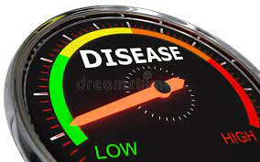
Measuring disease
The two most common means of measuring the burden of disease/assessing population’s health include
• mortality and
• morbidity
• Data on deaths and illness are often used as a surrogate/substitute measures of disease and health.(Naidoo and Wills, 2009)

Slide 7
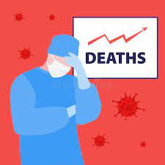
Mortality
▪ Mortality refers to the state of being mortal (destined to die).
▪ Mortality is the number of deaths due to a specific illness or condition.

Slide 8
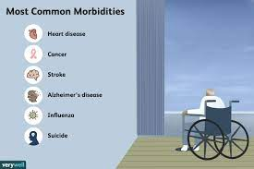
Morbidity
▪ The word morbid is associated to sickness and disease
▪ Morbidity is the state of being symptomatic or unhealthy for a disease or condition.
▪ Some examples of common morbidities are heart disease, diabetes, and obesity.
▪ You can have more than one morbidity ( i.e two or more
illness) at a time. This is called comorbidity.

Slide 9
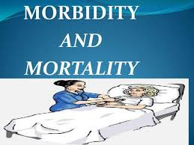
Importance of morbidity and mortality
▪ These measures describe the progression and severity of a given health event.
▪ They are useful tools to learn about risk factors of diseases and compare and contrast health events between different populations.

Slide 10
Activity
▪ Working in a groups, research the strategies that was implemented to measure Covid-19 in the UK
Feedback your findings to the whole class
15mins

Slide 11
Measuring Covid-19
• Prevalence data
• Incidence data
• Mortality and Morbidity data
• Hospital data
• Vaccine efficacy

Slide 12
HOW CAN DISEASE BE MONITORED?

Slide 13

Monitoring disease
• Disease can be monitored with the help of a public health surveillance system

Slide 14
WHAT IS SURVEILLANCE?

Slide 15
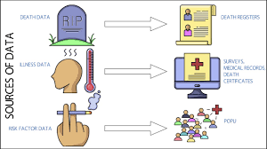
Public health surveillance
▪ Public health surveillance is the “ongoing, systematic collection, analysis, interpretation, and dissemination of health data to help guide public health decision making and action”.
▪ Surveillance is “equivalent to monitoring the
extent of a disease in the community”.(CDC, 2012)

Slide 16
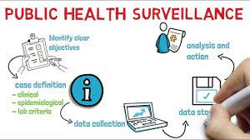
Public Health Surveillance
▪ This is achieved through the systematic collection and evaluation of morbidity and mortality reports and other relevant health information.
▪ The dissemination of these data and their interpretation to those involved in disease control and public health decision making.(CDC, 2012)

Slide 17
Public Health Surveillance
• Morbidity and mortality reports are “common sources of surveillance data for local and state health departments”.
• These reports generally are “submitted by health- care providers, infection control practitioners, or laboratories that are required to notify the health department of any patient with a reportable
disease such as meningitis, or AIDS”.
(CDC, 2012)

Slide 18
WHAT IS THE PURPOSE OF SURVEILLANCE?

Slide 19

Purpose of Surveillance
▪ The purpose of public health surveillance, which is sometimes called “information for action,” is to portray the ongoing patterns of disease occurrence and disease potential so that investigation, control, and prevention measures can be applied efficiently and effectively.(CDC, 2012)

Slide 20
Purpose of surveillance
▪ Measures incidence of infectious disease, with changes
potentially indicating an outbreak
▪ Tracks trends in occurrence and risk factors of an
infectious disease allowing targeted interventions
▪ Enables priority setting and planning of control measures specific e.g. to a particular region
(Adapted from Hawker et al. Communicable Disease Control and Health Protection Handbook, Third Edition. 2012, Blackwell Publishing)

Slide 21
Activity
▪ Working in a groups, research the strategies that was implemented to monitor Covid-19 in the UK
Feedback your findings to the whole class 15mins

Slide 22
Monitoring Covid-19
• Collecting data
• Vaccination data
• Lateral flow test and PCR test data
• Mutation identify by scientist

Slide 23
Activity
• Working in groups using the below link explore the Surveillance strategies that was use for COVID-19
https://www.ecdc.europa.eu/sites/default/files/doc uments/COVID-19-surveillance-strategy-9-Apr- 2020.pdf
Feedback your findings to the whole class

Slide 24
HOW CAN DISEASE BE CONTROLLED?

Slide 25
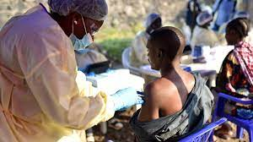
Disease control
Disease can be controlled in different ways. These include
▪ Immunisation
▪ Lifestyle behavioural changes
▪ Medication: antibiotics, antivirals, and antifungals.
▪ Modifying the environment: vector control
▪ Quarantine

Slide 26
WHAT IS IMMUNISATION?

Slide 27
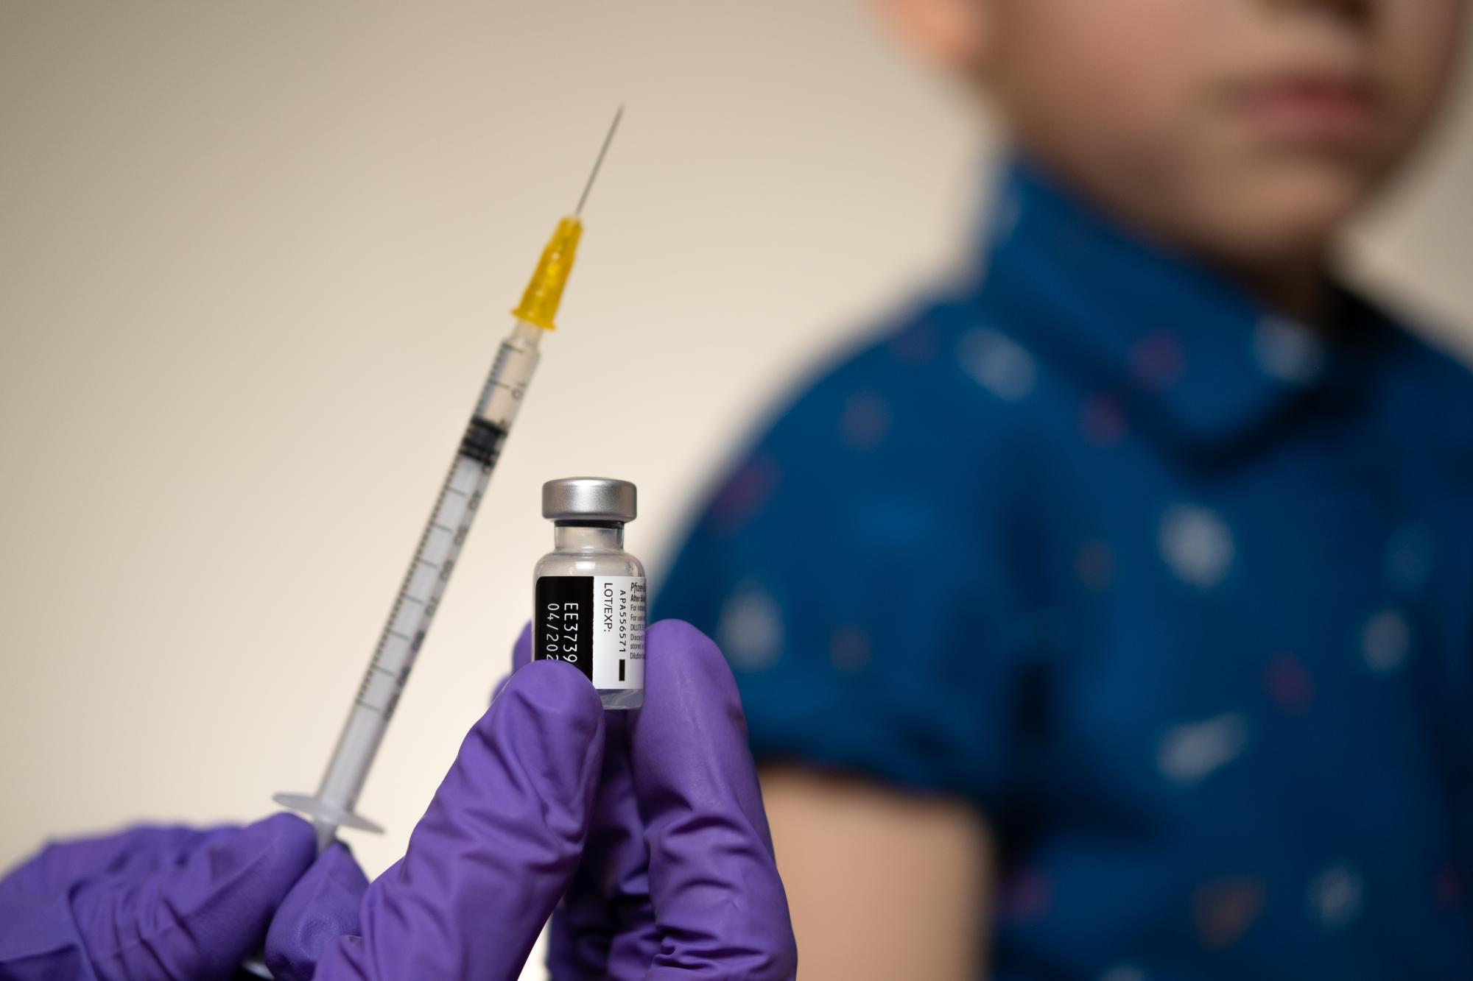
Immunisation
• Immunisation: A “process by which a person becomes protected against a disease through vaccination”.
• This term is often used interchangeably with vaccination.

Slide 28
Activity
▪ Working independently, research the meaning of the term vaccine
Feedback your findings to the whole class

Slide 29
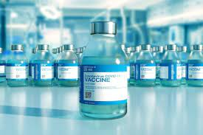
Activity: Answer
• Vaccine: A “preparation that is used to stimulate the body’s immune response against diseases”.
• Vaccines are usually “administered through needle injections, but some can be administered by mouth or sprayed into the nose”.
(CDC, 2012)

Slide 30
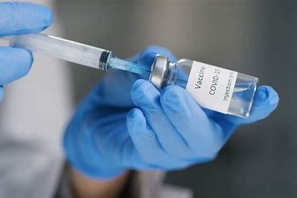
Immunisation
▪ Immunization is one of the most successful and cost-effective way by wish disease can be controlled.
▪ It has eradicated smallpox,
▪ Lowered the global incidence of polio so far by 99% and
▪ Achieved dramatic reductions in illness, disability and death from tetanus, whooping cough and measles. “

Slide 31
Immunisation programmes
To achieve a good immunisation programme the overall aim must be decided. Is it
▪ To protect those at highest risk
▪ or
▪ To eradicate, eliminate or contain disease
Immunisation Department, Centre for Infections

Slide 32
Immune response to vaccination
Aim of an ideal vaccine:
▪ To produce the same immune protection which usually follows natural infection but without causing disease
▪ To generate long-lasting immunity
▪ To interrupt spread of infection
Immunisation Department, Centre for Infections

Slide 33
Activity
▪ Working in a groups, research the strategies that was implemented to control Covid-19 in the UK
Feedback your findings to the whole class

Slide 34
Control of Covid-19
▪ Lockdown
▪ Vaccination programme
▪ Mass screening/testing
▪ Local restriction of movement
▪ Use of Personal Protective equipment (PPE)

Slide 35
Control of Covid-19
▪ Contact tracing
▪ Quarantine
▪ Isolation
▪ hand washing,
▪ maintaining physical/social distance,
▪ Covering the mouth and nose during coughs,
▪ and avoiding contamination of face with unwashed hands
▪ Use of face mask
(Girum et al., 2020)

Slide 36
Activity Answer
▪ Quarantine, contact tracing, screening, and isolation are effective measures
of COVID-19 prevention, particularly whenever integrated together.
▪ In order to be more effective, quarantine should be implemented early and covers larger community.
▪ Controlling population travel will enhance the effectiveness of quarantine. Screening, contact tracing, and isolation are effective particularly in areas where contact tracing is easily attainable.
▪ Although screening is the effective measure recommended by the WHO, since the disease is asymptomatic, it may miss a larger share of the population.
▪ Therefore, this should be integrated with other preventive measures.
▪ In order to control the COVID-19 epidemic, the health care system should consider high level of contact tracing, early initiation of nationwide quarantine measures, increasing coverage of screening service, and preparing effective isolation centres.

Slide 37
Control of Covid-19
Key control measures taken by major countries in 2020 to fight against COVID-19, include lockdowns,
▪ social distancing,
▪ wearing masks,
▪ hand hygiene, using shelter hospitals,
▪ large-scale testing,
▪ close-contacts tracking, and
▪ pandemic information monitoring, as well as their prevention and control effects.

Slide 38
References
• AlFattani, A., AlMeharish, A., Nasim, M., AlQahtani, K. and AlMudraa, S., 2021. Ten public health
strategies to control the Covid-19 pandemic: The Saudi Experience. IJID Regions, 1, pp.12-19.
• Centres for Disease Control and Prevention (2021) Immunization Basics | CDC Available at: https://www.cdc.gov/vaccines/vac-gen/imz-basics.htm (Accessed date 30th September 2022)
• Freedman (2020) Strategy for a Pandemic: The UK and COVID-19, Available at: https://www.tandfonline.com/doi/full/10.1080/00396338.2020.1763610 (Accessed date 12th October 2022)
• Girum, T., Lentiro, K., Geremew, M., Migora, B. and Shewamare, S., (2020). Global strategies and effectiveness for COVID-19 prevention through contact tracing, screening, quarantine, and isolation: a systematic review. Tropical medicine and health, 48(1), pp.1-15.
• Gov.UK (2022) Immunisation Available at: https://www.gov.uk/government/collections/immunisation (Accessed date 30th September 2022).
• Last JM. A (1998) Dictionary of Epidemiology. New York: Oxford University Press.
• National Health Service (2022) Why vaccination is safe and important Available at: https://www.nhs.uk/conditions/vaccinations/why-vaccination-is-safe-and-important/ (Accessed date 30th September 2022)
• Orenstein WA, Bernier RH. (1990) Surveillance: information for action. Pediatric Clinical North Am 37, pp.709–734. ce4 Aqa y

