Slide 1
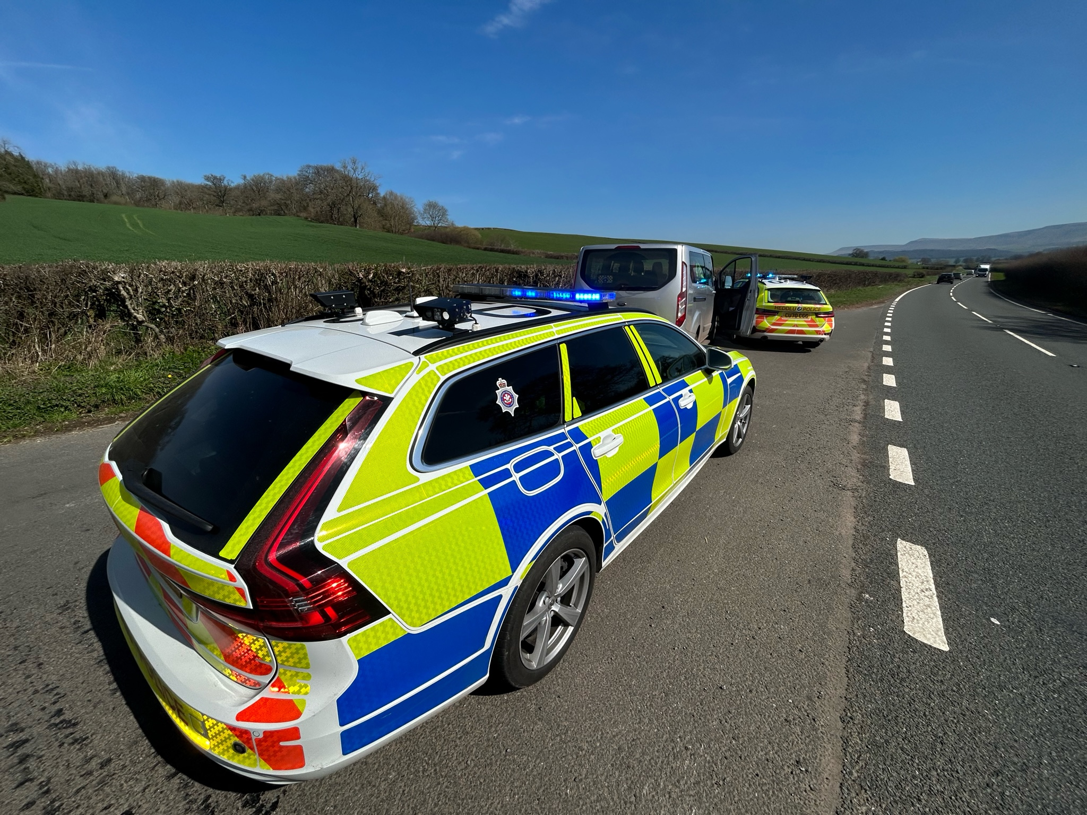

Roads Policing.
Use, Cause and Permit
Week 5 Part 1 recorded session

Slide 2
By the end of the session, students will be able to:
Explain the terms “Use”, “Cause” and “Permit” and,
Provide examples of offences where these further offences may be committed.

Slide 3
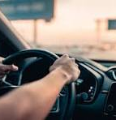
Use, cause or permit?
As the driver of a vehicle that you own, you are using it.
As the driver of a vehicle you have borrowed, you are using it.
When you drive your employer's car, van or other vehicle, even if it is in the course of business, you are using it.
An employer that instructs an employee to use a vehicle is causing them to use it.
A friend who lends their car to a mate, permits them to use the vehicle.
So, what does this mean for all of the parties? …..

Slide 4
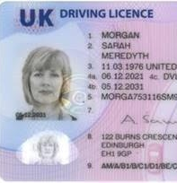
No drivers licence, or incorrect category.
Driver – uses other than in accordance with a licence.
Owner – permits the offence of driving, other than in accordance with a licence.
Employer – causes, driver to use a vehicle with no licence or incorrect category.

Slide 5
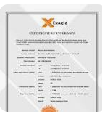


No valid insurance
No insurance
The driver commits an offence of driving without insurance, the owner an offence of permitting and the boss an offence of causing the vehicle to be used without insurance.

Slide 6

No valid MOT
Driver = Use.
Friend or rental company = permit.
Employer = Cause.

Slide 7
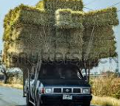
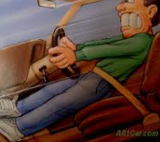
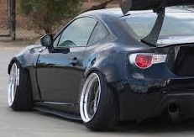
Dangerous condition
For example;
Driver Uses.
Friend Permits
Employer causes.

Slide 8
S. 40A Road Traffic Act 1988
40AUsing vehicle in dangerous condition etc.
A person is guilty of an offence if he uses, or causes or permits another to use, a motor vehicle or trailer on a road when—
(a)the condition of the motor vehicle or trailer, or of its accessories or equipment, or
(b)the purpose for which it is used, or
(c)the number of passengers carried by it, or the manner in which they are carried, or
(d)the weight, position or distribution of its load, or the manner in which it is secured,
is such that the use of the motor vehicle or trailer involves a danger of injury to any person

Slide 9
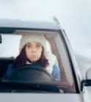
Case exercises
Helen, is driving her car to work and discovers that the fluid has run out in the wiper washer bottle. It is the middle of winter, and the roads have just been gritted. Discuss

Slide 10

Any Questions

