Slide 1

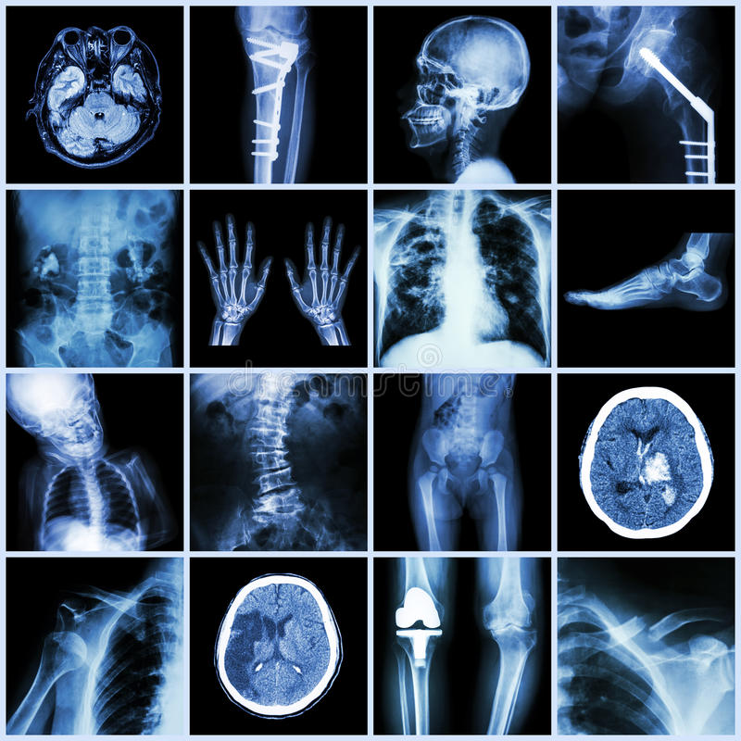

Falls prevention and health promotion
in elderly people
By Agnieszka Sewkani (2110678)
For Introduction to Health Research (BMNS4005) May 2022

Slide 2
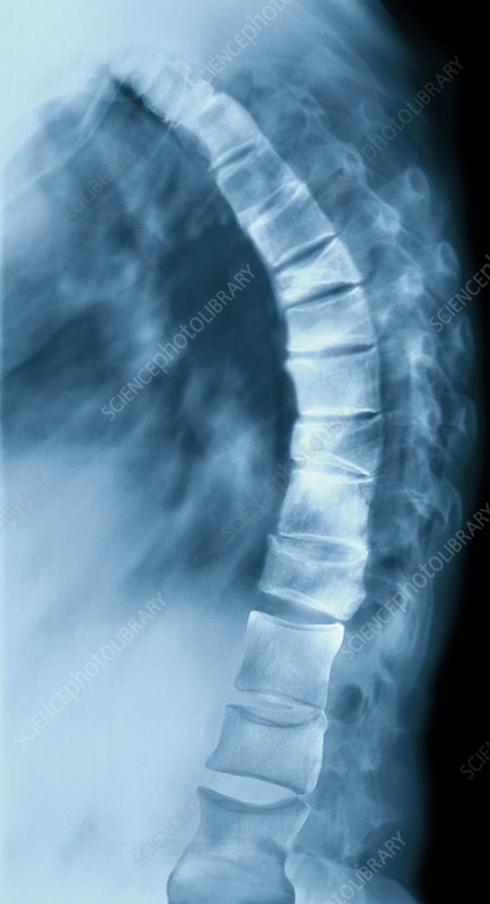
Introduction
Falls in elderly people
What are the risk factors
What information and advice are available for elderly people

Slide 3
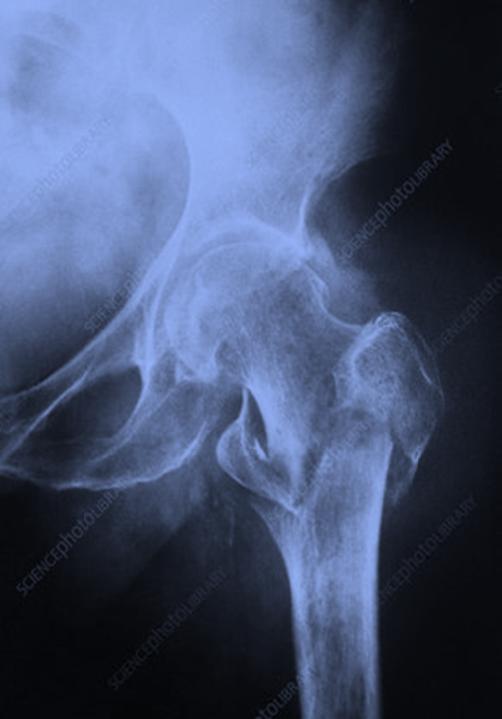
Older people and falls
1 in 3 age >65
1 in 2 age >80
Likely to have a fall AT LEAST once a year
> 220 000 Hospital admissions EVERY YEAR
Hip / pelvic fracture
Ribs fracture / chest injuries
Hip / shoulder dislocation
Head injuries
Bruising / sprains
Common fall consequences
(WHO, 2021), (NHS, 2021a), (Kennedy-Malone et al, 2019), (GOV. UK, 2022)

Slide 4
Risk factors of sustaining a fall in elderly people
Medications
side effects
Environmental
Age related
Alcohol
Antidepressants
Sedatives – benzodiazepines
Antihypertensive
Nonsteroidal
anti-inflammatory
Even small amount result in high alcohol concentration in blood
Mostly home hazards, like loose rugs
Lack of safety adjustments, like grab bars
Visual impairment
Muscle weakness
Balance problem
(Ray et al, 1987), (NHS, 2021b), (Tetley et al, 2018), (Gerlach et al, 2018), (Cai and Calhoun, 2018), (Walker et al, 2019), (Hicks et al, 2020), (Blaber et al, 2021), (Kuerbis et al, 2016), (Gulis et al, 2014), (Kyrdalen et al, 2019)

Slide 5





Health promotion and campaigns in falls prevention
www.ageuk.org.uk
They provide fall prevention information and advice on:
Physical and mental activities
Medication and health reviews
Home adaptations
Healthy wellbeing
www.rospa.com
www.ageingwellinwales.com
www.ageconnectswales.org.uk
www.gov.uk/government/publications/falls-applying-all-our-health
Local authorities
Local NHS and GP
Local pharmacy
(Fong et al, 2020), (Flint et al, 2020), (Finnegan et al, 2019), (Phelan and Ritchey, 2018), (Hyer, 2014), (Ali et al, 2021), (Bye et al, 2022), (Campani et al, 2021), (Capozi et al, 2020)

Slide 6
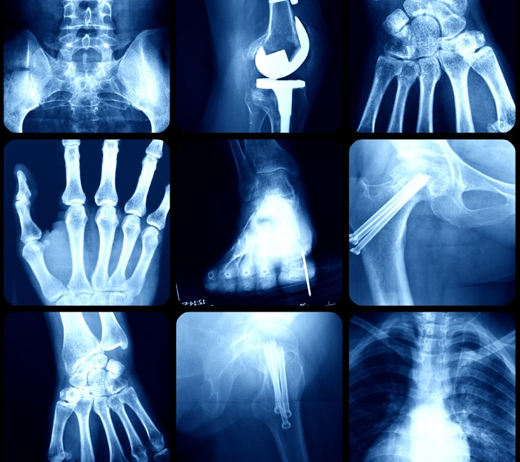
Conclusion
Most falls could be prevented if the right steps and actions are in place
Educating people about safe and healthy aging together with continues active lifestyle will reduce the fear of a fall

Slide 7
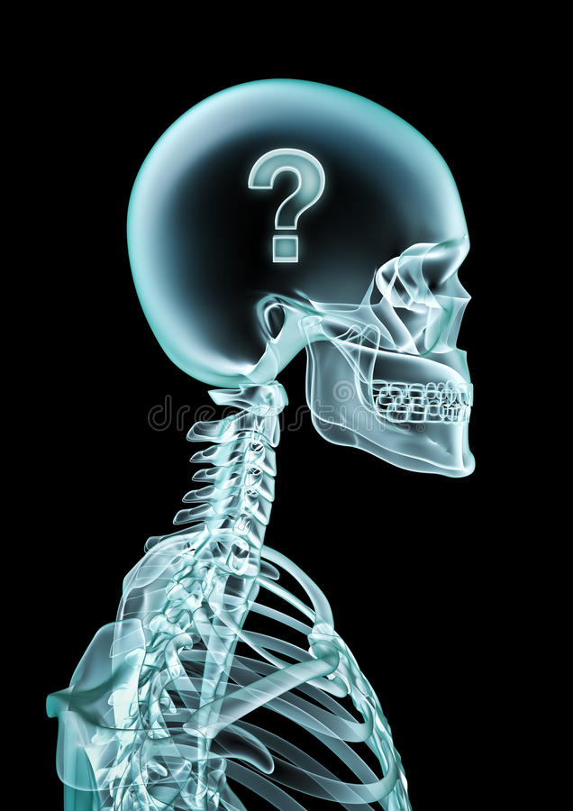
2110678@student.uwtsd.ac.uk

Slide 8


Slide 9
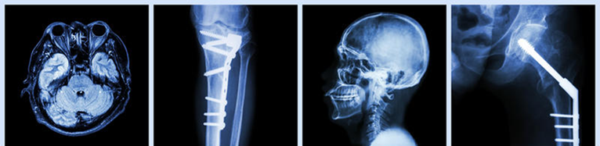

References:

