Slide 1
Sustainable tourism
Destination marketing

Slide 2
Why sustainable tourism?
Why sustainable tourism - the Travel Foundation

Slide 3
Big picture: conflicted obsessions
Whistler Blackcomb

Slide 4
Skiing holidays
Sustainable development issues

Slide 5
People love ….
The escape from their daily lives
The exhilaration of the fresh air and beauty of the landscape
The adrenalin rush of the speed and invigorating conditions
The achievement of mastering something new
A shared experience with friends and family
Escape from technology
No other holiday intertwined so much with the natural environment?

Slide 6
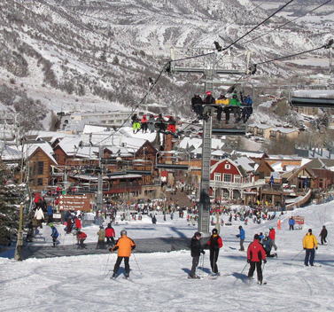
Ski tourism
Does Ski Tourism really differ that much from any other form of tourism?

Slide 7
The answer is no…
-There are still large numbers of people visiting an area in a seasonal fashion.
-There are day, weekend and long stay visitors
-It brings exactly the same pressure as beach tourism when you consider transport, infrastructure and development

Slide 8
Where skiing may differ…
Skiing & Traffic Management
Fragile Mountain Environment
Skiing’s Reliance on Weather Conditions
Skiers are ‘skilled consumers’ – how does this impact their needs and wants?

Slide 9
How to be a skier
https://youtu.be/YPg4HuIQt9c

Slide 10
Skiing infrastructure
The more familiar area where skiing differs is in its Infrastructure Requirements:
Pistes
Off Piste Skiing
Artificial Snow
Ski Lifts

Slide 11
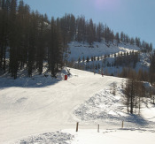
What is a Piste?
A piste is a marked ski run or path down a mountain for snow skiing, snowboarding or other mountain sports.

Slide 12
Impacts: Pistes
Resorts need for Pistes
Needs of ‘skilled consumers’ in their choice of Pistes
Environmental impact on creating and maintaining Pistes
Tree removal; Drainage Patterns and Pollution

Slide 13
Impacts: Artificial Snow
What is artificial snow and why is it used?
Very energy intensive and requires a lot of equipment.
Excess water consumption either from reservoirs built up the mountain, which are often unsightly, or from rivers.
Impact on Rivers
Skiers want peace and to relish the environment – snow machines can negatively impact the experience.

Slide 14
Green Piste: Protecting the Skiing Environment
https://youtu.be/oY3m7p2MAqM

Slide 15
Making Snow for the Olympics National Geographic
https://youtu.be/lZvJ49gJ9Tw

Slide 16
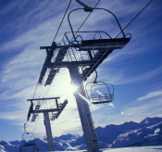
Impacts:
Ski Lifts
Why we need them!
  Essential for majority of skiers
  Winter and summer access
  Make the mountains accessible for all
The Impacts
  Year round visual impact
  Buildings up the mountain
  Cause impact when being built
  Energy use: emissions
  Noise

Slide 17
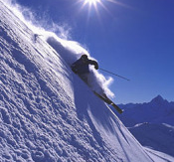
Off Piste Skiing
Challenging and fun!
Fewer people ☺
More natural way to ski?

Slide 18
Impacts: Off Piste Skiing
Challenge for our ‘skilled consumers’.
More natural way to ski?
Damage vegetation
Disturb feeding routes of animals
It also can be dangerous – both for the skier if they don’t know the area and also for the avalanche risk.

Slide 19
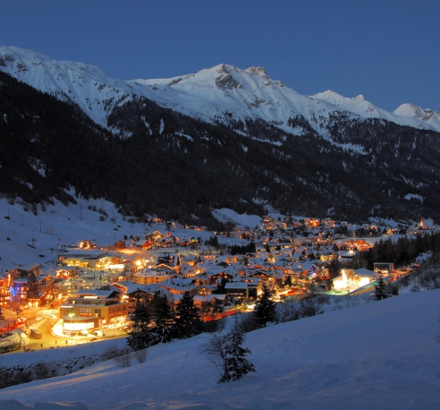

Resort issues
Energy and waste
Development and Planning
Architecture
Transport and Traffic
Social and Cultural impact

Slide 20
Impacts: Resort Issues
Social and Cultural Impacts
Resident year round population and influx of seasonal tourism
Chalets and Second Homes
Restaurants and other services rely on secondary spend
Impact of Brexit/weak pound

Slide 21
Impacts: Resort Issues
Planning and architectural controls (Val D’Isere)
Family Market in Soll in Austria (lager lout image)
In Saalbach, Austria (Family Market threatened)
Other resorts are considered more English than London at times! Losing Authenticity.
Large Corporate America

Slide 22
Resort destination development
Myrkdalen developments

Slide 23
Wengen
There are many resorts that suffer gridlock and traffic jams at the weekend
How has Wengen conquered this issue?
Lauberhorn World cup Alpine Ski Race held annually in mid-January above Wengen. The downhill course is currently (as of 2016) the longest in the world
The Lauberhorn ski races are among the highest-attended winter sports events in the world, attracting around 30,000 spectators each year
Has Wengen been successful in mastering the influx of tourism for the sports event?

Slide 24
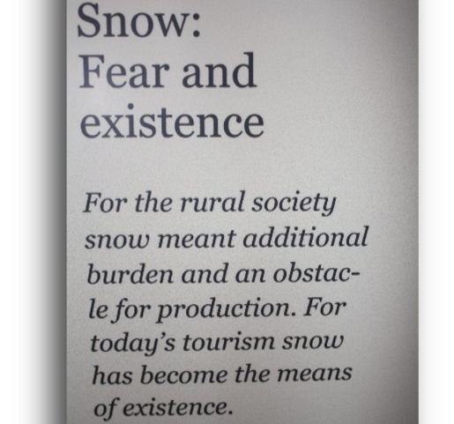
Skiing and Responsible tourism
What is Responsible Skiing?

Slide 25
Responsible tourism: solutions
Regardless of the impacts of ski tourism vitally important for the income
Out-migration in villages
Skiing enables young people to stay in the place they were brought up with new work opportunities
Responsible tourism is all about minimising the negative impacts and maximising the benefits
It’s all about balance

Slide 26
The balance - Pistes
Require extensive environmental impact assessment before development
The piste maintenance operations
Ski Operations and Environmental Management
Skilled consumers and addressing the “challenge”.
If the industry could standardise the definition and communication across Europe.

Slide 27
The balance – Artificial snow
Artificial snow – what is the way forward?
Snow Calculation
Renewable Energy
Chemical Additive Usage
Water Usage – resolution

Slide 28
The balance – ski lifts
And what is the way forward for ski lifts?
Full Environmental Impact Assessment should be carried out
Review protected areas, geology, routing, visual sightlines
Detachable Chair and Seasonal Storage
Renewable Energy

Slide 29
The balance – off piste skiing
For this there are two aspects – Safety and Environment.
Designing Boundaries
Patrolling and Distinction made for Feeding Routes
Interpretative Signage
Responsibility on the Skier to Respect the Environment.

Slide 30
The balance – resort solutions
Resort can set up transfer buses from airports and train stations
Pedestrianisation
Free bus services and electric vehicles
Resorts can introduce Architecture Guidelines
Resorts can have strict planning rules to ensure development is sustainable
If Resorts sell only locally produced souvenirs or decorate with local art

Slide 31
The balance – resort solutions
Hotels and Restaurants can source their supplies locally
The local hotels and restaurants can set up food partnerships with local producers
Tourist offices can assist local producers and craftsmen to create display areas
Create walking routes that take tourists to producers where they can show tourists around
Museums need to be interpreted well in a range of languages and kept open in the ski season.
How is Wengen finding the balance ? What are the sustainable options being explored in Switzerland? Winter/Summer Season. Transportation. Accommodation. Restaurants & Activities. Souvenirs.

Slide 32
Responsible skiing should:
Generate Greater Economic Benefits for Locals...
Make for Diverse Communities with a range of Employment Opportunities...
Involve Local People in decisions that affect their Community...
Minimise Negative Environmental Impacts through Planning and Consultation...
Give opportunities to contribute to the conservation of Cultural Heritage...
Provide a variety of more enjoyable Experiences for Skiers...
Provide access for Physically Challenged People

Slide 33
Tutorial question
In what ways does the Well-being of Future Generations Act (Wales) 2015 have an impact on sustainable tourism and hospitality development?
https://futuregenerations.wales

