Slide 1
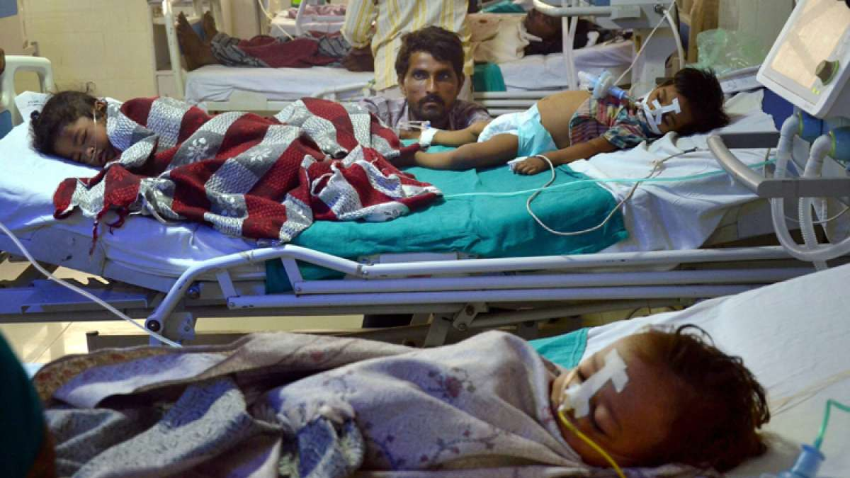
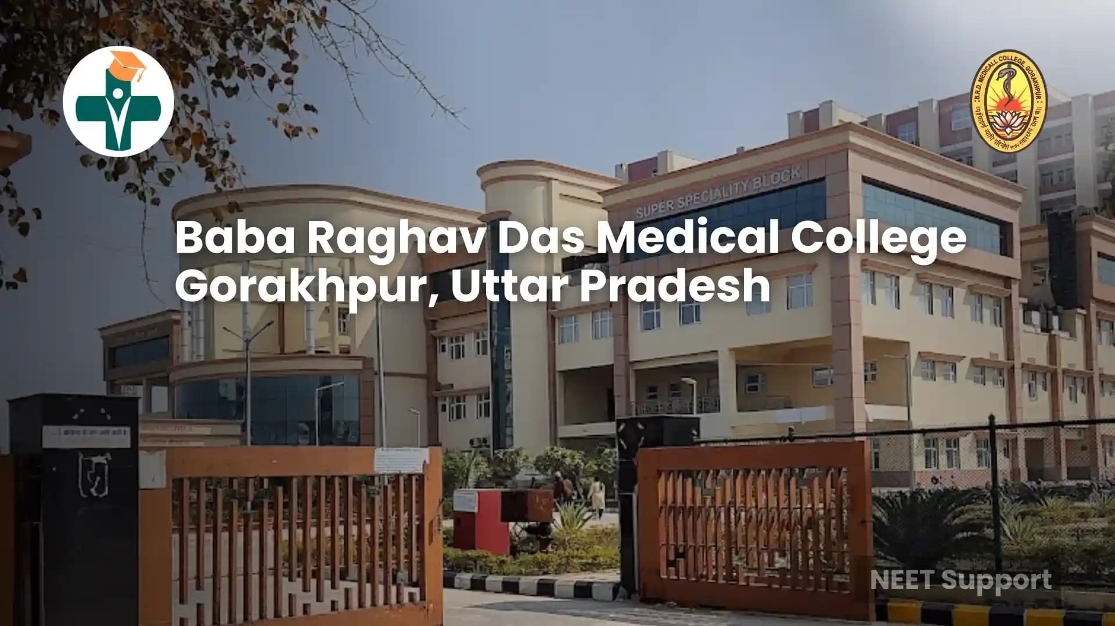
Name: Melvita Da Silva
Student ID: 2436452
Topic: Oxygen Supply Chain Failure and Governance Gaps: Lessons from the Gorakhpur BRD Hospital Tragedy
Programme: MSc Public Health and Social Care in Practice
Module Code: LCHS7006
Lecturer: Dr Fahad Khan

Slide 2
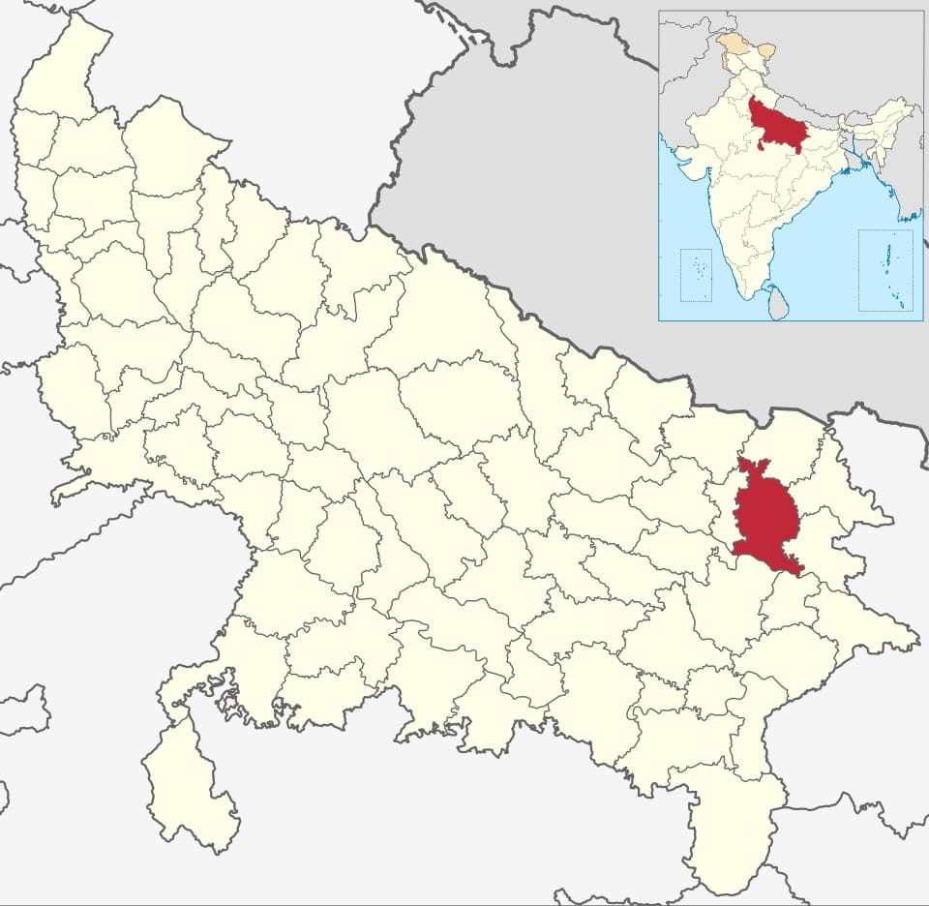
Background
The Gorakhpur hospital oxygen crisis occurred in August 2017 at BRD Medical College and Hospital in Gorakhpur, Uttar Pradesh, India, a major tertiary care Centre serving a large population, particularly children with acute encephalitis syndrome (AES) (Khan, 2018). The immediate cause was the failure of the hospital’s piped liquid oxygen system, compounded by delays in delivery of supplementary oxygen cylinders due to administrative and bureaucratic lapses, including delayed payments to suppliers and inadequate contingency planning (Indian Journal of Medical Ethics, 2018). The hospital’s high patient load, particularly in neonatal and AES wards, amplified the impact, as many critically ill children require continuous oxygen support. Over a 48-hour period, 81 patients died, including 63 children, highlighting the severe consequences of systemic failures in hospital infrastructure and supply chain management (Indian Journal of Medical Ethics, 2018; Khan, 2018). The incident led to national outrage, policy reviews on oxygen supply in hospitals, and recognition of the necessity of emergency backup systems in high-demand wards (Khan, 2018).
Source:India_Uttar_Pradesh_districts.svg

Slide 3

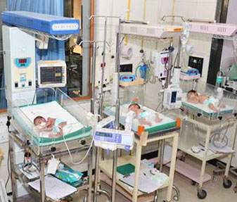
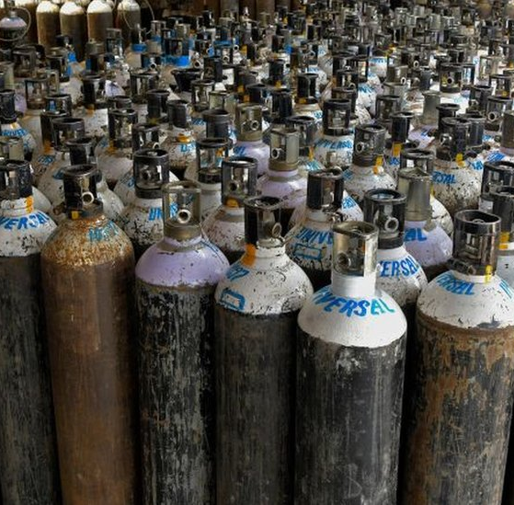

System Failure
1. Oxygen Supply Chain Failures
Non-payment of dues to supplier → interruption of liquid oxygen supply (Times of India, 2017)
Inadequate emergency reserves: Only ~57 cylinders available vs. ~350 required
(Indian Express, 2017)
Supplier located far away (~300 km), delaying emergency delivery (Times of India, 2017)
2. Hospital Administration & Clinical Failures
Understaffing and insufficient training: vacancies in senior resident roles; few trained neonatal nurses (Wikipedia, 2017)
Poor record-keeping: overwritten logbooks and no systematic monitoring (Times of India, 2017)
Delayed escalation to authorities, leading to unaddressed shortages (Indian Express, 2017)
3. Inadequate Infrastructure & Equipment
Overcrowded wards: Neonatal and pediatric ICUs exceeded capacity, limiting ability to provide timely oxygen therapy (IJME, 2018).
Non-functional backup oxygen systems: Backup oxygen pipelines and cylinders were either insufficient or poorly maintained (Caravan, 2018).
4. Poor Crisis Management & Emergency Preparedness
No contingency plan for sudden oxygen supply interruption.
Delayed response in reallocating oxygen to critical wards, even when shortage was reported (Indian Express, 2017).
5. Weak Administrative Oversight
Multiple layers of bureaucracy slowed decision-making in urgent situations.
Absence of accountability mechanisms: Hospital leadership failed to enforce standard operating procedures for critical supply management (OpIndia, 2017).
6. Financial Mismanagement
Delay in payments to suppliers, despite availability of government funds.
Inefficient budgeting: funds not earmarked for essential life-support resources like oxygen cylinders and ventilators (Times of India, 2017).

Slide 4
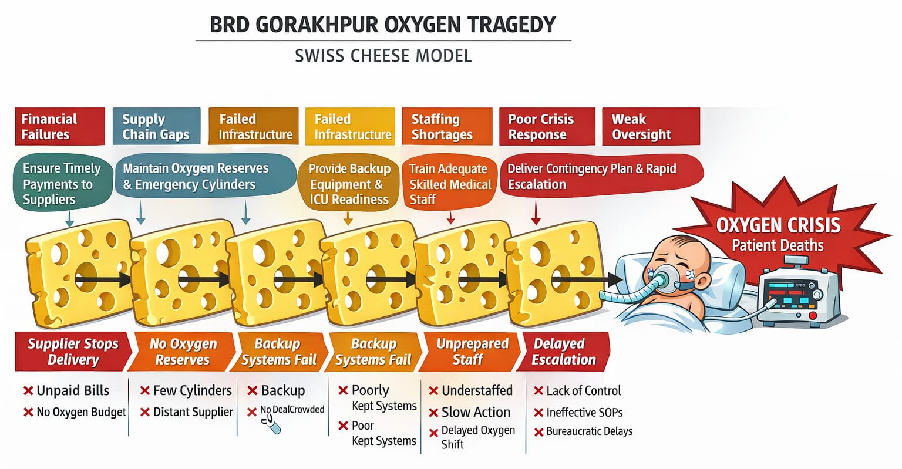

Slide 5
Swiss Cheese Model
Layer of Defence (Slice of Cheese) | Intended Function | Hole (Weakness)
1. Financial & Procurement Management | Ensure timely payment to oxygen suppliers; secure uninterrupted life-support supply | Delayed payments to supplier; no protected budget for oxygen; poor financial escalation
2. Oxygen Supply Chain & Logistics | Maintain adequate oxygen reserves and emergency backup cylinders | Only ~57 cylinders available vs. ~350 required; supplier ~300 km away; no real-time stock monitoring
3. Infrastructure & Equipment Backup | Functional backup oxygen pipelines and reserve systems; adequate ICU equipment | Non-functional/poorly maintained backup systems; overcrowded wards; limited ventilators
4. Hospital Administration & Workforce | Adequate staffing; proper clinical monitoring; accurate documentation | Vacant senior resident posts; limited trained neonatal nurses; overwritten logbooks
5. Crisis Management & Emergency Preparedness | Contingency plan for oxygen interruption; rapid escalation and redistribution | No emergency oxygen contingency plan; delayed escalation; slow oxygen reallocation
6. Governance & Administrative Oversight | Accountability, audits, and enforcement of SOPs | Bureaucratic delays; weak accountability; failure to enforce supply protocols

Slide 6
Benchmarking Chart: Oxygen Supply & Inspection Norms vs BRD Hospital Performance (2017)
Benchmark Parameter | Hospital Standard (NABH / GOI / WHO) | BRD Hospital Performance (Aug 2017) | Compliance % (Estimated Benchmark (gap)
Primary Oxygen Source | Central Liquid Medical Oxygen (LMO) or PSA plant with continuous piped supply | LMO installed but supply disrupted due to unpaid dues | ~50% (System existed, continuity failed)
Secondary / Backup Source | Functional manifold with adequate D-type cylinders (≥ 24–48 hr reserve) | Cylinders arranged ad-hoc; shortage reported during crisis | ~30–40%
Daily Oxygen Requirement Planning | For 200-bed hospital: ~90 D-type cylinders/day equivalent (GOI normative guide) | Estimated ~250 cylinders/day required in encephalitis season; reserve inadequate | ~40% compliance (~60% gap)
Minimum Reserve Stock | At least 2× daily consumption (24–48 hr buffer) | Stock reportedly fell below critical level (<12 hr buffer at crisis peak) | ~25% compliance
Payment & Vendor Management | Timely payment; documented procurement system (NABH FMS.6) | Vendor repeatedly warned about unpaid dues | ~20% compliance
Daily Stock Monitoring Log | Mandatory logbook for medical gas monitoring (NABH FMS) | Warnings issued; records suggest inadequate escalation | ~40% compliance
Alarm & Early Warning System | Pipeline low-pressure alarms & escalation SOP | Low pressure noticed but response delayed | ~50% compliance
Emergency Escalation Protocol | Defined chain of command & disaster management plan | Delayed administrative response | ~30% compliance
Regulatory Inspection & Audit | Periodic inspection, preventive maintenance, internal audit | System failure despite prior warnings | ~40% compliance
WHO Oxygen System Reliability Principle | Multi-source redundancy (Primary + Secondary + Reserve) | Reliance mainly on single LMO vendor; backup insufficient | ~35% compliance

Slide 7
Report Summary of Component 2
Introduction:
Exploring safety and quality issues in healthcare using a systems-based approach, examining system failures and policy impacts on service delivery, efficiency, and equity.
Identifying Root Causes:
Swiss Cheese Model – highlights gaps where multiple defenses fail, showing errors are often systemic.
Key Theories & Models:
Root Cause Analysis: Identifies underlying causes of adverse events.
Fishbone Diagram: Categorizes factors like people, processes, equipment, environment.
Systems Theory: Shows how small failures cascade through the system.
Donabedian Model: Evaluates quality via structure, process, and outcomes.
Policy Issues:
Staffing, funding, and procedural policies influence root causes, affecting healthcare delivery.
Impact on Services:
Root causes and policy issues affect quality, efficiency, and equity, guiding improvements for better patient outcomes.

Slide 8
References
The Caravan (2018) How the Gorakhpur oxygen tragedy unfolded. The Caravan Magazine. Available at: https://caravanmagazine.in (Accessed: 22 February 2026).
Indian Express (2017) Gorakhpur tragedy: Oxygen supply crisis and hospital lapses explained. The Indian Express. Available at: https://indianexpress.com (Accessed: 22 February 2026).
Indian Journal of Medical Ethics (IJME) (2018) The Gorakhpur hospital tragedy: Systemic failures in public health care. Indian Journal of Medical Ethics, 3(2). Available at: https://ijme.in (Accessed: 22 February 2026).
OpIndia (2017) BRD Medical College tragedy: Administrative accountability and financial lapses. OpIndia. Available at: https://opindia.com (Accessed: 22 February 2026).
Times of India (2017) Gorakhpur deaths: Oxygen supply stopped over non-payment of dues. The Times of India. Available at: https://timesofindia.indiatimes.com (Accessed: 22 February 2026).
Wikipedia (2017) 2017 Gorakhpur hospital deaths. Wikipedia. Available at: https://en.wikipedia.org (Accessed: 22 February 2026).
https://en.wikipedia.org/wiki/2017_Gorakhpur_hospital_deaths
Wikipedia Contributors (2026). 2017 Gorakhpur hospital deaths.https://en.wikipedia.org/wiki/2017_Gorakhpur_hospital_deaths
Gorakhpur tragedy: BRD Hospital agency denies shortage in oxygen supply. (2017). https://www.business-standard.com/article/current-affairs/gorakhpur-tragedy-brd-hospital-agency-denies-shortage-in-oxygen-supply-117081200363_1.html
30 kids die in 48 hrs in Gorakhpur hospital. (2017). Times of India. https://timesofindia.indiatimes.com/india/30-kids-die-in-48-hrs-in-gorakhpur-hospital/articleshow/60028742.cms
Gorakhpur hospital deaths: Supplier warned it would cut supply. (2017). The Indian Express. https://indianexpress.com/article/india/gorakhpur-hospital-deaths-yogi-adityanath-brd-medical-college-uttar-pradesh-encephalitis-oxygen-firm-warned-it-would-cut-supply-4794370/
Report: There was shortage of oxygen on Aug 11 last year. (2017). Times of India. https://timesofindia.indiatimes.com/city/lucknow/report-there-was-shortage-of-oxygen-on-aug-11-last-year/articleshow/65589675.cms
RTI query reveals there was oxygen shortage at BRD Hospital. (2018). Times of India. https://timesofindia.indiatimes.com/city/lucknow/rti-query-reveals-there-was-oxygen-shortage-at-brd-hospital/articleshow/65395029.cms
Gorakhpur tragedy: 7 deaths a day 'normal', says UP govt. (2017). Business Standard. https://www.business-standard.com/article/current-affairs/gorakhpur-7-deaths-a-day-normal-says-up-govt-ignoring-there-were-23-117081200312_1.html

