Slide 1

Litelok – Bike lock in Swansea
“Light, flexible, and strong”

Slide 2


Summary
Background of the company
SWOT analysis
Digital Marketing Audit
Recommendations
Conclusion
References

Slide 3
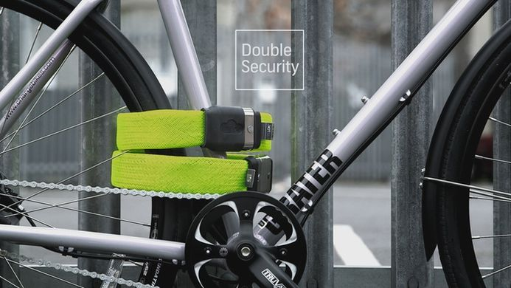
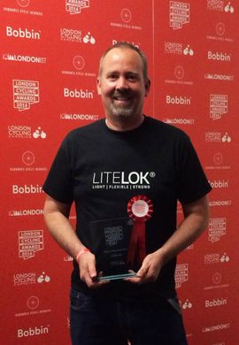
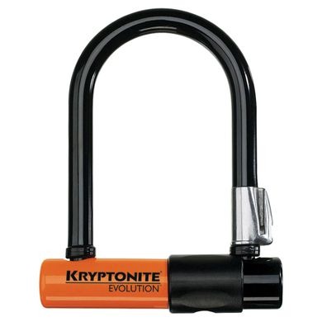
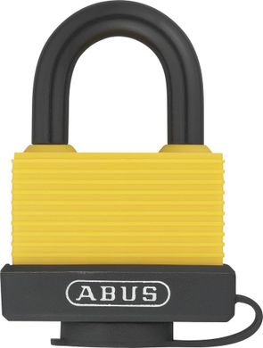
Litelok’s background
Litelok ID card
Organisation name: Litelok
Type of organisation: Civil society / Commercial business
Size: Small company with 15 employees
Founder: Neil Barron
Date: 2013
Based on: Swansea
Range of products: Secure bike lock
Customer base: Users of bike,
men between 30-60 years old / bike shop
Main competitors: Kryptonite and Abus
Mission or vision statement:
“We create innovative lightweight materials combined to create
a strong and flexible design” (Barron, 2018)

Slide 4
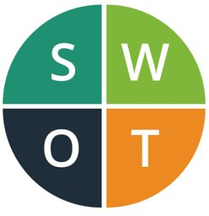

SWOT Analysis
Strengths:
Original and initiative design
Strong materials
High quality
Modern through the flexible lock
More and more people use bike today, and they need secure products because of the number of theft
Marketing strengths: attractive pages, nice pictures, and precise explanation
Sponsors
Weaknesses:
High price
Low updated of some social media
Low range of products
Brexit can generate decrease of the exportation and so decrease of the turnover

Slide 5
SWOT Analysis
Treats:
Brexit
Little size of the market
Two leaders competitors on the market
Competitors have strong online presence and are anchored in the market
People sceptics about innovative products
Opportunities:
Selling from internet
Variety of customer from all over the world
The lock can be use for bike, motorcycle, human tricycle
They can develop new range
Use social media to show their engagement
Create sponsor with athlete

Slide 6

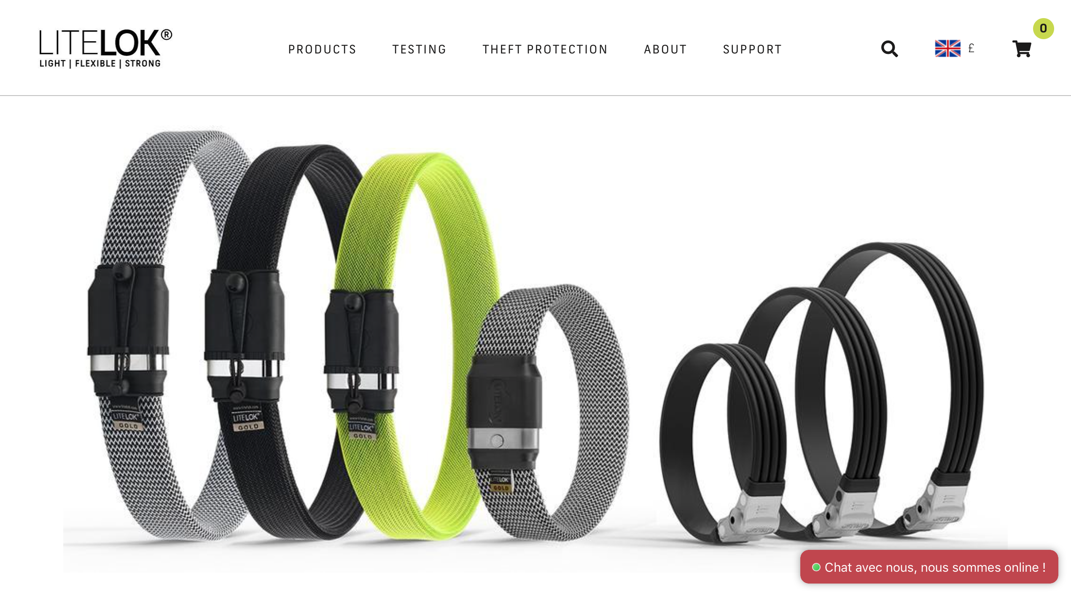
Digital Marketing Audit
Digital channels used: website, social media (Facebook, Instagram, Twitter, YouTube), LinkedIn
Contents:
The main digital channels use is the website which are also the sale platform of the brand.
The refined website are composed by a large range of sections, visitors can learn about the company and its products and production.

Slide 7
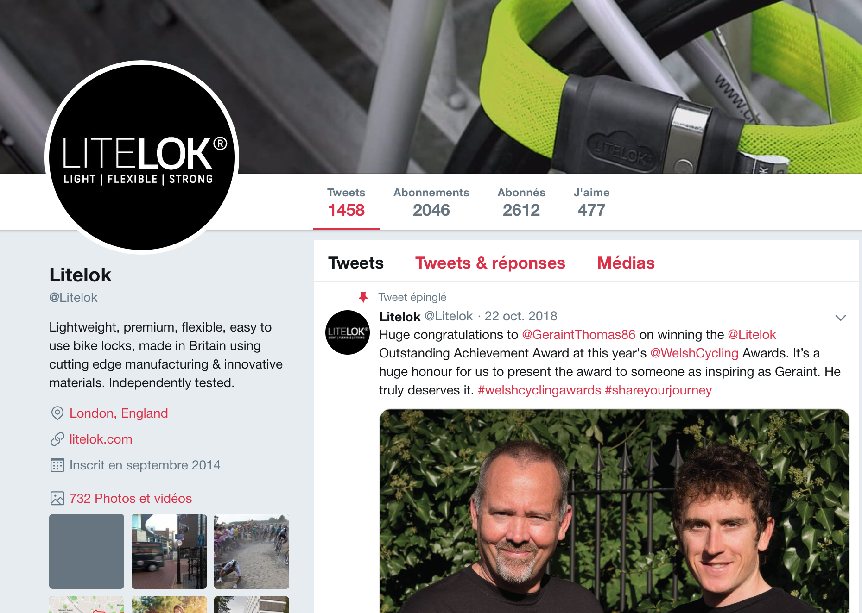
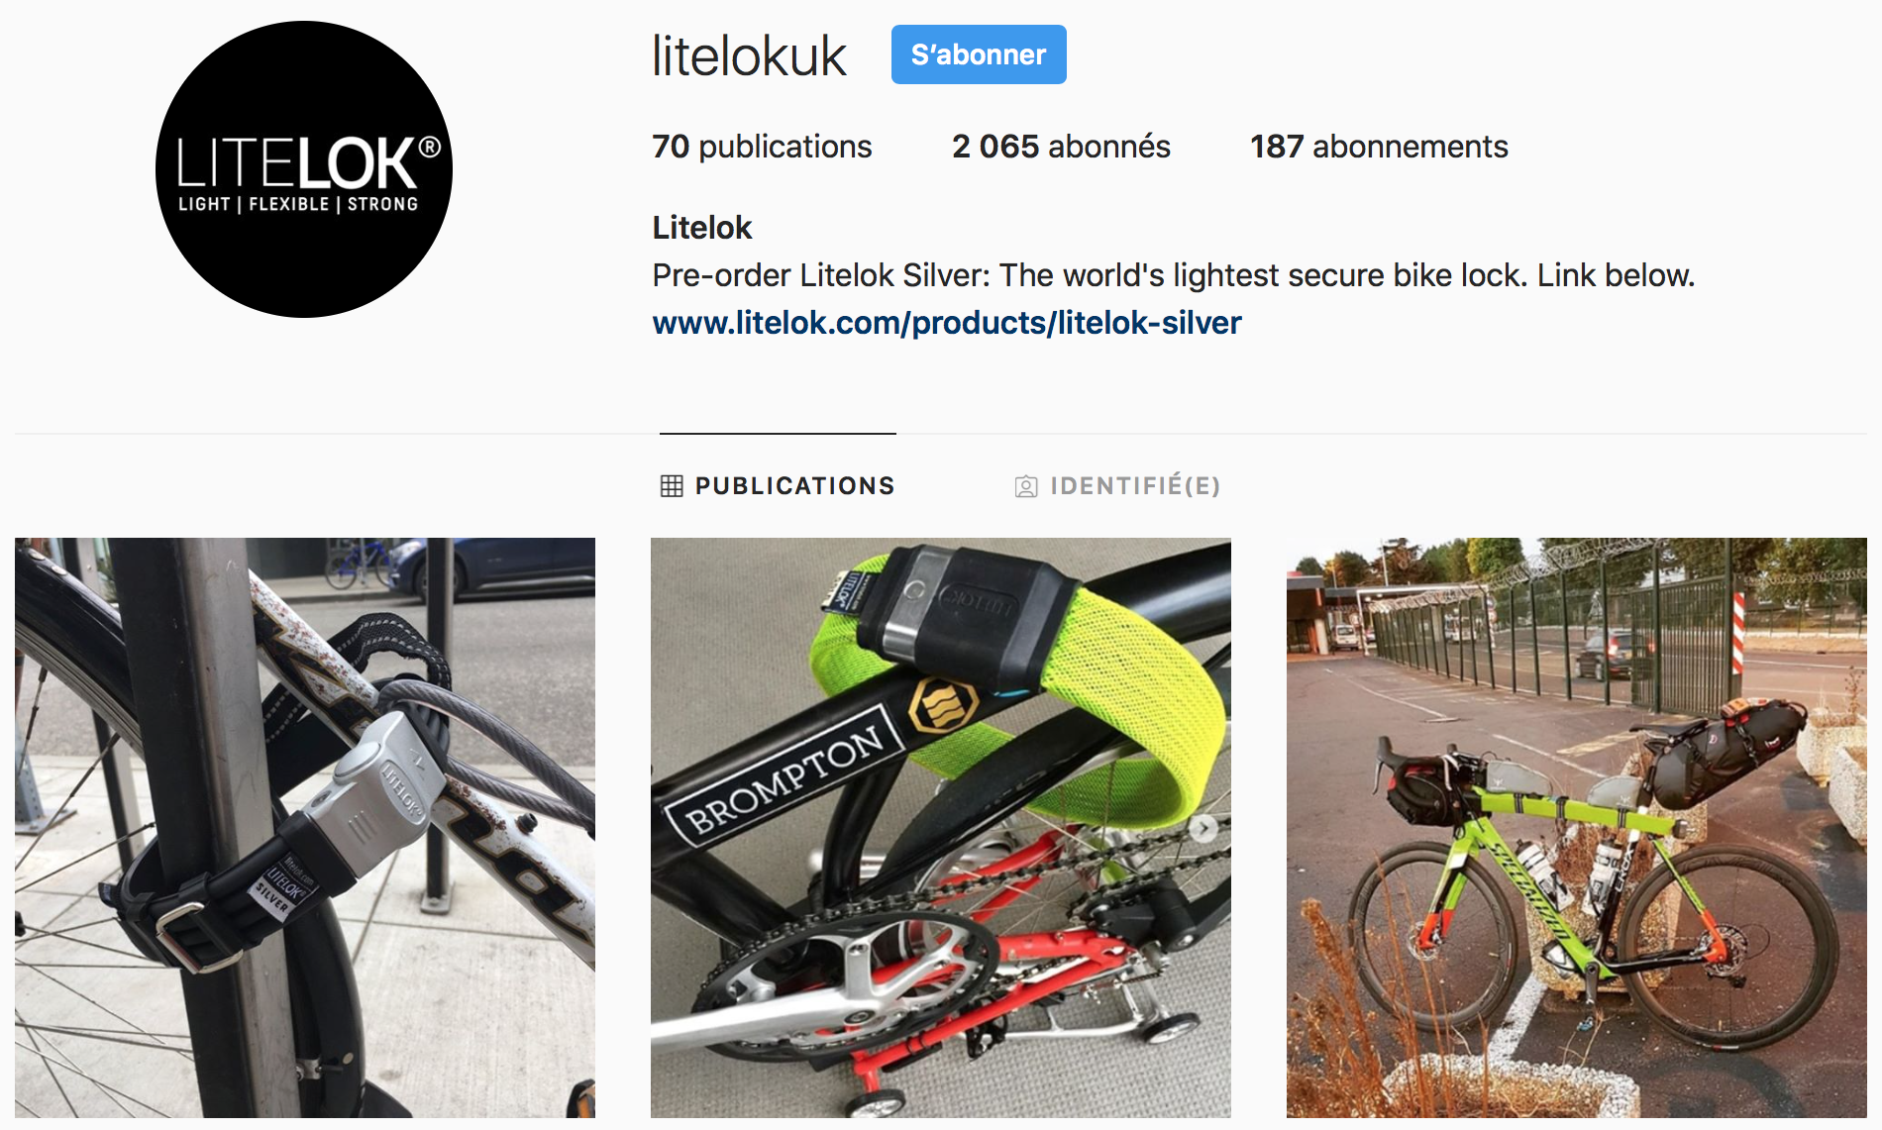
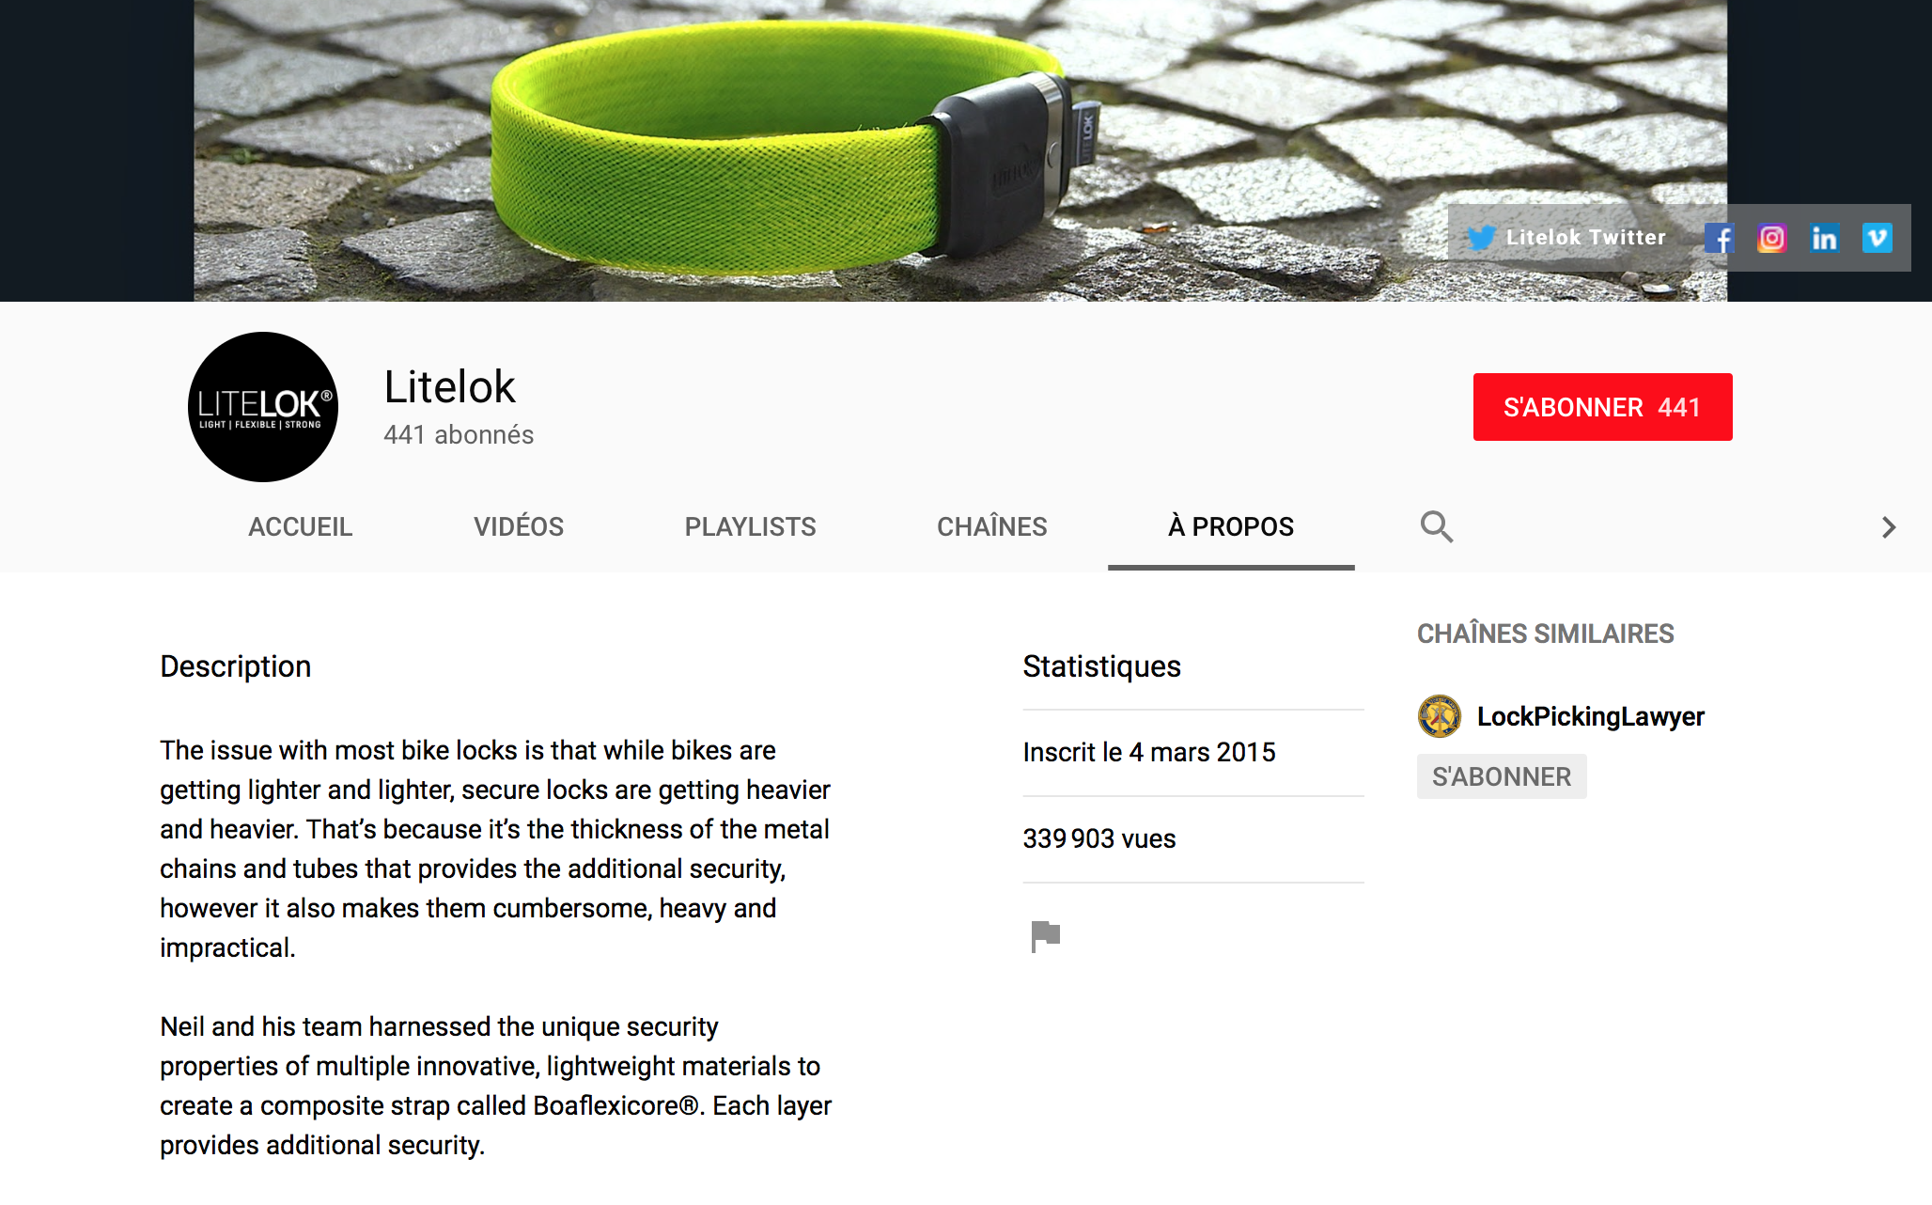
Digital Marketing Audit
Performance
Social media | Facebook | Instagram | Twitter | YouTube
Numbers of followers | 7,749 | 2,066 | 2,613 | 441
The company try to develop its presence and visibility on social media
On Instagram the company attract visitors with a smart quote “The world's lightest secure bike lock”.

Slide 8

Digital Marketing Audit
How effective they are with specific emphasis on measuring and monitoring
Tools could be using: Google analytics, Social This, Sum All, Agora Pulse, Twitonomy, Similar Web, Online Seranking, Academia to analyse and grow the audience and control it. The company can also directly used the analytics of the concerned social media but all information and data are not provide.
Litelok already use Google adverts, Facebook adverts, and Amazon adverts to analyse.
These analytic tools allow the company to reach three objectives:
The purchase of new customers
Creating customer loyalty
Contribute to the reputation of the brand

Slide 9
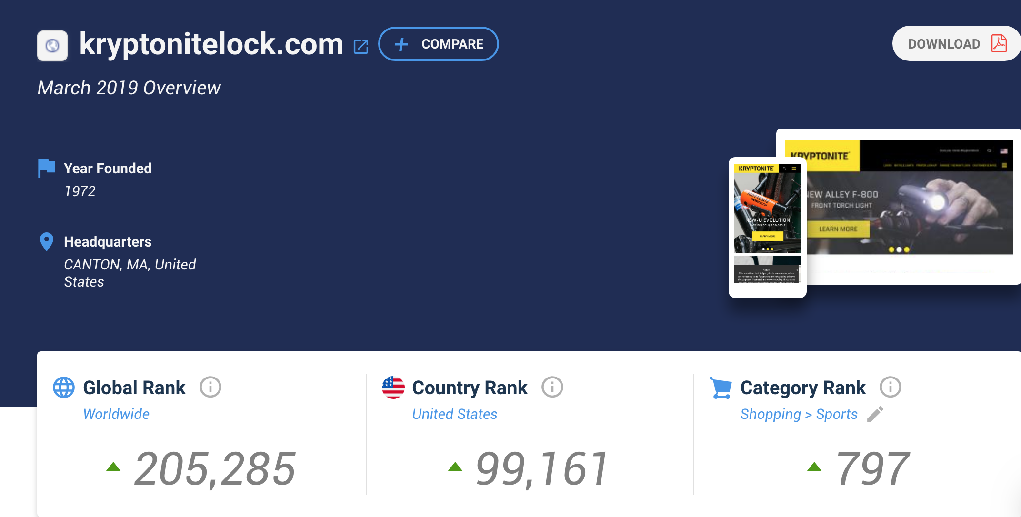
Digital Marketing Audit
Competitive analysis
KRYPTONITE : Leader number 1
Quality and design website Many languages proposed Lot of selections products Customer service Key of success: reactivity and regularity
YouTube | Instagram | Twitter | Facebook
3,300 subscribers | 10,900 followers | 3,408 followers | 14,440 like

Slide 10
Recommendations
Update all their different social media account and page
Create new range of products to innovate and propose something new to the customers
Open a store and participate to bike events
Establish sponsors with athlète
Develop YouTube video to show the lock production and attract people
Measure and monitor their digital channels to stay aware and take good decisions.

Slide 11

Conclusion
In conclusion, digital marketing is an important way to improve the company’s performance and attract customers.

Slide 12
References
Blair, 2018, Build fire, 18 Essential Metrics to Measure Your Digital Marketing, available at: https://buildfire.com/essential-metrics-measure-digital-marketing/
Blunt, 2018, Flyp chart, How to Conduct a Digital Marketing Audit That Will Improve Your Results Exponentially, available at: https://flypchart.co/digital-marketing-audit/
Gerogiou, 2017, Startup grind, The Why and How of a Digital Marketing Audit, available at: https://www.startupgrind.com/blog/the-why-and-how-of-a-digital-marketing-audit/
Litelok social media, available at: https://twitter.com/litelok / https://www.instagram.com/litelokuk/ / https://www.facebook.com/litelok
Litelok website, available at: https://www.litelok.com/#
Mintel press team, 2015, Mintel, Mad about the bike: sales of bicycle accessories outstrip sales of bikes, available at: https://www.mintel.com/press-centre/leisure/mad-about-the-bike-sales-of-bicycle-accessories-outstrip-sales-of-bikes
Modern Tech, 2018, YouTube, Top 5 : Best Bike Locks 2019, available at: https://www.youtube.com/watch?v=tZr0hT9WBjc
Sutton, 2017, Cycling industry, How much is the UK cycling market worth, available at: https://cyclingindustry.news/how-much-is-the-uk-cycling-market-worth/

Slide 13
Thanks for listening!
Now, questions time!
Chloé Jugan

