Slide 1
SHOBANA KORSAR SADIQ
POSTER task 2

Slide 2
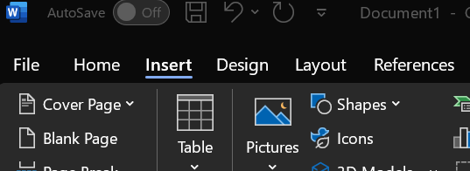
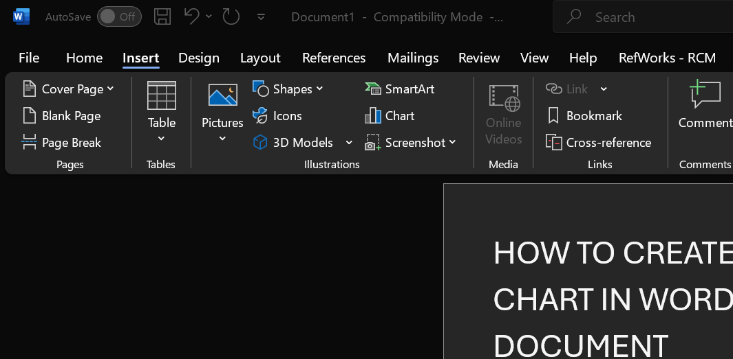
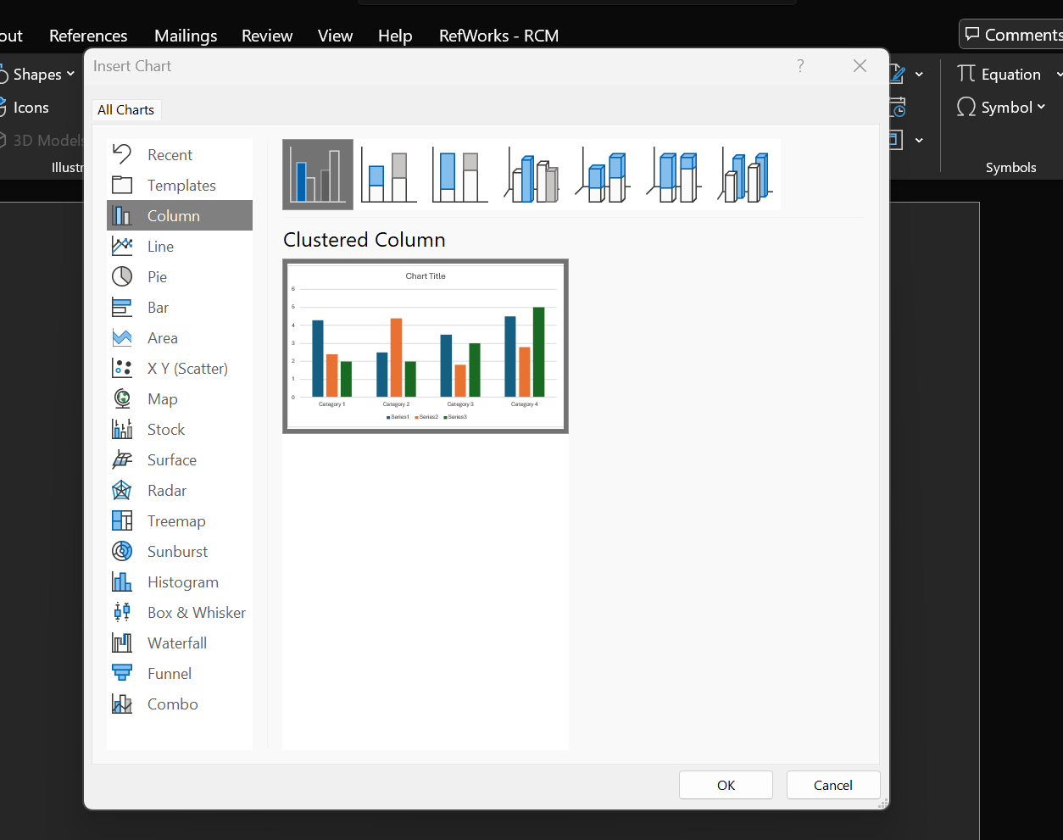
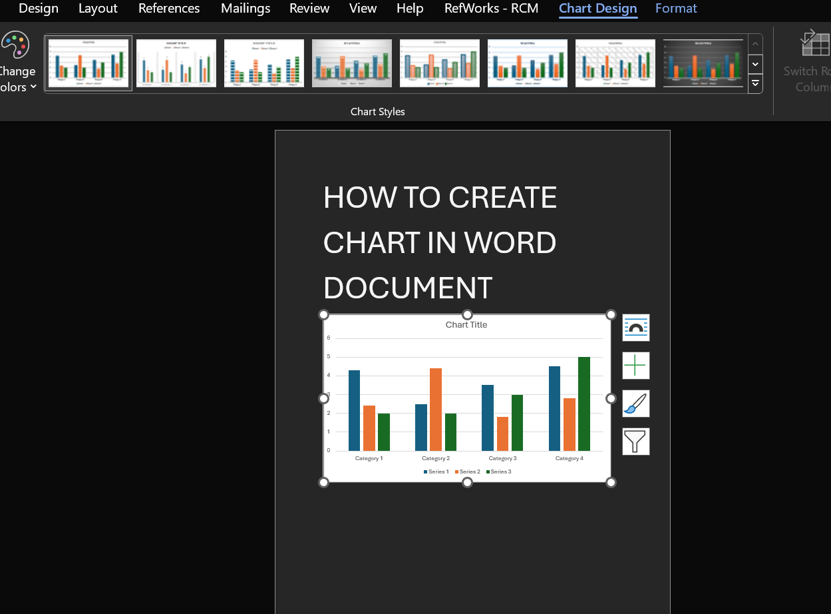
HOW TO CREATE A CHART IN A WORD DOCUMENT
Open the MS WORD on your computer and click on insert tab , then select chart .
Choose the type of chart you want to use and there's many options to choose from.
Replace the demonstrated example with your own data .

