Slide 1

Group E
Sofia sultana
Kushba Begum
Yasmin Bibi
Samina Rehman
Naheed Rehman

Slide 2

Family E’s profile
Mother - In an abusive relationship, mourning the loss of her baby
Boyfriend - Violent and abusive towards the mother and the boys
15-year-old son - Aggressive and lacking at school, involved with drugs. neglected by parents
8-year-old son - Aggressive/withdrawn at school and underperforming, neglected by parents
Father - Lives on his own and is violent towards the boys when they are with him

Slide 3
vulnerability factors
Economic
Social
Physical
Psychological
Educational
environmental

Slide 4

What is a vulnerable family?
Unemployment
Housing Concerns
Domestic Violence
Anti-social Behaviour
Regular truanting
Drugs/Alcohol abuse

Slide 5

Risk factors contributing to the vulnerability of the family and the impacts on the children
Risks and impacts
Domestic violence, verbal and emotional abuse of the children by their father
Children missing education
Concerns around the mother’s alcohol problem
Children’s Anti-social behaviour
Rent arrears
Mothers relationship problems with her new partner

Slide 6
The Impacts of Family Atmospheres on Children
INCONSISTENT
INHARMONIOUS
HOPELESS
MARTYRDOM

Slide 7
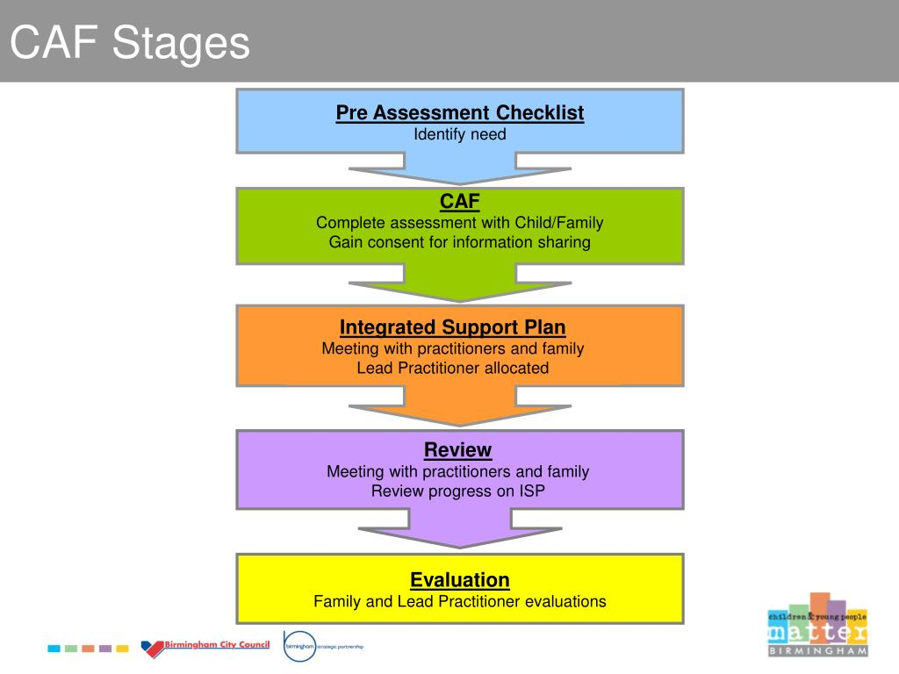
Assessing the Needs of Families

Slide 8
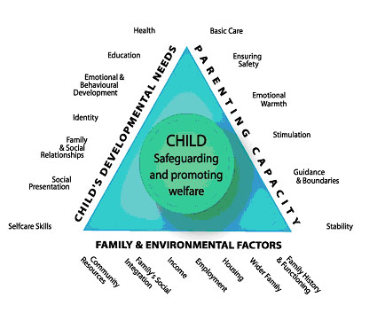
CAF Framework

Slide 9
Many local authorities use a staged process from “referral to closure”
This can vary in different areas but mainly corresponds to the table above

Slide 10
Multi-Agencies Involved
Neighbourhood housing agencies
Children services
Anti-social behavioral team
Substance misuse engagement team
Youth inclusion and support panel
Youth offending team

Slide 11

Substance Misuse Team
They help and support people with drink/drug problems. They provide primary care- based interventions for addicts which can be effective in reducing physical, psychological and social harm.

Slide 12
Neighbourhood Services
They offer advice and information on all council services including benefits and council tax. Advice on housing problems. Assistance and accommodation to those homeless people who are assessed as being in priority needs.

Slide 13
Children services
Children services were known as social services. Children services are responsible for supporting and protecting vulnerable children. They always work alongside with legislations and policies. It includes providing children and their families with extra help. Their aims are to take extra steps for children at risks.

Slide 14
Youth inclusion and Support Panel
Youth inclusion and support panel are multi agency planning groups who prevent offending and anti-social behaviour by offering voluntary support services to higher risk, 8-13-year olds and their families.

Slide 15
Youth Offending Team
Youth offending teams work with young people who get in trouble with the law. The team investigates the background of a young person and try to help them stay away from crime.

Slide 16
Anti-Social Behaviour Team
They support and protect people to improve communities and quality of life. The main aim is to utilise and work within a range of strategies and legislation to successfully tackle anti-social behaviour by enforcement or intervention action where needed.

Slide 17
How the involved agencies are working to help the family:
Neighbourhood housing agencies
Children services
Youth offending team/ youth inclusion team/ anti-social behaviour team
Substance misuse team

Slide 18
RECOMMENDATIONS
Work closely with vulnerable children and young people
Address the structural causes such as poverty, youth inclusions and support each other.
Mother needs rehabilitation due to addiction of drugs and alcohol intake.
The engagement of health services need to provide multiple treatments to the family.
Extended cognitive behaviour therapies to help the mother.
The social care provider needs to encourage mother to participate in social and cultural activities so her mind will not go to take any substances.
This is ongoing process until they change themselves.

Slide 19
RECOMMENDATIONS
Every child matters (DEFS 2003) strategies shows children health and well being by:
Providing youth trainings courses with the help of youth offending team to reduce the risk of criminal behaviour
Help the children to have their basic needs met
Need to communicate with children to build their confidence to move on in society.
Listen to the children carefully.
This support is ongoing until the age of 18.

Slide 20
REFERENCES
Radcliff, E., Racine, E., Brunner Huber L., & Whitaker B.E. (2012). Association between family composition and the well-being of vulnerable children in Nairobi, Kenya. Maternal and Child Health Journal, 16(6), 1232-1240
Vulnerability of families with children: Major risks, future challenges and policy recommendations Monika Mynarska, Bernhard Riederer, Ina Jaschinski, Desiree Krivanek, Gerda Neyer, and Livia Oláh
HM Government. (2018) working together to safeguard children. Available at https://assets.publishing.service.gov.uk/government/uploads/system/uploads/attachment_data/file/779401/Working_Together_to_Safeguard-Children.pdf. [Accessed on 24/02/2020].
No author. (2020).Homeless link. Available at https://www.homeless.org.uk/homeless-england/service/birmingham-city-council-neighbourhood-offices. Accessed on 24/02/2020.
BBC News. (2004). Youth inclusion and support panel. Available at http://news.bbc.co.uk/1/hi/programmes/panorama/3508231.stm. Accessed on 25/02/2020.
Gov.UK. (2020) Available at https://www.gov.uk/youth-offending-team. Accessed on 25/02/2020.
Cleaver, H., Unell, I., & Aldgate, J. (1999). Children’s Needs – Parenting Capacity: The Impact of Parental Mental Illness, Problem Alcohol and Drug Use, and Domestic Violence on Children’s Development. London: TSO.
Frost, N. (2005). Professionalism, Partnership and Joined-Up Thinking: A Research Review of Front-Line Working with Children and Families. Devon: Research in Practice. Available online at: www.rip.org.uk/publications/documents/researchreviews/review8.pdf, accessed 8 April 2008

Slide 21
References:
Hallett, C., & Birchall, E. (1995). Coordination and Child Protection. London: HMSO
Office for Standards in Education, Children’s Services and Skills (2007). Joint Area Review of Children’s Services from April 2007. London: Ofsted.
Parliament (1989). The Children Act 1989. London: HMSO

