Slide 1
Notes:
Welcome to UWTSD Institute of Inner-City Learning, Birmingham & London Disability. This presentation covers an overview of disability, we will share this presentation with you all after today. Please take note of any questions you may have throughout the workshop, and we will be able to answer all questions or expand on any particular sections at the end. Thank you.

Slide 2
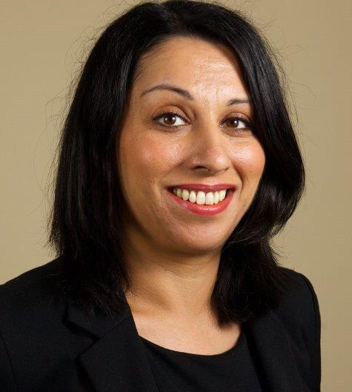
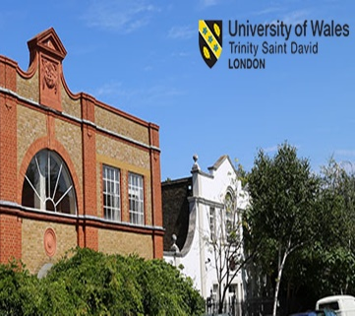
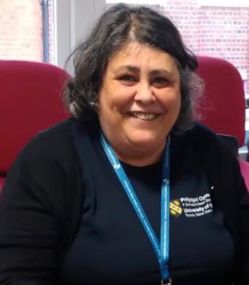
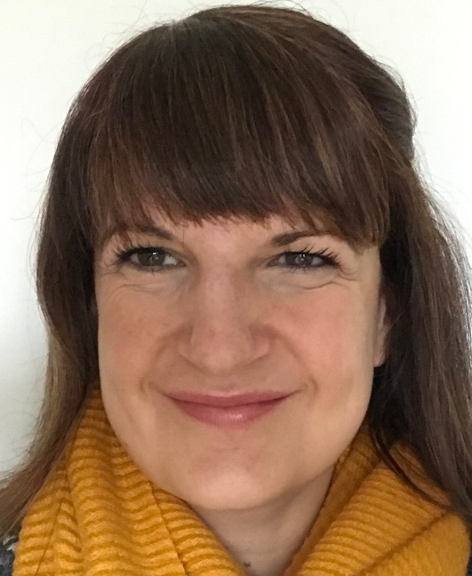
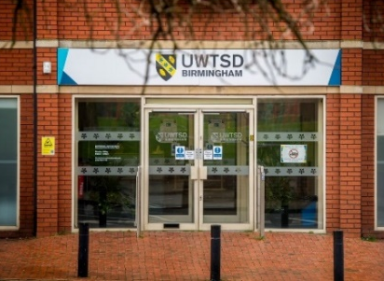
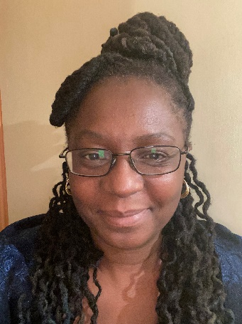
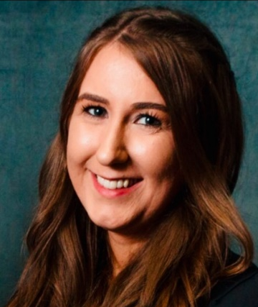
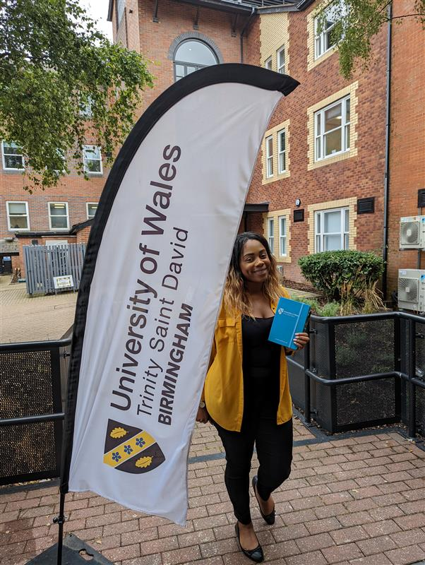
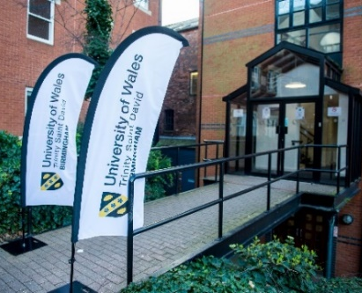
Learning Support Manager IICL Birmingham & London
Shervjeet Garcha
Meet the Team
Birmingham
Disability Advisers
Sparkhill
Ang Leonard
Quay Place
Hana Jacobson Jodiann Gayle
London
Disability Officers
Abi Luck
Carol Vaughan Roberts

Slide 3
Long-term health conditions or illnesses
Mental health conditions
Specific Learning Differences (SpLDs)
Autism Spectrum Condition (ASC)
Visual impairment/ Vision Loss
Hearing impairment/ Hearing Loss
Physical or mobility difficulties
What is not a disabilty?
Disabilities may Include…
Notes:
We support many different disabilities, all of which can be experienced differently from one individual to another.

Slide 4
Under the Equality Act 2010, an individual is considered disabled if they have a physical or mental impairment that has a long-term (12 months+) effect on their ability to carry out daily activities.
The Act protects disabled students from discrimination and provides the right to request university disability reasonable adjustments.
Equality Act 2010
Notes:
Within the Equality Act 2010, disability is a protected characteristic. According to individual student requirements, the university ensures that reasonable adjustments are implemented. The Equality Act has harmonised all equality legislation into one Act – this is designed to reflect that fact that we all have multiple protected characteristics (e.g. a disabled woman could experience discrimination for either or both of those reasons) and to enable the seeking of redress to be easier, with just one piece of legislation to use and one body, the EHRC, to enforce it and advise on it. The Act covers race, age, sex, sexual orientation, religion/belief, gender re-assignment, marriage/civil partnership, pregnancy & maternity.
in the Guidance now - explicitly lists student-type activities, such as keeping to a timetable, following instructions and preparing written documents.

Slide 5

You may have heard the phrase ‘Safeguarding is Everyone's Business’
So is Disability!
Consider how you support our students and fellow staff.
Are you currently supporting or have signposted a student to our service?
The Disability Team is here to help.
The law applies to you as an individual, not just the institution.
Notes:
Disability is everyone's business!

Slide 6
Medical Model
Emphasises that it is an individual’s disability.
Believes only a medical cure can treat.
Focuses greatly on what an individual cannot do.
Social Model
Emphasises that attitudes, policies, and physical, societal barriers disable.
Believes that addressing barriers makes inclusive environments.
Focuses on accepting disability as an ordinary part of life.
Models of Disability
The Disability Team adopts the Social Model of Disability.
Notes:
Two main models of disability are the medical model, and the social model. The medical model focuses on what an individual cannot do due to their disability. However, the Disability team adopts a social model view, of addressing societal barriers that disable individuals, in order to create a disability inclusive environment.

Slide 7
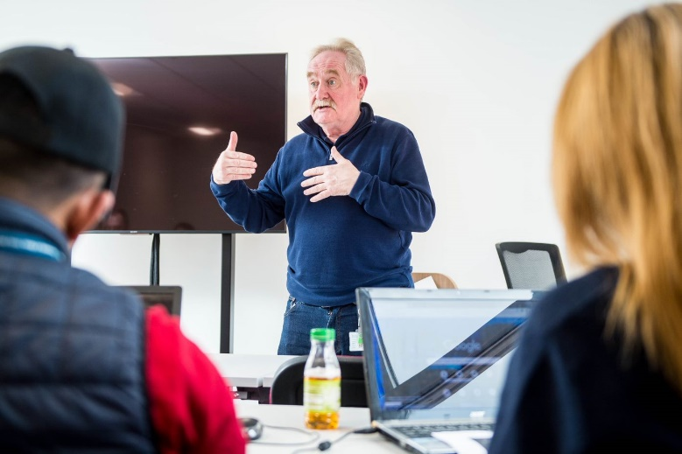
Advice and Guidance
With medical/diagnostic evidence, we can:
Implement reasonable adjustments (e.g., extra time for assessments, comfort breaks, use of an office chair)
Advise and liaise with university lecturers and professional staff
Additionally, we:
Signpost to external resources
Provide guidance on Disabled Students' Allowance (DSA)
Supporting Students
Notes:
We support students by providing advice and guidance, and additionally provide guidance in relation to Disabled Students’ Allowance or signposting to external resources. We always encourage students to be proactive and engage with lecturers and staff throughout their studies, however from time to time we may need to liaise with yourselves regarding a specific student if they are unable to.

Slide 8
We communicate individual student support requirements to Programme Managers who disseminate the information to their lecturers.
Students can declare a disability at any time throughout their course.
How we Communicate with Lecturers
Notes:
Both the Birmingham and London Disability Teams contact lecturers at the start of each term regarding the student support process.
We communicate individual student support requirements to PMs and lecturers including reasonable adjustments.

Slide 9

Students are commonly undiagnosed and may be reluctant or fearful of engaging
We encourage students to access support for dyslexia as soon as possible.
First complete an online dyslexia screening - ‘Do-IT Profiler’ and if appropriate a formal diagnostic assessment.
Dyslexia Screening
Notes:
Dyslexia indicators can become apparent and recognised at any time during their learning at UWTSD.
Please do engage with us and inform us if you have any concerns regarding a student who may be struggling with their studies.

Slide 10
DSA is support towards the study-related costs
Students may receive support with the costs of:
Specialist technology, e.g. laptop with assistive software
Specialist equipment e.g. ergonomic workstation
Non-medical helpers e.g. a BSLI, study skills tutor, mentor, specialist note taker
Support towards travel costs and other costs e.g. printing
Student Finance
Disabled Students’ Allowance (DSA)

Slide 11
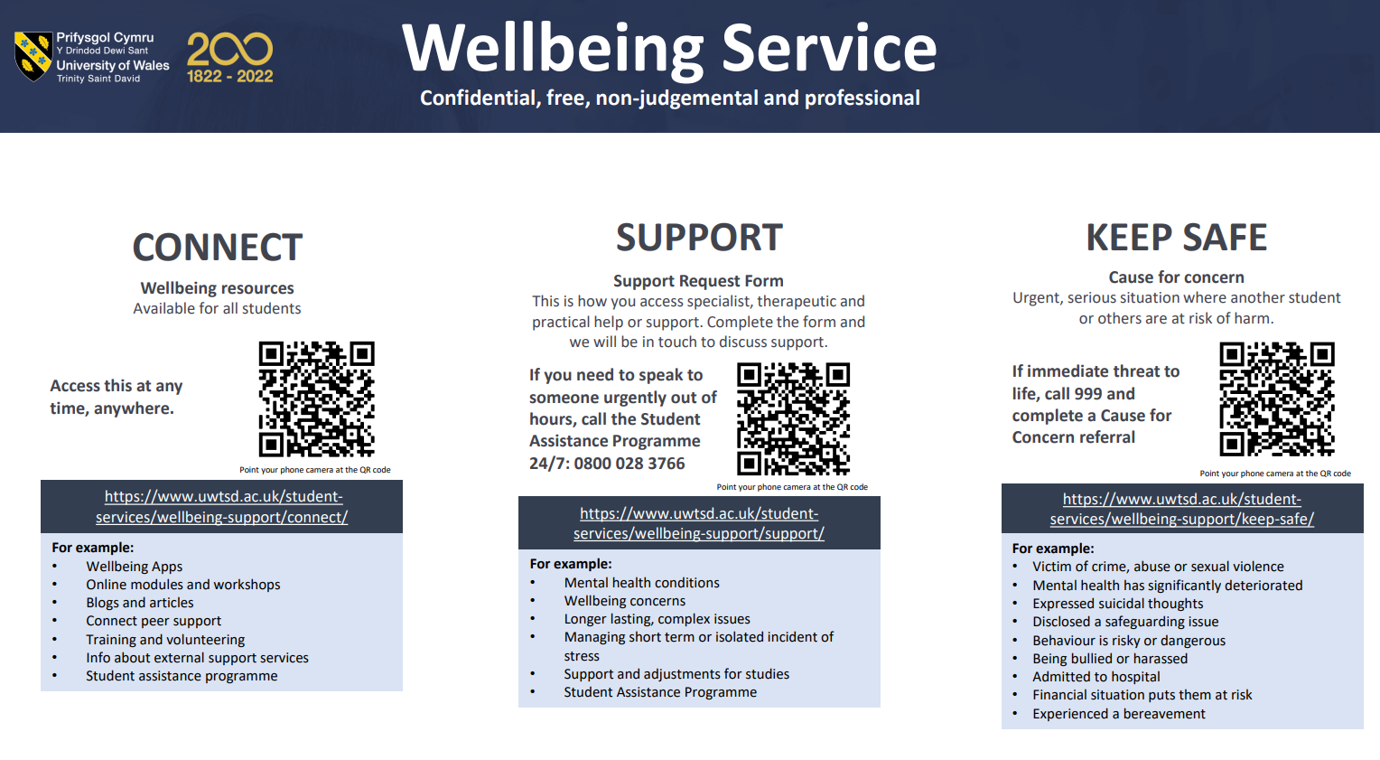

Slide 12
Is there a danger to their life or someone else?
Ask if you’re unsure
Cause for Concern Referral Form
https://live.uniticms.com/uwtsd/register/?form=welfare
Safeguarding
IICL Learning Support Manager Safeguarding Officer for London & Birmingham

Slide 13
Encourage them to disclose
Discretion is paramount
Signpost to the Disability Team or the Wellbeing Team
Make your resources inclusive
Good Practice when Supporting Disabled Students
Notes:
Good practice when supporting disabled students

Slide 14
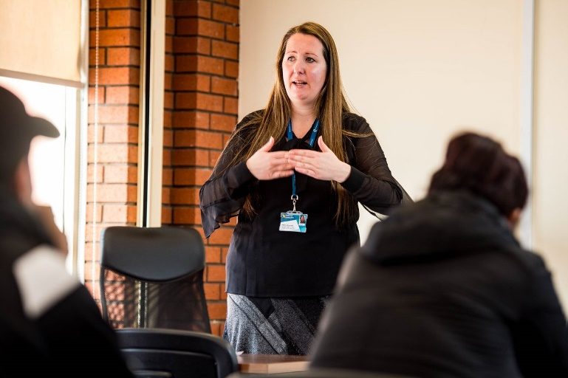
We continually aim to raise disability awareness and confidence across the campuses, for example by facilitating:
Disability Workshops
Collaborative work with other specialist teams e.g. Wellbeing and Careers
Disability Awareness & Confidence

Slide 15
Contact us
London
LondonDisability@uwtsd.ac.uk
0207 127 7400
Birmingham
disability.birmingham@uwtsd.ac.uk
0121 229 3000
Thank you
We value and welcome feedback and suggestions.
Do contact us with any ideas, queries or concerns.

